Slide 1
Thoughts on Improving Roaming under Existing Architecture
Date: 2023-10-20
Authors:
Name | Affiliations | Address | Phone | Email
Guogang Huang | Huawei
Xiaofei Bai
Hao Zhang
Guanyu Zhang
Yuchen Guo
Yunbo Li
Ming Gan
Notes:
September 2012

Slide 2
Abstract
To improve the roaming performance between MLDs, there are three potential research directions so far.
  Hot-standby association[1-3]
    i.e. the non-AP MLD completes all the negotiations (e.g. security handshake, link setup and so on) with one or more neighboring AP MLDs in advance except switching the data path. The non-AP MLD is still associated with the current AP MLD.
  Improve data continuity by transferring Tx/Rx context [4]
  Improve Beacon Request/Report measurement [5]
In this contribution, we discuss some other candidate directions, e.g.
  Enable over-the-DS hot-standby association
  Improve Beacon Request/Report measurement
  Optimize IP address request procedure

Slide 3
Enable over-the-DS hot-standby association
For the roaming based on the hot-standby association, we have the following observations,
  The transmission rate drops seriously during the roaming due to the poor link quality.
  Since at least one affiliated STA needs to switch to the corresponding channel and do the hot-standby association with one or more neighboring AP MLDs, this also will affect the data transmission and accordingly cause the drop of the overall transmission rate.
  This phenomenon is more serious for the eMLSR non-AP MLD, as it only has one regular radio for the data transmission. 11bn should provide an method to improve the roaming performance for all types of non-AP MLDs.

Slide 4
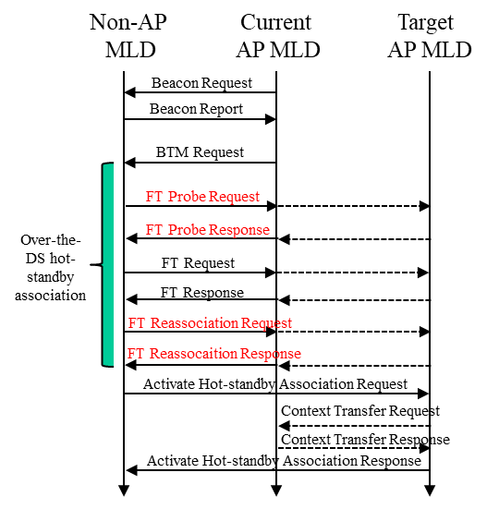
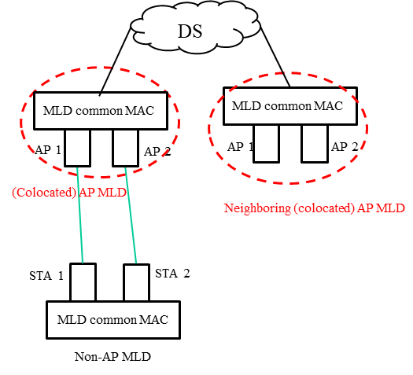
Proposal 1
We propose to design an over-the-DS hot-standby association (which is similar to the existing over-the-DS FT protocol). Specifically,
  The non-AP MLD exchanges FT Probe Request/Response frames with the current AP MLD to get info on neighboring AP MLDs
  The non-AP MLD exchanges FT Reassociation Request/Response frames with the current AP MLD to do hot-standby associations with neighboring AP MLDs
Thus the non-AP MLD doesn’t need to switch the channel unless it is measuring RSSIs of neighboring AP MLDs.
Fig. 2 Procedure of proposed improved roaming with hot-standby association
Fig. 1 Existing architecture

Slide 5
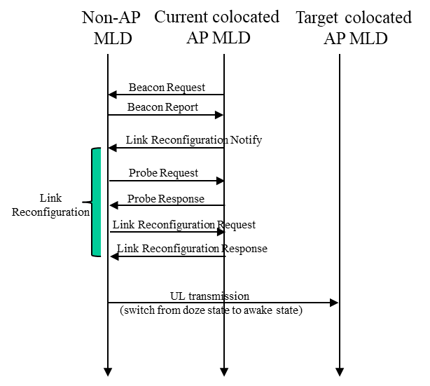
Proposal 1 (Cont.)
By defining the over-the-DS hot-standby association, we can provide a competitive performance compared with the roaming performance under the non-colocated AP MLD architecture.
  Because in the non-colocated AP MLD, the non-AP MLD shall exchange Link Reconfiguration Request/Response frames with the current colocated AP MLD to add links with neighboring colocated AP MLDs.
  It’s reasonable to allow that the non-AP MLD can exchange Probe Request/Response frames with the current colocated AP MLD to get the info on neighboring colocated AP MLDs.
Non-colocated AP MLD
Non-colocated AP
MLD common MAC
MLD common MAC
MLD common MAC
AP 1
AP 2
AP 1
AP 2
(Colocated) AP MLD
Neighboring (colocated) AP MLD
Fig. 2 Procedure of roaming under non-colocated AP MLD architecture
STA 1
STA 2
MLD common MAC
Non-AP MLD
Fig. 3 Non-colocated AP MLD architecture

Slide 6
Improve Beacon Request/Report measurement
Considering the following reasons, a more efficient measurement is required
  Regardless of measurement mode (active/passive), it typically takes more than 100-200ms to complete the measurement process.[5]
    For passive measurement, Beacon interval is usually set to 100-200ms. In cases where a STA fails to receive a Beacon from an OBSS AP for some reason, the measurement process will take even longer.
    For active measurement, STA allocates approximately 100-200ms to collect probe responses from all APs.
  Different vendors have different implementations of the Beacon Request/Report measurement protocol, e.g.
    The AP requests a STA to do the Beacon Request measurement, but the STA cannot feed back the Beacon Report in time or it ignores the measurement request due to some reason.
    Since different vendors have different calculation methods, the RCPI and RSNI values reported by different vendors vary widely.
  Seamless roaming needs a more efficient measurement

Slide 7


Proposal 2
We propose to define a new measurement mode for the Beacon Request measurement to allow the STA to use the NDPR+NDPA+NDP procedure to speed up the measurement.
Detail Procedure
  AP1 requests STA1 to do a Beacon Request measurement with the new measurement mode.
  STA1 switches to CH2 and sends a NDPR to request AP2 to send a test signal (e.g. NDPA + NDP)
  AP2 sends a test signal
  STA1 switches to CH3 and sends a NDPR to request AP3 to send a test signal
  AP3 sends a test signal
  STA1 feeds back the Beacon Reports to AP1.
②
①
STA1
③
AP2 (CH2)
AP1 (CH1)
⑥
⑤
④
AP3 (CH3)

Slide 8
Optimize IP address request procedure
STA
Current AP
Target AP
When a STA is roaming from the current AP to a target AP, it will initiate an IP address request to update its IP address.
  If the STA supports the FILS (fast initial link setup) protocol, it can directly include a FILS IP Address Assignment element within (Re)association Request and Response frames to speed the roaming procedure.
  But the FILS protocol hasn’t been widely used in products.
Actually, at some cases, the IP address assignment update is not needed if the following condition is true
  The current AP and the target AP are within the same layer-2 network and are served by the same DHCP server.
Beacon Request
Probe Request
Probe Response
Beacon report
BTM Request
BTM Response
FT Request
FT Response
Reassociation Request
Reassociation Response
Encrypted Data [DHCP Discover]
Encrypted Data [DHCP Offer]
Encrypted Data [DHCP Request]
Encrypted Data [DHCP ACK]

Slide 9
Proposal 3
Hence, we propose to add a bit (e.g. IP Address Update Required) in the Neighbor Report element to indicate whether the STA needs to request the IP address update when it roams to this reported AP.
  If the IP Address Update Required bit is equal to 1, the STA shall request a new IP address by including a FILS IP Address Assignment element within (Re)association Request and Response frames or initiating a separate IP address request procedure. Otherwise, the STA shall not request a new IP address.

Slide 10
References
[1] 11-20-0834-09-00be-tentative-re-association-for-non-ap-mld
[2] 11-22-1580-01-0uhr-aperspectiveonproposeduhrfeaturesforenterpriseusecases
[3] 11-23-0324-01-0uhr-roaming-requirements
[4] 11-23-0322-00-0uhr-improve-roaming-between-mlds
[5] 11-23-0668-02-0uhr-coordinated-measurement

Slide 11
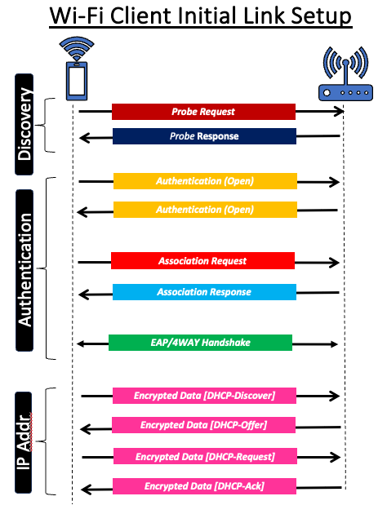
Annex
When a STA successfully associates with an AP, it will initiate an IP address request. Specifically,
  STA sends a DHCP Discover message in a broadcast manner.
  DHCP server replies a DHCP Offer message with an allocated IP address in a broadcast manner.
  STA takes out the allocated IP address and sends a DHCP Request Message to DHCP server.
  DHCP server replies a DHCP ACK Message.

