Slide 1
Analysis on the LDPC rate matching
Date: 11/01/23
Name | Affilations | Address | Email
Xiaogang Chen | Spreadtrum Communications, USA | 2680 N 1st St. San Jose, CA. 95134 | Xiaogang.chen1@unisoc.com
Sean Chiu
Chunyu Hu
William Li
John Yi

Slide 2
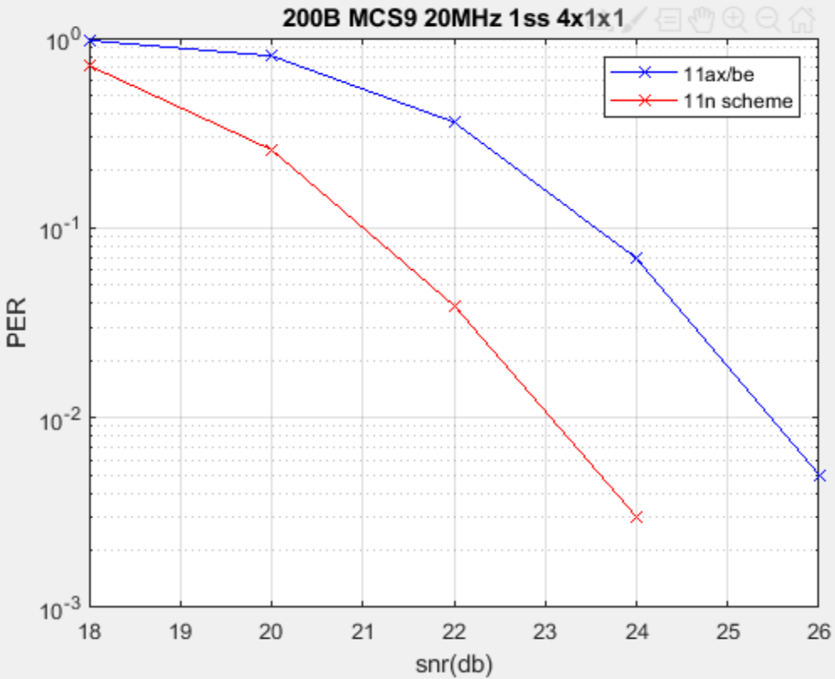
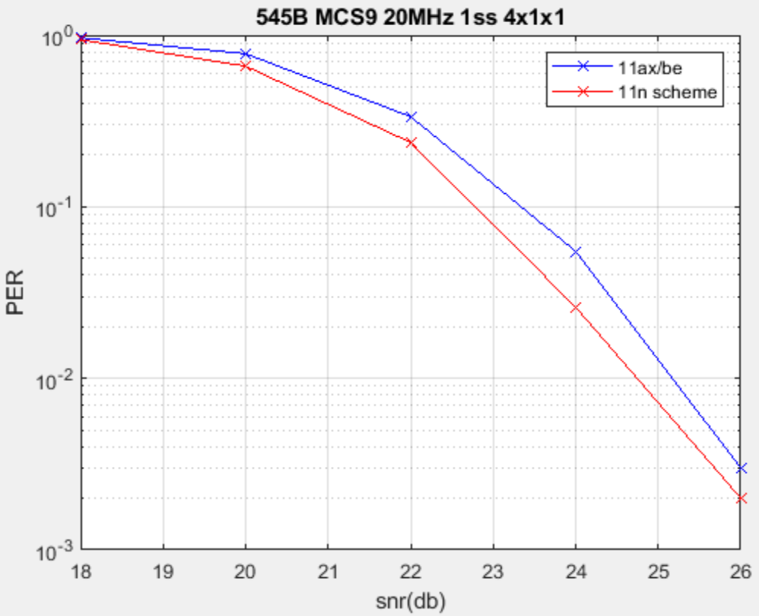
Recap of [1] – Performance degradation
[1] raised several issues in the current design of LDPC rate matching (including 11ac/ax/be):
Performance degradation comparing with 11n due to the 11ac rate matching scheme, which has been reused in 11ax/be (left figure);
 |  | Sensitivity(dB@10% PER) |  | Gap (dB) ChDNLoS
MCS | nBytes | 11n | 11ac | 11n-11ac
4 | 201 | 13.309 | 15.337 | -2.03
4 | 323 | 14.339 | 15.360 | -1.02
4 | 687 | 15.213 | 15.400 | -0.19
4 | 849 | 15.170 | 15.670 | -0.5
4 | 1011 | 15.253 | 15.685 | -0.43
7 | 201 | 18.933 | 23.006 | -4.07
7 | 336 | 21.195 | 23.038 | -1.84
7 | 539 | 21.719 | 23.218 | -1.5
7 | 741 | 22.516 | 23.152 | -0.64
7 | 944 | 22.887 | 23.158 | -0.27

Slide 3
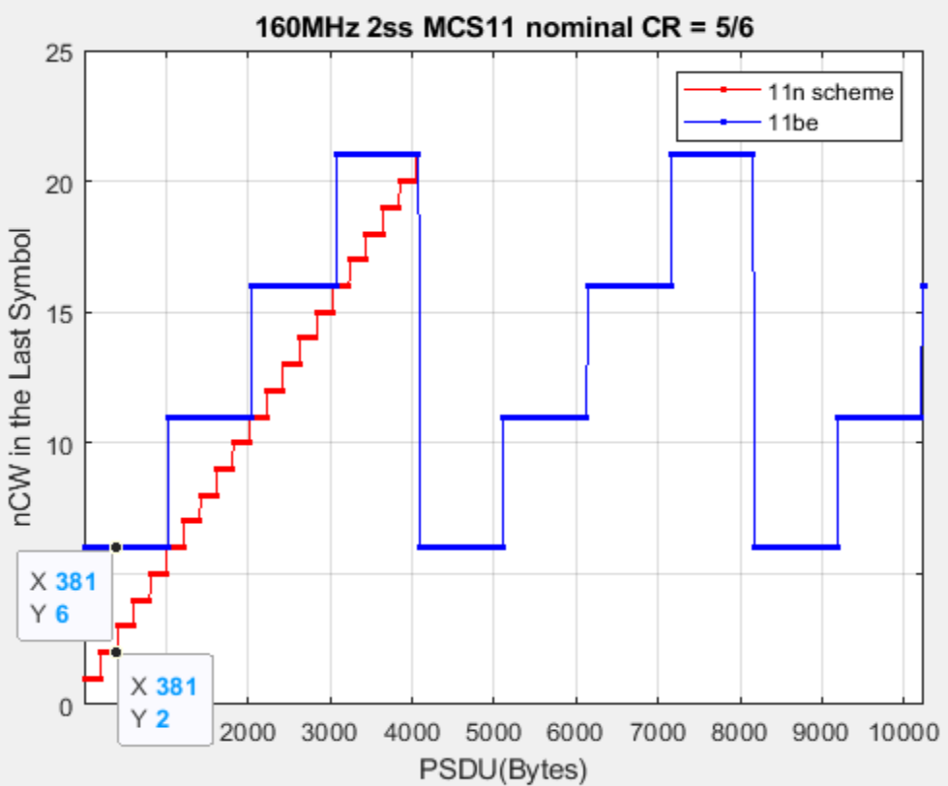
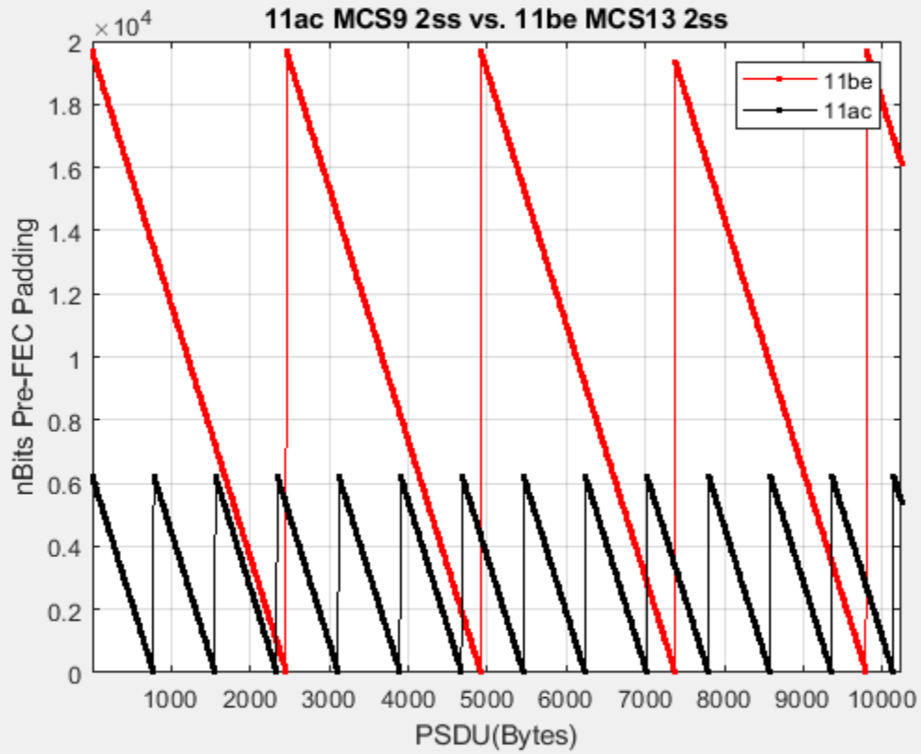
Recap of [1] – Power consumption & last symbol processing
Power consumption and potential performance degradation due to the excessive pre-FEC padding;
  Reduced number of iterations for LDPC decoding in the last symbol may compromise performance.

Slide 4
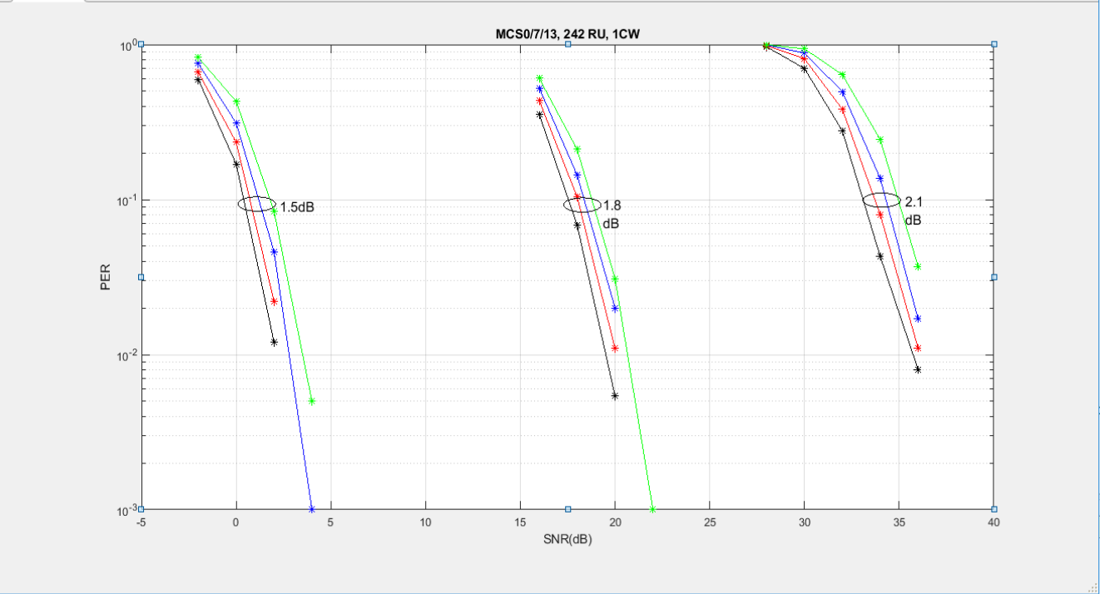
Recap of [1] - Overpuncturing
Overpuncturing (Updated cases included in the excel).
Puncturing itself may introduce 0.5~2dB loss depends on puncturing ratio (10%-30%)
    Blk: 0% Punc; Red: 10% Punc; Blue: 20% Punc; Green: 30% Punc.
    Note: sims is for 1 CW (1944) in ChDNLoS 4x2x1.
  Shortening may offset the performance loss due to puncturing.
One example of 20MHz MCS0 1ss
Pld 361B has punc ratio~23%.
Pld 360B has punc ratio~2%.
Sensitivity loss is ~0.4dB.
This issue will be discussed later depends on the outcome of the previous issues.

Slide 5
Overview of the solutions
Category.1 reuse 11n:
will be analyzed in Opt.1;
Best performance;
Preamble overhead increases liner with the number of users.
Category.2 patch 11be:
Will be analyzed in Opt.2 and Opt.3
A compromise between performance and preamble overhead.
Category.3 redesign rate matching:
Maybe needed to accommodate new features such as HARQ;
Not included in this slides deck.

Slide 6
Solutions – Opt.1
Reuse 11n scheme.
Explicitly indicate the PSDU size instead of implicitly conveying the information.
Any bits used to fill up to the symbol boundary will help improve LDPC decoding performance.
  This is the reason 11n can potentially gain an insane 4dB over 11ac.
  Achieve the best performance (over all the options) with the largest signaling overhead.
Requires a maximum of 24 bits for the PSDU size indication.
  The overhead linear increase with the number of STAs in one PPDU:
    For SU transmission, 1 symbol, extra 4us is required carry the extra signaling if MCS0 is used.
    For the case of 4 STA MU transmission, 2 symbol, extra 8us is required to carry the extra signaling if MCS0 is used.
    For the case of 8 STA MU transmission, 4 symbol, extra 16us is required to carry the extra signaling if MCS0 is used.
    For the case of 32 STA MU transmission, 15 symbol, extra 60us is required to carry the extra signaling if MCS0 is used.
  However, the performance gain may offset the extra air time because a higher MCS may be used, or less retransmission is conducted.
The extra signaling overhead could be small in the field or could be compensated by the performance gain.

Slide 7
Sims of Opt.1
Natively, Opt.1 outperforms 11be scheme for most case;
  Upper figures
Given the same OTA time, Opt.1 outperforms 11be scheme for all case;
  Bottom figures
The black rectangle indicates the “illness” cases
  11be is paying longer OTA time but buying worse performance.
Refer to backup slides for a few more cases
  Behaviors are very consistent for all the cases.
Note:
  Please refer to [1] for PER curve.
  effective CR is highly correlated with PER as proved in [1]. So eff_CR is used for performance indication.

Slide 8
Solutions – Opt.2
Enforce LDPCExtra. (transmitter force LDPCExtra being set even it’s not really triggered)
Already allowed in TB PPDU.
A simple solution for transmitter which
  Will improve performance (shown in the next two pages);
  Increases 4us extra airtime (assuming nominal PE = 16us);
  Doesn’t reduce the number of padding bits (2nd issue in the backgroud).
  Fully controlled by the Tx.
Receiver may need to change the de-rate matching scheme depends on how it’s currently implemented.
  Rx shall strictly follow the LDPCExtra indication in the preamble instead of doing its own calculation.

Slide 9
Sims of Opt.2 - Comparisons on the effective coding rate
Opportunistic gain could be achieved depends on the combination of MCS, RUSize, nSS
  A combination of larger data rate means more parity bits will be added with extra symbol, so the combination of larger data rate
    has larger gain;
    has more chance to harvest the gain.

Slide 10
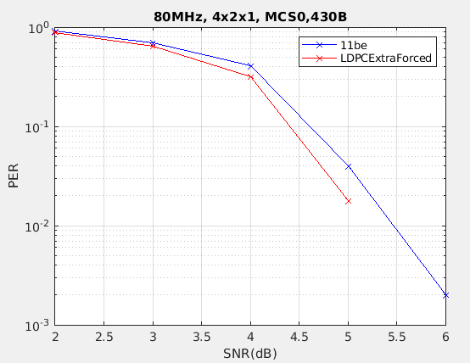
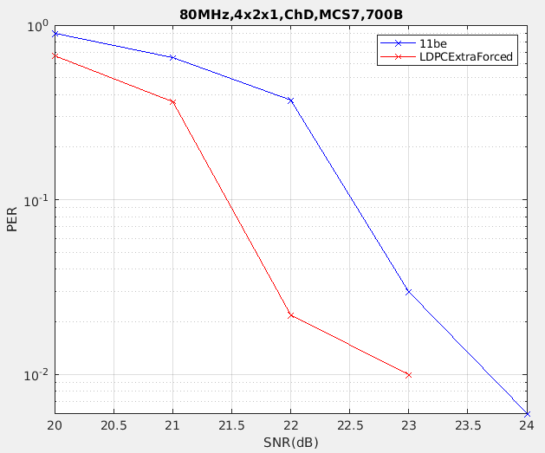
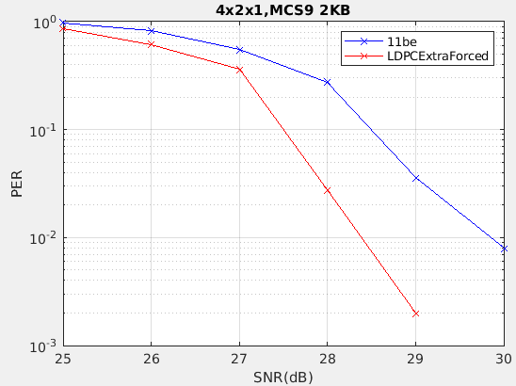
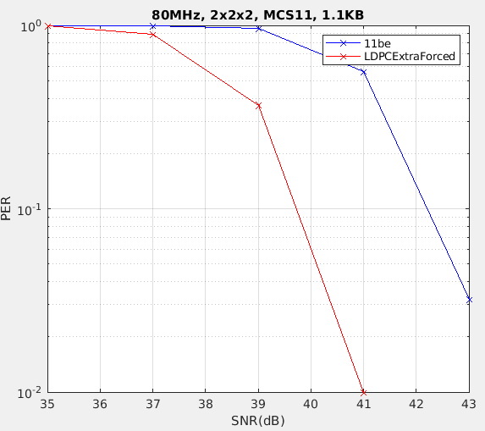
Sims of Opt.2 - Comparisons of PER
Sims Assumptions:
80MHz, 4Tx->2Rx, 1/2SS. No Bfing.
MCS 7/9/11/0 with different payload sizes.
Observations:
Gain is highly correlated with the gap of the effective coding rate in previous slide.
~1dB gain is observed for higher MCS.

Slide 11
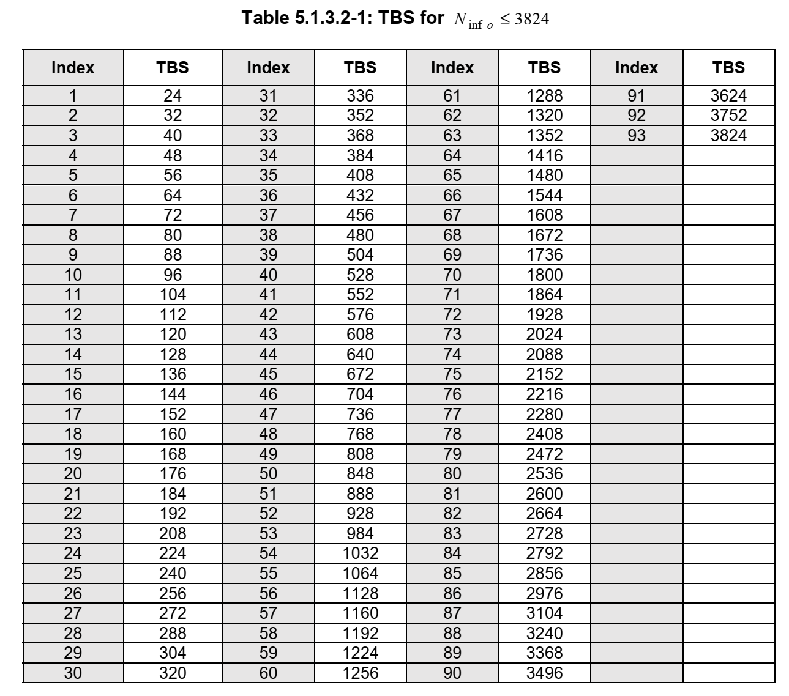
Solutions – Opt.3
Optimize the pre-FEC padding factor.
Reason of the huge number of padding bits is padding has to be applied to the quarter symbol boundary in 11ax/be.
  Consider the N_dbps of 78400 bits (2SS, 4KQAM, 320MHz) - > ~20K bits -> 10 LDPC CW padded maximum.
Table on the right side is the way that 5GNR used to pad the PSDU
  Pre-FEC padding is also added but much finer granularities are chosen.
Solution: increase the granularity of the Pre-FEC factor for PSDU size (padding size) calculation while keeping the current Pre-FEC factor when LDPCExtra is triggered.
  Reduces the average number of CW/symbol.
  Opportunistically introduces performance gain.

Slide 12
Sims of Opt.3 (1/2)
Sims Assumptions:
  n bits in the legend means a whole symbol is break down into 2^n boundaries for pre-FEC padding.
    Note that if LDPCExtra is triggered, a quarter symbol is added as in 11be.
Observations:
  Assuming a reasonable LDPC decoder processing capability, to meet the turn around (SIFS+PE), Rx either
    reduce the maximum number of iteration in the last symbol, or
    Increase the number of loaded engines.
  With opt.3, nCW/Symbol reduces significantly in the last symbol.
  Refer to a few more results in the backup.

Slide 13
Sims of Opt.3 (2/2)
Opt.3 outperforms 11be for most combinations because of the efficient usage of resources to reduce coding rate;
  dotted red and x green curves.
The extra symbol provides further gain for Opt.3.
Larger gain for higher MCS.
Refer to Backup for other combinations

Slide 14
Summary
Options\Considerations | Performance | Signaling Overhead | nCW/Symbol | Standards/Implementation changes | Note
1 | Best | Largest | Smallest | Reuse 11n. Some modifications needed. | Recommended
2 | Average | No extra signaling | Same as 11be | Minimum
3 | Average | Negligible | Much less than 11be | Minimum+
2+3 | Better | Negligible | Much less than 11be | Minimum+ | Recommended
Either reusing 11n scheme or using the combination of opt.2 and opt.3 is recommended.

Slide 15
SP
Do you agree that in an UHR MU PPDU, the transmitter may set the LDPC Extra Symbol Segment field to 1 regardless of the value derived from the calculations.
  Note: “UHR MU PPDU” is referring to a SU transmission or OFDMA transmission which includes more than one user. The name will be changed depends on the decision from the group.

Slide 16
Reference
[1] 11-23-0667-01-0uhr-revisiting-of-the-rate-matching-for-ldpc

Slide 17
Backup- distribution of the packet size in the field[1]
Laptop for daily use: email, documents, remote desktop, etc.
Topic / Item | Average | Min Val | Max Val | Percent
Packet Lengths | 280.72 | 154 | 2042 | 100%
40-79 | - | - | - | 0.00%
80-159 | 154 | 154 | 154 | 0.04%
160-319 | 204.57 | 160 | 319 | 88.89%
320-639 | 424.35 | 320 | 638 | 4.69%
640-1279 | 1119.83 | 641 | 1274 | 4.81%
1280-2559 | 1591.25 | 1284 | 2042 | 1.57%
>=2560 | - | - | - | 0.00%
Laptop Webex
Topic / Item | Average | Min Val | Max Val | Percent
Packet Lengths | 330.6 | 154 | 1969 | 100%
40-79 | - | - | - | 0.00%
80-159 | 154 | 154 | 154 | 0.01%
160-319 | 250.42 | 160 | 318 | 57.07%
320-639 | 405.22 | 320 | 632 | 41.37%
640-1279 | 1108.72 | 640 | 1279 | 0.72%
1280-2559 | 1448.25 | 1280 | 1969 | 0.83%
>=2560 | - | - | - | 0.00%
Smart Phone: Everything except 4K video streaming
Topic / Item | Average | Min Val | Max Val | Percent
Packet Lengths | 506.28 | 164 | 2044 | 100%
80-159 | - | - | - | 0.00%
160-319 | 214.45 | 164 | 319 | 59.37%
320-639 | 433.04 | 320 | 638 | 17.98%
640-1279 | 929.73 | 641 | 1279 | 7.60%
1280-2559 | 1530.46 | 1280 | 2044 | 15.06%
>=2560 | - | - | - | 0.00%
Smart Phone: 4K Video streaming
Topic /Item | Average | Min Val | Max Val | Percent
Packet Lengths | 1339.18 | 164 | 2042 | 100%
80-159 | - | - | - | 0.00%
160-319 | 201.56 | 164 | 319 | 4.14%
320-639 | 430.95 | 322 | 636 | 1.13%
640-1279 | 872.41 | 645 | 1263 | 1.31%
1280-2559 | 1407.11 | 1283 | 2042 | 93.42%
>=2560 | - | - | - | 0.00%
  Although the max PSDU size is >15MByte in theory, the PPDU size is usually small for many applications.
          All PPDU in statistics are Qos Data coded by LDPC in 11ax PPDU.
        Every statistics are conducted based on capturing ~1 million QoS packet from different vendors.
        Chance of aggregation is low for smaller packet and high for larger packet.

Slide 18
Backup for Opt.1 (1/2)

Slide 19
Backup for Opt.1 (2/2)

Slide 20
Backup for Opt.3 (1/2)

Slide 21
Backup for Opt.3 (2/2)

Slide 22
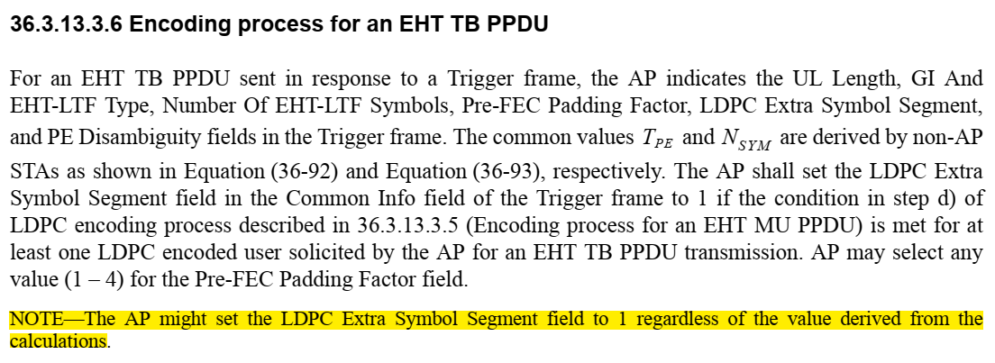
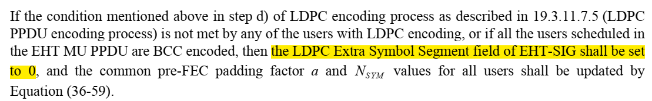
Back up on the setting of LDPCExtra
In the subclause of MU PPDU Encoding:

Slide 23
The way receiver validating LDPCExtra setting
Step 1: based on L_LENGTH and signaling in EHT-SIG (MCS, a, LDPCExtra) to derive the PSDU size;
Step 2: loop back to rate matching procedure and reuse rate matching to derive LDPCExtra and compare with the signaling in EHT-SIG.

