Slide 1
M-AP Coordinated Transmission framework
Date: 11-01-2023
Authors:
Name | Affiliation | Address | Phone | Email
Arik Klein | Huawei Technologies |  |  | arik.klein@huawei.com
Genadiy Tsodik |  |  |  | genadiy.tsodik@huawei.com
Shimi Shilo |  |  |  | Shimi.Shilo@huawei.com
Oded Redlich |  |  |  | oded.redlich@huawei.com

Slide 2
Introduction
802.11 UHR SG discussed Multi-AP coordination as a set of features that will yield additional efficiency gain and increased throughput when multiple OBSSs share resources for a coordinated transmission
  As opposed to current WLAN architecture, where the operation of Overlapping BSSs is not coordinated, thus STAs from different overlapping BSSs might interfere with each other and reduce the total throughput of the WLAN network.
  The importance of such coordination increases in highly dense WLAN areas where overlapping channels are often used in BSSs with close proximity.
TGbn has agreed to adopt the following coordination schemes: Co-SR (TXOP-based with power control) and Co-BF (TGbn SFD, Motion #29)
In this contribution we want to share our thoughts on the unified framework for M-AP Coordinated transmission for enabling a modular and efficient coordinated transmission in UHR and beyond.

Slide 3
Short Recap
In [1] and [2] TGbe agreed on the following two main roles for APs that participate in a coordination [3]:
  Sharing AP – the TXOP holder that shares its resources with other APs
  Shared APs – all the APs allocated with resources for coordinated transmission by the Sharing AP
The roles above are dynamic: A single AP is designated as a Sharing AP in a TXOP it obtains and can be designated as a Shared AP in a TXOP obtained by other APs
There are additional coordination schemes (still under discussions) to be considered as candidate schemes: Co-TDMA, C-RTWT, JT, Co-OFDMA and Co-UL MU-MIMO [4], [7] – [9]

Slide 4
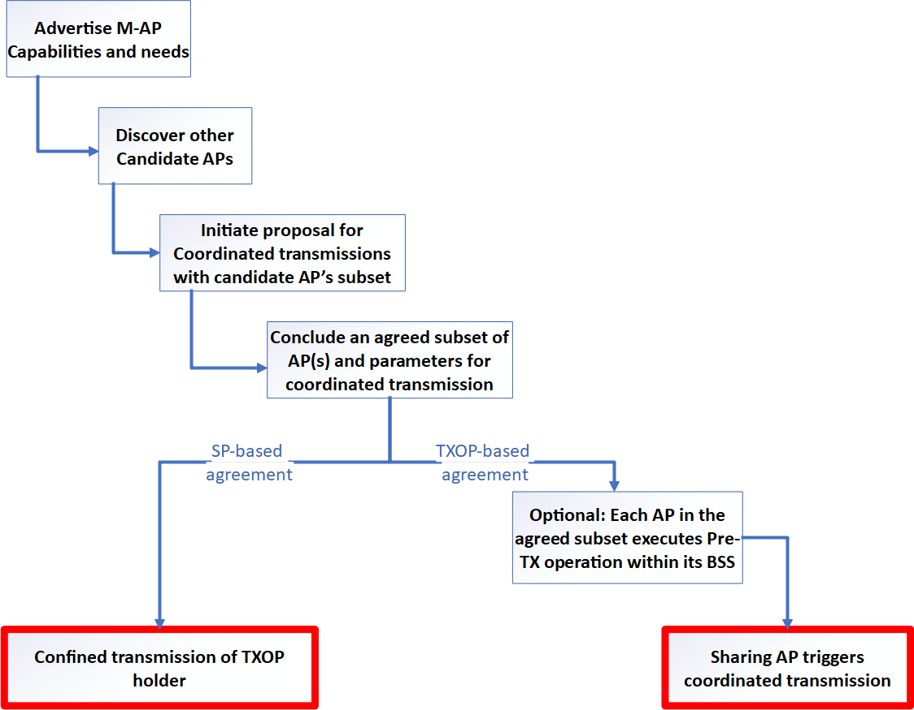
Why a unified framework?
The M-AP coordinated transmission is the output of a coordination process between a group of APs
  Several preliminary steps
  are taken by the APs prior to
  the triggering of the
  coordinated transmission
  These steps result in a
  coordinated transmission,
  where each participant knows when
  and with which parameters it should
  operate within its BSS.

Slide 5
Why a unified framework?
The coordination scheme only defines the technique being used to share the resources between the participant OBSSs (i.e. Sharing AP and Shared APs)
  It does not define the exact parameter values that will be used by each participant OBSS
  It does define a different set of parameters that have to be defined before that coordination scheme is used.
  Each coordination scheme has its gain vs. complexity tradeoff ,which affects how and when it will be used.
  A UHR AP may support more than a single coordination scheme.
The unified framework defines the various stages the OBSS APs need to take prior to the initiation of a coordinated transmission.
  This framework includes stages that are common for all the coordination schemes.

Slide 6
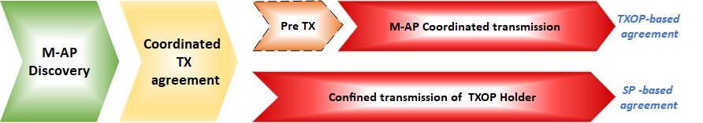
M-AP coordinated transmission framework
The M-AP coordinated transmission includes the following sequential stages:
  M-AP Discovery
  M-AP Coordination Agreement setting
  Additional stages for TXOP-based agreement
    Pre-Tx
    M-AP Coordinated transmission initiation
  Additional stages for TXOP-based agreement
    Confined transmission of a TXOP holder.

Slide 7
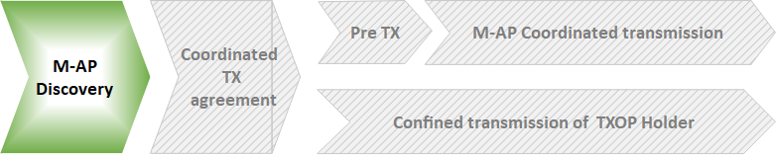
Stage 1: M-AP Discovery
Add a new information element for M-AP Coordination
  Includes all the parameters and capabilities supported by the AP for the purpose of M-AP coordinated transmission.
  The element will be received only by UHR APs that support M-AP Coordinated transmission operation.
An AP that supports M-AP coordinated transmission can be discovered
  Passively (i.e. using Beacon frames) or
  Actively (i.e. sending dedicated management frames among APs, such as: M-AP Probe Request).
NOTE: This stage can be implemented in wireless or wireline using different set of exchanged messages

Slide 8
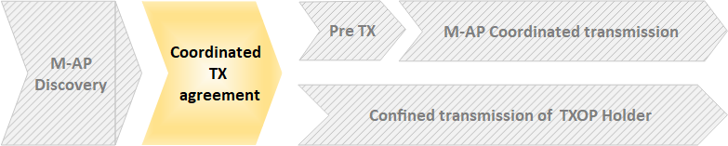
Stage 2: M-AP Coordination agreement setting
M-AP coordination agreement: agreement that is established between two or more OBSS APs.
  This set of APs will participate in the coordinated transmission
An M-AP Coordination agreement is required since an AP would agree to become a sharing AP and “give up” some of the resources in the TXOP it obtains only if there is a guarantee – by other APs - that each of these APs will share some of their resources with the AP when it will obtain a TXOP (and will become a sharing AP)
NOTE: This stage can be implemented in wireless or wireline using different set of exchanged messages

Slide 9
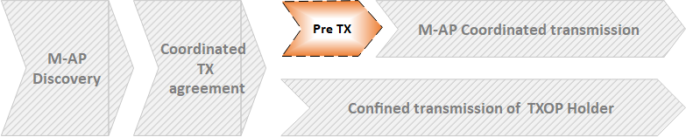
Stage 3: Pre-TX operation
NOTE: This stage is relevant only for TXOP-based coordination scheme
An optional stage that includes operations performed in each BSS prior to the coordinated transmission.
These operations may include (but are not limited to):
  Sequential sounding in Coordinated BF (C-BF) or Joint Transmission (JT) coordination schemes,
  Switching primary channel in Co-OFDMA coordination scheme
  etc.
If carried out, the Pre-TX operation is required to be executed in the first TXOP obtained by an AP that is a member of the coordination agreement, once an agreement has been established.
NOTE: This stage can be implemented in wireless or wireline using different set of exchanged messages

Slide 10
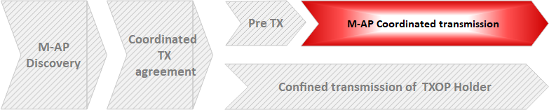
Stage 4: M-AP Coordinated Transmission initiation
NOTE: This stage is relevant only for TXOP-based coordination scheme
A coordinated transmission that is triggered by the sharing AP.
The number of shared APs and their allocated resources for the current TXOP is defined either:
  In a predefined assignment included in the coordination agreement
  Dynamically assigned by the Sharing AP (per TXOP).
The Coordinated transmission occurs on a portion of the TXOP obtained by the Sharing AP.

Slide 11
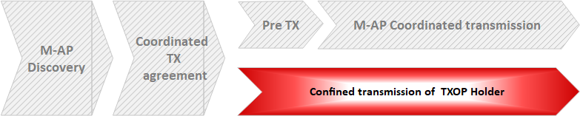
Stage 3b: Confined transmission of TXOP holder
NOTE: This stage is relevant only for SP-based coordination scheme
The TXOP holder which is a member of coordination agreement, can exchange frames subject to the following rule:
  The TXOP has to be completed / terminated before the start of any OBSS TWT SP that was coordinated with an OBSS AP under a coordination agreement or till its duration is expired, whichever comes first.

Slide 12
Summary
This contribution presents a unified framework for an M-AP Coordinated transmission.
  It is common for any M-AP coordinated transmission, regardless of the coordination scheme(s) being used.
The proposed framework includes 2 sequential stages for both TXOP-based schemes and SP-based schemes:
  M-AP discovery.
  Coordination agreement setting
The proposed framework includes additional 2 sequential stages for TXOP-based schemes
  Pre-TX BSS operation (an optional stage, relevant for some of the TXOP-based coordination schemes)
  M-AP Coordinated transmission initiation.
The proposed framework includes additional stage for SP-based schemes
  Confined transmission of TXOP holder.

Slide 13
SP1
Do you support defining a common framework of a M-AP Coordination for various coordination schemes?
  NOTE: Coordination schemes such as (but not limited to): Co-SR (TXOP-based with power control), Co-BF, TBD Co-TDMA , TBD C-RTWT, etc.
Yes / No / Abstain
  Supporting submissions: 11-22/1530r1, 11-23/293r0, 11-23/1871r5, 11-23/1932r3, 11-23/2022r1, 11-24/0072r0, 11-24/453r0, 11-24/511r1, 11-24/512r0, 11-24/719r0, 11-24/842r0, 11-24/1217r2, 11-24/1220r0

Slide 14
SP2
Do you support defining a common framework of a M-AP Coordination that includes the following procedures:
  M-AP Coordination Discovery procedure
  M-AP Coordination agreement negotiation procedure
Note: Details of the procedures and whether the above procedures are mandatory / optional - TBD
Yes / No / Abstain
  Supporting submissions: 11-22/1530r1, 11-23/293r0, 11-23/1871r5, 11-23/1932r3, 11-23/2022r1, 11-24/0072r0, 11-24/453r0, 11-24/511r1, 11-24/512r0, 11-24/719r0, 11-24/842r0, 11-24/1217r2, 11-24/1220r0

Slide 15
References
[1] 11-24-0209-04-00bn-Specification Framework for TGbn
[2] 11-23-1895-02-00bn-c-tdma-frame-sequence
[3] 11-23-1912-01-00bn-coordinated-tdma-procedure
[4] 11-23-1868-02-00bn-coordinated-spatial-reuse-design
[5] 11-23-1975-00-00bn-coordinated-spatial-re-use-for-uhr
[6] 11-24-0142-00-00bn-residual-interference-in-cbf
[7] 11-24-0639-00-00bn-mac-protocol-aspects-of-multi-ap-coordination
[8] 11-23-1932-03-00bn-further-considerations-on-coordinated-twt
[9] 11-23-2022-01-00bn-r-twt-for-multi-ap-follow-up
[10] 11-22-1895-00-00uhr-thoughts_on_map_assumptions
[11] 11-24-0072-00-00bn-map-channel-access-procedure
[12] 11-24-1217-02-00bn-multi-ap-coordination-setup-scheme
[13] 11-24-1220-00-00bn-a-framework-for-coordinated-access-points

