Slide 1
Discussion on SST and A-PPDU
Date: 2023-10-27
Authors:
Name | Affiliations | Address | Phone | email
Ross Jian Yu | Huawei |  |  | ross.yujian@huawei.com
Mengshi Hu
Ming Gan

Slide 2
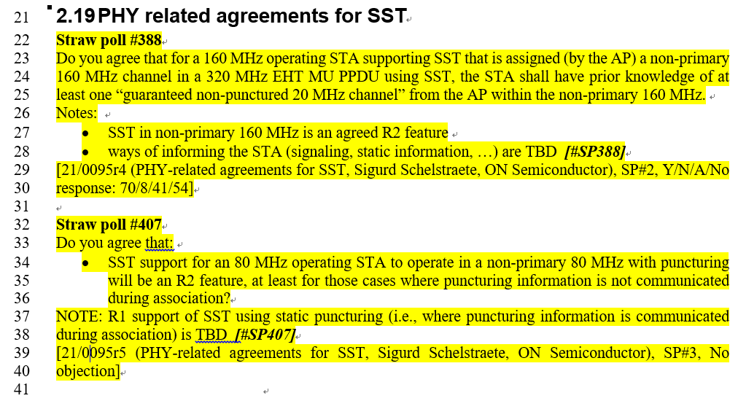
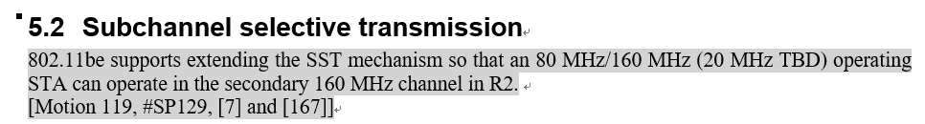
Agreed SPs for “11be R2” [1]

Slide 3
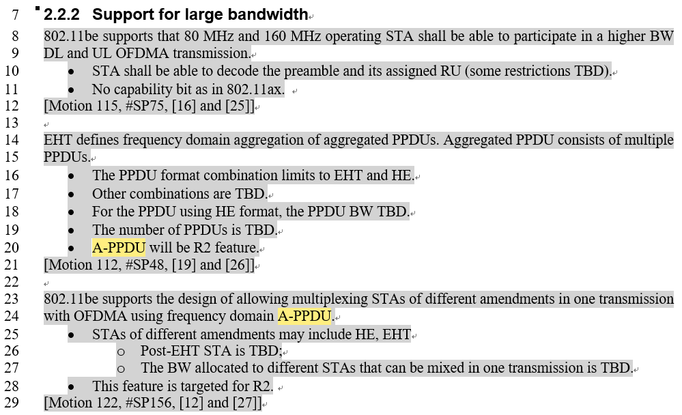
Agreed SPs for “11be R2” [1]
The current situation is that 11be doesn’t support SST on S160. In general, 11be AP and STA doesn’t support A-PPDU.
  Whilst in the spec, an EHT non-AP STA capable of 320 MHz supports transmission of an EHT PPDU in S160, with an HE PPDU in P160.

Slide 4
UHR A-PPDU combinations (1/3)
Non-UHR HE and EHT STAs don’t support A-PPDU. Assuming UHR STA supports A-PPDU, we may have the following possible combinations when the aggregated bandwidth is 160 MHz:
  As it is optional for non-EHT HE STA to support large bandwidth OFDMA, hence Opt (1) enhances maximum bandwidth from 80 MHz to 160 MHz, twice Tput gain, when there exists 80 MHz capable only non-EHT HE STA.
  Opt (2) is beneficial if some potential UHR feature makes UHR PPDU better than EHT PPDU in A-PPDU scenario, exact feature or gain needs further study.
  80 MHz HE + 80 MHz EHT/UHR PPDU makes L-length in different 80 MHz different, and will lead to L-SIG Reception error by non-EHT HE STA.
    HE-SIG-A difference in different 80 MHz may lead to HE-SIG-A reception error, needs further implementation check
  80 MHz EHT + 80 MHz EHT or 80 MHz UHR + 80 MHz UHR doesn’t show obvious benefits compared with 160 MHz EHT or UHR PPDU.
80 MHz
HE PPDU
EHT PPDU
80 MHz
HE PPDU (by UHR STA)
UHR PPDU
(1)
(2)

Slide 5
UHR A-PPDU combinations (2/3)
Non-UHR HE and EHT STAs don’t support A-PPDU. Assuming UHR STA supports A-PPDU, assuming the maximum bandwidth for UHR is 320 MHz, we may have the following possible 160 MHz + 160 MHz combinations:
  Opt (a) enhances maximum bandwidth from 160 MHz to 320 MHz, twice Tput gain.
  Opt (b) is beneficial if some potential UHR feature (e.g., UEQM, higher coding rate) makes UHR PPDU better than EHT PPDU, exact feature or gain needs further study.
  Compared with Opt (a), Opt (c) is beneficial if some non-UHR EHT STA can transmit EHT TB PPDU in S160 according to 11be spec. Exact implementation status TBD.
  Other 160 MHz + 160 MHz options include HE+HE, EHT+EHT, UHR+UHR, the gain compared with the above options or a 320 MHz EHT or UHR PPDU are not clear.
HE PPDU
EHT PPDU
HE PPDU
160 MHz
UHR PPDU
UHR PPDU
EHT PPDU (by UHR STA)
160 MHz
(a)
(b)
(c)

Slide 6
UHR A-PPDU combinations (3/3)
Non-UHR HE and EHT STAs don’t support A-PPDU. Assuming UHR STA supports A-PPDU, assuming the maximum bandwidth for UHR is 320 MHz, we may have the following 80 MHz + 80 MHz + 160 MHz possible combinations:
  Opt (d) enhances maximum bandwidth from 80 MHz to 320 MHz, Four times Tput gain.
  Opt (e) doesn’t show obvious gain compared with Opt (b).
  Compared with Opt (d), Opt (f) is beneficial if some non-UHR EHT STA can transmit EHT TB PPDU in S160 according to 11be spec. Exact implementation status TBD.
  Other 80 MHz + 80 MHz+ 160 MHz options, and other 80 MHz *4 options, the gain compared with the above options or a 320 MHz EHT or UHR PPDU are not clear.
80 MHz
HE PPDU
EHT PPDU
HE PPDU
80 MHz
HE PPDU (by UHR STA)
EHT PPDU (by UHR STA)
HE PPDU (by UHR STA)
UHR PPDU
UHR PPDU
EHT PPDU (by UHR STA)
160 MHz
(d)
(e)
(f)

Slide 7
Preferred combinations
As a summary, the current preferred combinations include:
Other modes need further study.
More options are possible assuming preamble puncturing.
  E.g., (80 + X + 160)*4
80 MHz
HE PPDU
80 MHz
HE PPDU (by UHR STA)
(1)
HE PPDU
80 MHz
HE PPDU
160 MHz
80 MHz
HE PPDU (by UHR STA)
UHR PPDU
UHR PPDU
160 MHz
160 MHz
(a)
(d)

Slide 8
Signaling for SST (1/2)
There exists signaling which moves the non-AP UHR STA to S160 channel. The signaling for SST can be combined with TWT, or exists separately at the beginning of a TXOP.
  With preamble puncture, anchor channel, or temporary primary channels need to be defined for each 80 MHz subchannels.

Slide 9
Signaling for SST (2/2)
There exists signaling which moves the non-AP UHR STA to S160 channel. The signaling for SST can be combined with TWT, or exists separately at the beginning of a TXOP.
  With preamble puncture, anchor channel, or temporary primary channels need to be defined for each 80 MHz subchannels.

Slide 10
Signaling for non-TB transmission
Within A-PPDU, each PPDU indicates its own bandwidth.
Moreover, the aggregated bandwidth, or exact bandwidth combinations may also be signaled (needs further study).

Slide 11
Signaling for TB transmission (1/2)
802.11be already defines a single trigger frame which can enable A-PPDU of HE + EHT PPDU, whilst the spec disallows the AP to trigger such combinations.
EHT PPDU can be simply changed to UHR PPDU by changing PHY version ID, and hence Opt (a) can be supported .
Regarding the preferred mode, some further work is needed to support Opt (1) and Opt (d).

Slide 12
Signaling for TB transmission (2/2)
An alternative way of transmitting trigger frame is to use DL A-PPDU to transmit several trigger frames, one trigger corresponds to one TB PPDU.
  Need to define temporary primary channel.
  Moreover, the aggregated bandwidth, or exact bandwidth combinations may also be signaled (needs further study).

Slide 13
Summary
In this contribution, different possible A-PPDU combinations are firstly discussed. The preferred modes at this stage are shown.
Signaling regarding SST, non-TB transmissions and TB transmissions are discussed in high level.
Detailed signaling, sequence design, phase rotation, spectral mask etc. can be further studied.

Slide 14
References
11-20-1935-66-00be-compendium-of-straw-polls-and-potential-changes-to-the-specification-framework-document-part-2
11-22-1416-01-00be-discussion-on-sst-and-a-ppdu

