Slide 1
CR for FT case
Name | Affiliation | Address | Phone | email
Yan Li | ZTE Corporation |  |  | li.yan16@zte.com.cn
Jay Yang
Yun Li

Slide 2
CID | Comment | Proposed Change | Resolution
131 | IRM is currently only part of 4-way handshake. The MAC address used for next association should be possible to change also in Fast Transition. | Allow STA to use different MAC address in each Fast BSS Transition. Please add possibility to signal the next MAC address in the FT signalign. | Revised. Agree with the commenter in principle. As the FT key hierarchy is established by the fixed mac address of the non-AP STA，we have to consdier a method to guarantee both of AP and non-AP STA can use valid FT key in the case of random mac address. The next few slides provide two potential resolutions and corresponding signalings.
136 | IRM is currently only part of 4-way handshake. The MAC address used for next association should be possible to change also in PASN setup. | Allow STA to use different MAC address in each Fast BSS Transition. Please add possibility to signal the next MAC address in the FT signaling. | Revised. The comment and proposed change indicate different cases. The PASN case has been resolved in D1.0. If the commenter want to propose the FT case, i agree with the comment in principle. As the FT key hierarchy is established by the fixed mac address of the non-AP STA，we have to consdier a method to guarantee both of AP and non-AP STA can use valid FT key in the case of random mac address. The next few slides provide two potential resolutions and corresponding signalings.
274 | The draft supports changing the Device ID or IRM MAC address at Reassociation, but does not appear to support such change when using FT (which is the popular way to do Reassociation, now). | Consider a method to support ID/MAC Address changing with FT protocol | Revised. Agree with the commenter in principle. As the FT key hierarchy is established by the fixed mac address of the non-AP STA，we have to consdier a method to guarantee both of AP and non-AP STA can use valid FT key in the case of random mac address. The next few slides provide two potential resolutions.

Slide 3
Recap of FT protocol
FT(Fast BSS transition)
FT key hierarchy
  PMK-R0
  PMK-R1
  PTK
FT procedure includes:
  FT initial mobility domain association
  FT protocol
FT protocol includes two methods:
  over-the-Air
  over-the-DS

Slide 4
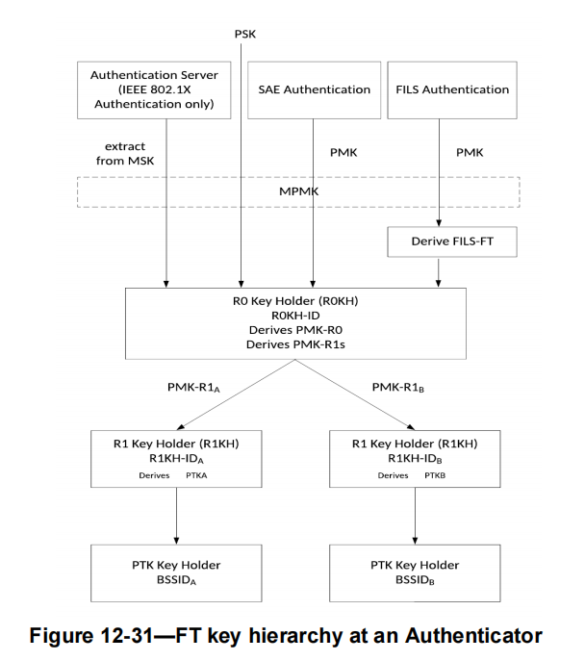
Recap of FT key hierarchy(1)
FT key hierarchy has three levels of keys(i.e. PMK-R0,PMK-R1 and PTK)^{[1]}.
The construction of FT key hierarchy is shown as the right figure.
R0KH derives the PMK-R0 from MPMK and should be responsible for maintaining PMK-R0 and deriving a PMK-R1 for each R1KH
R1KH maintians PMK-R1 and derives PTK

Slide 5
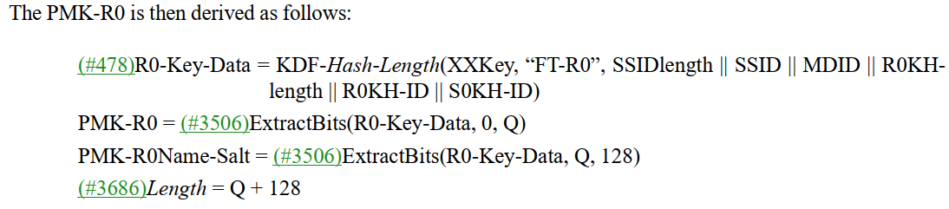
Recap of FT key hierarchy(2)
The MAC address of non-AP STA is one of the input parameter to generate PMK-R0 and PMK-R1.
  as both of S0KH-ID and S1KH-ID are the SPA
where

Slide 6
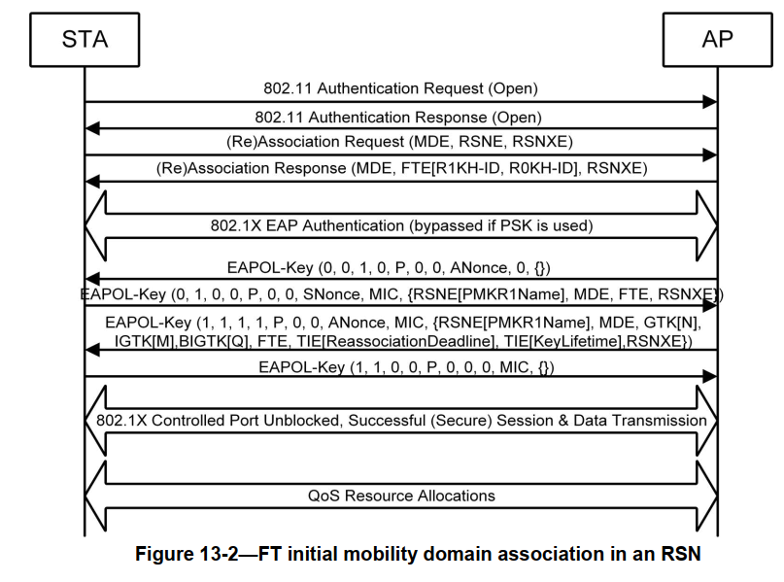
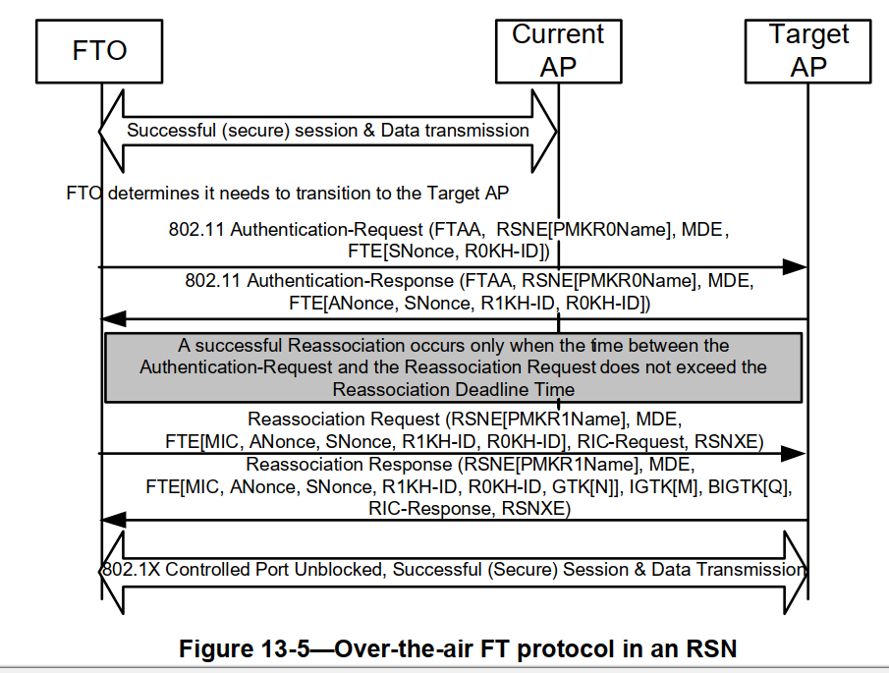
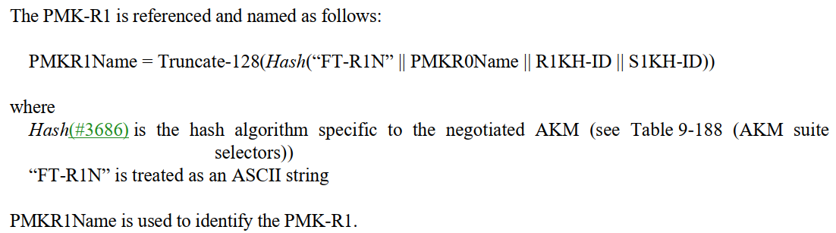
Recap of FT procedure
FT procedure can be divided into two parts:
initial mobility domain association(as the figure 13-2)
FT protocol (as the figure 13-5)
FTO should use the same MAC address in initial association and FT protocol.
The PMKR1Name along with the MAC address of FTO will be stored in the target AP after the initial association
FTO(non-AP STA) sends authentication request carrying PMKR0Name
the target AP will derive PMKR1Name based on the recived PMKR0Name and FTO MAC address, and verify whether the new derived PMKR1Name matches the stored PMKR1name

Slide 7
Motivation
  Due to the trackable issue concern during FT procedure, some venders may be in favor of the usage of RMA. However, a new problem is that the target AP can’t recognize and match the corresponding PMKR1 to the STA with RMA in FT case according to the analysis above.
  Now two features(device ID and IRM) defined by TGbh allow the non-AP STA using a different MAC addresss in the FT case to enhance security requirement.
  In the next few slides, two options are introduced to settle the FT key hierarchy issue[1]
  Note 1-the FT key hierarchy is derived from the current mac address(SPA) of the FTO.When the mac address of FTO is changed, AP can’t recognize it and find the correct key.

Slide 8
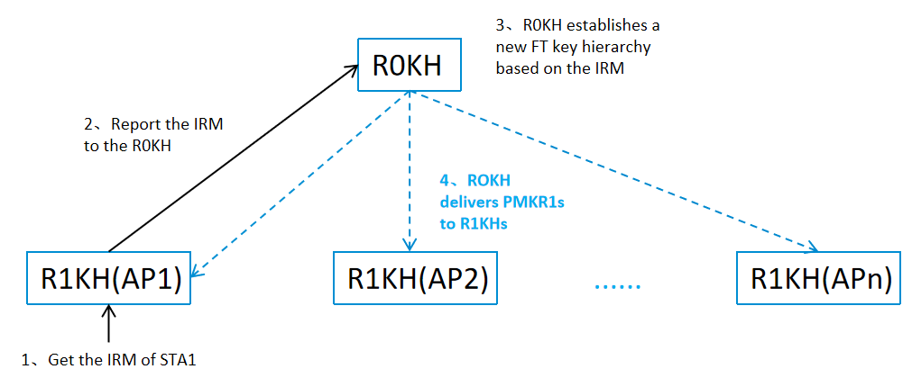
Option 1: generate a batch of new PMK-R1s
  In the initial associaiton, AP1 gets the IRM from STA1
  AP1 forwards IRM(assuming such IRM for FT case) to R0KH
  R0KH generates new PMKR1s based on the IRM according to the FT key hierarchy for STA1, and distributes the new generated PMKR1 to the corresponding R1KH
  S0KH will generates the new PMKR1 of the target AP before/during roaming
  When STA1 roams to AP2, both of them will use the new PMK-R1 along with IRM
  Once a new IRM is provided to R0KH in FT procedure, the R0KH and S0KH will generate new PMKR1s for next roaming.
In this option, new PMK-R1s should be generated each time before STA1 roams in the ESS(from the aspect of the ESS, STA1 is recognized as a new STA, because a new hierarchy(i.e., original PMKR0, new PMKR-R1s and PTKs based on IRM) has been established for it)

Slide 9
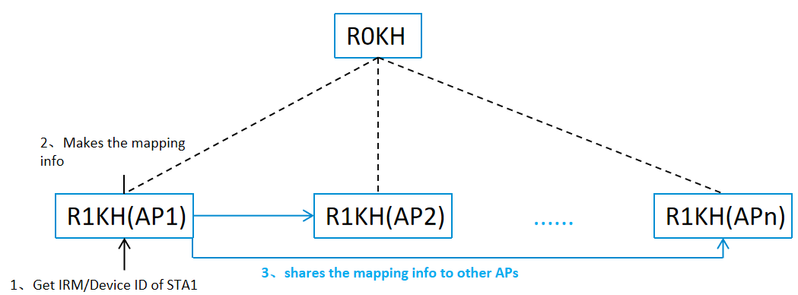
Option 2: Reuse the PMK-R1s
(11bh identifer maps to the original MAC address of the STA)
  In the initial associaiton, AP1 gets the IRM from STA1, or provides Device ID to STA1
  AP1 maps the 11bh identifier(IRM/Device ID) to the STA original MAC address used in the initial association
  AP1 shares the mapping info. to the other APs(AP2,etc.) in the same ESS(via the R0KH or via the direct link)
  When STA1 carrying 11bh identifier roams to AP2, AP2 will recognize the STA1 and find the stored PMK-R1 of the STA1.
In this option, the original FT key hierarchy(established in the initial associaiton) can always be reused when STA1 roams in the ESS(from the aspect of the ESS, STA1 with random mac address is always recognized as the STA with the mac address used in the initial association)
The stored map info. may like this: <11bh identifier<--->original MAC address<-->PMK-R1>

Slide 10
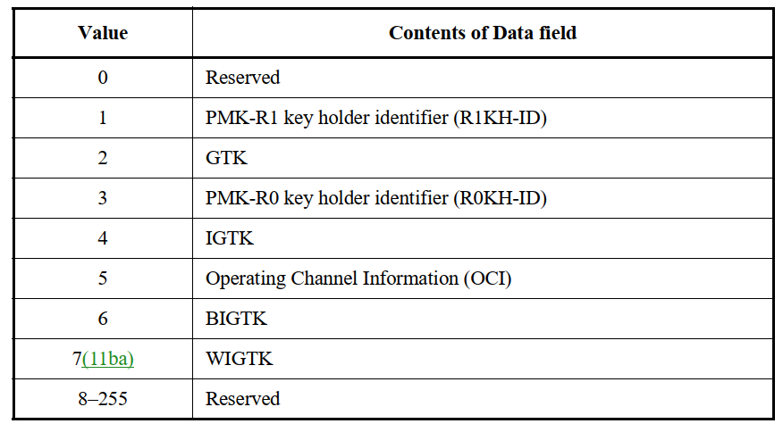
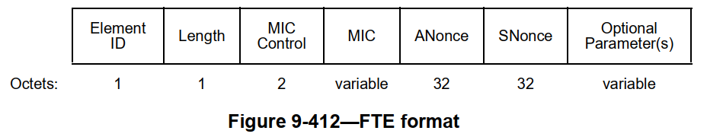
Signaling
For the initial association, the signaling for IRM/Device ID exchange is in the 4-way handshake,which has been resolved in the 11bh Draft 1.0
For the FT protocol( i.e., transition), new elements(IRM and Device ID) need to be added in the optional parameter(s) field in the FTE for next roaming
  The optional parameters field in the FTE can be encrypted[1]
Note 1:following the simialr way as GTK delivery in the optional parameter(s) of the FTE in baseline

Slide 11
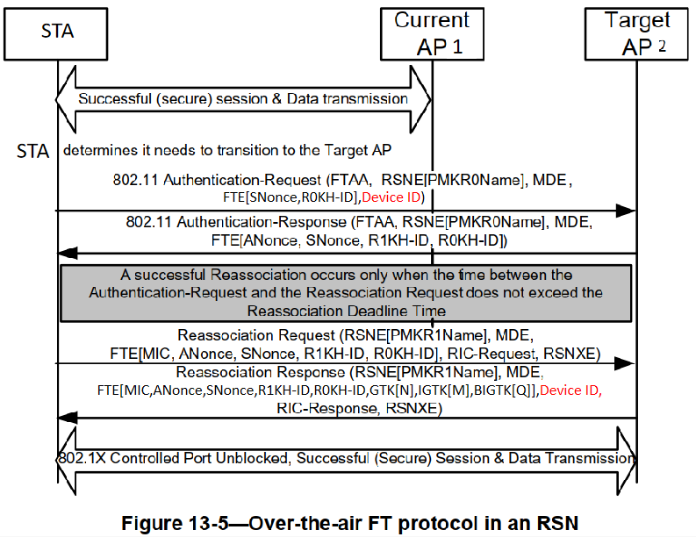
Signaling for Device ID
An instance for signaling of Device ID :
  authenticaiton request(message 1): STA provides the plaintext Device ID in the FTE for identification.
  reassociation response(message 4) : AP provides a new Device ID to the STA in encrpyted manner.
Note 1:message 1 shall carry the Device ID for the FT authentication and the Device ID is unencrypted because PTKSA hasn’t been negotiated at this time

Slide 12
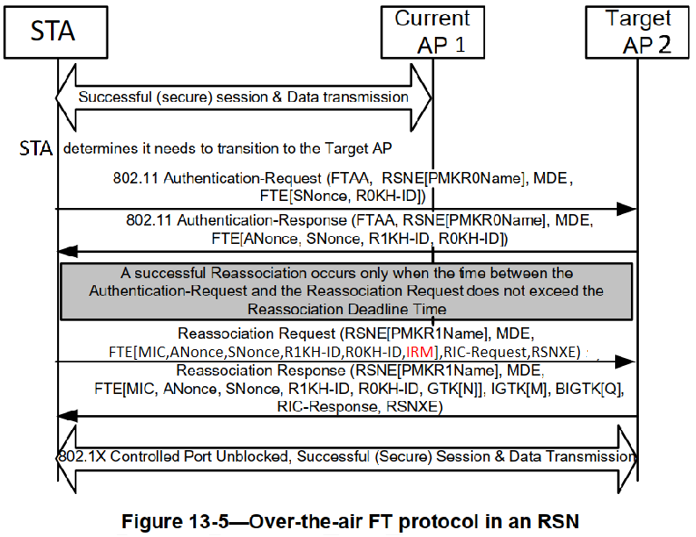
Signaling for IRM
An instance for signaling of IRM :
  authenticaiton request(message 1): STA provides the IRM in the MAC header for identification.
  reassociation request(message 3) : STA provides an new IRM for the next association/roaming in encrypted manner.

Slide 13
Summary
Option | IRM support | Device ID support | Modification of the SPEC | Impact in implementation
1.generates new PMKR-R1s | yes | no[1] | define a new procedure to generate new PMK-R1s for the STA once a new IRM is provided | extra computational cost to get new PMK-R1s if a new IRM provided
2.reuse the PMK-R1s | yes | yes | make and share the mapping info(11bh identifier to STA original MAC) among all the APs in the ESS | only share the new remapping info once a new 11bh identifier provides.
In summary, Option 2 seems to be simpler on the modification of the SPEC and implementation, comparing to Option 1
Note 1- when AP1 provides only Device ID to the R0KH, R0KH can’t generate new PMKR1s without MAC address of STA1 for the next association.

Slide 14
Straw Poll
  Which one do you support to settle FT key hierarchy issue[1]:
    Option 1 : generate new PMK-R1s
    Option 2 : reuse the PMK-R1s(11bh identifer maps to the original MAC address of the STA)
  Note 1-the FT key hierarchy is derived from the current mac address(SPA) of the FTO.When the mac address of FTO is changed, AP can’t recognize it and find the correct FT key.

Slide 15
THANK YOU ☺

Slide 16
Reference
[1] Draft P802.11REVme_D3.0
[2] Draft P802.11bh_D1.0

