Slide 1
Protection of Extended TXOP Sharing
November 2023
Date: 2023-10-27
Authors:
Name | Affiliations | Address | Phone | Email
Si-Chan Noh | Newracom |  |  | sc.noh@newracom.com
Joonsoo Lee |  |  |  | js.lee@newracom.com

Slide 2
Motivation
Reusing EHT’s Triggered TXOP Sharing(TXS) framework for extended TXOP sharing is under discussion in [2-5]
UHR can define a new method of TXOP sharing allows a sharing AP to share its obtained TXOP among other single/multiple BSS(s)
The domain of TXOP sharing issues can be modified/extended when enabling the TXOP sharing between multiple APs (M-APs)
This contribution discusses TXOP sharing issues for UHR STAs when a sharing AP allocates a portion of its obtained TXOP to another AP. Furthermore, a mechanism that enables UHR STAs, which are relevant only to the sharing AP, to utilize the channel within the allocated time, thereby increasing medium efficiency

Slide 3
Recap : TXS Procedure [1]
“An EHT AP may allocate time within an obtained TXOP to an associated non-AP EHT STA by transmitting MU-RTS TXS Trigger frame”
Non-AP EHT STA behavior
“After a non-AP EHT STA receives an MU-RTS TXS Trigger frame from its associated AP that contains a User Info field that is addressed to it, the STA may transmit one or more non-TB PPDUs within the time allocated in the MU-RTS TXS Trigger frame”
“The time allocation shall start when the PHY-RXEND.indication primitive of the PPDU that contains the MU-RTS TXS Trigger frame has occurred.”

Slide 4
Recap : NAV Rule in TXS [1]
“After sending the CTS solicited by an MU-RTS TXS Trigger frame from the associated AP, the STA that sends the responding CTS shall ignore the intra-BSS NAV either until the end of the time allocation signaled in the MU-RTS TXS Trigger frame”
When an EHT STA is not received PHY-RXSTART.indication from the PHY during a NAVTimeout, the EHT STA is not permitted to reset its NAV
“An EHT STA that uses information from a received MU-RTS TXS Trigger frame as the most recent basis to update its NAV should not reset its NAV after the NAVTimeout has expired unless the STA receives a CF-End frame that satisfies the conditions in 26.2.5 (Truncation of TXOP) and 10.23.2.10(Truncation of TXOP)”
Thus, when an EHT STA which is not participating in TXS procedure does not overhear CTS frame during a NAVTimeout, it does not reset its NAV

Slide 5
Protection in 11be
In 802.11be, an AP can share a portion of an obtained TXOP within its BSS (i.e., one associated non-AP EHT STA)
Such TXOP sharing within the BSS, protection of other STAs is inevitable to allow recipient STA of the MU-RTS TXS Trigger frame (TF) to transmit one or more non-TB PPDUs within allocated time
Follow the rules (i.e., MU-RTS Trigger/CTS frame exchange for EHT STAs)
Preceded by an optional CTS-to-self before transmit MU-RTS TXS TF
Not reset its NAV after the NAVTimeout has expired when the EHT STAs only overhear MU-RTS TXS TF

Slide 6
Protection in UHR
In UHR, extended TXOP sharing is under discussion (e.g., allowing a TXOP acquired by a sharing AP to be shared with single/multiple BSS(s))
When TXOP sharing between M-APs, protection of other STAs is needed to allow the shared AP to transmit or soliciting PPDUs in its BSS within the allocated time
However, in some scenarios where there is a UHR STA only relevant to the sharing AP that does not affect the shared AP’s BSS, it is beneficial to allow UHR STA to contend for channel within allocated time
It means that the domain of TXOP sharing issues can be modified due to the TXOP sharing is extended from single BSS to M-APs

Slide 7
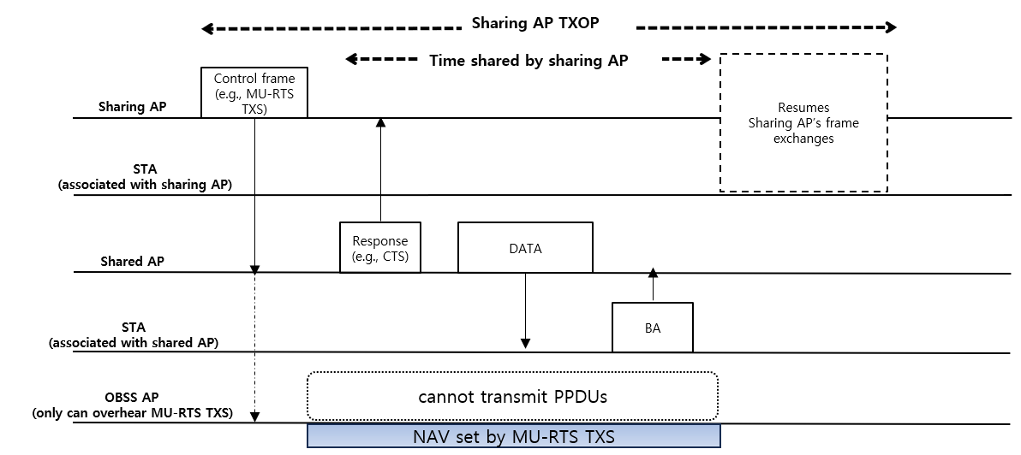
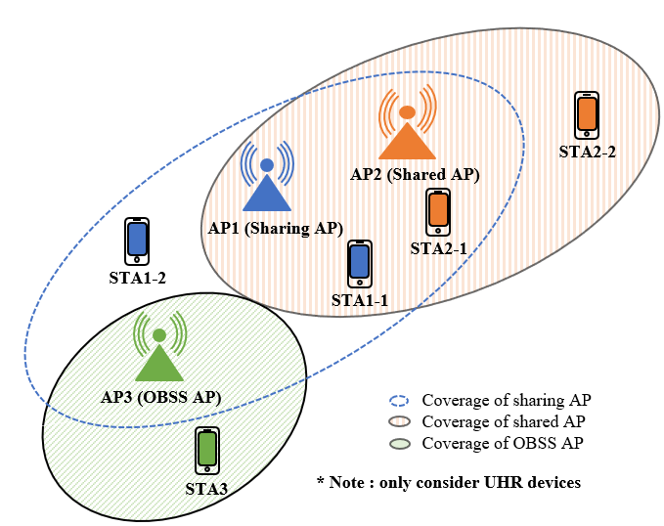
Modified TXOP sharing Issue
The sharing/shared AP can exchange frames for TXOP sharing
The STAs only can overhear MU-RTS TXS TF (e.g., STA1-2 and AP3) does not reset its NAV according to current NAV rule in previous slide 4
The STA1-2 should not reset its NAV due to the AP1 cannot transmit any PPDUs within allocated time
However, the AP3 may not cause collisions with the AP2’s BSS within allocated time, and does not reset its NAV until the end of the allocated time, it can lead to resource wastage
For this reason, it is beneficial to have a scheme that allows the AP3 to utilize the channel within allocated time to increase medium efficiency

Slide 8
Proposed Solution
The MU-RTS TXS TF can be designed to address TXOP sharing signaling to a shared AP and it should be differentiated with 11be TXS procedure
The UHR device can distinguish the MU-RTS TXS TF for the purpose of TXOP sharing in 11be or TXOP sharing between M-APs in UHR
Moreover, it can identify whether it is associated with the sharing AP or not
If it is not associated with the sharing AP, it can identify the MU-RTS TXS TF is soliciting frame for its BSS or other BSS through the User Info of the MU-RTS TXS TF

Slide 9
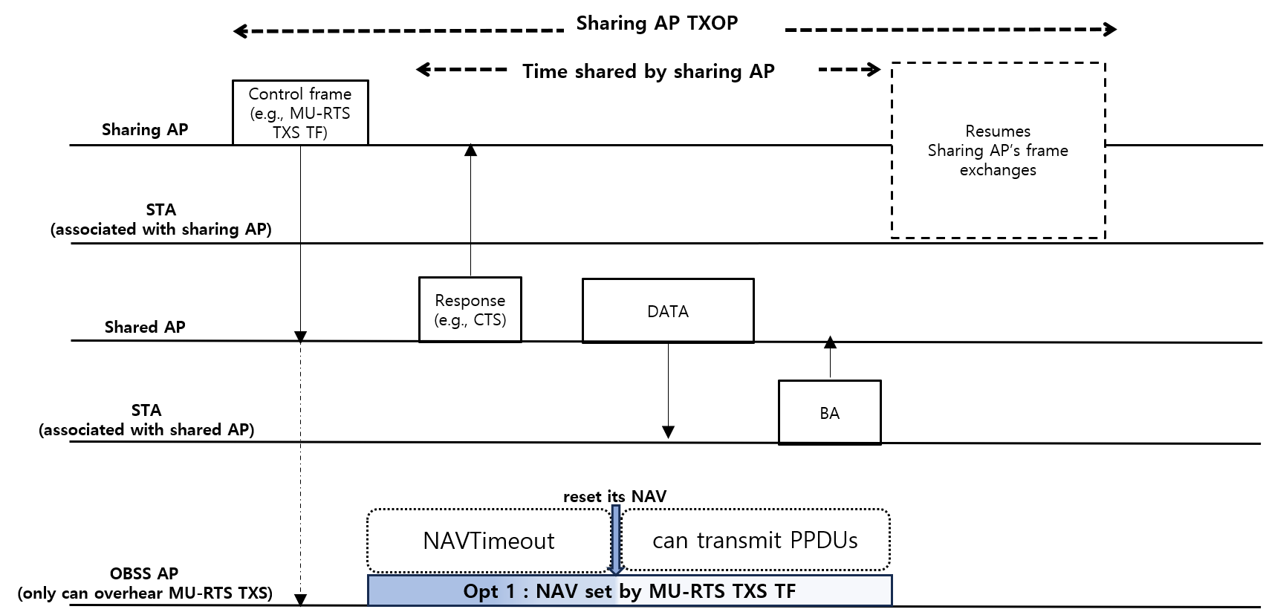
Proposed Solution (Cont’d)
Candidate solution
Option 1 : Reset its NAV after the NAVTimout has expired when the UHR device is not associated with the sharing AP and only overhears MU-RTS TXS TF which is not for its BSS
Pros : simply modify current rule
Cons : only can support UHR devices

Slide 10
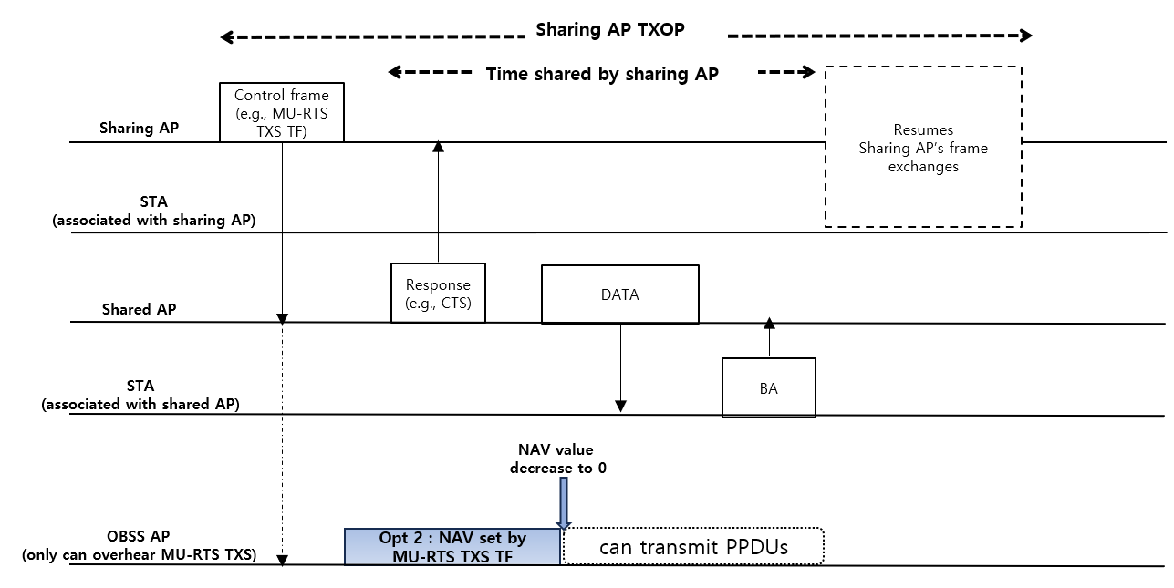
Proposed Solution (Cont’d)
Candidate solution
Option 2 : Set the duration field of MU-RTS TXS TF that doesn’t cover all the shared AP’s BSS frame exchanges
Pros : simply modify current rule
Cons : cannot overall protection within allocated time

Slide 11
Summary
The domain of TXOP sharing issues can be extended when enable the TXOP sharing between M-APs
If a UHR STA does not affect a shared AP’s BSS within allocated time in TXOP sharing manner, allow the UHR STA to contend for channel within allocated time can increase medium efficiency

Slide 12
Reference
[1] Draft P802.11be D5.0
[2] 23/581, Non-AP initiated TXOP sharing
[3] 23/261r0, C-TDMA procedure in UHR
[4] 23/0249r1, Extended TXOP Sharing
[5] 23/0739r1, Follow-up on Coordinated TDMA (C-TDMA)

