Slide 1
Buffer Status Report in Multi-AP
Date: 2023-11-01
Authors:
Name | Affiliations | Address | Phone | Email
Pei Zhou | TCL |  |  | zhoupei36@gmail.com
Zhanjing Bao | TCL

Slide 2
Introduction
In UHR, multi-AP coordination is considered as an important feature to increase not only throughput but also reliability
UHR PAR [1]: Technical solutions to meet the needs of cutting edge applications should address both deployments with a single isolated BSS and deployments with multiple non-collocated BSSs in dense environments where in-band and optionally out-of-band (including via IEEE 802.3) AP coordination can be available (e.g., enterprise, residential).
Currently, there are several multi-AP coordination schemes discussed in both 802.11be and UHR
C-TDMA, C-OFDMA, C-SR, C-BF, J-TX, etc.
[2] proposed a C-TDMA procedure by reusing the EHT TXS framework. The object is to enhance coordination among APs in time to improve the reliability of the network in latency, throughput and fairness
Observation: Before TXOP sharing, the sharing AP needs to determine how much time allocate to shared AP(s).
[3] proposed a Coordinated AP Time/Frequency Sharing procedure in 802.11be for worst case-latency improvement and throughput fairness
SP #3: Define a mechanism for the TXOP owner AP to solicit feedback from the set of APs to learn the resource needs and the intent to participate in a coordinated AP transmission.
Other multi-AP coordination schemes (C-SR [4], C-BF, J-TX, etc) may also need to know the resource needs in advance
For example, the sharing AP may prioritize inviting the shared AP(s) with low latency traffic to perform C-SR, C-BF, J-TX, etc.
Therefore, the precondition to perform multi-AP coordination is to obtain resource needs from shared APs.

Slide 3
Possible methods for obtaining resource needs
Sharing AP can use the following methods to obtain Shared APs’ resource needs, and then determine how much resource should be allocated to each Shared AP (e.g., for C-TDMA and C-OFDMA) or invite which shared AP(s) to participate in coordinated transmission.
Method 1: Based on Shared AP’s resource request
Each Shared AP indicates its required resources (e.g., time duration, BW/RU) to Sharing AP
Shared AP can actively include its required resources in an unsolicited frame
Shared AP can include its required resources in a frame solicited by Sharing AP
Sharing AP allocates required resources to each Shared AP
Drawback:
If the total amount of resources requested by Shared APs exceeds what Sharing AP can provide, Sharing AP doesn’t know how to execute the resource allocation
An arbitrary Shared AP may request more resources than needed, which will cause fairness issue to other Shared APs
Method 2: Based on Shared AP’s Buffer Status Report (BSR)
Shared AP reports its BSR (with potential modifications) to Sharing AP
Sharing AP evaluate all Shared APs’ BSR and determine the resource allocation
In our opinion, method 2 is preferred to assist Sharing AP in multi-AP coordination.

Slide 4
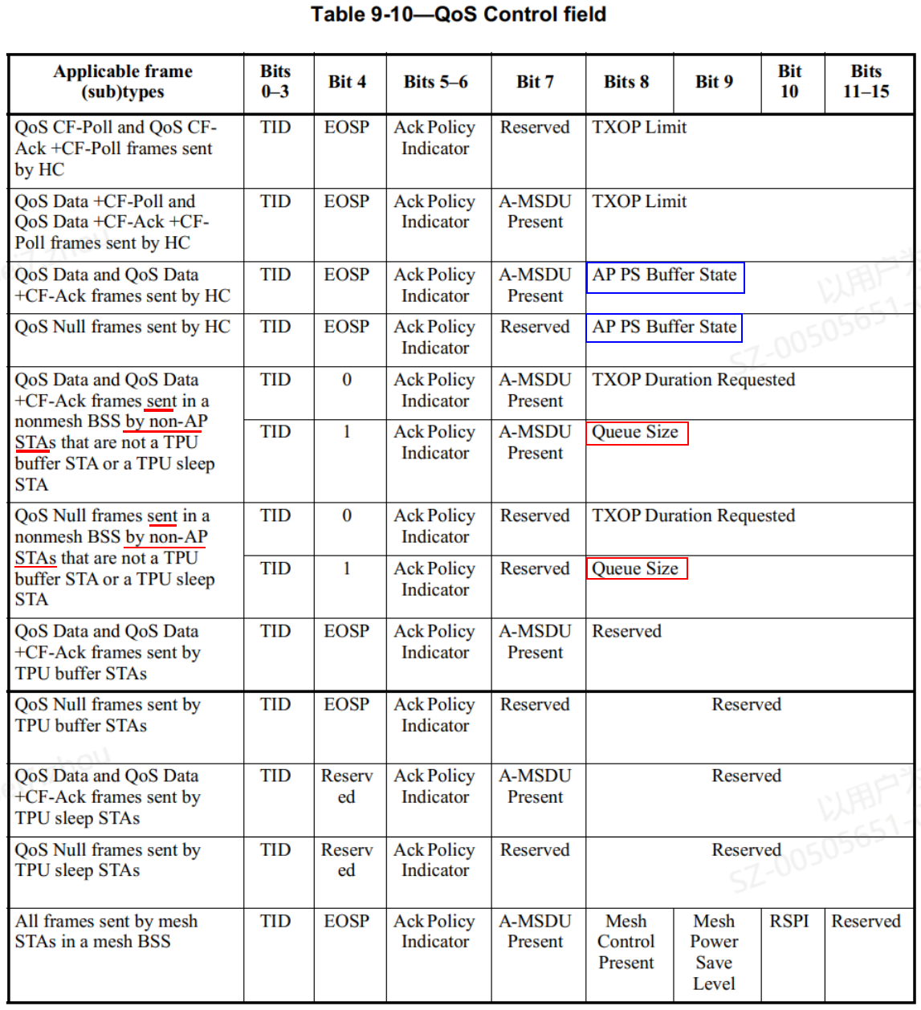
Re-cap: BSR in single BSS
The non-AP STA can either implicitly deliver BSRs in the QoS Control field or BSR Control subfield of any frame transmitted to the AP (unsolicited BSR) or explicitly deliver BSRs in any frame sent to the AP in response to a BSRP Trigger frame (solicited BSR). [5]
a) QoS Control field
The buffer status reported in the QoS Control field consists of a queue size value for a given TID
The Queue Size subfield indicates the amount of buffered traffic for a given TC or TS:
— at a non-AP non-HE STA sending the frame that contains this subfield, or
— at a non-AP HE STA for transmission to the HE STA identified by the receiver address of the frame that contains this subfield.
The AP PS Buffer State subfield indicates the PS buffer state at the AP for a STA.
b) BSR Control field
The Control Information subfield in a BSR Control subfield contains buffer status information used for UL MU operation (see 26.5.2 (UL MU operation)).
UL MU operation allows an AP to solicit simultaneous immediate response frames from one or more non-AP HE STAs.
Observation: Currently, there is no BSR exchange procedure between APs (e.g., between Sharing AP and Shared APs).

Slide 5
Proposal(s): C-BSR in UHR multi-AP
In multi-AP coordination, if Sharing AP wants to allocate proper resource to proper Shared APs, the following enhancements may need to be made:
Shared AP can report its “C-BSR” to Sharing AP by the following methods
Unsolicited C-BSR
Solicited C-BSR (by Sharing AP’s BSRP Trigger frame)
(Shared) AP’s C-BSR (Coordination BSR) should include the following
Multiple (or all) associated non-AP STAs’ UL buffer status
DL buffer status for multiple (or all) associated non-AP STAs
Both of the above
Note: The detailed C-BSR format needs further study.

Slide 6
Summary
We highlighted the necessities to share C-BSR between APs in multi-AP coordination
We proposed the methods to share C-BSR between APs
Unsolicited C-BSR
Solicited C-BSR
We proposed the potential contents that need to be included into the C-BSR
Multiple (or all) associated non-AP STAs’ UL buffer status
DL buffer status for multiple (or all) associated non-AP STAs

Slide 7
Straw Poll 1
Do you agree to add the following text to the TGbn SFD:
TGbn shall define the method to share (Coordinated-)Buffer Status Report (C-BSR) between APs.
Note: the detailed method is TBD.
Y/N/A

Slide 8
Straw Poll 2
Do you agree to add the following text to the TGbn SFD:
Sharing AP can use one of more of the following methods to obtain the C-BSR of Shared AP:
Unsolicited C-BSR
Solicited C-BSR
Note: the detailed methods are TBD.
Y/N/A

Slide 9
Straw Poll 3
Do you agree to add the following text to the TGbn SFD:
The C-BSR of Shared AP may contain one or more of the following contents:
Multiple associated non-AP STAs’ buffer status for the Shared AP
Buffer status at the Shared AP for multiple associated non-AP STAs
Note: the detailed C-BSR format is TBD.
Y/N/A

Slide 10
References
[1] 11-23-0480-03-0uhr-uhr-proposed-par
[2] 11-23-0041-00-0uhr-considerations-on-coordinated-tdma
[3] 11-19-1582-02-00be-coordinated-ap-time-and-frequency-sharing-in-a-transmit-opportunity-in-11be
[4] 11-23-1917-00-00bn-coordinated-spatial-reuse
[5] Draft P802.11REVme_D4.1

