Slide 1
Multi-AP Joint Transmission Simulations with Impairments
Date: 2023-11-13

Slide 2
Introduction
A previous submission [1] presented results on multi-AP joint transmission for residential scenarios
  Different AP configurations are considered (2- and 4-antennas)
    Extender vs. Mesh scenario
  JT performance is compared with beamforming and MU-MIMO reference performance
  In [1], no impairments were considered for joint transmission
This contribution further investigates:
  A mathematical model for impairments of joint transmission
    Frequency offset between APs in particular
  Analysis of simulation results w.r.t. UHR goals

Slide 3


In-Home Scenario
Coverage Simulation
Residential scenario based on [3]
3 rooms, STAs placed on grid, equal number of drops at each position

Slide 4
AP and Station Configurations
2 APs in 3 rooms (positioned as shown on slide 3)
  Mesh scenario
    2 APs with 2 antennas each
Serving 4 STAs in the residence (3 rooms)
  All STAs are 2-antenna STAs
  STA locations are varied in different simulation drops

Slide 5
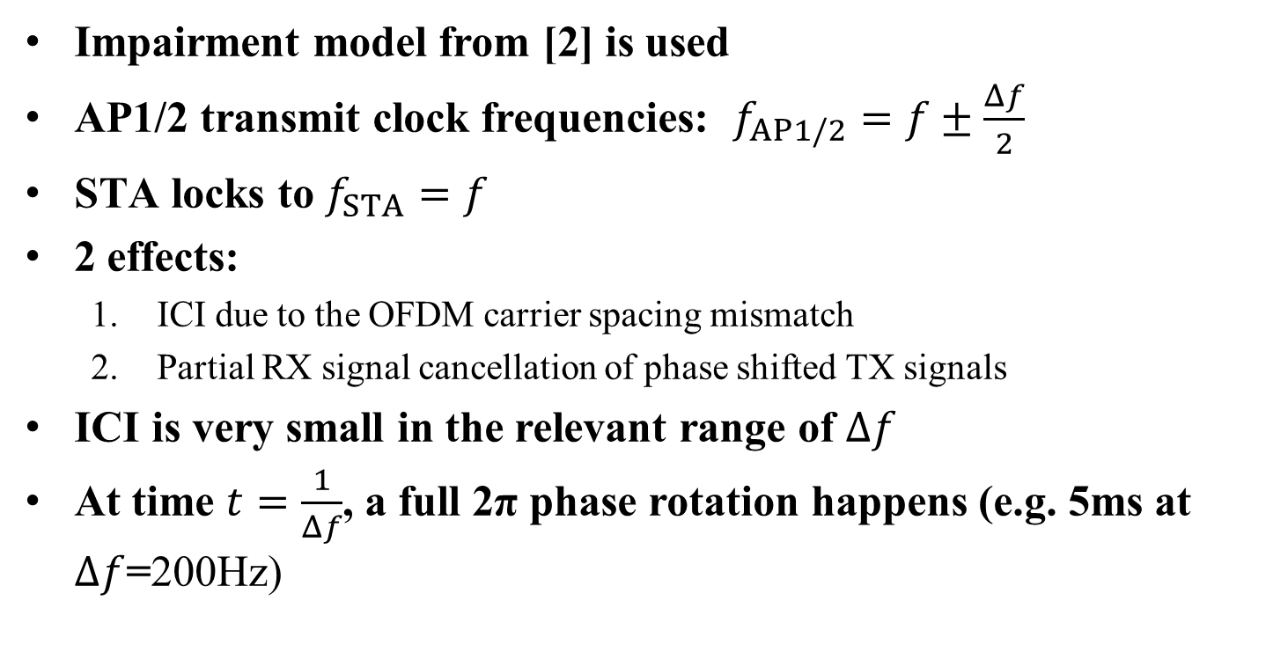
Impairments - Different AP Clocks
Impairment model from [2] is used
AP1/2 transmit clock frequencies: $f_{AP1/2}=f±\frac{Δf}{2}$
STA locks to $f_{STA}=f$
2 effects:
  ICI due to the OFDM carrier spacing mismatch
  Partial RX signal cancellation of phase shifted TX signals
ICI is very small in the relevant range of $Δf$
At time $t=\frac{1}{Δf}$, a full 2π phase rotation happens (e.g. 5ms at $Δf$=200Hz)

Slide 6

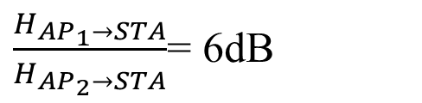
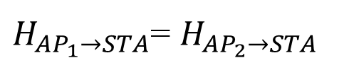
Different AP Clocks (Time Domain Model)
Signals from the two APs combine differently at different times due to clock offset
  Phase difference can cause destructive interference
  More pronounced the more similar the channels are
Performance degradation:
  RX equalizer does not adapt to changing channel fast enough
  Precoder and channel don’t match, causing residual interference in MU-MIMO
$H_{{AP}_{1}→STA}$= $H_{{AP}_{2}→STA}$
Example: $Δf$=200Hz
$\frac{H_{{AP}_{1}→STA}}{H_{{AP}_{2}→STA}}$= 6dB

Slide 7
Presentation of Simulation Results
Results are summarized in Rate distributions:
  CDF with rates of individual STAs
  CDF with aggregate rates for the 4 STAs
  Results can be compared between JT, MU-MIMO, …
  “All cases” refers to random AP-STA assignment
  “Best AP” refers to an optimized AP-STA assignment (w.r.t. sum rate)

Slide 8
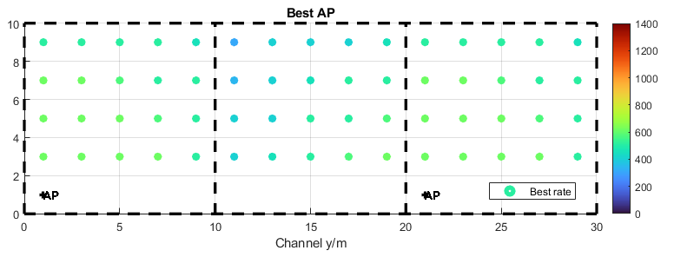
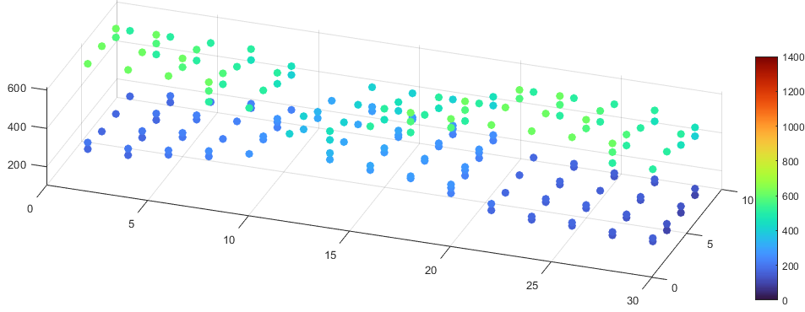
Presentation of Simulation Results (2)
Visualization of coverage
  Show scatter plot of the rates (of individual STAs) at all simulated locations

Slide 9
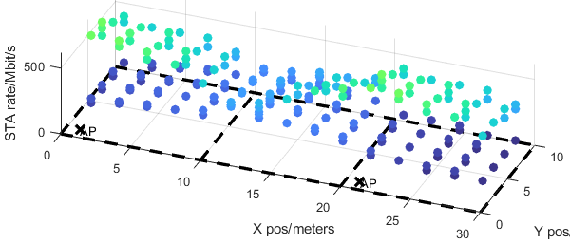
SU MIMO (Beamforming) results
Rate distributions
Coverage
  STAs may be assigned to an arbitrary AP (all cases)
  Or to the “Best AP” which gives the highest rate

Slide 10
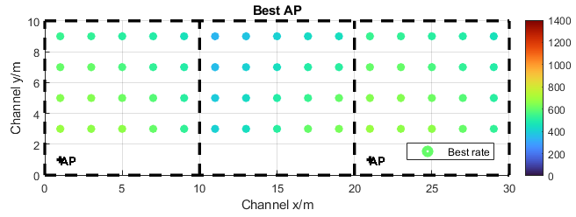
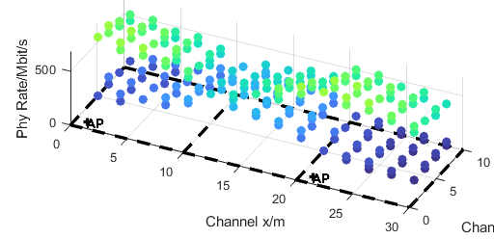
MU MIMO results
Rate distributions
Coverage

Slide 11
SU vs. MU MIMO Comparison
Similar coverage, similar rate statistics
MU MIMO gives around 20% rate gain of the median rate over SU MIMO for 2-antenna STAs
Assignment to the closest AP(“Best AP”) is essential for high data rates
  For both BF and MU-MIMO

Slide 12
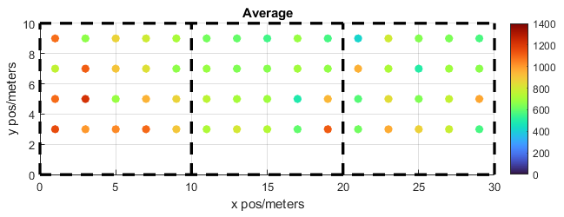
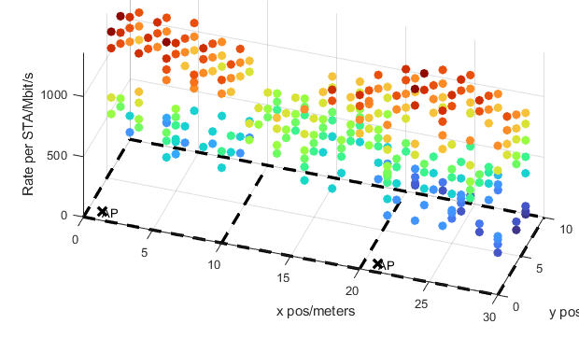
Mesh Topology – Joint Transmission results (no impairments)
Rate distributions
Coverage

Slide 13
Observations on JT with 2-antenna APs
(no impairments)
While the aggregate rates outperform MU MIMO in all cases, individual STAs may have low rates
Coverage wise, this happens when 3 or more STAs are close to of the APs (in room 1 or in room 3)
To fix this issue, the number of simultaneously serve STAs must be reduced, when this condition is met

Slide 14
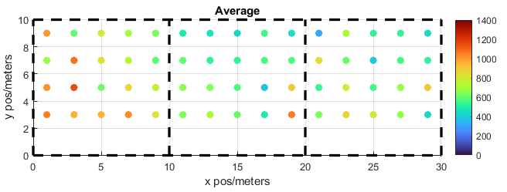
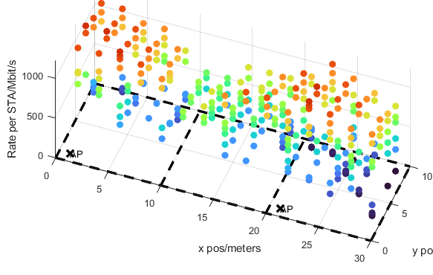
Mesh Topology – Joint Transmission clock (20Hz offset between APs)
Rate distributions
Coverage

Slide 15
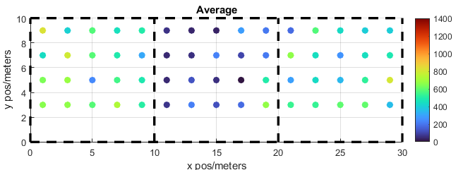
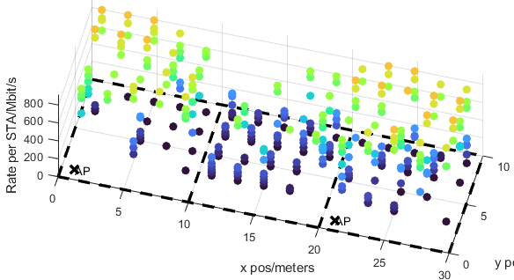
Mesh Topology – Joint Transmission clock (100Hz offset between APs)
Rate distributions
Coverage

Slide 16
Observations on JT with clock offset
Observations
At 20Hz clock offset, performance is degraded by about 10%
A higher clock offset (100Hz) causes a severe performance loss, with some STAs having zero rate
STAs with similar distance to both APs (Room 2) suffer the most

Slide 17
Conclusions
JT is very sensitive to frequency offsets between the participating APs
  Even for very low frequency offsets (20 Hz), a performance impact is visible, especially for long packets >1ms
  Performance degrades quickly for higher offsets. At 100 Hz offset, performance is severely degraded, with many individual STAs getting no throughput
Getting low enough frequency offsets may require new, dedicated synchronization mechanisms

Slide 18
References
[1] “Multi-AP Simulations: framework and Joint Transmission results”, IEEE 802.11-23/1176r1
[2] Manolakis, K., Oberli, C., Jungnickel, V., & Rosas, F, "Analysis of synchronization impairments for cooperative base stations using OFDM." International Journal of Antennas and Propagation 2015 (2015).
[3] Simone Merlin, etc., “TGax Simulation Scenarios”, IEEE 802.11-14/0621r3
[4] “Joint Transmission for UHR – A Refresher and New Results”, IEEE 802.11-22/2188r0

Slide 19
APPENDIX

Slide 20
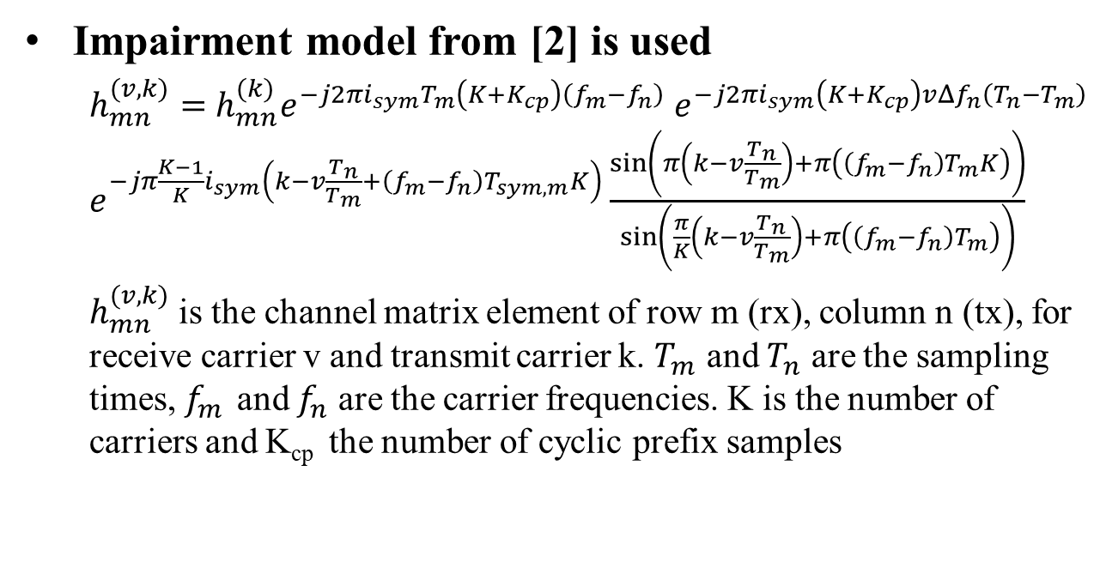
Different AP Clocks
Impairment model from [2] is used
  $h_{mn}^{(v,k)}=$ $h_{mn}^{(k)}e^{−j2πi_{sym}T_{m}\left(K+K_{cp}\right)\left(f_{m}−f_{n}\right)}$ $e^{−j2πi_{sym}\left(K+K_{cp}\right)vΔf_{n}\left(T_{n}−T_{m}\right)}$ $e^{−jπ\frac{K−1}{K}i_{sym}\left(k−v\frac{T_{n}}{T_{m}}+\left(f_{m}−f_{n}\right)T_{sym,m}K\right)}\frac{\sin\left(π\left(k−v\frac{T_{n}}{T_{m}}\right)+π\left(\left(f_{m}−f_{n}\right)T_{m}K\right)\right)}{\sin\left(\frac{π}{K}\left(k−v\frac{T_{n}}{T_{m}}\right)+π\left(\left(f_{m}−f_{n}\right)T_{m}\right)\right)}$
  $h_{mn}^{(v,k)}$ is the channel matrix element of row m (rx), column n (tx), for receive carrier v and transmit carrier k. $T_{m}$ and $T_{n}$ are the sampling times, $f_{m }$and $f_{n}$ are the carrier frequencies. K is the number of carriers and K_{cp} the number of cyclic prefix samples

Slide 21
Simulation parameters
Parameter | Value
TX/RX Antennas | 2/2
APs/STAs | 2/4 (2 STAs per AP)
Spatial streams | 1 or 2 (optimized)
Bandwidth | 160 MHz
AP TX Power | 18 dBm
Channel model | D NLOS [3]
MCS | 0-13 (optimized)
Frequency | 5.25GHz, ±20/100Hz [4]
GI | 1.6µs
TX/RX SNR | 41dB/43dB
Channel aging/Doppler | 1.2km/h, 6Hz
BF quantization | ideal
Precoder type | SVD (SU), MMSE (MU)
Sounding interval | 100ms (SU), 10ms (MU)
Overhead | Sounding and MAC overhead not considered
Parameter | Value
SU time allocation | 25% for each STA
MU allocation | 2 STAs served by one AP 50% time for per AP
RX Equalizer | MMSE+LMS adaptation
Backhaul capacity | 10Gbit/s full duplex

