Slide 1
Follow up on the Relay Transmission
November, 2023
Date: 2023-11-10
Authors:
Name | Affiliation | Address | Phone | Email
Dongguk Lim | LG Electronics | 19, Yangjae-daero 11gil, Seocho-gu, Seoul 137-130, Korea |  | dongguk.lim@lge.com
Eunsung Park |  |  |  | Ensung.park@lge.com
Jinyoung Chun |  |  |  | jiny.chun@lge.com
Insik Jung |  |  |  | insik0618.jung@lge.com
Jinsoo Choi |  |  |  | js.choi@lge.com
Insun Jang |  |  |  | insun.jang@lge.com
Sunhee Baek |  |  |  | sunhee.baek@lge.com
Geonhwan Kim |  |  |  | geonhwan.kim@lge.com
Yelin Yoon |  |  |  | yl.yoon@lge.com
Dongju Cha |  |  |  | dongju.cha@lge.com
HanGyu Cho |  |  |  | hg.cho@lge.com
Sanggook Kim |  | 10680 Treena St San Diego, CA 92131 |  | sanggook.kim@lge.com

Slide 2
Introduction
In [1], we introduced the relay operation in UHR to provide improved SNR and range extension.
  We considered the various points to apply the relay operation in UHR and addressed the scenario for relay transmission.
In [2 ~ 3], we have dealt with some features to be considered for relay operation as well as frame exchange based on AP controlling.
  A Relay STA was considered as a non-AP STA and we progressed the discussion about it.
In this contribution, we address some considerations related to received comments regarding a definition for a type of Relay STA.

Slide 3

Recap : Relay Operation [2,3]
The relay operation can provide the improved QoS (i.e., reliability and throughput) to STA in a BSS.
  A Relay STA has better link quality/channel condition than a direct link.
    Based on the enhanced link quality/channel condition, the high-order MCS level can be used for the transmission.
To achieve efficient relay operation, following things should be considered.
  An appropriate STA selection for relay operation
  Channel measurement for each link
  TXOP sharing for relaying
Relay STA
STA1
AP1
STAn

Slide 4
Definition of the Relay STA
Based on [1~ 4] and received comments from a couple of members during the presentation, we may consider the relay STA type as follow.
  One type is that it has no AP function.
    This STA may also be associated with AP.
  Another type is that it has AP function
    This STA may be considered as an AP has a Relay capability or a New AP that composed of simple function for relay protocol.
In the next slides, we investigate more detailed considerations related to those two types of relay STA.

Slide 5
Case1 : Relay STA has no AP function
The Relay STA can be defined as a new type of non-AP STA that operates only for relaying or a non-AP STA that has the capability of relaying.[1]
  The Relay STA doesn’t have AP functions such as scheduling, beaconing/management, and function to link wireless networks.
  As in the existing operation, the relay STA performs an association process with an AP, and based on this, the AP can know whether the relay STA exists in a BSS.
    To identify the Relay STA, the specific AID or information pair (e.g., AID and capability info) can be used.
The connection procedure for relay operation between relay STA and non-AP STA is not required.
BSS
AP1
STA1
Link connection with AP
STA3
Relay STA
STA2

Slide 6
Case1 : Relay STA has no AP function
In terms of Frame exchange for relay operation,
  The relay operation is controlled or managed by the AP.
  As introduced in [2,3], the following operation should be performed based on the frame exchange with the AP.
    Relaying can be performed during the SP or TXOP which is set by the AP in a BSS.
      The TXOP sharing defined in 11be can be used for this with simple modification.
      By considering the situation in a BSS, AP can easily manage the relay operation and it can minimize the impact on the BSS operation according to the relay operation.
    For the efficient transmission between the Relay STA and end-STA, AP should know the channel status between Relay STA and end-STA.
      For this, we can reuse a sounding sequence defined in 11bf that is defined peer-to-peer channel measurement. please refer to the appendix.

Slide 7
Case1 : Relay STA has no AP function
In terms of Relay transmission,
  The Relay STA transmits the data received from AP to the end STA by applying the DF (i.e., decoding and forwarding) as described in [1,4].
    Relay STA does not perform encryption and decryption of data for relay transmission. (i.e., The security key is not shared with Relay STA.)
      The adverse impacts caused by fake relays can be prevented
  Relay STA can perform some processes related to low MAC as follows.
    MAC header decoding, ACK/BA processing, etc.
  In order to indicate the final acknowledgement, it may need to define an end-to-end ACK/BA.
    As shown in [2], it can be omitted by adjusted process.
  To support range extension, a simple relaying of a management frame may be required, and regarding this, we need to for further study.

Slide 8
Case2 : Relay STA has an AP function
Relay STA may be considered as an AP that has relay capabilities or a new AP that is composed of simple function for relay protocol.
  It can be discovered by the management frame such as the beacon frame and probe response frame.
    For relay operation, New IEs or New frame exchange between source AP and relaying AP may be required.
  In order to perform the best relaying, a Relay STA selection metric(e.g., QoS, load balancing, etc.) may be considered.
  And, since Relay STA may be located in the range of other BSS for efficient relay transmission, we should consider the following.
    Increased inter-BSS interference
    Increased collision and contention due to an adjacent AP
BSS1
BSS2
Link connection with AP1
Relay STA (AP2)
Link connection between APs
AP1
Link connection
between relay STA and non-AP STA
STA1
STA2

Slide 9
Case2 : Relay STA has an AP function
It may require the settings of the link connection between two APs such as Multi-AP coordination/collaboration for efficient relaying.
  For pre-link formation, multiple frame exchanges could be considered for discovery and capability negotiation, etc.,
  In addition, TXOP sharing between APs or enhanced rTWT as discussed in MAP may be considered in order to adjust time and resources for relaying.
    For example, TXOP sharing between APs may be performed as follow

Slide 10
Case2 : Relay STA has an AP function
Since the Relay STA can operate as an AP during relaying, we should consider the following
  The different primary channel between Relay STA and source AP
    If the primary channel is different, for relay transmission, a relay STA should change a channel before relaying or an end STA(i.e., non-AP STA) should change a channel.
  Link connection between Relay STA and non-AP STA which is associated with other AP
    Since the end-STA is an unassociated STA in terms of a relay STA, a procedure for negotiating the capabilities of the end-STA may be required for relay transmission.
  The relay transmission requires information sharing between source AP and relay STA. So, for data sharing or forwarding, it may consider the burden and backhaul capacity for data sharing between multiple APs.

Slide 11
Summary
In this contribution, we tried to identify the considerations regarding the Relay STA’s type.
  Two types of Relay STA are considered.
    One type is that it has no AP function.
    Another type is that it has an AP function.
Using Relays in UHR to provide improved QoS and extended coverage requires more careful handling of each of the considerations identified in this contribution, as well as other considerations depending on the type of Relay STA.

Slide 12
Reference
[1] 11-23-0042-00-0uhr-Thought for Range Extension in UHR
[2] 11-23-1138-01-0uhr-Features to consider for efficient relay operation
[3] 11-23-1139-00-0uhr-Relay Transmission in UHR
[4] 11-23-1175-00-0uhr-uhr-relay-follow-up

Slide 13
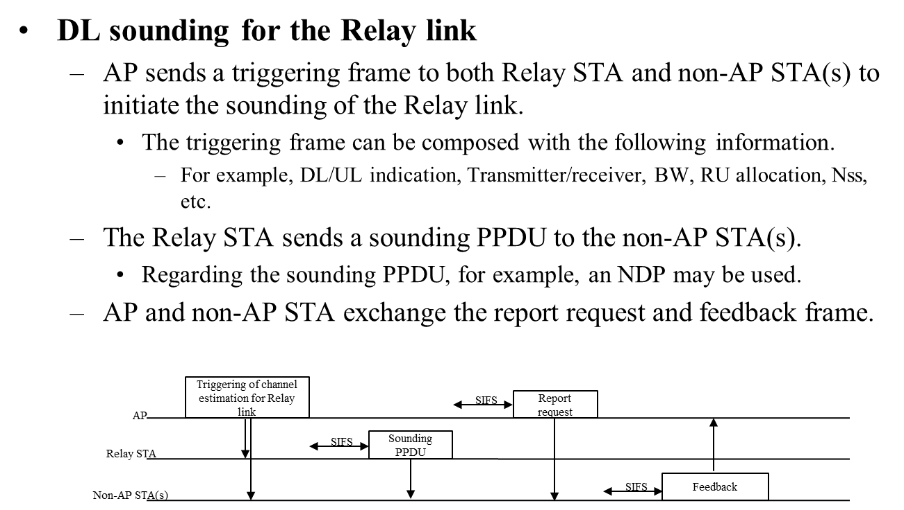
Appendix
DL sounding for the Relay link [2]

Slide 14
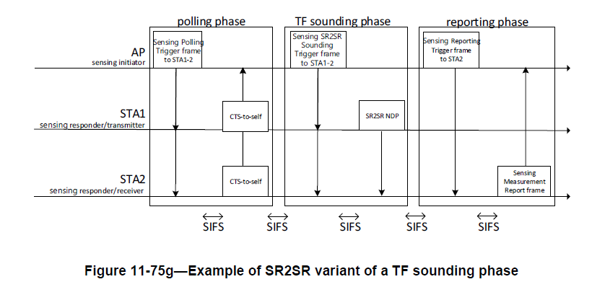
Appendix
SR2SR sensing measurement in 11bf

