Slide 1
The security consideration in MAP scheme

Slide 2
Background
UHR PAR:
  THE UHR SG focuses on the WLAN connectivity improvement, e.g. higher reliability, lower latency and manageability improvement.
  The connectivity improvement is not on the single infrastructure network, but also in multiple infrastructure networks
A batch of features are discussed on how to improve the WLAN connectivity in MAP scheme,like co-OFDMA,co-SR,co-beamforming, etc.
  Sharing AP competes the channel resource, and grants the channel resource to the shared AP via a Trigger frame
  Sharing AP may have extra information exchange with the shared AP via MGMT frame,like BQR,BSR,etc.
Problem
  Without any protection, the 3rd party can monitor all the frame exchange between two APs
  Without the authentication, a malicious AP may mimics a legitimate AP and join the MAP co-ordination procedure, to attack the whole network.

Slide 3
Motivation
  Reference [2] and [3] are proposed to protect the Trigger frame and other control frame to improve the reliability.
  We propose to cover the frame protection in the MAP scheme as well.
    Need to define a procedure to generate the key stuff to protect the MAP frames exchange.
      The MAP frames include Group/individual addressed Trigger frame, and other MGMT. frames.
    A sharing AP may authenticate one or more shared APs without the association procedure
    An AP may support different authentication schemes in different scenarios, the new defined MAP protection scheme should cover all kinds of authentication mode.
    The sharing AP and shared AP have the equal status,the new defined MAP protection scheme should allow them to authenticate each other.

Slide 4
Propose to reuse the PASN protocol in MAP scheme
  PASN is widely used in 11az and 11ba draft to protect FTM and WUR frame respectively.
  PASN is extended in 11bh draft to deliver the encrypted 11bh identifier.
  PASN supports no-authentication, SAE, FILS and FT mode, and it can meet all kinds of AP authentication requirement.
  PASN protocol allows the two entities authenticate each other during 3-way handshake.

Slide 5
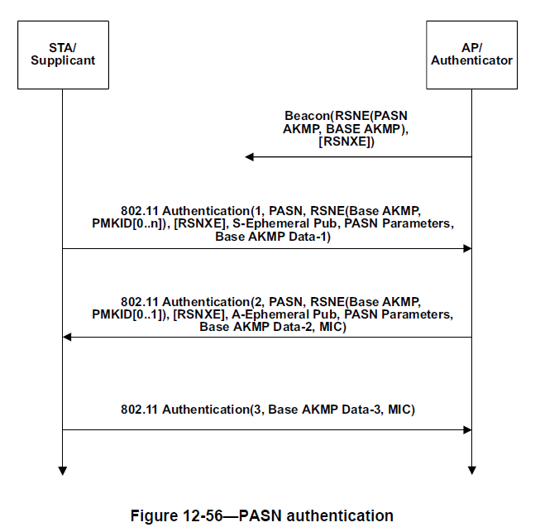
Recap the PASN protocol
PTK is derived from PMK and Diffie-Hellman shared secret protocol with a simple formula as bellow.
PTK = KDF-HASH-NNN (PMK, “PASN PTK Derivation”, SPA || BSSID || DHss)

Slide 6
The consideration of extension on PASN in MAP scheme
TCK is derived from PTK to protect individual control frame
Group keys are delivered from master AP to protect group addressed control and MGMT. frame
Following the extension in 11bh draft, Group key is delivered to slave AP via 2-PASN/3-PASN authentication frame.
Need to define an extra signaling exchange procedure to decide which side become the master AP to generate and maintain the group keys.
RSNE to indicate the chosen cipher-suite.

Slide 7
THANK YOU ☺

Slide 8
reference
[1] 11-23-0480-00-0uhr-uhr-proposed-par.pdf
[2] 11-23-0352-01-0uhr-enhanced-security-discussion.pptx
[3] 11-23-0286-00-0uhr-trigger-frame-protection.pptx

Slide 9
Straw Poll #1
Do you support to consider the frame protection in MAP co-ordination scheme?

