Slide 1
The security consideration in MAP scheme

Slide 2
Background
UHR PAR:
  THE UHR SG focuses on the WLAN connectivity improvement, e.g. higher reliability, lower latency and manageability improvement.
  The connectivity improvement is not on the single infrastructure network, but also in multiple infrastructure networks
A batch of features are discussed on how to improve the WLAN connectivity in MAP scheme,like co-OFDMA,co-SR,co-beamforming, etc.
--Sharing AP competes the channel resource, and grants the channel resource to the shared AP via a Trigger frame
--Sharing AP may have extra information exchange with the shared AP via MGMT frame,like BQR,BSR,etc.

Slide 3
motivation
  reference [2] and [3] are proposed to protect the Trigger frame and other control frame to improve the reliability.
  The similar proposal should cover the frame protection in the MAP scheme as well.
  need to define a procedure to generate the key stuff to protect the frames in MAP schemes.
    including Group/individual addressed Trigger frame, and other MGMT. frames.
  a sharing AP may authenticate one or more shared APs without the association procedure
  AP may support different authentication schemes in different scenarios, the new defined MAP protection scheme should cover all kinds of authentication mode.
  The sharing AP and shared AP have the equal status,the new defined MAP protection scheme should allow them to authenticate each other.

Slide 4
Propose to reuse the PASN protocol in MAP scheme
  PASN is widely used in 11az and 11ba draft to protect FTM and WUR frame respectively
  PASN is extended in 11bh draft to deliver the encrypted 11bh identifier
  PASN supports no-authentication, SAE, FILS and FT mode, can meet all kinds of AP authentication requirement
  PASN protocol allows the two entities authenticate each other during 3-way handshake

Slide 5
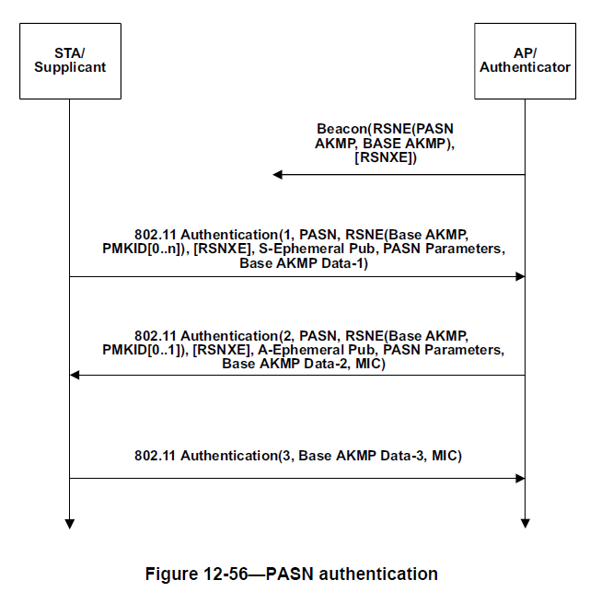
Recap the PASN protocol
PTK = KDF-HASH-NNN (PMK, “PASN PTK Derivation”, SPA || BSSID || DHss)

Slide 6
The consideration of extension on PASN in MAP scheme
TCK is derived from PTK to protect individual control frame
Group key is delivered from master AP to protect group addressed control frame
Following the extension in 11bh draft, Group key is delivered to slave AP via 2-PASN/3-PASN authentication frame.
Need to define an extra signaling exchange procedure to decide which side become the master AP to generate and maintain group key.
RSNE to indicate the chosen cipher-suite.

Slide 7
THANK YOU ☺

Slide 8
reference
[1] 11-23-0480-00-0uhr-uhr-proposed-par.pdf
[2] 11-23-0352-01-0uhr-enhanced-security-discussion.pptx
[3] 11-23-0286-00-0uhr-trigger-frame-protection.pptx

Slide 9
Straw Poll #1
Do you support to consider the frame protection in MAP co-ordination scheme?

