Slide 1
AP Power Management
Date: 2023-09-01
Authors:

Slide 2
Abstract
There are requirements and recommendations to improve the energy efficiency of APs.
There are protocols and options in existing IEEE 802.11 specifications and proposals in the next generation 802.11bn UHR for AP power save.
AP power save protocols should be carefully designed to avoid any negative impact on functionality and performance for IEEE 802.11 networks.
This contribution considers options for AP power save while limiting the negative impact on APs and non-AP STAs.

Slide 3
AP Power Management
In IEEE 802.11bn, there are requirements to improve the energy efficiency of 802.11 APs [1, 2, 3, 4], especially for
  Soft AP/Mobile Hotspot/Mobile AP running on battery-device [13, 14]
  Some APs also would be idling or in low duty cycle mode during certain time of the day:
    Socket powered APs/home APs: early mornings
    APs in enterprise/office/industrial environments: off-work hours
    APs in stadiums/shopping malls: outside of operating hours
Having the ability to reduce power consumption would be helpful in preserving battery for Soft/Mobile APs and be more eco-friendly for socket powered, home and enterprise APs.
There are some protocols/options from existing IEEE 802.11 specifications and UHR proposals for AP power save [5, 6, 7]. Power save protocols for APs should be carefully designed to avoid functionality and performance degradation.
A fundamental requirement for the AP is that it shall always be on, so that
  Clients are able to scan, find the AP and associate
  Have data communication
There are trade-offs between power save levels and performance requirements for AP power save.

Slide 4
Related Work
Existing protocols for non-AP STA power save
  PS-Poll, SMPS (static, dynamic), PSMP (Power Save Multi-Poll), TXOP PS
  TIM, TIM segmentation, DTIM, ATIM, APSD (unscheduled, scheduled)
  TWT (individual, broadcast, trigger-based, restricted), RAW (Restricted Access Window), WUR, …
Existing protocols for AP power save
  Limit the channel width, MCS, # antenna, NSS [6]
  Limit the 802.11 generation/version/feature
  Power control, sensitivity control
  Scheduled PS for APs in S1G [5, 6]
  Scheduled and unscheduled PS for AP or PCP in PBSS and DMG infrastructure BSS
Other options/proposals for AP power save
  BSS Termination (AP power down notification) [9];
  802.11ba WUR and Wake Up AP [11, 12]
  RAW/S-APSD/TWT with limited SP or Listen Interval [13, 14], then the AP turns into doze state
Current UHR proposals for AP power save
  Unscheduled AP PS and utilize MLD: certain link in active mode and other links in PS mode [5, 6, 7]
  Scheduled AP PS:
  TWT-based duty cycling for APs [6, 14];
  dynamic AP PS: SMPS/EMLSR for APs [6]
AP always in Awake state
AP may be in Doze state on certain link(s)

Slide 5
AP Power Save challenges
Goal:
  To improve the energy efficiency of APs while limiting the negative impact on functionality and performance
Challenges:
  Need to ensure that legacy devices are operable
  AP able to respond to probe requests, serve on-demand data, and latency sensitive traffic
Proposal: Define AP Power Save mechanism through adjustment of the AP’s schedule & capability
  Different power states to support different power save levels and performance requirements
  Power state transition and capability information to provide different trade-off options
  Options for APs and STAs to interrupt/update/request/report/adjust/feedback/… the power save mode/level/schedule

Slide 6

AP Power Save Proposal: Overview
The AP balances power save levels and performance requirements by adjusting its schedule & capability. In the scheduled time window, the AP may be in
  Doze state: The AP sends Absence Notification in Beacon, Probe Response, or Action frames to other STAs. The AP remains in the doze state and is absent during the scheduled time window.
  Listen state: The AP remains in the listen state performing CCA or signal detection. The AP may respond to legacy devices or on-demand data in deferred or immediate manners.
  Reduced capability: The AP may use a reduced capability subset, such as single antenna, reduced BW, lower MCSs, etc., instead of utilizing the full capability set.

Slide 7
AP Power Save Proposal: Absence Notification
AP may use absence notification and go into a power save mode transitioning between an awake and a doze state
  Absence notification can be published by AP in beacon, probe response, and action frames
The intention is to provide predictable and periodic behaviors, to ensure smooth network operations
Potential Issues: STAs need to know the awake/doze schedule of the AP. Otherwise following issues may arise
  Legacy device may lose connectivity [8, 9]
  Other connectivity issues: STAs unable to scan, temporary loss of synchronization; high roaming delay
  Performance issues:
    longer delay for network scanning, discovery, association;
    reduced throughput; higher packet loss rate; reduced efficiency, inaccurate/inefficient link adaptation, increased congestion, QoS/latency sensitive data may not be served in a timely manner

Slide 8
AP Power Save Proposal: Power State Transition
To address the potential issues introduced by Absence Notification, APs can stay in Listen state with different power state transition capabilities.
Compared with Doze state, APs in Listen state may have less power saving, introducing less functional capability and performance degradation.
  APs in Listen state may respond to on-demand data requirements and change the schedule, or exit the PS mode early and respond immediately.
APs and non-AP STAs have options to influence the schedule
  APs may use different schedule parameters such as duration, interval, count, power state, power state transition capability, etc., to balance power saving and performance requirements.
  APs may change the schedule based on network conditions, traffic volume, amount of power consumption reduction, functionality and performance, etc.
  Non-AP STAs may indicate their presence information in Probe Request or Action frames to influence the schedule and may send Schedule Request to obtain the most recent schedule.

Slide 9
AP Power Save Proposal: Summary
Outside/inside of the scheduled time window (see slide 6) |  |  | Impact on power saving and performance |  | Can support or can be supported by legacy APs/STAs |  | Power Mgmt. Mode
outside | inside |  | Power save level | Performance degradation | Support for legacy STAs and on-demand data | Supported by legacy APs
 | Power State | Power State Transition
Awake | Doze (Absent) | radio off*: not able to transmit, receive, listen, or update the buffer | High | High | No | No | Power Save Mode
 | Listen | Cannot be interrupted: cannot switch to TX state to respond until the next available Awake state. May switch to RX state to update the buffer | Medium to High | Medium | Partial Support** | Partially Supported***
 |  | Can be interrupted: can switch to TX state to respond ASAP | Low to Medium | Low to Medium | Yes | Yes
 | Awake | Can switch to TX/RX/Listen state, capability adaptation with reduced capability, e.g., SISO and non-HT mode | Low to Medium | Low to Medium | Partial Support* | Partially Supported*** | Active Mode
 |  | Can switch to TX/RX/Listen state, with full capability | None | None | Yes | Yes
radio off*: may or may not use WUR
Partial Support**: can support in terms of functionality, but may have reduced performance in certain scenarios
Partially Supported***: legacy APs can support, but other STAs may not be aware or may not be able to understand

Slide 10
Information Elements
Schedule information, e.g., interval, duration, start time, count.
  May reuse existing elements such as Schedule element and/or existing functions such as TWT
Capability information
  power state info: doze state, listen state, or awake state with reduced capability
  power state transition info: if in listen state (or WUR)
    not interruptible, or interruptible. If interruptible,
      the whole schedule
      or only the current time window
  To indicate/notify whether operating w/ reduced capability: a subset of the full capability, e.g., single antenna, non-HT, reduced BW, low MCSs, low power listening mode [15], etc.
  May reuse existing procedures such as Operating Mode Indication/Notification
    Schedule info and capability info can be in separate IEs or in a single IE.

Slide 11
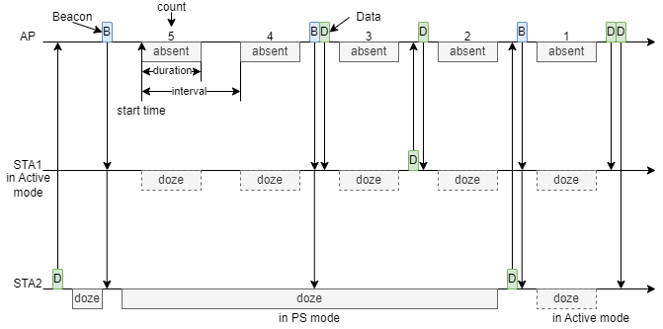
Example 1: Transitions between Absent and Awake states
The AP can specify the schedule and send Absence Notification in Beacon, Probe Response, or Action frames
STAs that can receive & decode the schedule may change to Doze state when the AP is absent

Slide 12
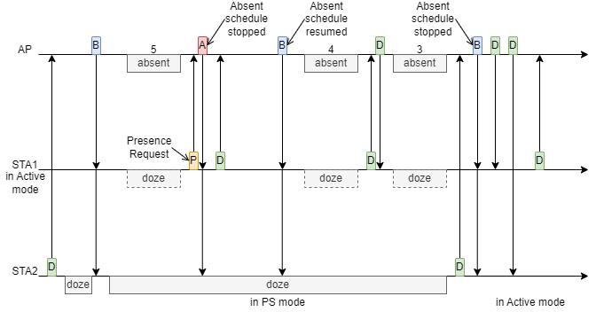
Example 2: Presence Request from STAs
STAs can send Presence Request to influence the schedule of the AP
The AP shall send the new schedule in Beacons
The AP may send the new schedule in Action frames during the Awake state based on the previous schedule

Slide 13
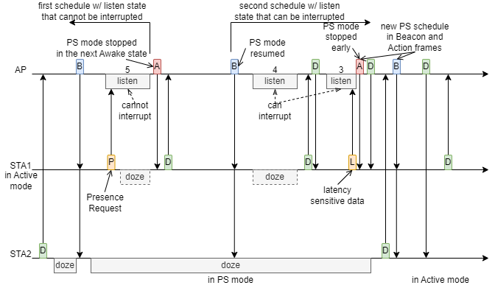
Example 3: Transitions between Awake and Listen states
The AP can stay in Listen state to be aware of legacy devices, Presence Request and STA availability of data
If the AP receives Presence Request or indication of availability of data:
  The AP may respond to a presence request STAs with the new schedule in the next available Awake state, or exit the Listen state early and respond to STAs immediately
  The AP shall send the new schedule in Beacons to other STAs
  During the scheduled Awake state, the AP can send Presence Response in Action frames to other STAs by unicast/broadcast

Slide 14
Conclusion
A brief summary of existing protocols for non-AP STA power save, and existing protocols/options and 802.11 UHR proposals for AP power save
A proposal of scheduled AP power save to improve the energy efficiency of APs while limiting the negative impact on functionality and performance
  Absence Notification allowing APs to be absent for certain time periods
  Capability options allowing APs to respond to legacy devices and on-demand data with different urgency requirements
    Power state transition capability
    Capability adaptation with reduced capability
  Scheduling options allowing APs/STAs to interrupt/update/request/report/adjust/feedback/... the schedule in different scenarios such as different network conditions/requirements, power saving requirements, and tolerance of functional & performance degradation

Slide 15
References
[1] Dorothy Stanley, Liaison statement from Wi-Fi Alliance re: energy efficiency, IEEE 802.11-23/0917r0, 2023
[2] Amelia Andersdotter, et al., 802.11 AP Power Save PAR addition proposal, IEEE 802.11-23/0244r1, 2023
[3] Amelia Andersdotter, et al., Green AP and resilience requirements for home networks, IEEE 802.11-22/1790r0, 2022
[4] Lili Hervieu, et al., A Perspective on UHR Features for Operator Residential Deployments, IEEE 802.11-22/1809r0, 2022
[5] Liwen Chu, et al., AP MLD power management, IEEE 802.11-23/0015r0, 2023
[6] Alfred Asterjadhi, et al., Considerations for enabling AP power save, IEEE 802.11-23/0010r0, 2023
[7] Guogang Huang, et al., Considering Unscheduled AP Power Save, IEEE 802.11-23/0225r0, 2023
[8] Po-Kai Huang, et al., WUR Operating Channel, IEEE 802.11-17/1333r2, 2017
[9] Allan Thomson, ap power down notification, IEEE 802.11-08/0947r2, 2008
[10] Stefan Aust, AP Power Saving, IEEE 802.11-11/0046r2, 2011
[11] Stefan Aust, TGah Use Case AP Power Saving in Smart Grid, IEEE 802.11-11/0273r0, 2011
[11] Xiaofei Wang, et al., AP Power Saving, IEEE 802.11-17/0728r2, 2017
[12] Xiaofei Wang, et al., On AP Power Saving Usage Model, IEEE 802.11-17/1388r2, 2017
[13] Jay Yang, et al., MLD AP Power-saving(PS) Considerations, IEEE 802.11-20/1115r6, 2020
[14] Kyumin Kang, et al., Considerations on Soft AP Power Saving, IEEE 802.11-21/0885r1, 2021
[15] Xiaogang Chen, et al., Low Power Listening Mode, IEEE 802.11-22/1414r1, 2022

