Slide 1
Multi-AP Coordinated Spatial Reuse
Date: 2023-10-24
Authors:

Slide 2
Abstract
This contribution discusses coordinated spatial reuse (Co-SR) as a potential multi-AP feature for the IEEE 802.11bn standard. First, a trade-off that is associated with Co-SR is highlighted. Then, a general Co-SR method for downlink channel access is proposed and evaluated, in terms of aggregate goodput and average/worst-case packet delivery delay.

Slide 3
Background
Coordinated spatial reuse (Co-SR)
Potential gains
Transmit power/modulation and coding index
Time
A reduction in frame delivery delay [mean or standard deviation (STD)], as a result of a decrease in the channel access delay for a coordinated AP (Co-AP) by exploiting the TXOPs shared by other Co-APs
An increase in aggregate goodput as a result of concurrent transmissions by CoAPs over the same frequency channel
No TXOP sharing
TXOP sharing using Co-SR
AP 1
AP 2
Channel bandwidth
Frequency
Potential losses
Illustration of channel access by two APs
Transmission of control (overhead) frames for AP coordination
An increase in a physical layer protocol data unit (PPDU) transmission duration, due to PPDU transmission with a reduced data rate, as a result of a reduction in transmit power or modulation and coding scheme (MCS) index
Start of channel contention by AP1
Start of channel access by an AP1
Frequency
AP1 channel access delay
AP1 back-off counter freezing
No Co-SR
Channel busy duration
Transmission by AP2
Transmission by AP1
Tradeoff associated with Co-SR
Arbitrary inter-frame spacing (AIFS) and back-off counter decrement
AIFS and back-off counter decrement
time
Start of channel contention by AP1
Start of channel access by an AP1
Channel access delay
PPDU transmission duration
Overhead for multi-AP coordination
Total frame delivery delay
Aggregate goodput
Frequency
AP1 channel access delay
Co-trigger frame
Transmission by AP2
Due to employment of a lower MCS index
Co-SR
Channel busy duration
Transmission by AP1
AIFS and back-off counter decrement
SIFS
time
Notes:
Co-SR can be considered as a type of TXOP sharing

Slide 4
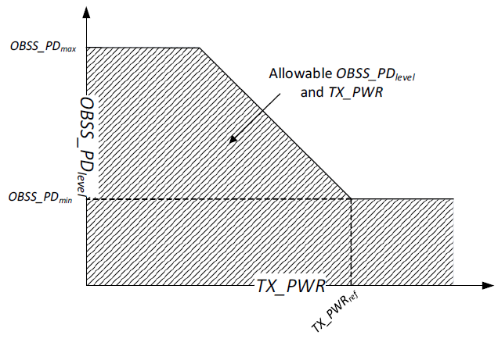

Background
OBSS PD-based SR in the IEEE 802.11ax standard
Issue illustration
Standard values
Favorable SR scenario
Non-favorable SR scenario
STA1
STA2
STA1
STA2
AP1
AP2
AP1
AP2
Desired signal
The OBSS PD-based SR does not differentiate between the two cases
Interference signal
Main issues
Signal used for OBSS
PD-based SR enablement
An STA determines whether or not to exploit OBSS PD-based SR (i.e., whether or not to ignore an ongoing PPDU transmission) based solely on the signal strength level received from the PPDU transmitter, without any consideration of the impact of SR on the current PPDU receiver(s)
If multiple STAs decide to simultaneously exploit OBSS PD-based SR for an ongoing PPDU transmission, the interference level may significantly increase, even with the standard OBSS PD-level and transmit power adjustment (i.e., there is no control on the number of STAs that can simultaneously access the channel using OBSS PD-based SR)
Simultaneous OBSS PD-based SR enablement
STA1
STA3
STA2
AP3
AP1
AP2
Excess interference at STA1 due to simultaneous OBSS PD-based SR by AP2 and AP3

Slide 5
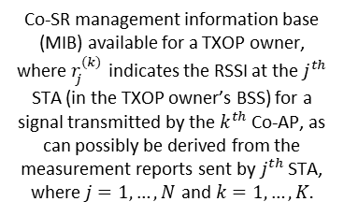
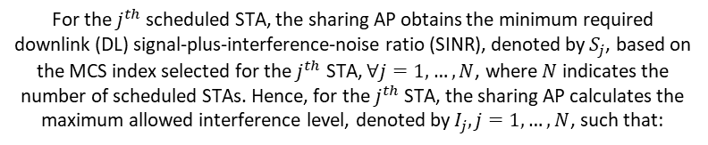
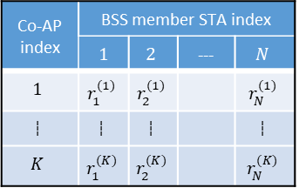



General Co-SR Method – Sharing AP Procedure
Set of Co-APs to be considered for Co-SR
Calculation of the maximum allowed interference level at each destination STA
For the$j^{th}$ scheduled STA, the sharing AP obtains the minimum required downlink (DL) signal-plus-interference-noise ratio (SINR), denoted by$S_{j}$, based on the MCS index selected for the$j^{th}$ STA, ∀$j=1,…,N$, where$N$ indicates the number of scheduled STAs. Hence, for the$j^{th}$ STA, the sharing AP calculates the maximum allowed interference level, denoted by$I_{j}, j=1,…,N$, such that:
Calculation of the maximum allowed interference level at destination STAs
The maximum allowed interference level for each scheduled STA
$$I_{j}=R_{j}−S_{j}−M$$
A margin to account for RSSI variations, e.g., $M=3$ dBm
Specification of the maximum allowed transmit power for Co-APs
Received signal strength indicator (RSSI, in dBm) of a signal transmitted from a sharing AP to the$j^{th}$ STA. Note that, the$R_{j}$ value may be known to a TXOP owner as a result of beacon measurement reports that are periodically sent by the$j^{th}$ STA,$j=1,…,N$.
A value that indicates the transmit power for each Co-AP
Co-trigger frame
transmission
Co-AP index | BSS member STA index
 | $1$ | $$2$$ | --- | $$N$$
$$1$$ | $$r_{1}^{(1)}$$ | $$r_{2}^{(1)}$$ |  | $$r_{N}^{(1)}$$
--- | --- | --- |  | ---
$$K$$ | $$r_{1}^{(K)}$$ | $$r_{2}^{(K)}$$ |  | $$r_{N}^{(K)}$$
Co-SR management information base (MIB) available for a TXOP owner, where$r_{j}^{(k)}$ indicates the RSSI at the$j^{th}$ STA (in the TXOP owner’s BSS) for a signal transmitted by the$k^{th}$ Co-AP, as can possibly be derived from the measurement reports sent by$j^{th}$ STA,
where$j=1,…,N$ and$k=1,…,K.$
Co-SR module
Total number of Co-APs

Slide 6
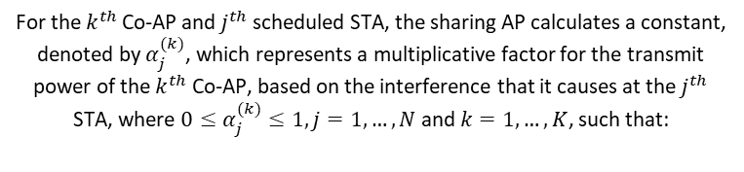


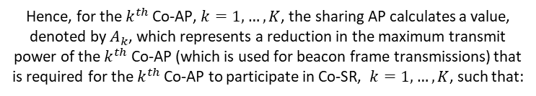
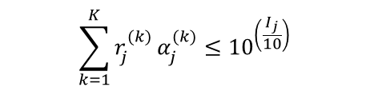
General Co-SR Method – Sharing AP Procedure
Set of Co-APs to be considered for Co-SR
Specification of the maximum allowed transmit power for each Co-AP participating in Co-SR
For the$k^{th}$ Co-AP and$j^{th}$ scheduled STA, the sharing AP calculates a constant, denoted by $α_{j}^{(k)}$, which represents a multiplicative factor for the transmit power of the$k^{th}$ Co-AP, based on the interference that it causes at the$j^{th}$ STA, where $0≤α_{j}^{(k)}≤1, j=1,…,N$ and$k=1,…,K$, such that:
Calculation of the maximum allowed interference level at destination STAs
The maximum allowed interference level for each scheduled STA
$$\sum_{k=1}^{K}{r_{j}^{(k)}}α_{j}^{(k)}≤{10}^{\left(\frac{I_{j}}{10}\right)}$$
Specification of the maximum allowed transmit power for Co-APs
A value that indicates the transmit power for each Co-AP
Hence, for the$k^{th}$ Co-AP, $k=1,…,K$, the sharing AP calculates a value, denoted by$A_{k}$, which represents a reduction in the maximum transmit power of the$k^{th}$ Co-AP (which is used for beacon frame transmissions) that is required for the$k^{th}$ Co-AP to participate in Co-SR, $k=1,…,K$, such that:
Co-trigger frame
transmission
$$A_{k}=10\log\left(\min_{j}{α_{j}^{(k)}}\right)$$
Co-SR module
If$A_{k}>−∞$ (or equivalently if $\min_{j}{α_{j}^{(k)}}>0$ ), the $k^{th}$ Co-AP is selected for Co-SR

Slide 7
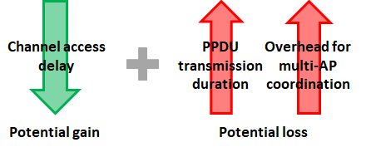
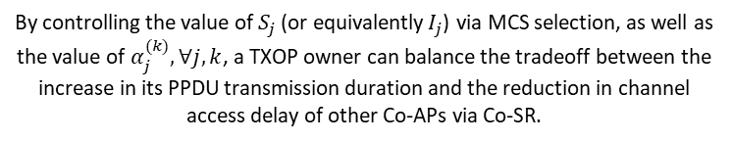
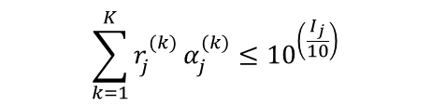
General Co-SR Method – Sharing AP Procedure
Set of Co-APs to be considered for Co-SR
Specification of the maximum allowed transmit power for each Co-AP participating in Co-SR
For the$k^{th}$ Co-AP and$j^{th}$ scheduled STA, the sharing AP calculates a constant, denoted by $α_{j}^{(k)}$, which represents a multiplicative factor for the transmit power of the$k^{th}$ Co-AP, based on the interference that it causes at the$j^{th}$ STA, where $0≤α_{j}^{(k)}≤1, j=1,…,N$ and$k=1,…,K$, such that:
Calculation of the maximum allowed interference level at destination STAs
The maximum allowed interference level for each scheduled STA
$$\sum_{k=1}^{K}{r_{j}^{(k)}}α_{j}^{(k)}≤{10}^{\left(\frac{I_{j}}{10}\right)}$$
Specification of the maximum allowed transmit power for Co-APs
A value that indicates the transmit power for each Co-AP
By controlling the value of$S_{j}$ (or equivalently$I_{j}$) via MCS selection, as well as the value of $α_{j}^{(k)}, ∀j,k$, a TXOP owner can balance the tradeoff between the increase in its PPDU transmission duration and the reduction in channel access delay of other Co-APs via Co-SR.
Co-trigger frame
transmission
Co-SR module

Slide 8
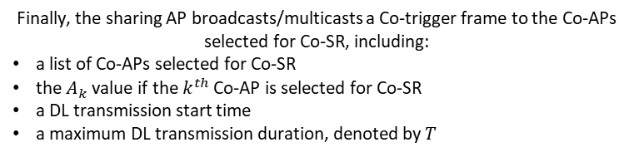
General Co-SR Method – Sharing AP Procedure
Set of Co-APs to be considered for Co-SR
Coordination-trigger (Co-trigger) frame transmission
Calculation of the maximum allowed interference level at destination STAs
The maximum allowed interference level for each scheduled STA
Finally, the sharing AP broadcasts/multicasts a Co-trigger frame to the Co-APs selected for Co-SR, including:
a list of Co-APs selected for Co-SR
the$A_{k}$ value if the$k^{th}$ Co-AP is selected for Co-SR
a DL transmission start time
a maximum DL transmission duration, denoted by$T$
Specification of the maximum allowed transmit power for Co-APs
A value that indicates the transmit power for each Co-AP
Co-trigger frame
transmission
This step is the main step that has a standard impact, the previous steps are all implementation dependent
Co-SR module

Slide 9
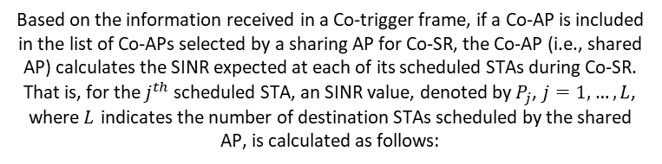


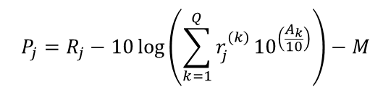
General Co-SR Method – Shared AP Procedure
Co-trigger frame content
MCS calculation for Co-SR
Based on the information received in a Co-trigger frame, if a Co-AP is included in the list of Co-APs selected by a sharing AP for Co-SR, the Co-AP (i.e., shared AP) calculates the SINR expected at each of its scheduled STAs during Co-SR. That is, for the$j^{th}$ scheduled STA, an SINR value, denoted by$P_{j}$, $j=1,…,L$, where$L$ indicates the number of destination STAs scheduled by the shared AP, is calculated as follows:
MCS calculation for
Co-SR
The RSSI at the$j^{th}$ STA (in the shared AP’s BSS) for a signal transmitted by the$k^{th}$ Co-AP,
where$j=1,…,N$ and$k=1,…,K.$
MCS value for each scheduled STA
The number of Co-APs selected for Co-SR
$$P_{j}=R_{j}−10\log\left(\sum_{k=1}^{Q}{r_{j}^{(k)}}{10}^{\left(\frac{A_{k}}{10}\right)}\right)−M$$
Avoidance of interference from destination STAs
Hence, based on the calculated SINR value$, P_{j},$the shared AP determines an MCS index to be employed for the$j^{th}$ STA during Co-SR,$j=1,…,L$.
Co-SR module

Slide 10
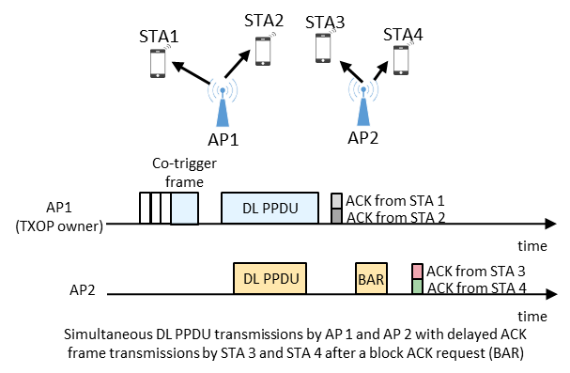
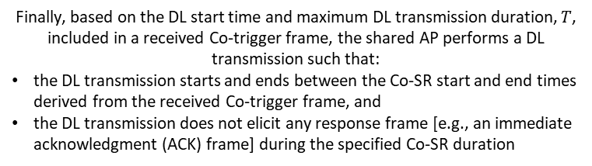
General Co-SR Method – Shared AP Procedure
Co-trigger frame content
Avoidance of interference from destination STAs
Finally, based on the DL start time and maximum DL transmission duration, $T$, included in a received Co-trigger frame, the shared AP performs a DL transmission such that:
the DL transmission starts and ends between the Co-SR start and end times derived from the received Co-trigger frame, and
the DL transmission does not elicit any response frame [e.g., an immediate acknowledgment (ACK) frame] during the specified Co-SR duration
MCS calculation for
Co-SR
MCS value for each scheduled STA
Avoidance of interference from destination STAs
Co-SR module

Slide 11
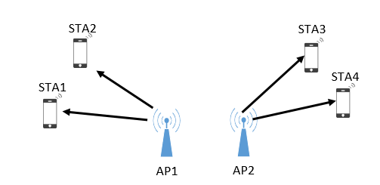
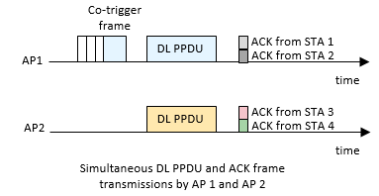
General Co-SR Method – Shared AP Procedure
Co-trigger frame content
Avoidance of interference from destination STAs
Alternatively, in some scenarios, the ACK frames from destination STAs can be simultaneously transmitted, which requires an alignment of the end of DL PPDUs
MCS calculation for
Co-SR
MCS value for each scheduled STA
Avoidance of interference from destination STAs
Co-SR module

Slide 12
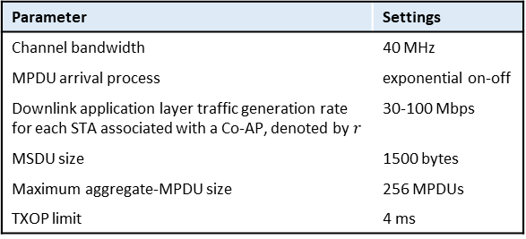
Performance Evaluation
Simulated network topology
Simulation scenarios
STA1
STA2
Scenario # | x (dBm) | y (dBm) | w (dBm) | MCS for AP 1 and AP2 (without Co-SR) | MCS for AP 1 and AP2 (with Co-SR)
1 | -80 | -80 | -35 | 11 | 11
2 | -80 | -80 | -41 | 11 | 11
3 | -80 | -80 | -46 | 11 | 9
4 | -80 | -80 | -52 | 11 | 7
5 | -80 | -80 | -58 | 11 | 4
6 | -78 | -78 | -35 | 11 | 11
7 | -74 | -74 | -35 | 11 | 11
8 | -70 | -70 | -35 | 11 | 9
9 | -67 | -67 | -35 | 11 | 9
10 | -62 | -62 | -35 | 11 | 7
11 | -58 | -58 | -35 | 11 | 5
w dBm
x dBm
x dBm
w dBm
Decreasing the RSSI from AP 1 to STA 1 and from AP 2 to STA 2
y dBm
y dBm
Increasing the interference from AP 1 to STA 2 and from AP 2 to STA 1
AP1
AP2
Desired signal
Interference signal
Simulation parameters
Peak aggregate goodput results (Mb/s)
Parameter | Settings
Channel bandwidth | 40 MHz
MPDU arrival process | exponential on-off
Downlink application layer traffic generation rate for each STA associated with a Co-AP, denoted by$r$ | 30-100 Mbps
MSDU size | 1500 bytes
Maximum aggregate-MPDU size | 256 MPDUs
TXOP limit | 4 ms
 |  | Scenario index
 |  | 1, 2, 6, and 7 | 3, 8, and 9 | 4 and 10 | 11 | 5
Channel access method | No Co-SR | 217.2
 | Co-SR | 407.9 | 330.5 | 216.8 | 216.8 | 216.8
Increase by Co-SR (%) |  | 88% | 52% | ~0% | ~0% | ~0%

Slide 13
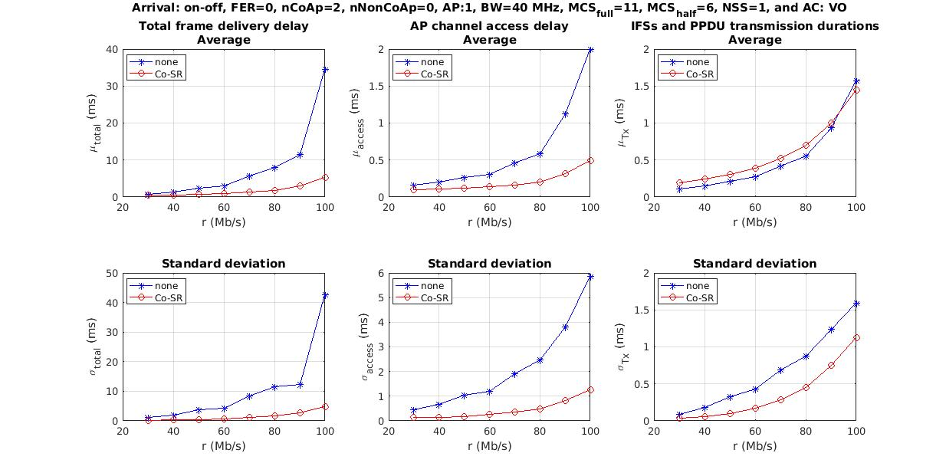
Performance Evaluation
Scenarios 3, 8, and 9
Total packet delivery delay
Channel access delay
Interframe-spaces (IFSs) and PPDU transmission durations
The increase is due to a large number of aggregated MPDUs, as a result of high channel access delay values in the absence of Co-SR
Significant improvement in total packet delivery delay mean due to Co-SR
Expected improvement in channel access delay due to Co-SR
Expected increase in PPDU transmission duration and control overhead due to Co-SR
The significant reduction in the average and standard deviation of the total packet delivery delay definitely results in a considerable reduction in the worst-case packet delivery delay, e.g., 99th percentile of the delay
Significant improvement in total packet delivery delay standard deviation due to Co-SR

Slide 14
Conclusions
Co-SR is a multi-AP coordination feature that has a good potential of increasing the aggregate goodput and reducing the average/worst case packet delivery delay
Further topics needs to be investigated, including the:
  inclusion of a mandatory or optional information exchange phase before each channel access using Co-SR
  requirement to align the start and end of all PPDUs transmitted using Co-SR
  acknowledgment policy for DL PPDUs transmitted using Co-SR
  employment of beamforming during Co-SR
  Co-SR parameters specified by a sharing AP
  development of a Co-SR method for uplink channel access

Slide 15
Related UHR SG Contributions
[1] 11-22-1822-00-0uhr-recap-on-coordinated-spatial-reuse-operation
[2] 11-23-0616-00-0uhr-overhead-analysis-of-coordinated-spatial-reuse
[3] 11-23-0668-02-0uhr-coordinated-measurement
[4] 11-23-0058-00-0uhr-spatial-reuse-in-coordinated-m-ap-for-uhr
[5] 11-23-0325-00-0uhr-coordinated-spatial-reuse-for-uhr
[6] 11-23-0776-01-0uhr-performance-of-c-bf-and-c-sr
[7] 11-23-1023-02-0uhr-coordinated-spatial-reuse-in-a-4-ap-topoplogy
[8] 11-23-1037-00-0uhr-performance-of-coordinated-spatial-reuse
[9] 11-23-0420-01-0uhr-spatial-reuse-improvements-for-uhr
Notes:
The last reference focuses on parametrized spatial reuse, but we still include it

Slide 16
Back-up Slides

Slide 17
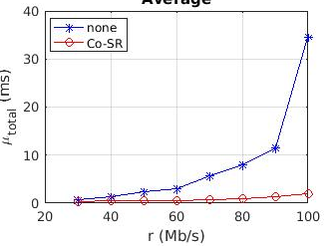
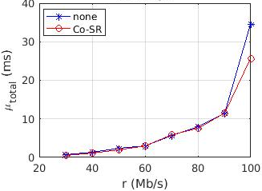
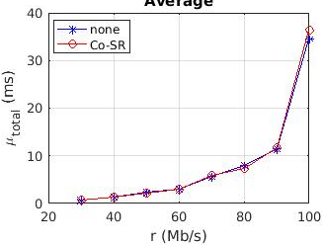
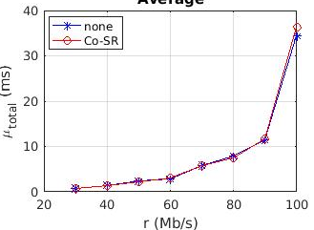
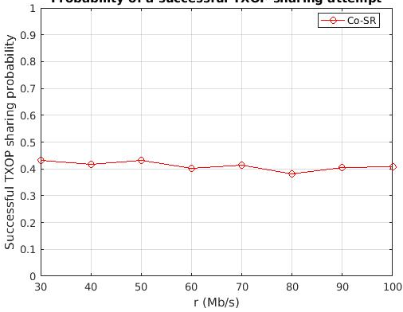
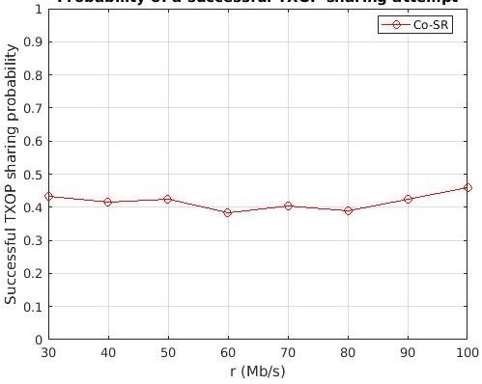
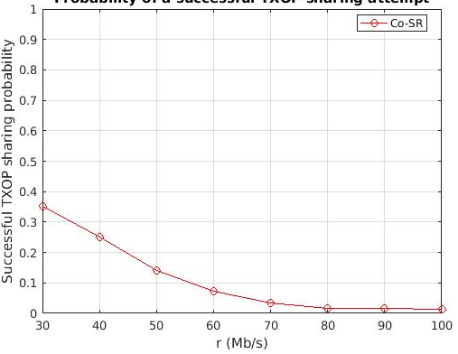
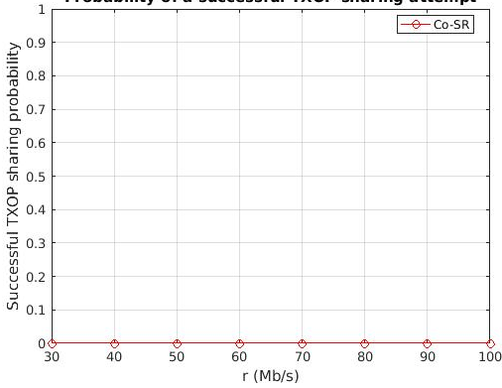
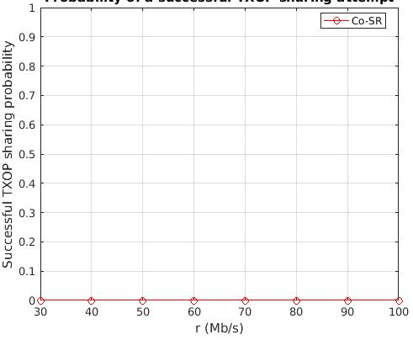

Performance Evaluation
Average packet delivery delay ($μ_{total}$) results
Scenarios 1, 2, 29, and 30
Scenarios 3, 31, and 32
Scenarios 4 and 33
Scenarios 34
Scenarios 5
Probability of a successful Co-SR attempt
Scenarios 1, 2, 29, and 30
Scenarios 3, 31, and 32
Scenarios 4 and 33
Scenarios 34
Scenarios 5

