Slide 1
TPE update for unassociated STA
Authors:
Name | Affiliations | Address | Phone | email
Ali Raissinia | Qualcomm |  |  | alirezar@qti.qualcomm.com

Slide 2
Objective
Background:
  802.11bf allows an unassociated STA to participate in sensing operations
  Similar to situations in 802.11bk, an unassociated STA needs to learn critical update included in a Transmit Power Envelope (TPE) element
    The similar concept applies to static puncturing pattern update (i.e. Disabled Subchannel Bitmap)
Issue:
  It is not defined yet on how an unassociated STA learns the critical update of TPE as indicated by CID # 3155
Objective:
  Define a procedure for such update and make it similar to that defined in 11bk to maximize the reuse

Slide 3
Summary of Proposed Solutions
Option A:
  Terminate existing session (with the Sensing Measurement Termination frame)
  Re-establish session with the updated TPE included in the frame(s) for session negotiation (e.g. a Sensing Measurement Request frame or a Sensing Measurement Response frame)
  Pros: simple rule change and expansion to the frames for session negotiation
  Cons: requires additional termination and re-establishment of the session for continuation of the session.
Option B:
  Update the existing session during a measurement sensing exchange sequence. Two cases:
    For non-TB sensing measurement exchange: details in slides 4
    For TB sensing measurement exchange: details in slides 5-6
  Pros: avoid interrupting the existing session, similar to the 11bk procedure
  Cons: need to add minor updates to frame exchange sequences

Slide 4
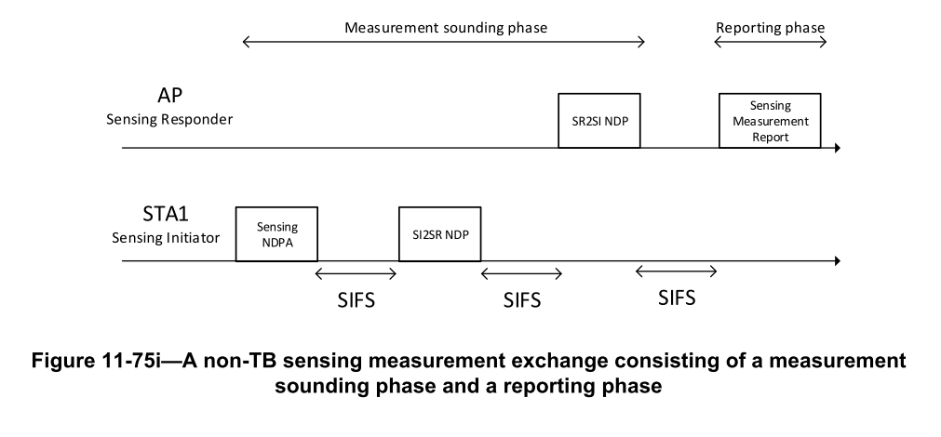
For non-TB sensing measurement exchange
Send the updated TPE together with the Sensing Measurement Report frame, The critical update can be:
  Option1: included in a separate frame that is aggregated together with the Sensing Measurement Report frame (i.e., A-MPDU, similar to 11bk)
    The separate frame can be a Sensing Measurement Response frame or a Sensing Measurement Termination frame
  Option2: Included in the Sensing Measurement Report frame itself, such as a (sub)element.
Proposal
Send the latest TPE

Slide 5
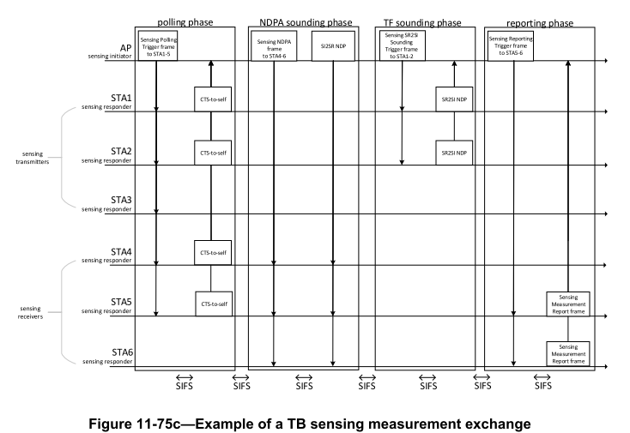
Proposed Solution (Option B)
Assume a critical update (e.g TPE) just happened before this Trigger-Based (TB) sensing measurement exchange
1. AP indicates in any of Trigger frames that a critical update to TPE has occurred (e.g. the Comeback subfield in the User Info field)
2. An unassociated STA (e.g. STA5) retrieve the updated TPE after the measurement exchange

Slide 6
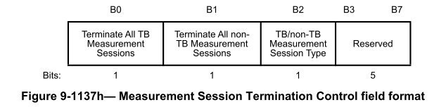
Details on Retrieving the updated TPE
The unassociated STA sends a Sensing Measurement Query frame to the AP.
  In response, the AP responds with a frame that contains the update
    The frame can be a Sensing Measurement Response/Request frame Sensing Measurement Termination frame extended to include the update TPE
      The critical update can be included as an element or subelement
      If the Sensing Measurement Termination frame is used, one of the reserved bit can be used to indicate that the intention is to update the current session instead of terminating it and the parameters(s) associated critical update is included (e.g. the latest TPE is included in the Termination frame as well)

Slide 7
Summary
We discussed two candidate solutions for an unassociated STA to learn the critical update of TPE as indicated by CID # 3155 :
  Option A: terminate existing session and re-establish session with the updated TPE included in the frame(s) for session negotiation
  Option B: update the existing session during a measurement sensing exchange sequence (preferred)
  The solution can be extended to update static puncturing pattern (i.e. Disabled Subchannel Bitmap) also

