Slide 1
MIMO Dynamic Polarization Multiplexing and Beamforming:
A Proposed IEEE802.11bn PHY
Date: 2023-11-15
Authors:

Slide 2
Abstract
Breakthrough Dynamic Polarization Multiplexing and Beamforming multi-signal processing combines unrestricted order RF stream MIMO Multiplexing with steerable high directivity Beamforming to yield EHT-based P2P radios transporting 92 Gbps beyond 28 km and PMP radios distributing 27 GbE across nearly 80 km²

Slide 3
What’s new this time around
At the September 802.11WNG session TWI unveiled “Dynamic Polarization”, a proposed PHY for the nascent TGbn. “DPMXBF” (or “DP”) employs patented digital polarization modulation to MIMO-multiplex up to 32 EHT streams within a single 320 MHz channel
The DPMXBF tutorial presented in September has been affixed hereto as Appendix A
A manual closed form analysis of a 4-stream DP Tx-Rx has also been added as Appendix B
Also, at that last session’s end an esteemed colleague raised a truly existential question: “Wouldn’t the so-claimed 92 Gbps information transport within only 320 MHz completely violate Shannon’s Theorem?” Appendix C, also attached hereto, explains why not
The following slides expand/refine upon two previously identified key DPMXBF Use Cases, and incorporate a call for TGbn to also develop certain DP-complementary PHY/ MAC extensions arguably essential to ultimately successful IEEE802.11bn products and services

Slide 4
Proposed IEEE802.11bn PHY
32 IEEE802.11be concurrent, cochannel RF streams
  32x32 MIMO Dynamic Polarization Multiplexing (“DP-32”)
  32x32 MIMO Tx/Rx DLOS/ nLOS/ NLOS Beamforming/Beamsteering
  AP MU-MIMO Tx Multibeam
  Client MU-MIMO Rx Interference Cancellation
  Client MU-MIMO Rx NLOS Multipath Recombination
  5-7 GHz UNII Operation
  4096 QAM
  320 MHz BW
  92.2 Gbps Peak Data Rate
  Over 28 km PDR P2P Free-Space Range
  27 GbE across 79 km² PMP Foliage-obstructed Throughput

Slide 5
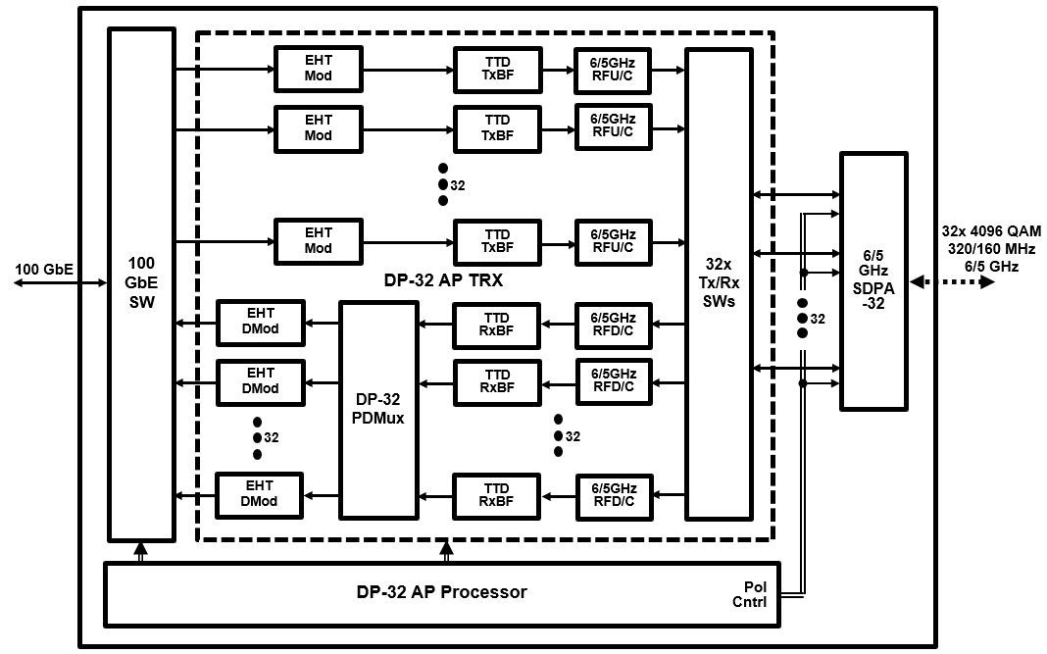
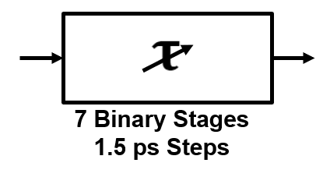
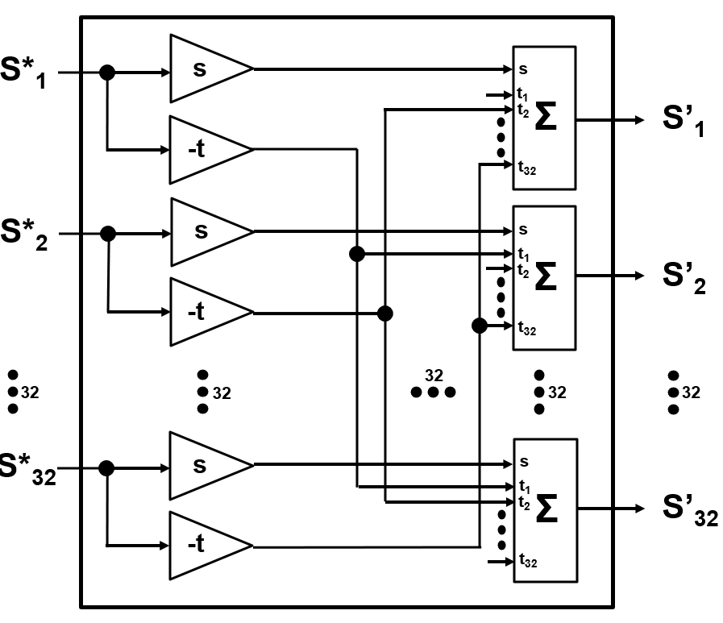
Contemplated 92.2 Gbps “WiFi-bn” Access Point
(32 Polarization-Multiplexed and Transceived EHT RF Streams)
92/46 Gbps 320/160 MHz 6/5 GHz DP-32 AP/MeshNode
TTD xBF
DP-32 PDMux

Slide 6
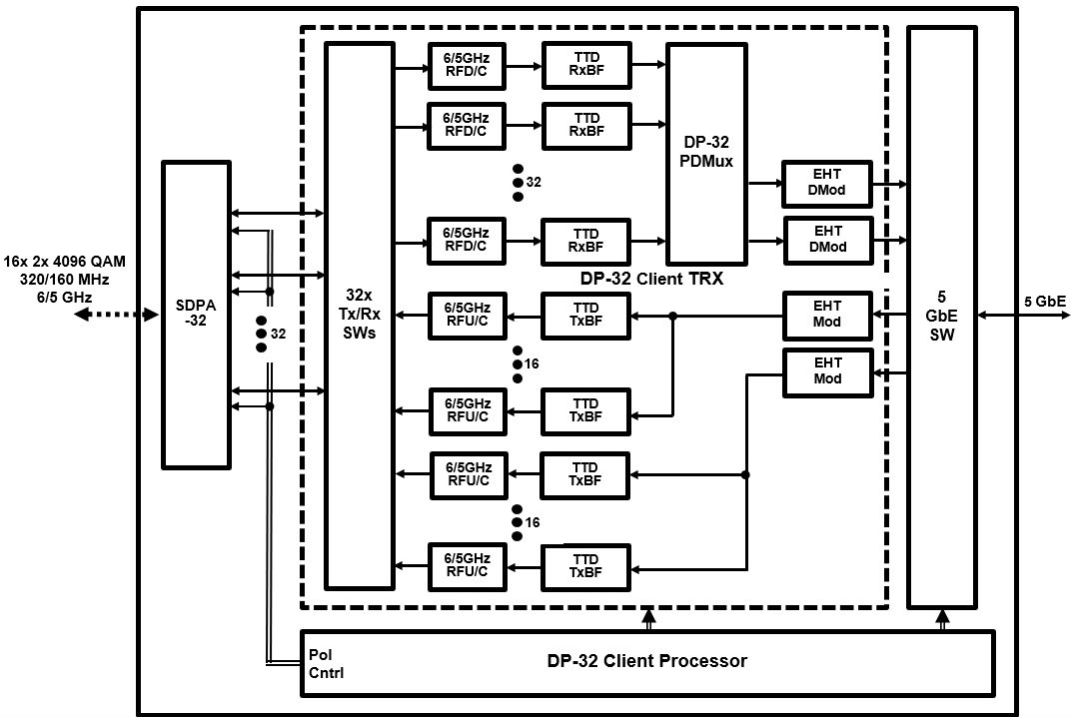
Contemplated 5.8 Gbps WiFi-bn Client
(32 Polarization Multiplexed/ 2 Transceived EHT RF Streams )
5.8/2.9 Gbps 320/160 MHz 6/5 GHz DP-32 Client
TTD xBF
DP-32 PDMux

Slide 7
Point to Point WiFi-bn
Terrestrial Internet Backhaul Application
P2P WiFi-bn AP Configuration
Modulation/Coding | MCS13 (4096Q5/6)
Bandwidth (B) | 320 MHz
TRX Frequency (fc) | 6705 MHz (6 GHz Ch 151)
Tx Power (P_{Tx}) | +36 dBm (Regulatory Maximum)
SDPA Element Gain (G_{Element}) | 19 dBi (30º Beamwidth)
SDPA Array Gain (G_{Array}) | 16 dBi (6Hx6W-2Hx2W Boresight)
Ambient Temperature T | 25º C
Noise Figure (F) | 2.2 dB
P2P WiFi-bn AP-AP Link Configuration
Signal/Noise Ratio (SNR) | 55 dB (1e-6 PER)
SDPA Gain (G_{Tx} = G_{Rx}) | 35 dBi (G_{Element} + G_{Array})
Noise Power (kTBF) | -87 dBm
    By Regulatory Fiat, the above P2P WiFi-bn link’s Free Space Path Loss works out to
    WiFi-bn FSPL|_{MCS13} = P_{Tx} + G_{Tx} + G_{Rx} – kTBF - SNR = 138 dB
    And the corresponding P2P WiFi-bn 92 Gbps Free-Space Range to
    R = SQRT(FSPL)c/4πf_{c} = 28.2 km

Slide 8
Point to Multipoint WiFi-bn
Terrestrial Internet Distribution Application
PMP WiFi-bn AP/ Client Configuration
Modulation/Coding | MCS13 (4096Q5/6) to MCS0 (B1/2)
Bandwidth (B) | 320 MHz
TRX Frequency (fc) | 6705 MHz (6 GHz Ch 151)
AP EIRP (EIRP_{Tx}) | +36 dBm (Regulatory Maximum)
Client SDPA Element Gain (G_{RxElement}) | 16 dBi (45º Beamwidth)
Client SDPA Array Gain (G_{RxArray}) | 16 dBi (6Hx6W-2Hx2W Boresight)
Ambient Temperature T | 25º C
Noise Figure (F) | 2.2 dB
    PMP WiFi-bn Peak Data Rate at Free Space Range:
Mod/Cod | BDR (Mbps) | XDR (Gbps) | SNR (dB) | FSPL (dB) | FSR (km)
MCS13 4096Q5/6 | 2882 | 92.2 | 55 | 100 | 0.36
MCS12 4096Q3/4 | 2594 | 83.0 | 53 | 102 | 0.45
MCS11 1024Q5/6 | 2402 | 76.9 | 49 | 106 | 0.71
MCS10 1024Q3/4 | 2162 | 69.2 | 47 | 108 | 0.90
MCS9 256Q5/6 | 1922 | 61.5 | 43 | 112 | 1.4
MCS8 256Q3/4 | 1799 | 55.3 | 41 | 114 | 1.8
MCS7 64Q5/6 | 1441 | 46.1 | 36 | 119 | 3.1
MCS6 64Q3/4 | 1297 | 41.5 | 34 | 121 | 4.0
MCS5 64Q2/3 | 1153 | 36.9 | 30 | 125 | 6.3
MCS4 16Q3/4 | 865 | 27.7 | 27 | 128 | 9.0
MCS3 16Q1/2 | 577 | 18.5 | 23 | 132 | 14.1
MCS2 4Q3/4 | 432 | 13.8 | 21 | 134 | 17.9
MCS1 4Q1/2 | 288 | 9.2 | 17 | 138 | 28.2
MCS0 B1/2 | 144 | 4.6 | 14 | 141 | 38.2
PMP WiFi-bn Link Configuration
G_{Rx} | 32 dBi (G_{RxElement} + G_{RxArray})
kTBF | -87 dBm
PMP WiFi-bn Link Obstruction RF Attenuation
Outdoor Foliage | 1 dB/ meter
Indoor Drywall | 2 dB/ Wall
Exterior Stucco | 6 dB/ Wall
Exterior Masonry | 15 dB/ Wall
    PMP WiFi-bn Average Data Rate across Obstructed Range:
ObsR* (km) | Eq FSR (km) | FSPL (dB) | SNR (dB) | MCS Range | Tpt (Gbps)
1.0 | 2.0 | 115 | 40 | MCS13-MCS7 | 59.7
2.5 | 5.0 | 123 | 32 | MCS13-MCS5 | 43.8
5.0 | 10.0 | 129 | 26 | MCS13-MCS3 | 31.3
10.0 | 20.0 | 135 | 20 | MCS13-MCS1 | 18.4
    PMP WiFi-bn Data Rate vs Range:
    FSPL = EIRP_{Tx} + G_{Rx} – kTBF – SNR
    FSPL = 155 - SNR
    *- 6m Outdoor Foliage

Slide 9
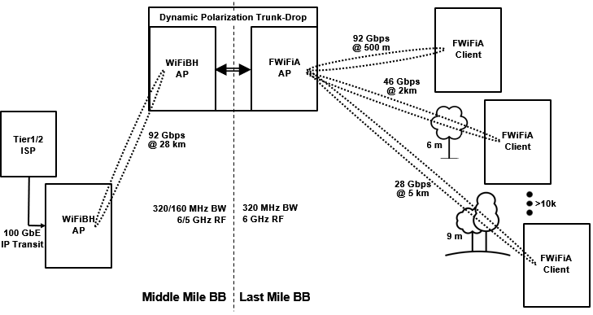
Key WiFi-bn Use Cases
    Point to Point Ultra-High-Capacity WiFi Backhaul (“WiFiBH”) Middle Mile Broadband
    Internet Exchange Broadband Source to Broadband Distribution Point connectivity
    Point to Multipoint Ultra-High-Capacity Fixed WiFi Access (“FWiFiA”) Last Mile Broadband
    BBDP (i.e., a “Dynamic Polarization Trunk-Drop”) to Broadband CPE connectivity

Slide 10
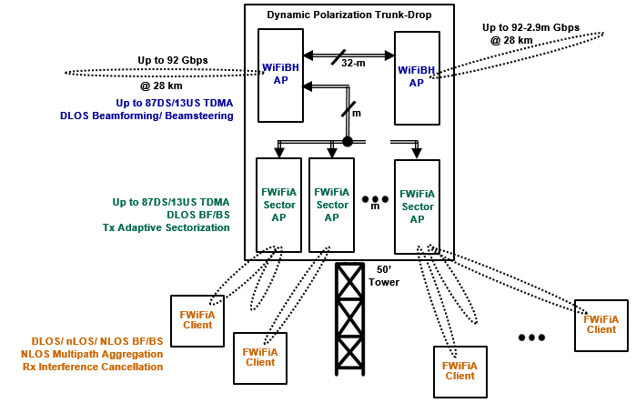
Dynamic Polarization Trunk-Drop Architecture

Slide 11
Proposed Dynamic Polarization-complementary TGbn Tasks
    Although possessed of the world’s fastest Physical Layer, the proposed WiFi-bn constructs need further associated PHY/MAC extensions to yield truly compelling products and services:
    Link Throughput Maximization TDMA MAC
    (Let’s max out the already massive pipe)
      AP up to 90%/ 10% Downstream/ Upstream traffic split
      AP up to 32k Client Access List
    Direct-/ near-/ Non-Line-of-Sight Link Optimization PHY
    (Gotta deal with those pesky almost universally obstructed Base Station-Subscriber links)
    MIMO AP Tx DLOS Beamforming/ Beamsteering
    MU-MIMO AP Tx Adaptive Sectorization
    MIMO Client Rx DLOS/ nLOS/ NLOS Beamforming/ Beamsteering
    MU-MIMO Client Rx AP Beamsplit Multipath Aggregation/ Diversity Combining
    Resilient Unlicensed Band Operations PHY
    (Just like at 2.4 and 5, it’s ultimately gonna be a jungle at 6 GHz)
    MU-MIMO Client Rx Interference Cancellation
  This is a call for any and all interested doteleveners to collaborate with TWI in developing these mission-critical WiFi-bn capabilities

Slide 12
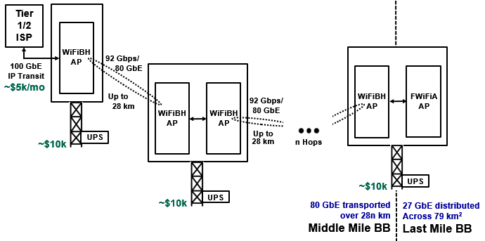
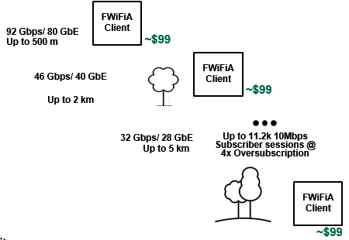

Representative “TownWiFi” Network
Link Type | Data Rate | Range | Network Capacity
WiFiBH AP-AP | 92.2 Gbps | 28.0 km/ Free Space | 80 GbE @ 87/13 TS
FWiFiA AP - Client | 92.2 Gbps 46.1 Gbps 36.9 Gbps 18.5 Gbps 13.8 Gbps | 300 m/ Free Space 1 km/ 6m Foliage 2.5 km/ 6m Foliage 5km/ 6m Foliage 10 km/ 6m Foliage | 80 GbE/ 32.0k Subs 52 GbE/ 20.8k Subs 38 GbE/ 15.2k Subs 27 GbE/ 10.8k Subs 16 GbE/ 6.4k Subs
Subscriber-Allocated TownWiFi Costs | 6 GHz RF Attn
WiFi-bn Infrastructure | <$10
WiFi-bn CPE | $99
60/60/24/7 10Mbps BB | <$1/ mo

Slide 13
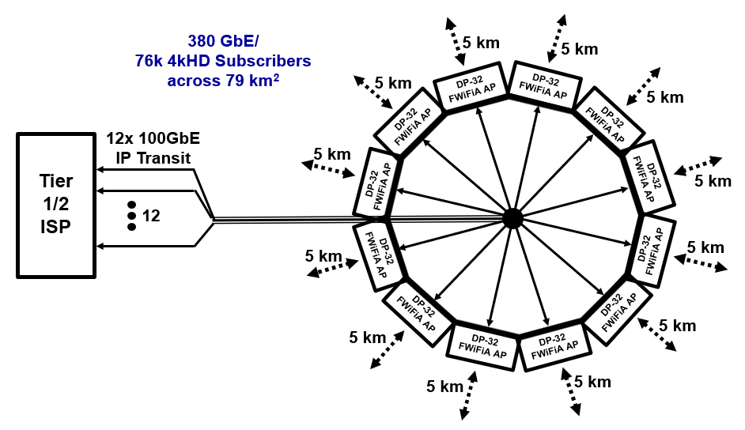
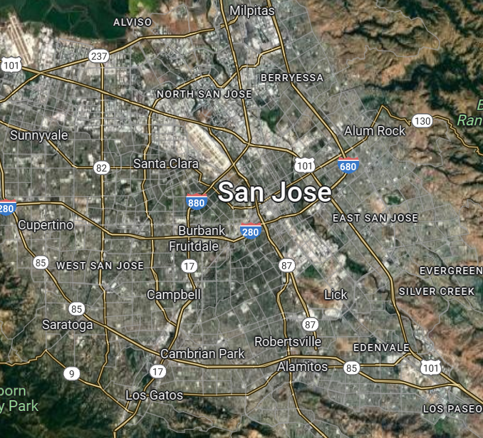


Representative “MetroWiFi” Network
~$60k/mo
~$250k
Link Type | Data Rate | Range | Network Capacity
12x FWiFiA AP - Client | 1.11 Tbps 553 Gbps 443 Gbps 222 Gbps 166 Gbps | 300 m/ Free Space 1 km/ 6m Foliage 2.5 km/ 6m Foliage 5km/ 6m Foliage 10 km/ 6m Foliage | 960 GbE/ 384k Subs 624 GbE/ 250k Subs 456 GbE/ 182k Subs 324 GbE/ 130k Subs 192 GbE/ 77k Subs
User-Allocated MetroWiFi Costs | 6 GHz RF Attn
WiFi-bn Infrastructure | <$2
WiFi-bn CPE | $99
60/60/24/7 10Mbps BB | <$1/ mo

Slide 14
What Does All This Mean to Us 802.11 folk?
(One Guy’s Idle Musings, Analyses and Conclusions )
Musing 1: WiFi-bn will promptly obsolete all other WAN Broadband connectivity technologies
Analysis 1: WiFi-bn can deliver Any Time, All the Time 4kHD Home BB for, what, ~$15/mo? $10? $5?
Cable delivers Sometimes 4kHD Home BB for ~$60/mo
5G does NOT deliver Any 4kHD Home BB, at any price
FTTP and LEOSat BB aren’t even in the conversation
Conclusion 1: Most of the world’s 1.4B fixed Broadband connections will rapidly migrate to WiFi-bn once WiFiBH and FWiFiA equipment become widely available
Musing 2: There will be enormous immediate and lasting demand for WiFi-bn
Analysis 2: Assuming just 1.2B WiFi-bn BB migrations means ~400M new WiFi-bn subs/yr for 3 years, or 400M (3-yr life) WiFi-bn Clients sell annually for the foreseeable future
Given 1 FWiFiA AP per 2000 Clients, 2 WiFiBH APs per FWiFiA AP and a systemic 3x network overbuild means (4e8/2e3 x 3 x 3 =) 1.8M WiFi-bn APs sell yearly, also ftff
Conclusion 2: WiFi chip/radiomakers will sell as much WiFi-bn as they can build, as fast as they can build it
Musing 3: WiFi-bn could come available much faster than many would think
Analysis 3: As WiFi-bn comprises a trivial WiFi-7 spin, DP-32 AP/ Client SoC platforms could arrive by 2025 100k’s of WiFiBH/FWiFiA APs and 10M’s of FWiFiA Clients then should come available by 2026
Conclusion 3: TGbn will be under the gun to standardize the DP PHY and complementary PHY/MAC extensions in record time to support the above

Slide 15
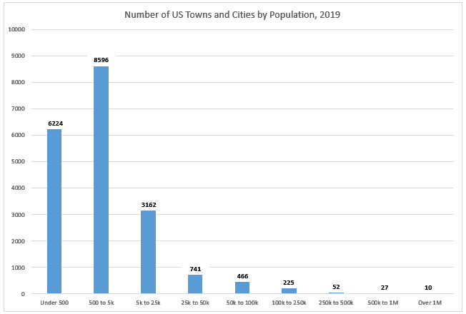
A Concrete, Imminent Example
(One Guy’s Not so Idle MA&C)
      NsI Musing 1: Per the graph, ~12.5k towns in the USA boast between 500 and 50k residents
      NsI Analysis 1: Those towns comprise ~75M (generally Broadband-underserved) households
      Represent the entire (overwhelmingly untapped) market for ~1k US WISPs
      Just 1-2 TownWiFi buildouts each would well-BB-serve ALL those towns
      Those 1k WISPs are ready, willing and able to build out the instant WiFi-bn arrives!
      NsI Conclusion 1: The USA market demand for WiFi-bn APs and Clients on Day 1 of availability:
      70M FWiFiA Clients + 70k WiFiBH/ FWiFiA APs

Slide 16
Proposed Dynamic Polarization PHY Summary
    The novel DPMXBF PHY presented here, a way-out-of-left-field MIMO Multiplexing re-think, would launch 802.11 into the rarefied 100GbE-over-kilometers realm long dominated exclusively by fiber
    Further PHY and MAC extensions deliver the ultra-high reliability performance required by carrier class PMP and P2P WiFi-bn
    Dynamic Polarization and recommended extensions deserve serious consideration for adoption by the new IEEE802.11bn standard

Slide 17
One Final Thought
Having studiously avoided those trite 4 little words until now:
IEEE802.11bn Dynamic Polarization WILL
finally, uniquely, definitively and irreversibly BtDD

Slide 18
Appendix A
DPMXBF Analysis

Slide 19
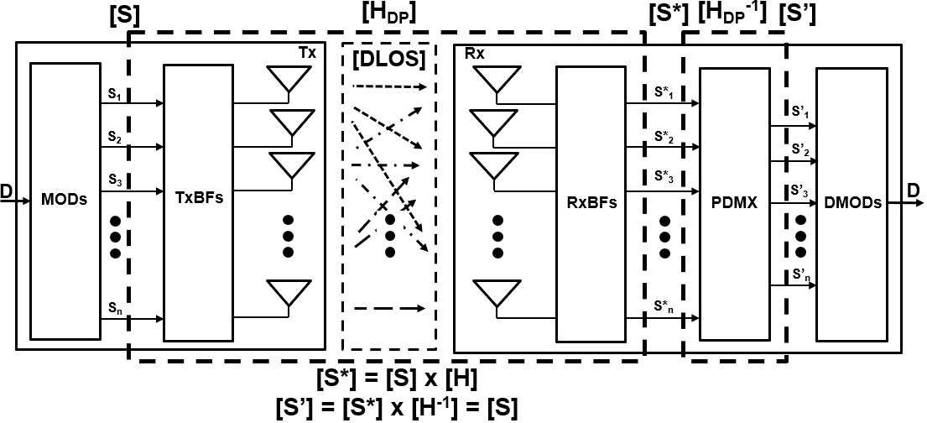
Reciprocally Interference-Free Cochannel Propagation of
Unrestricted Count RF Spatial Streams in DLOS Channels
MIMO Dynamic Polarization Multiplexing and Beamforming
DPMXBF Propagation Channel Model
[H_{DP}] represents the DPMXBF medium transfer function as well as the TRX Polarization Multiplexer
If [H_{DP}] is non-singular, it has an inverse [H_{DP}]⁻¹ representing the TRX Polarization Demultiplexer
The analysis following will verify [H_{DP}] non-singularity and gauge its computational tractability

Slide 20
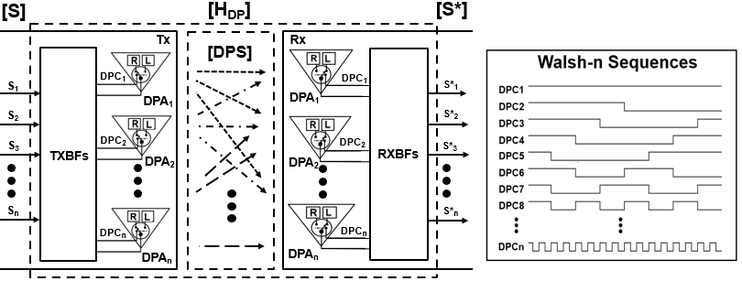
[H_{DP}] Characterization
  “n” selectable Dual-Pol Tx Antennas (“DPAs”) distinctly Polarize n RF Spatial Streams [S] (S_{i}, i = 1, 2 … n)
  with n respective Walsh-m (m>n) binary orthogonal codes [DPC] to yield the polarization-decorrelated [DPS]
  Transmit Beamforming (TxBF) aggregates all the DPS_{i} for high directivity transmission toward n Rx DPAs
  n Rx DPA “matched polarization filters” De-polarize [DPS] using the same Tx Walsh sequences prior to high directivity RxBF detection, thereby yielding the (DPMXBF) polarization-multiplexed [S*] (S*_{ij}, i, j = 1, 2 … n)

Slide 21
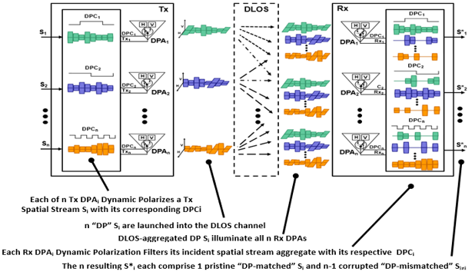
[H_{DP}] Operation
As the DPC_{i} all comprise Walsh binary orthogonal sequences,
ALL S*_{i=j} = 1 and ALL S*_{i≠j} = r, where r (in theory) equals 0.5

Slide 22
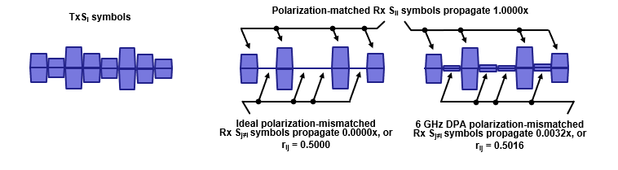

[H_{DP}] Dynamic Polarization Multiplexer Representation
  In practice, however, the [H_{DP}] DPMXBF Propagation Channel correlation index r corresponds to the cross-pol isolation measured between a realizable Rx DPA’s selectable orthogonally polarized elements
    For example, commercially available X-band Dual-Pol antennas spec xpol iso at -25dBc typical
    Therefore, [H_{DP}] can be expressed as
    [H_{DP}] is non-singular (as well as deterministic, time-invariant and uniform), meaning there exists an [H_{DP}]⁻¹ DPMXBF Polarization Demultiplexer that is also deterministic, time-invariant and uniform (!)

Slide 23


[H_{DP}]⁻¹ Dynamic Polarization Demultiplexer Representation
    So, given the DP Propagation Channel/Polarization Multiplexer represented by
    There exists a DPMXBF Polarization Demultiplexer (“PDMX”)represented by

Slide 24
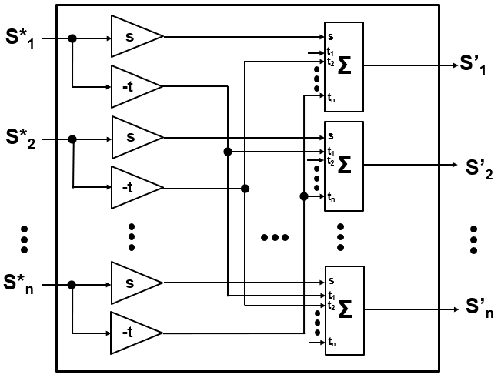
Dynamic Polarization Demultiplexer Implementation
    The DPMXBF Polarization Demultiplexer operation [S’] = [S*] x [H_{DP}]⁻¹
    (= [S]) may be equivalently expressed computationally and by hardware (i.e., the physical TRX PDMX) by:
    and
    The Dynamic Polarization Demultiplexer comprises trivial hardware

Slide 25
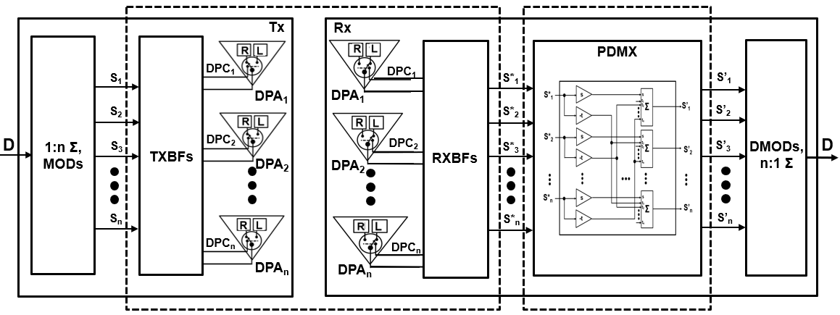


Dynamic Polarization TRX Model
[H_{DP}] DPMXBF Propagation Channel
[H_{DP}⁻¹] DPMXBF PDMX

Slide 26
Appendix B
Illustrative Dynamic Polarization Example:
Closed Form Analysis of a
DPMXBF Tx-Rx Link featuring n = 4, r = 0.505

Slide 27
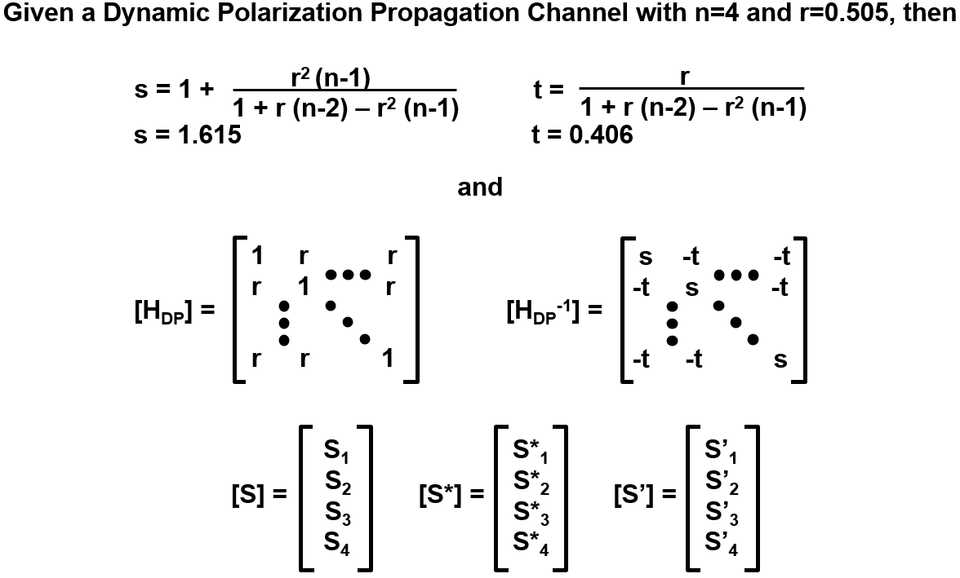
DPMXBF TRX Analysis Part 1

Slide 28
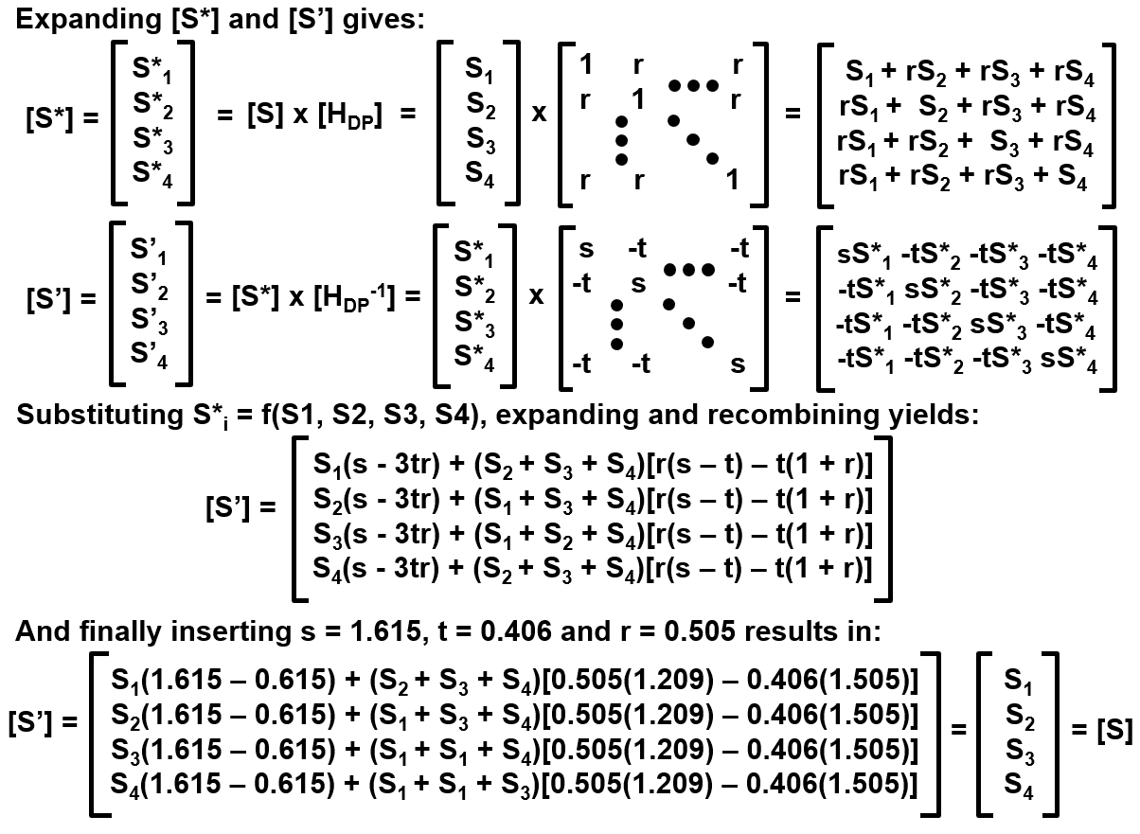
DPMXBF TRX Analysis Part 2

Slide 29
Appendix C
DPMXBF and the Shannon Limit

Slide 30
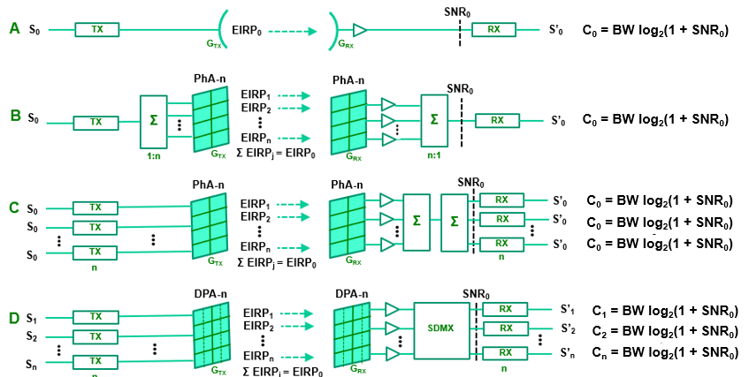
Dynamic Polarization and the Shannon Limit, Part 1
How does DP-n NOT exceed Shannon’s maximum channel capacity?
    Consider the canonical Shannon Tx-Rx Channel of Figure A, below
    A signal S₀ of bandwidth BW transmitted through a directional antenna of gain G_{TX} at power level EIRP₀ , detected through another antenna of gain G_{RX} and ultimately received as S’₀ with a S/N ratio SNR₀ propagates across the transmission channel of Shannon capacity C₀ = BW log2 (1 + SNR₀) shown
    Consider now a perfectly equivalent Tx-Rx channel in Figure B
    Directional antennas G_{RX} and G_{TX} replaced by perfectly equivalent phased arrays G_{RX} and G_{TX}

Slide 31

Dynamic Polarization and the Shannon Limit Part 2
And yet another perfect equivalent Tx-Rx in Figure C:
S₀ and S’₀ 1:n splits replaced by equivalent n x S₀ and S’₀ replicas, all traversing distinct C₀ capacity channels
And finally, consider the not-really-sleight-of-hand of Figure D:
n S0 and S’0 replaced by perfectly equivalent distinct Si, i = 1, 2 … n, the phased array antennas by SDPAs and the Rx n:1-1:n splitter combiner by a Pol- Demux, all traversing distinct C₀ capacity channels
An n^{th} order DPMXBF link comprises n Shannon channels, not just one
PDMX

