Slide 1
GAS Request Fragmentation
Date: 2023-12-07
Authors:

Slide 2
Abstract
There are a couple of use cases within the Wi-Fi Alliance that require a GAS Request message to support fragmentation.

Slide 3
GAS
Generic Advertisement Service
Allows a STA to transmit an unsolicited query request to a peer STA (typically an AP) to request infrequent information from a server (e.g. AP location, network access). The server can be either in the AP or behind the AP.
The query response contains “hint” information to be used on a best effort basis. This information is usually valid at an infrastructure AP.
GAS is a 4 stage protocol exchange including a delay mechanism.
It also allows fragmentation and provides a group addressed response mode.

Slide 4
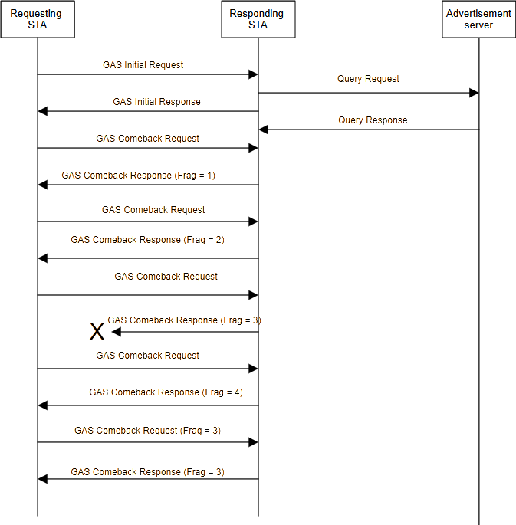

Slide 5
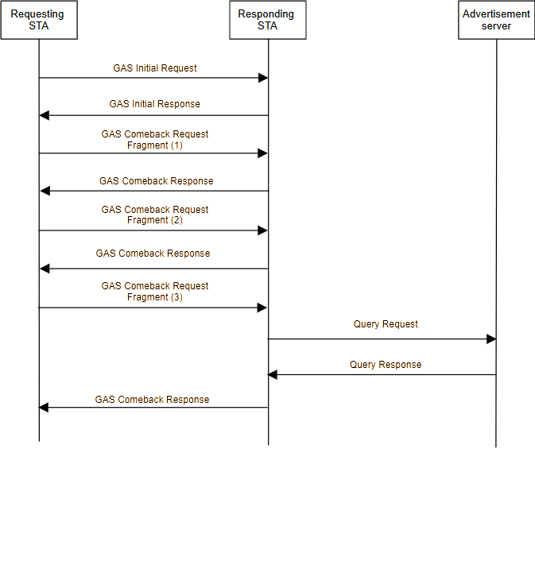

Slide 6
Notes
The existing “response” fragmentation behavior can be made symmetric.
“GAS Query Response Fragment ID” renamed to “GAS Query Fragment ID”, to avoid confusion in the new text.
The Group Addressed (GA) GAS behavior has not been touched.

Slide 7
Feedback
Q: How does the AP know that the STA wants to fragment a request. Is there a flag in the GAS initial request. How is this done for the existing GAS initial response??
A: This mechanism was missing. The requesting STA adds the Fragment ID field to the GAS Extension field in the GAS initial request to indicate that the GAS query request will be fragmented.
Q: How does the AP know the size of the query request, when the STA starts to fragment. It may be too large for it.
A: There is no (original) feature to do this.
Q: The updates to the GAS Comeback Request need to be parseable. The mix of elements and frames is a mess. Add a length to the frame (as a subfield), so the overall frame can be parsed.
A: A new GAS Comeback Request Fragment frame has been created to produce a cleaner solution. This is used when the GAS Initial Request signals that fragmentation is required.

