Slide 1
GAS Request Fragmentation
Date: 2023-10-10
Authors:

Slide 2
Abstract
There are a couple of use cases within the Wi-Fi Alliance that require a GAS Request message to support fragmentation.

Slide 3
GAS
Generic Advertisement Service
Allows a STA to transmit an unsolicited query request to a peer STA (typically an AP) to request infrequent information from a server (e.g. AP location, network access). The server can be either in the AP or behind the AP.
The query response contains “hint” information to be used on a best effort basis. This information is usually valid at an infrastructure AP.
GAS is a 4 stage protocol exchange including a delay mechanism.
It also allows fragmentation and provides a group addressed response mode.

Slide 4
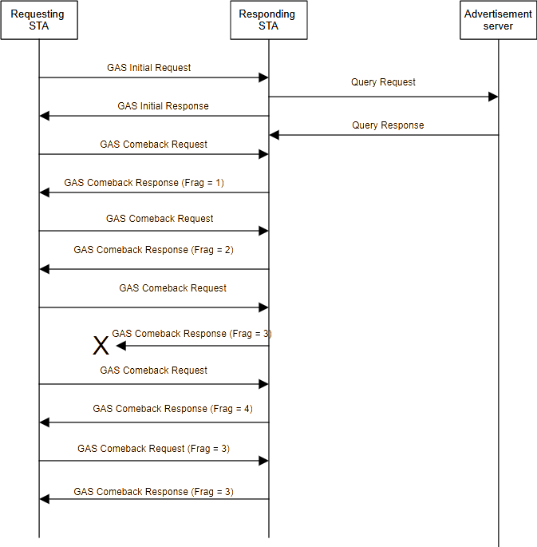

Slide 5
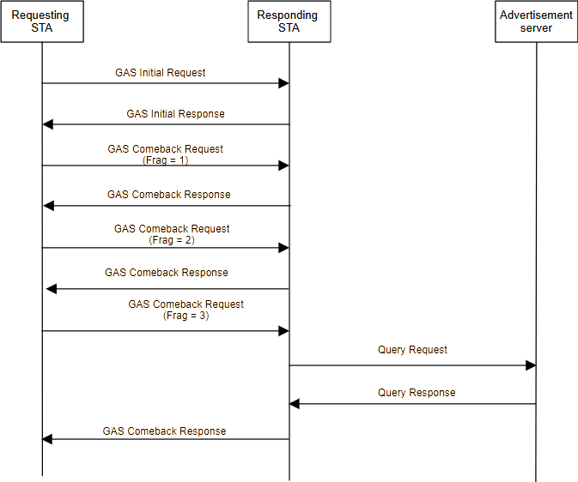

Slide 6
Notes
The existing “response” fragmentation behavior can be made symmetric.
“GAS Query Response Fragment ID” renamed to “GAS Query Fragment ID”, to avoid confusion in the new text.
The Group Addressed (GA) GAS behavior has not been touched.

