Slide 1
Redundant receiver requirements
Date: 2023-09-11
r0 (September 11, 2023): Initial draft

Slide 2
Abstract
PHY clauses contain increasingly large tables specifying receiver requirements such as minimum receive sensitivity. Many entries in such tables duplicate entries in predecessor PHYs, and are effectively redundant. It would be better to delete many such requirements and stop adding new ones.

Slide 3
CID 5015*
CID | Clause/ Page | Comment | Proposed Change
5015 (John Coffey) | 21.3.18.1 / 3491.22 | A significant portion of the table duplicates the corresponding table for HT. (This pattern is repeated across the specification.) The spec should not restate what is substantially the same requirement over and over again. | Split the last two rows (dealing with 256-QAM) off into a separate table. For the remaining rows, delete the columsn dealing with 20 MHz and 40 MHz.
* Withdrawn by the commenter

Slide 4
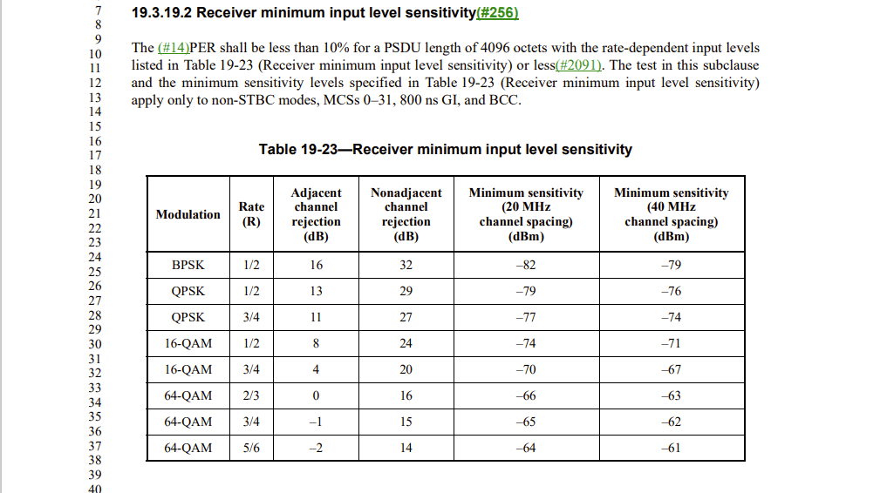
HT receive sensitivity table

Slide 5
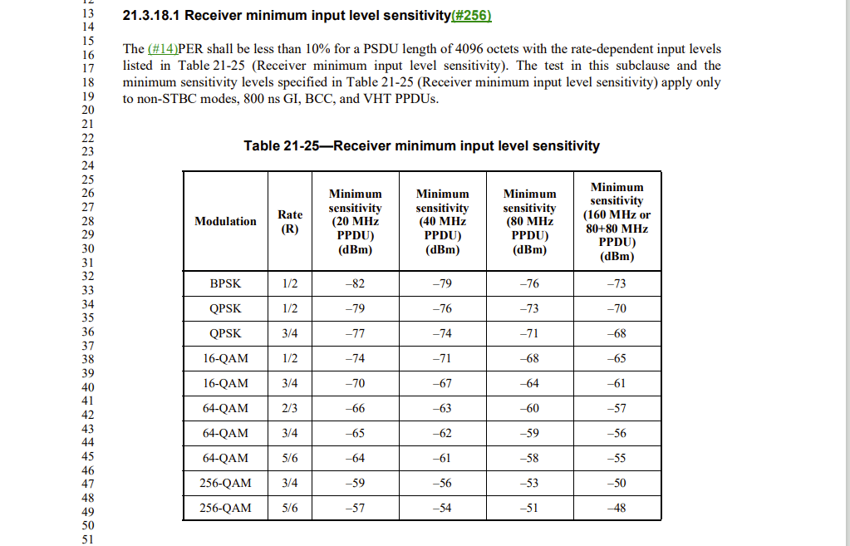
VHT receive sensitivity table

Slide 6
The requirements are representative
The HT table requires -82 dBm for BPSK, rate ½, 20 MHz channel spacing for a PSDU length of 4096 octets
Why only this PSDU length? What about other PSDU lengths?
Do we not want receivers to have acceptable sensitivity for other PSDU lengths?
If we do, where are the requirements?
The requirement for 4096 octets is a sufficient sample
We do want receivers to have acceptable sensitivity for other PSDU lengths, but the standard takes the approach that it is not necessary to specify that as a separate requirement for each such PSDU length
If a receiver satisfies the requirement for a PSDU length of 4096 octets, that is evidence that quite a lot of receiver functions are operating correctly: detection, synchronization, FFT, BCC decoder, etc.
If the receiver works at 4096 octets, we infer that it works at other PSDU lengths
And if it doesn’t, it isn’t the fault of the specification

Slide 7
VHT table essentially includes HT one
Requirements are not exactly the same
BPSK rate ½ in 20 MHz requires -82 dBm with VHT PPDU
The preamble is different
VHT preamble is checked at 80 MHz
First 8 entries in 80 MHz column are mandatory for VHT
So, we could (arguably) infer the results in the highlighted region

Slide 8
EHT table essentially includes HE one
Standing alone, the overlap between HT and VHT for minimum receive sensitivity is not so jarring
But the same pattern appears over and over again, and looks set to continue expanding for the foreseeable future
At right: EHT versus HE
Repeat for adjacent channel rejection and others

Slide 9
What to do?
It looks as if we will probably not resolve this in REVme. But we will soon move on to REVmf. How should we proceed?
Leave it as is and continue adding new PHY receiver tables in the same style
Leave existing REVme PHY receiver tables as they are and trim future tables, including EHT, as they are rolled in
Remove redundant information from PHY receiver tables back to VHT

