Slide 1
Dynamic Polarization Spatial Multiplexing and Beamforming WLANs:
Smashing the Age-old MIMO Paradigm
Date: 2023-09-14
Authors:

Slide 2
Abstract
Breakthrough Walsh-sequenced Polarization MIMO processing combines unbounded order spatial stream Multiplexing with steerable high directivity Beamforming to yield EHT-based Dynamic Polarization Multiplexing and Beamforming WLANs transporting, for instance, up to 92 Gbps Fiber Replacement Backhaul beyond 18 km, within a 320 MHz channel at 6 GHz. “DPMXBF” merits serious consideration as a TGbn PHY.

Slide 3
Dynamic Polarization WLANs
Proposed “DPMXBF” 802.11 PHY
32 IEEE802.11be RF spatial streams
  32x32 MIMO Polarization Multiplexing
  32x32 MIMO Beamforming
  5-7 GHz UNII Operation
  4096 QAM
  320 MHz BW
  92,224 Mbps peak Data Rate
  > 550 m WLAN Free Space Range
  > 2.8 km Fixed Wireless Access FS Range
  > 18 km Fiber Replacement Backhaul FS Range

Slide 4
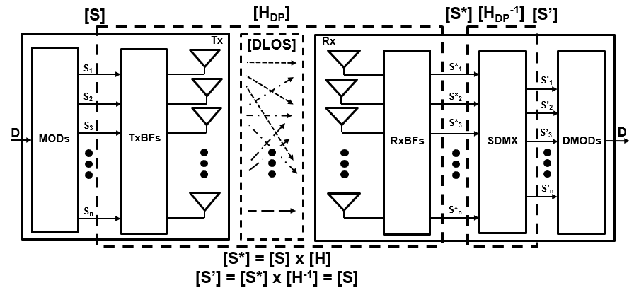
Dynamic Polarization MIMO
Reciprocally Interference-Free Cochannel Propagation of
Countless WLAN Spatial Streams in Terrestrial DLOS Channels
DPMXBF Propagation Channel Model
[H_{DP}] represents the DPMXBF medium transfer function as well as the TRX Polarization Multiplexer
If [H_{DP}] is non-singular, it has an inverse [H_{DP}]⁻¹ representing the TRX Polarization Demultiplexer
The analysis following will verify [H_{DP}] non-singularity and gauge its computational tractability

Slide 5
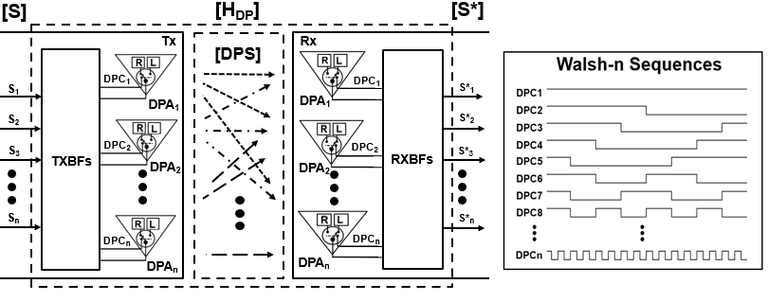
[H_{DP}] Characterization
  “n” Tx selectable Dual-Pol Antennas (“DPAs”) “Polarization Differentiate” n RF Spatial Streams [S]
  (i.e., S_{i}, i = 1, 2 … n) with n distinct, corresponding Walsh-m (m>n) sequences [DPC] to yield [DPS]
  Transmit Beamforming (TxBF) aggregates the DPS_{i} for high directivity transmission toward n Rx DPAs
  The n Rx DPAs “Differentiated Polarization Filter” [DPS] with the identical TxBF Walsh-m sequences for high directivity detection by the RxBFs, yielding the DP polarization-multiplexed [S*] (i.e., S*_{ij}, i, j = 1, 2 … n)

Slide 6
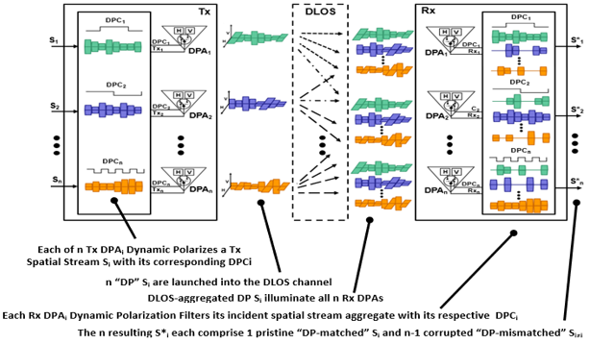
[H_{DP}] Operation
As the DPC_{i} comprise Walsh binary orthogonal sequences,
ALL S*_{i=j} = 1 and ALL S*_{i≠j} = r, where r (in theory) equals 0.5

Slide 7
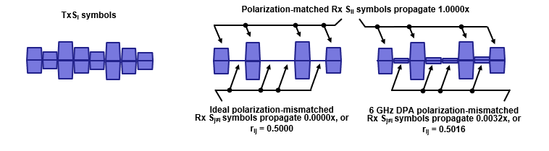

[H_{DP}] Polarization Multiplexer Representation
  In practice, however, the [H_{DP}] DP Propagation Channel correlation index r corresponds to the cross-pol isolation measured between a realizable Rx DPA’s selectable orthogonally polarized elements
    For example, commercially available X-band Dual-Pol antennas spec xpol iso at -25dBc typical
    Therefore, [H_{DP}] can be expressed as
    [H_{DP}] is non-singular (as well as deterministic, time-invariant and uniform), meaning there exists an [H_{DP}]⁻¹ DP WLAN Polarization Demultiplexer that is also deterministic, time-invariant and uniform (!)

Slide 8


[H_{DP}]⁻¹ TRX Polarization Demultiplexer Representation
    So, given a DPMXBF Propagation Channel represented by
    There exists a DPMXBF Polarization Demultiplexer represented by

Slide 9
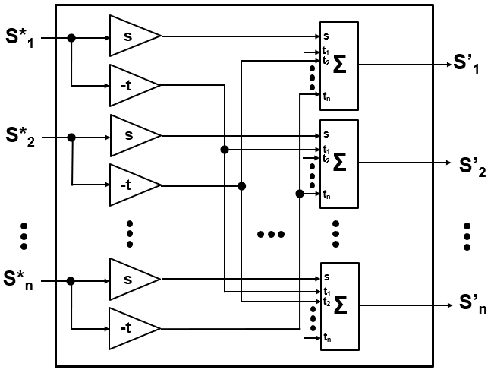
DPMXBF TRX Polarization Demultiplexer Implementation
    The DPMXBF Tx-Rx Transfer Function [S’] = [S*] x [H_{DP}]⁻¹ (= [S]) may be equivalently expressed computationally as well as by hardware (i.e., the physical DP TRX SDMX) by:
    and
    The DP Polarization Demultiplexer reduces to a trivial hardware implementation

Slide 10
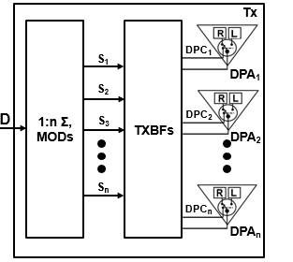

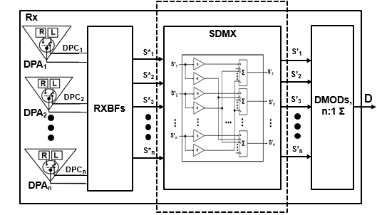


Comprehensive Dynamic Polarization WLAN Model
[H_{DP}] DPMXBF Propagation Channel
[H_{DP}⁻¹] DPMXBF WLAN SDMX

Slide 11
Dynamic Polarization Applications
    Ultra-High-Capacity WLAN Mesh
    Dual Platform Dynamic Polarization Routers 3x faster than today’s best WiFi-7 devices
      PMP 32nd order Dynamic Polarization (“DP-32”) WLAN AP/ Meshnode distributes 92 Gbps/ relays 46 GHz at 6 GHz across 180º
      Pairs with a PMP WiFi-6 “AP Drop” distributing 4.1 Gbps at 2.4 and 5 GHz across 360º
      P2P DP-32 WLAN Client receives 5.8 Gbps at 6 GHz beyond 560m
      Pairs with a PMP WiFi-6 “Client Drop” also distributing 4.1 Gbps at 2.4/5 GHz across 360º
    Ultra-High-Capacity Fixed Wireless Access
    Today’s FWA is 95% 5G, Dynamic Polarization could flip it ALL to WiFi
      PMP DP-32 FWA AP distributes up to 92 Gbps at 6 GHz across 60º
      P2P DP-32 FWA Client receives up to 5.8 Gbps at 6 GHz beyond 2.8 km
    Fiber Replacement Backhaul
    P2P WiFi-7 Backhauls (using 1 m Dishes) transport 5.8 Gbps at 6 GHz beyond 10 km
    P2P DP-32 FRBH Nodes transport up to 92 Gbps at 6 GHz beyond 18 km

Slide 12
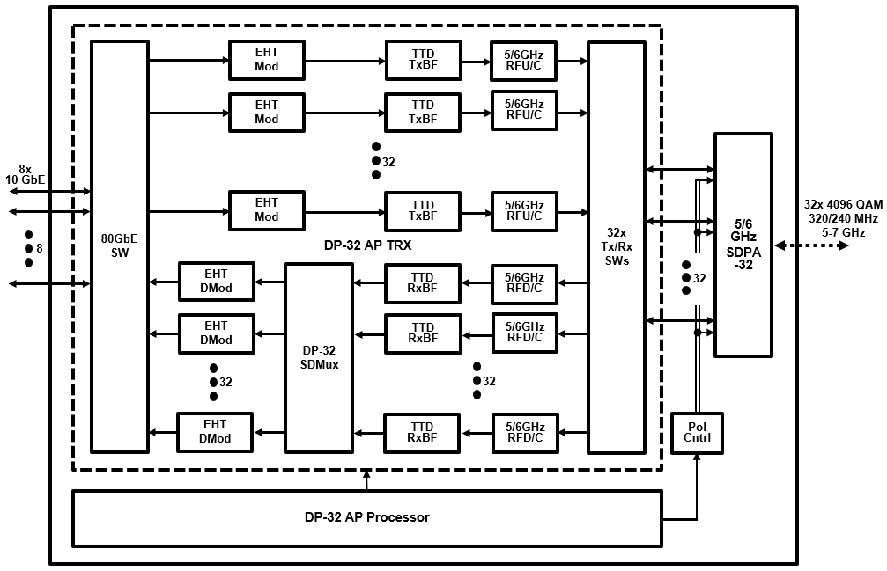
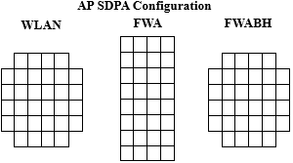
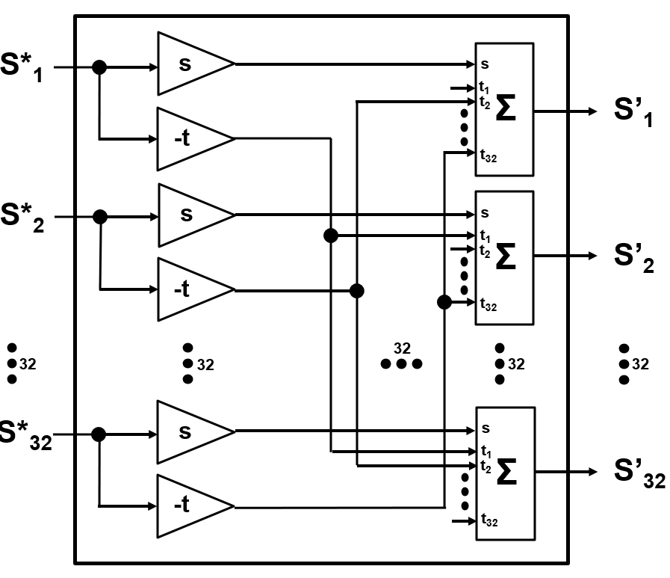
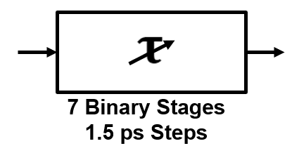
Contemplated 92 Gbps DP-32 Access Point/ Meshnode
(32 EHT Spatial Streams)
92/69 Gbps 6/5 GHz DP-32 AP/MN
DP-32 AP/Meshnode SDPA-32 Phased Array
Node Type | Element Directivity | SDPA Gain
WLAN AP/MN | 180º | 20.5 dBi
FWA AP | 60º | 30.5 dBi
FRBH N | 30º | 36.5 dBi
SDPA Beamwidth (WxH): 16.9º x 16.9º
DP-32 SDMux
TTD xBF

Slide 13
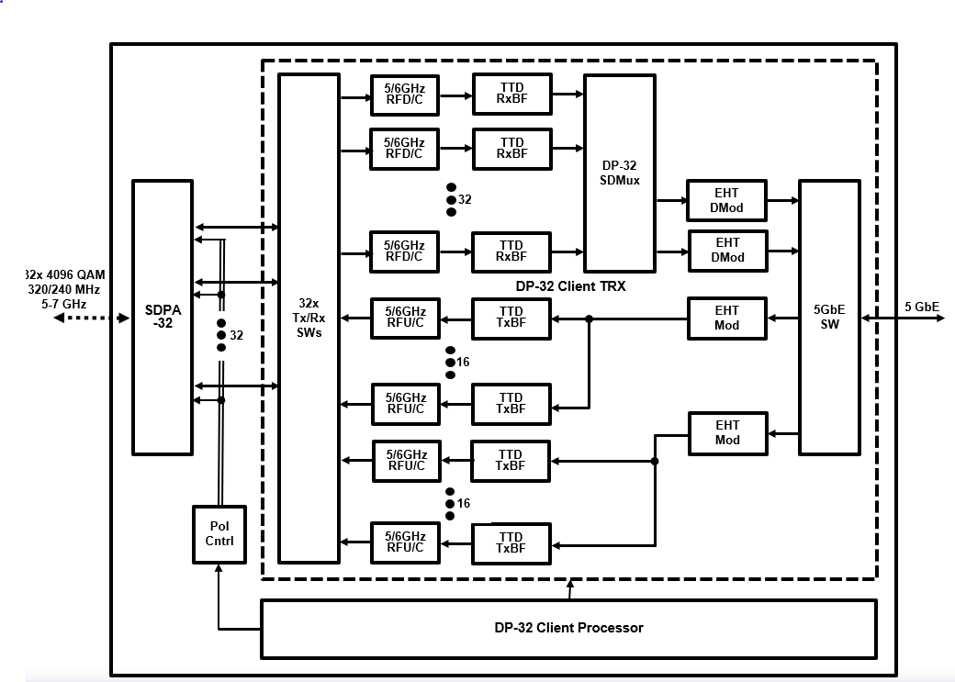
Contemplated 5.8 Gbps DP-32 Client
(2 EHT Spatial Streams)
5.8/4.3 Gbps 6/5 GHz DP-32 Client
DP-32 Client SDPA-32 Phased Array
Node Type | Element Directivity | SDPA Gain
WLAN Client | 180º | 20.5 dBi
FWA Client | 90º | 26.5 dBi
SDPA Beamwidth (WxH): 16.9º x 16.9º
TTD xBF
DP-32 SDMux

Slide 14
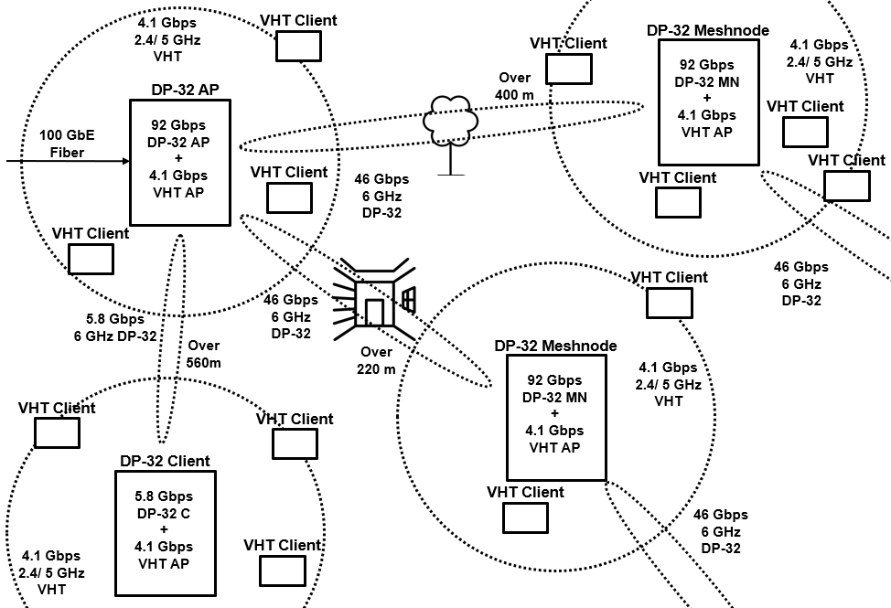
Contemplated Dynamic Polarization WLAN Mesh Network
Link Obstruction | 6 GHz RF Attenuation
Outdoor Foliage | 1 dB/ meter
Indoor Drywall | 2 dB/ Wall
Exterior Stucco | 6 dB/ Wall
Exterior Masonry | 15 dB/ Wall
Link Type | Data Rate | Range | NW Capacity
AP – MN MN - MN AP/MN - C | 92.2 Gbps 46.1 Gbps 5.8 Gbps | 565 m/ Free Space 422 m/ 3 m Foliage 222 m/ 1 ID + 1 ES | >40k concurrent Users

Slide 15
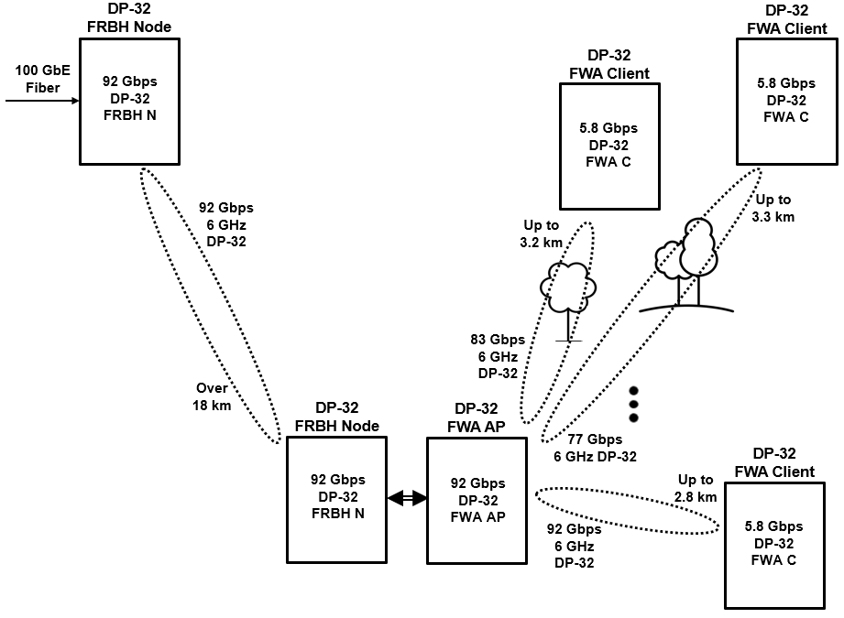
Contemplated Dynamic Polarization FRBH + FWA Network
Link Obstruction | 6 GHz RF Attenuation
Outdoor Foliage | 1 dB/ meter
Link Type | Data Rate | Range | NW Capacity
FRBH N - N | 92.2 Gbps | 18.0 km/ Free Space
FWA AP – C | 92.2 Gbps 83.0 Gbps 76.9 Gbps | 2.8 km/ Free Space 3.2 km/ 3m Foliage 3.3 km/ 5m Foliage | >40k Subscribers provided 5x Oversubscription

Slide 16
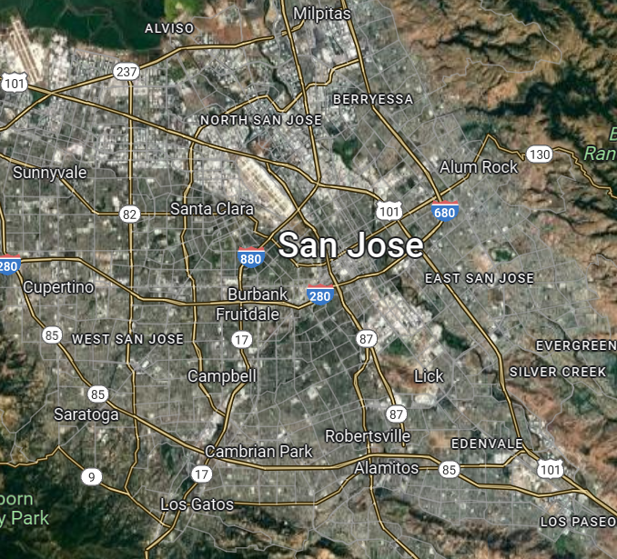
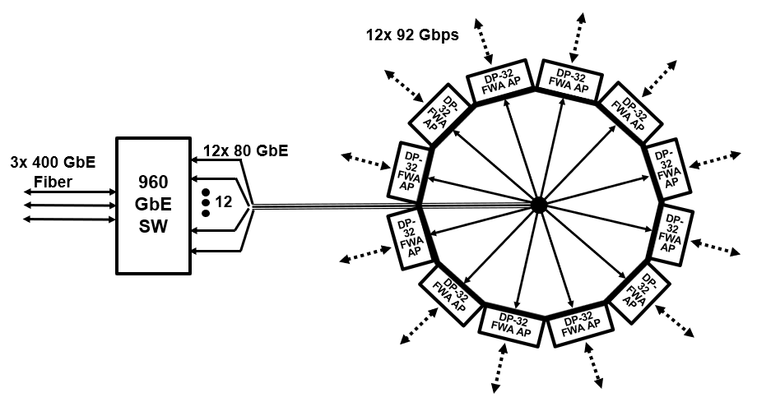
Contemplated Dynamic Polarization Metro Wireless
Link Type | Data Rate | Free Space Range | NW Capacity
12x FWA AP – C | 1107 Gbps 996 Gbps 922 Gbps | 0 – 2.8 km 2.8 - 4.5 km 4.5 – 5.8 km | >480k Subscribers provided 5x Oversubscription

Slide 17
DPMXBF WLANs Summary
    Polarization Multiplexing, a new, way-out-of-left-field reformulation of MIMO (NOT Spatial) Multiplexing boosts 802.11 speeds to nearly 100 Gbps at well-beyond kilometer ranges
    DPMXBF deserves consideration as an integral PHY for the nascent 802.11bn standard

Slide 18
Appendix A
Illustrative DPMXBF Example:
Closed Form Algebraic Derivation of a
Dynamic Polarization Multiplexing and Beamforming TRX:
with n = 4, r = 0.505

Slide 19
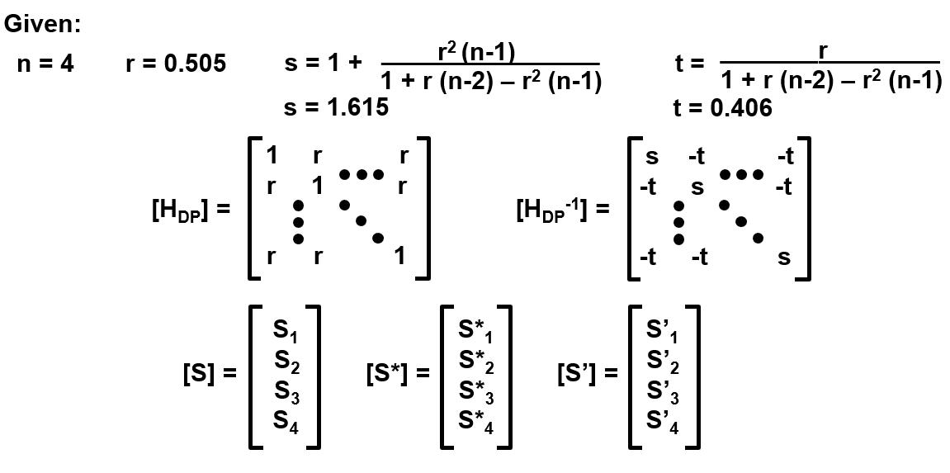
DPMXBF TRX Deconstruction

Slide 20
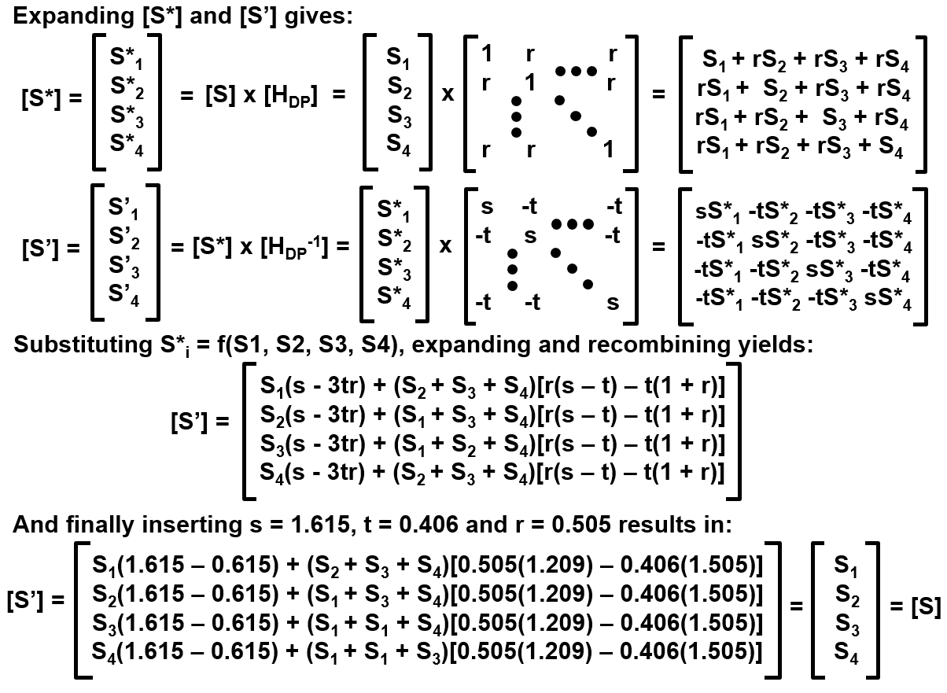
DPMXBF TRX Deconstruction

