Slide 1
Low Latency Transmission in EMLMR
Date: 2023-09-11
Authors:

Slide 2
Abstract
11be introduced the EMLMR operation to increase throughput.
The EMLMR operation of 11be might have a latency issue:
  When a low-latency frame occurred for the EMLMR non-AP MLD to transmit while receiving a frame from the AP MLD, the non-AP MLD has to wait until the end of reception.
In the 11bn PAR, tail of latency reduction is included.
  “at least one mode of operation capable of reducing latency by 25% for the 95th percentile of the latency distribution compared to the Extremely High Throughput MAC/PHY operation”
This contribution discusses low latency traffic transmission in EMLMR operation.

Slide 3
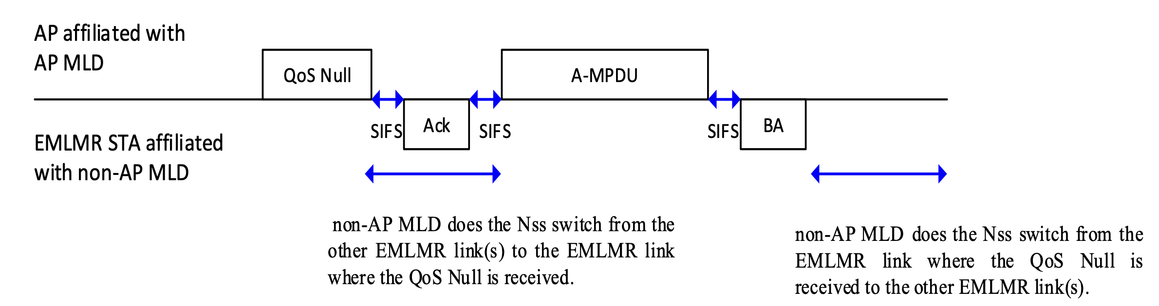
Background: 11be EMLMR operation
When the EMLMR non-AP MLD receives initial frame from the AP MLD on the one of the EMLMR links, the non-AP MLD shall switch RF chains to the link.
  More Nss can be deployed for the high throughput transmission.
While the EMLMR non-AP MLD is receiving a frame in one of EMLMR links, the EMLMR non AP MLD cannot receive or transmit in the other EMLMR links.

Slide 4
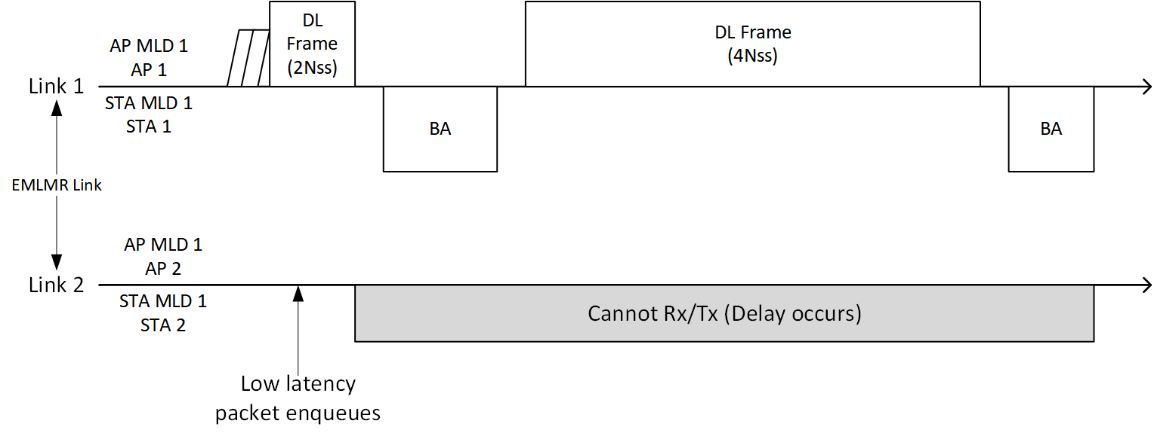
Issue: Latency in EMLMR operation
While the EMLMR non-AP MLD is receiving or transmitting on one of the EMLMR links, the non-AP MLD cannot use the other EMLMR links.
  When low latency frames are enqueued to the non-AP MLD while the non-AP MLD is operating in the EMLMR mode, the non-AP MLD should wait until the end of the EMLMR mode operation.

Slide 5
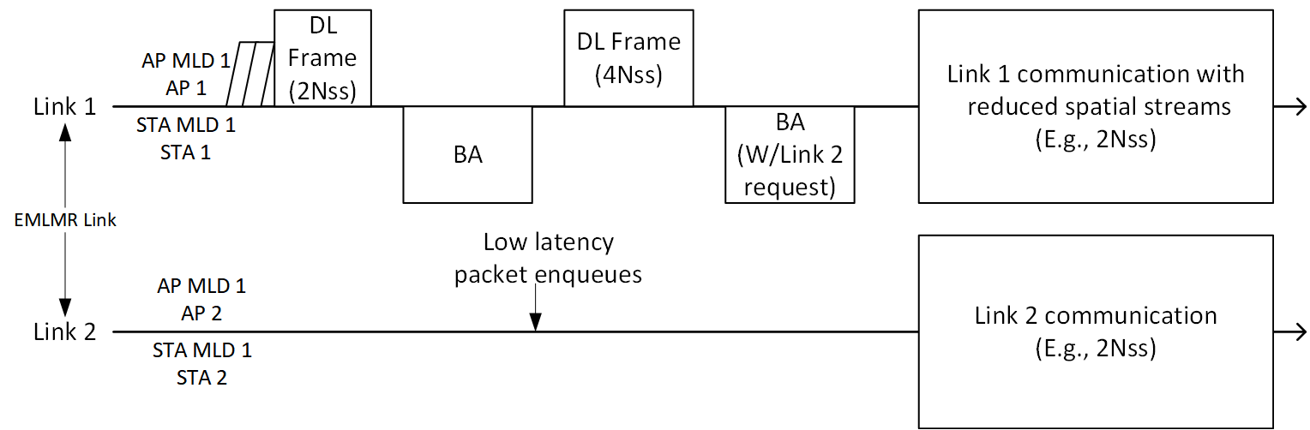
Low Latency EMLMR Operation
STA 1 of the STA MLD can request the AP MLD 1 to release some of Nss for transmitting low latency packets using other links.
AP MLD can release some of Nss in link 1 and AP MLD and STA MLD can communicate with the reduced spatial streams in link 1.
STA MLD can utilize the released Nss to transmit low latency packets in the other link(s).

Slide 6
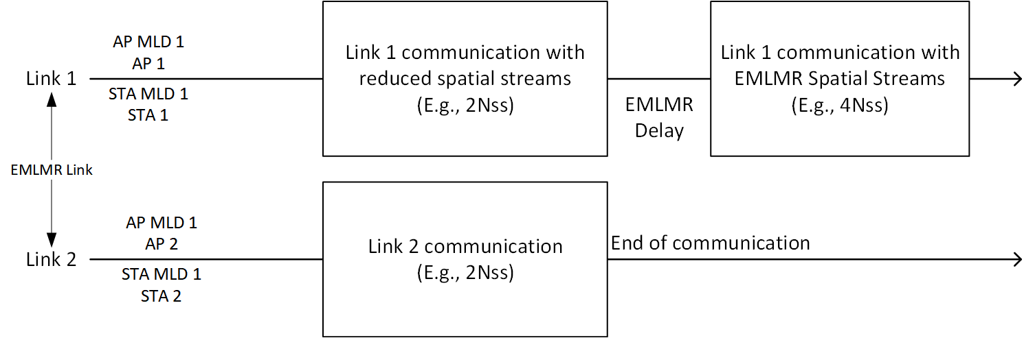
Low Latency EMLMR Operation (cont’d)
After the communication in link2 ends, AP MLD and STA MLD can communicate in link 1 with EMLMR Nss and MCS.

Slide 7
Summary
In this contribution, the low latency transmission method for the EMLMR operation is discussed.
  While the EMLMR non-AP MLD is receiving frames in one of the EMLMR links, some Nss can be released from the EMLMR operation and non-AP MLD can transmit low latency traffic packets using the other EMLMR links with the released Nss.
  Low latency frames of the non-AP MLD or the AP MLD can be transmitted during the EMLMR operation.

Slide 8
References
[1] 11-23/1166r3: UHR proposed PAR, https://mentor.ieee.org/802.11/dcn/23/11-23-0480-03-0uhr-uhr-proposed-par.pdf

