Slide 1
Machine learning meets Wi-Fi 7: a multi-link traffic allocation-based RL use case
Date: 2023-09-12
Authors:
Name | Affiliations | Address | Phone | email
Pedro E. Iturria Rivera | University of Ottawa | 800 King Edward Avenue Ottawa, ON K1N 6N5 |  | pitur008@uottawa.ca
Dr. Melike Erol-Kantarci |  |  |  | melike.erolkantarci@uottawa.ca

Slide 2
Overview
This presentation will be comprised by:
Introduction
  Timeline of Wi-Fi evolution.
  A primer on Wi-Fi 7: New features and differences.
  Wi-Fi 8?: What to expect.
RL meets Multi-Link Operation in IEEE 802.11be: Multi-Headed Recurrent Soft-Actor Critic-based Traffic Allocation
  Motivation.
  Overview of the Multi-Headed Recurrent Soft-Actor Critic.
  System Model.
Multi-Headed Recurrent Soft-Actor Critic
  Dealing with Non-Markovian environments in RL.
  State Space Selection.
  Action Space Selection.
  Reward Function.
Traffic Considerations
Performance Evaluation
Simulation Results
Conclusions

Slide 3
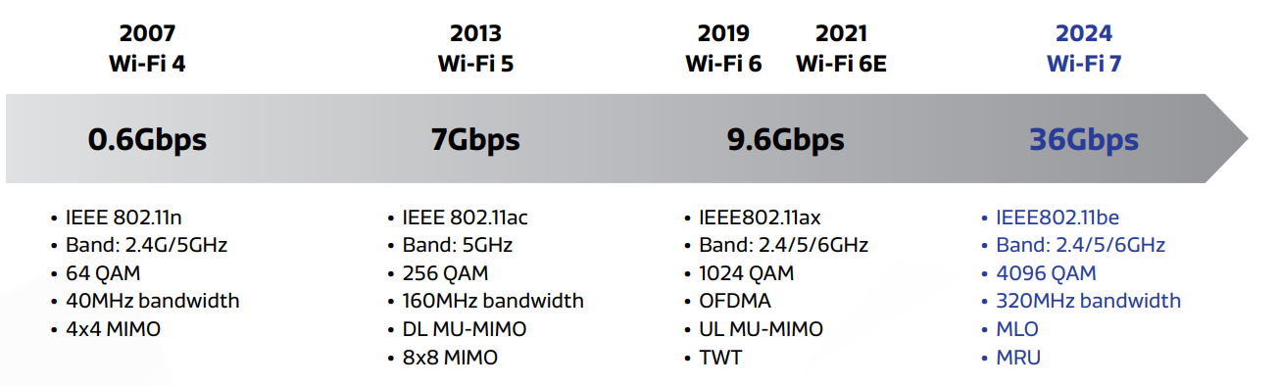
Timeline of Wi-Fi evolution
Key evolutions of different Wi-Fi generations*
IEEE 802.11 Working Group (as 2023-08-31)**
Final 802.11 WG Approval → September 2024
*IEEE 802.11 WG. https://www.ieee802.org/11/Reports/802.11_Timelines.htm
Mediatek, “Key Advantages of Wi-Fi 7: Performance, MRU & MLO”, White paper, Feb 2022.

Slide 4
A primer on Wi-Fi 7: New features and differences (I)
Where we come from?
Wi-Fi 6, based on IEEE 802.11ax dealt with crowded deployments by improving network efficiency and battery consumption.
What are the new features?
Direct Enhancements of 802.11ax:
Support of 320 MHz transmissions (doubles the 160 MHz of 802.11ax)
2. Use of higher modulation orders, optionally support 4096-quadrature amplitude modulation (QAM) — up from 1024-QAM in 802.11ax — with a strict –38 dB requirement on the constellation error vector magnitude (EVM) at the transmitter.
3. Allocation of multiple resource units, that is, groups of OFMDA tones, per STA. This extra degree of flexibility leads to more efficient spectrum utilization
*E. Au, “Specification Framework for TGbe,” IEEE 802.11-19/1262r23, Jan. 2021.

Slide 5
A primer on Wi-Fi 7: New features and differences (II)
Draft 1.0-2.0 Release 1
Multi-Link Operation
Multi-Link Discovery and Setup
Channel Access and Power Saving
Traffic-Link Mapping
Low-Complexity AP Coordination

Slide 6
A primer on Wi-Fi 7: New features and differences (III)
Draft 3.20 Release 2
MIMO Enhancements
Advanced AP Coordination
Hybrid Automatic Repeat Request (HARQ)
Coordinated OFDMA
Low-Latency Operations
Joint Single- and Multi-User Transmissions
Coordinated Beamforming

Slide 7
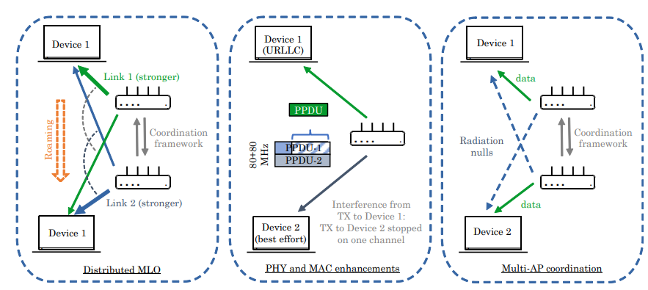
Wi-Fi 8?: What to expect.
The study group of IEEE 802.11bn UHR (Ultra High Reliability) a.k.a Wi-Fi 8 was created in July 2022 with end of standardization cycle by 2028.
Wi-Fi 8 will be focusing on improving the following aspects with respect its predecessor (no specific details to the date) :
Data rates, even at lower signal-to-interference-plus-noise ratio (SINR) levels.
Tail latency and jitter, even in scenarios with mobility and overlapping BSSs (OBSSs).
Reuse of the wireless medium.
Power saving and peer-to-peer operation
To facilitate such improvement, some interest and study groups are worth to mention that will support such enhancements:
1. IEEE 802.11 AI/ML Topic Interest Group (TIG)
2. IEEE 802.11 Real Time Applications (RTA) Topic Interest Group (TIG)
3. Integrated mmWave (IMW) SG
L. G. Giordano, G. Geraci, M. Carrascosa, and B. Bellalta, What Will Wi-Fi 8 Be? A Primer on IEEE 802.11bn Ultra High Reliability. 2023. https://arxiv.org/abs/2303.10442

Slide 8
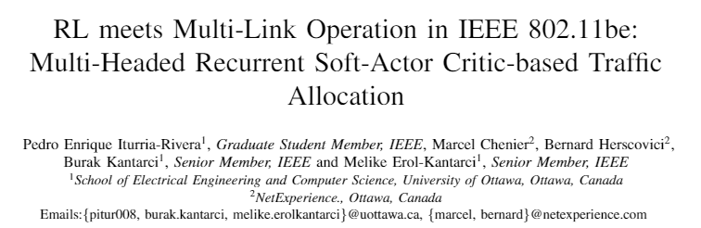
*Accepted in IEEE International Conference of Communications (ICC) 2023, Rome, Italy

Slide 9
Motivation
IEEE 802.11be —Extremely High Throughput—, commercially known as Wireless-Fidelity (Wi-Fi) 7 is the newest IEEE 802.11 amendment that comes to address the increasingly throughput hungry services such as Ultra High Definition (4K/8K) Video and Virtual/Augmented Reality (VR/AR).
To do so, IEEE 802.11be presents a set of novel features that will boost the Wi-Fi technology to its edge.
To achieve superior throughput and very low latency, a careful design approach must be taken, on how the incoming traffic is distributed in MLO capable devices.
In this paper, we present a Reinforcement Learning (RL) algorithm named Multi-Headed Recurrent Soft-Actor Critic (MH-RSAC) to distribute incoming traffic in 802.11be MLO capable networks.

Slide 10
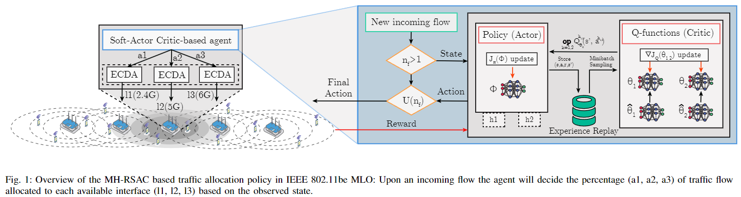
Overview of MH-RSAC
In this work, we focus our interest on MLO in 802.11be. Specifically, MLO allows Multi-Link Devices (MLD)s to concurrently use their available interfaces for multi-link communications. In this context, we intend to optimize the traffic allocation policy over the available interfaces with the aid of Reinforcement Learning (RL).

Slide 11
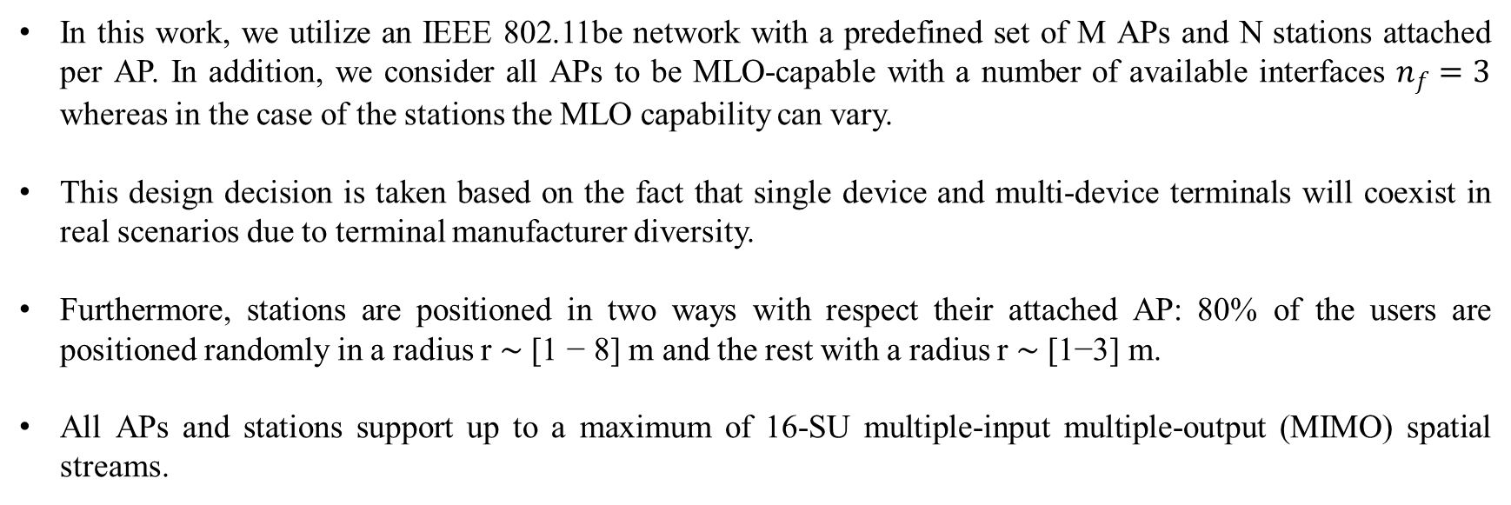
System Model
In this work, we utilize an IEEE 802.11be network with a predefined set of M APs and N stations attached per AP. In addition, we consider all APs to be MLO-capable with a number of available interfaces $n_{f}=3$ whereas in the case of the stations the MLO capability can vary.
This design decision is taken based on the fact that single device and multi-device terminals will coexist in real scenarios due to terminal manufacturer diversity.
Furthermore, stations are positioned in two ways with respect their attached AP: 80% of the users are positioned randomly in a radius r ∼ [1 − 8] m and the rest with a radius r ∼ [1−3] m.
All APs and stations support up to a maximum of 16-SU multiple-input multiple-output (MIMO) spatial streams.
¹ IEEE P802.11, “TGax Simulation Scenarios,” IEEE, Tech. Rep., 2015. [Online]. Available: https://mentor.ieee.org/802.11/dcn/ 14/11-14-0980-16-00ax-simulation-scenarios.docx

Slide 12
Multi-Headed Soft-Actor Critic
The SAC agent introduced initially in [2] is a maximum entropy, model-free and off-policy actor-critic method:
Relays on the inclusion of a policy entropy term into the reward function to encourage exploration.
It reutilizes the successful experience of the minimum operator in the selection of the double Q-Functions that comprise the critic.
In addition to the previous considerations, we include:
Substitute the minimum operator by an average operator that allowed to reduce the bias of the lower bound of the double critics [10].
Modify the structure of the critic and the actor of the discrete SAC to allow multi-output.
[2] T. Haarnoja, A. Zhou, P. Abbeel, and S. Levine, “Soft actor-critic: Off policy maximum entropy deep reinforcement learning with a stochastic actor,” in 35th International Conference on Machine Learning (ICML), 2018.
[10] H. Zhou, Z. Lin, J. Li, D. Ye, Q. Fu, and W. Yang, “Revisiting Discrete Soft Actor-Critic,” 2022. [Online]. Available: https://arxiv.org/abs/2209.

Slide 13
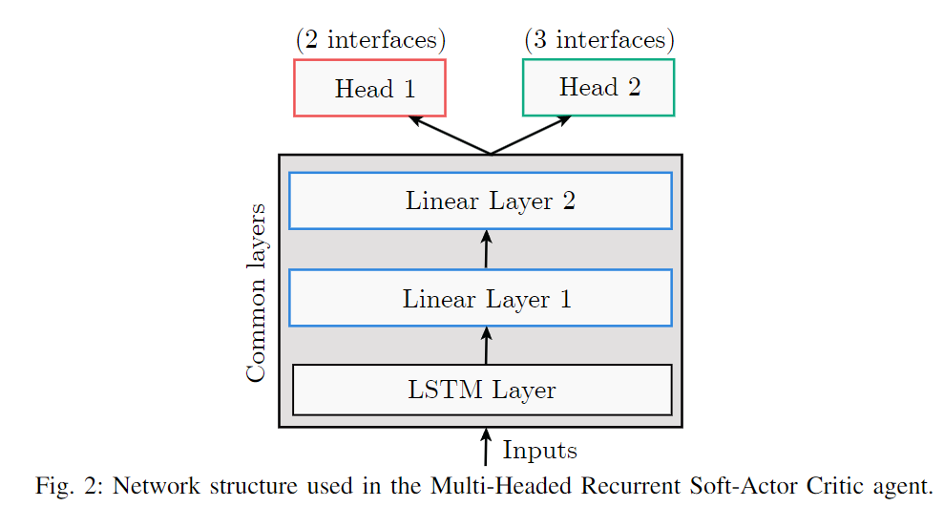

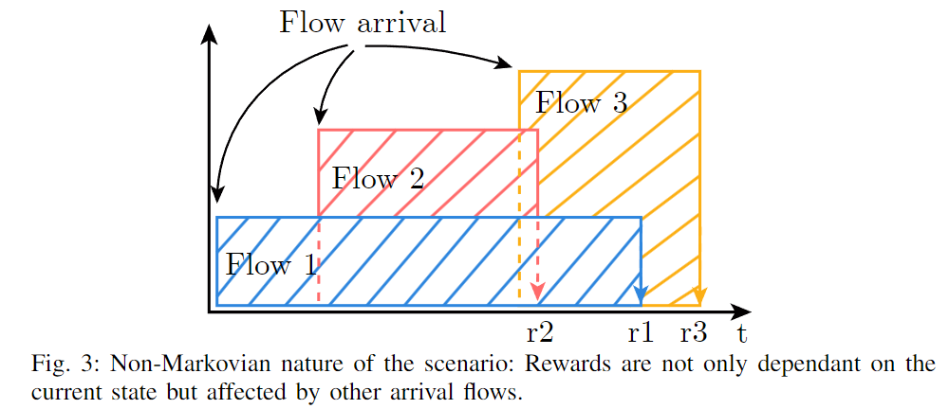
Dealing with Non-Markovian environments in RL
Reinforcement Learning faces some challenges when dealing with non-Markovian environments. The reason is that RL main goal is to maximize the reward given a certain state and action as:
When the previous relationship is not fulfilled due partial observability of the Markovian state, the observation state should include more that one input and utilize a portion of the interaction history.
Notes:
In Fig. 3, we show an example of the non-markovian behavior of our environment. For instance, the reward obtained upon the arrival
of Flow 1, r1 is affected by the arrival of Flow 2. That means that the reward obtained given the action taken upon Flow 1 arrival is
affected as well by the action taken upon FLow 2 arrival as well. Such behavior violates the assumption of being on the presence of an MDP. To solve the beformentioned issue, we include as the first layer of the model’s structure of the MH-RSAC a Long Short-Term
Memory (LSTM) neural network as shown in Fig. 2. In addition, we add two more linear layers after the LSTM layer.

Slide 14
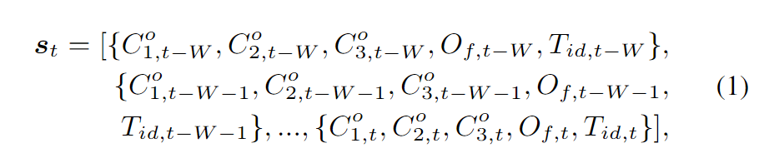
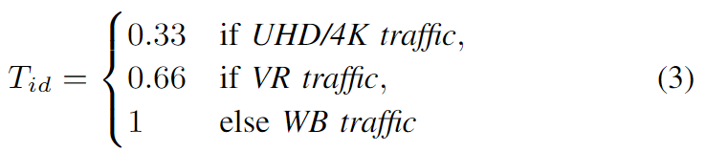

State Space Selection
The environment is modeled as a Partially Observable Markov Decision Process (POMDP), thus a sequence of the observation space is considered instead one instance. The action space is defined as:
Furthermore, we define $O_{f}$ and $T_{id}$ ,respectively as:
where $A_{f}$ corresponds to the number stations receiving traffic flows and $N_{A}$ the number of stations attached to the corresponding AP.

Slide 15
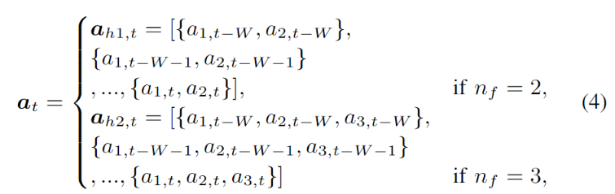
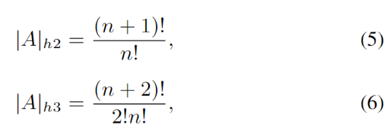
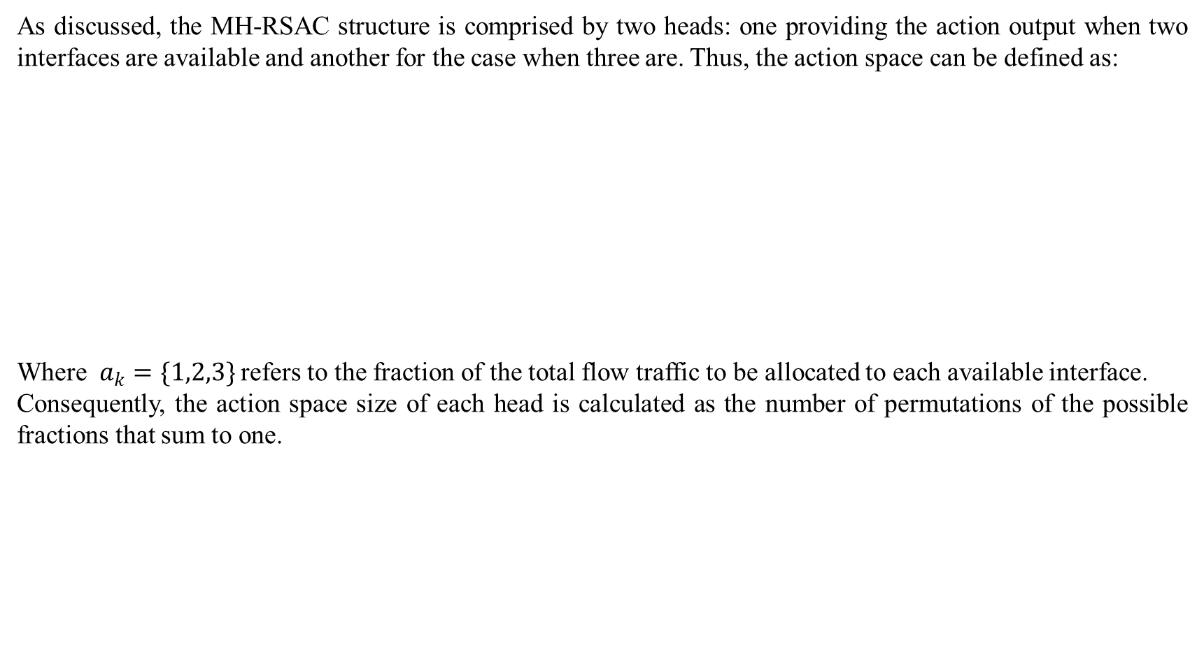
Action Space Selection
As discussed, the MH-RSAC structure is comprised by two heads: one providing the action output when two interfaces are available and another for the case when three are. Thus, the action space can be defined as:
Where $a_{k}=\{1,2,3\}$refers to the fraction of the total flow traffic to be allocated to each available interface.
Consequently, the action space size of each head is calculated as the number of permutations of the possible fractions that sum to one.

Slide 16


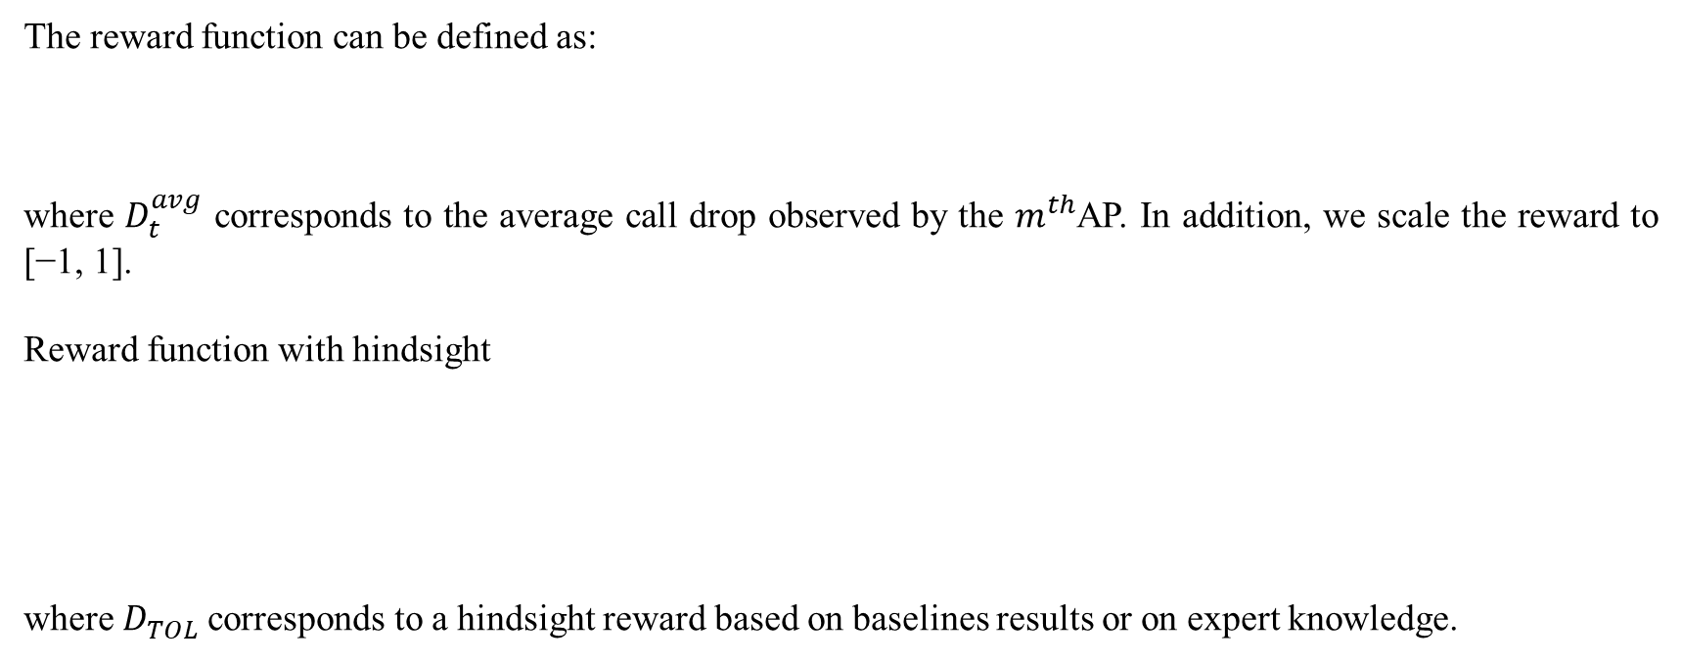
Reward function
The reward function can be defined as:
where $D_{t}^{avg}$ corresponds to the average call drop observed by the $m^{th}$AP. In addition, we scale the reward to [−1, 1].
Reward function with hindsight
where $D_{TOL}^{}$corresponds to a hindsight reward based on baselines results or on expert knowledge.

Slide 17
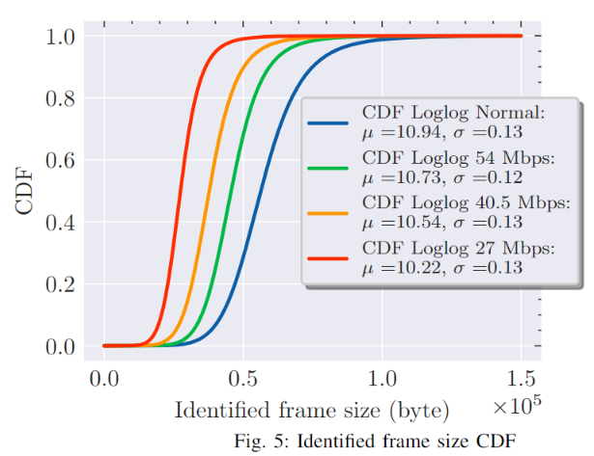
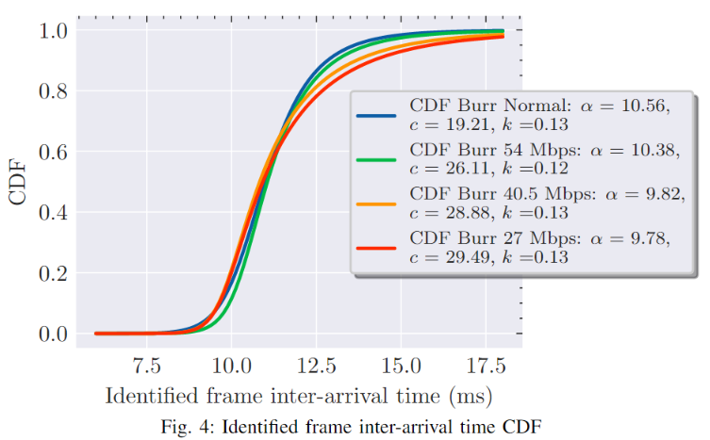
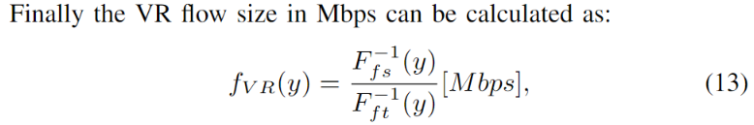

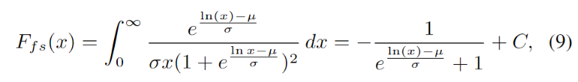


Traffic Considerations
In this work, we utilize a VR cloud server model and derive the Cumulative Distribution Functions (CDF) to be utilized as one of our simulation traffic flows. The derivation of the inverse of the CDF for the frame inter-arrival time and frame size is described below:

Slide 18
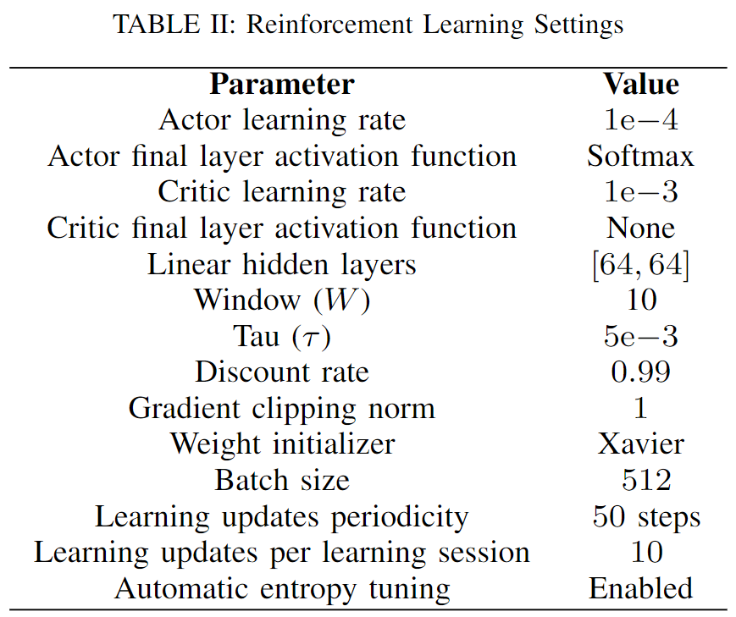
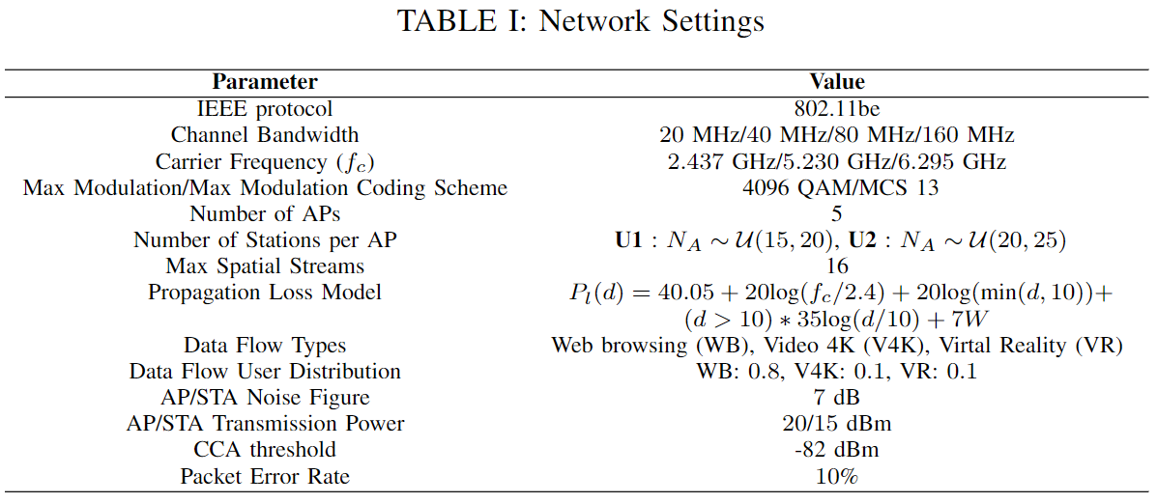
Performance Evaluation
Simulations are performed using the flow-level simulator Neko 802.11be [5] and Pytorch-based RL agents. The communication between the simulator and the RL agents is done using the ZMQ broker library.

Slide 19
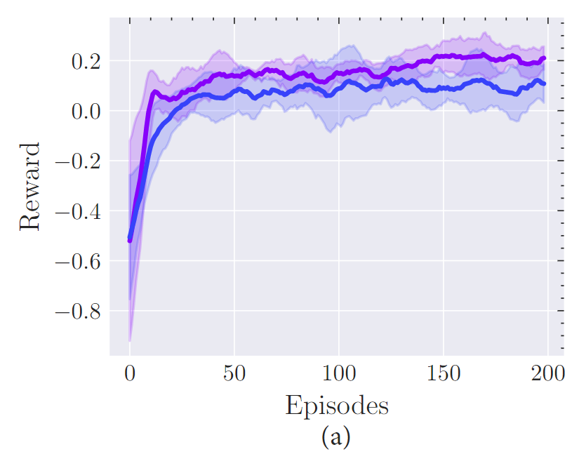
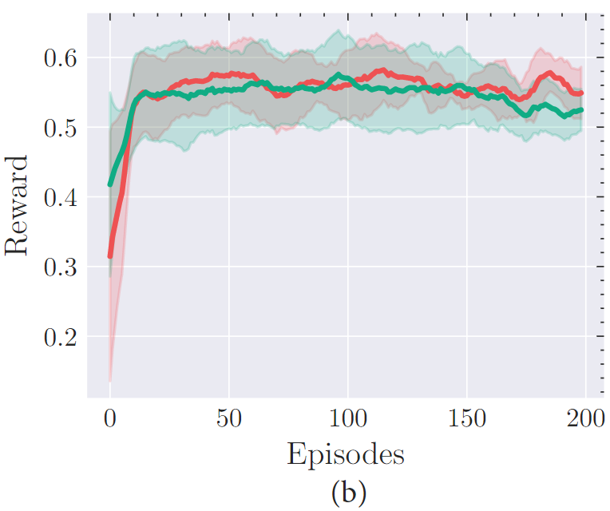
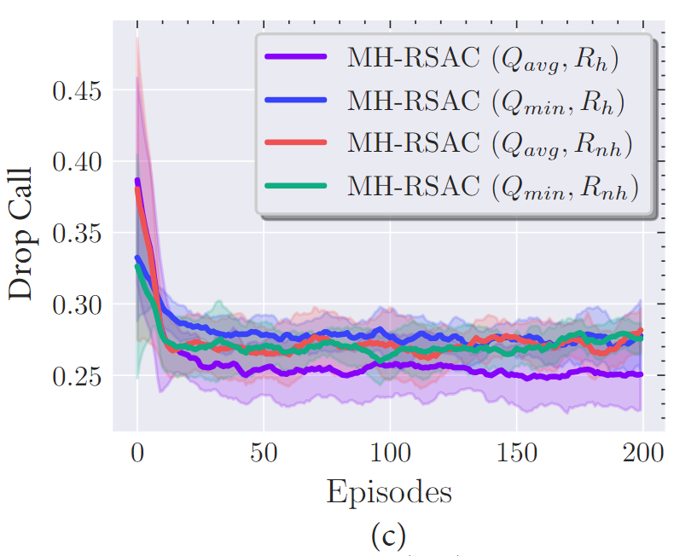
Simulations results
Notes:
We present the performance results of our proposed scheme in terms of convergence, flow satisfaction per interface and Drop Call.
Figure 6 shows the convergence behavior of the U2 scenario for the SAC variants proposed in this work. The figures that depict
the scenario U1 are not shown in this work, as they show similar information. Figure 6 (a) shows how the “avg” operator outperforms
the “min” operator when the reward with hindsight is considered. Conversely, the previous behavior does not repeat when the rewards
without hindsight are utilized as shown in Fig. 6 (b). Finally, we show
the convergence in terms of Drop Call for the four variants in Fig. 6
(c) where the best convergence is achieved when the “avg”operator
with rewards with hindsight are used. The previous results confirm
that the goal rewards strategy proposed in this work affects positively
to the learning process in non-Markovian scenarios.

Slide 20
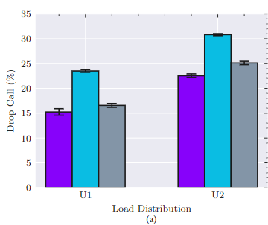
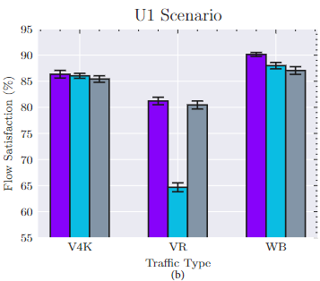
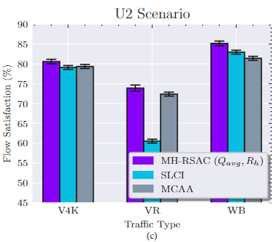
Simulations results

Slide 21
Conclusions
We have presented a Soft-Actor Critic (SAC) Reinforcement Learning (RL) named Multi-Headed Recurrent Soft-Actor Critic (MH-RSAC) that is capable to perform traffic allocation in Multi-Link Operation 802.11be networks:
We have used two main techniques to reduce the non-Markovian behavior of the scenario that involve the usage of Long Short-Term Memory (LSTM) neural networks and rewards with hindsight.
We have compared the proposed RL algorithms in terms of convergence and observed the best performance for the case of the MH-RSAC with “avg” operator and utilization of rewards with hindsight, MH-RSAC (Qavg, Rh).
Results have showed that MH-RSAC (Qavg, Rh) outperforms in terms of TDR the Single Link Less Congested Interface (SLCI) baseline with an average gain of 34.2% and 35.2% and the Multi Link Congestion-aware Load balancing at flow arrivals (MCAA) baseline with 2.5% and 6% in the U1 and U2 proposed scenarios, respectively.
Results have showed an improvement of the MH-RSAC scheme in terms of FS of up to 25.6% and 6% for the SCLI and MCAA, respectively.

Slide 22
Thank you!
Email: pitur008@uottawa.ca

Slide 23
References
[1] P. E. Iturria-Rivera and M. Erol-Kantarci, “Competitive Multi-Agent Load Balancing with Adaptive Policies in Wireless Networks,” in IEEE
19th Annual Consumer Communications & Networking Conference (CCNC), 2022, pp. 796–801.
[2] T. Haarnoja, A. Zhou, P. Abbeel, and S. Levine, “Soft actor-critic: Off policy maximum entropy deep reinforcement learning with a stochastic actor,” in 35th International Conference on Machine Learning (ICML), 2018.
[3] S. Zhao, H. Abou-zeid, R. Atawia, Y. S. K. Manjunath, A. B. Sediq, and X.-P. Zhang, “Virtual Reality Gaming on the Cloud: A Reality Check,” pp. 1–6, 2021.
[4] A. Lopez-Raventos and B. Bellalta, “IEEE 802.11be Multi-Link Operation: When the best could be to use only a single interface,” in 19th
Mediterranean Communication and Computer Networking Conference (MedComNet), 2021.
[5] M. Carrascosa, G. Geraci, E. Knightly, and B. Bellalta, “An Experimental Study of Latency for IEEE 802.11be Multi-link Operation,” in
IEEE International Conference on Communications (ICC), 2022, pp. 2507–2512.
[6] A. Lopez-Raventos and B. Bellalta, “Dynamic Traffic Allocation in IEEE 802.11be Multi-Link WLANs,” IEEE Wirel. Commun. Lett.,
vol. 11, no. 7, pp. 1404–1408, 2022.
[7] M. Yang and B. Li, “Survey and Perspective on Extremely High Throughput (EHT) WLAN — IEEE 802.11be,” Mobile Networks and
Applications, 2020.
[8] M. Carrascosa-Zamacois, G. Geraci, L. Galati-Giordano, A. Jonsson, and B. Bellalta, “Understanding Multi-link Operation in Wi-Fi 7:
Performance, Anomalies, and Solutions,” 2022. [Online]. Available: https://arxiv.org/abs/2210.07695
[9] S. Fujimoto, H. Van Hoof, and D. Meger, “Addressing Function Approximation Error in Actor-Critic Methods,” in 35th International Conference on Machine Learning (ICML), 2018.
[10] H. Zhou, Z. Lin, J. Li, D. Ye, Q. Fu, and W. Yang, “Revisiting Discrete Soft Actor-Critic,” 2022. [Online]. Available: https://arxiv.org/abs/2209.

