Slide 1
Latency Consideration of Industrial Scenarios
Date: 2023-XX-XX
Authors:
Name | Affiliations | Address | Phone | Email
Yue Xu | Huawei | Huawei Nanjing R&D Institute, Nanjing, Jiangsu, China, 210012 |  | xuyue57@Huawei.com
Chenhe Ji
Chun Pan
Xiaofei Bai

Slide 2
Introduction
Latency is one of the most important guiding criteria in the UHR (Ultra High Reliability) SG. The industrial scenario is one of the most comprehensive scenarios when considering WLAN.
This presentation introduces a gap between latency performance in the document of UHR SG (e.g., PAR) and the requirements in real industrial scenarios. It also provides an example to illustrate it.
In this contribution, we suggest to provide information to make the latency definition, especially in industrial scenarios, clearer and also shrink the gap.

Slide 3
Background
The approved UHR SG PAR intends to consider, compared to EHT MAC/PHY operation, at least one mode of operation that is capable of [1] :
- Throughput enhancements
- Reducing latency
- Increased reliability of WLAN connectivity
- Increased manageability and mobility support
- Increased performance in congested environments
- Power savings enhancements
There are several use cases of industrial scenarios discussed in [2] [3] ,
AGV (Automated Ground Vehicle) / AMR (Autonomous Mobile Robot) | Involving communication, including guidance control, process data exchange, video/image, and emergency stop, between robots and a control system,
Sensors | Periodical report of information to the control system. High-density deployment environment.
Robot/drone motion control | Remote operation with haptics communication, programmed robot operation with emergency stop.
Video transfer | High-definition video transferring from cameras.
AR/VR/XR | Walk-by health monitoring, combining video feed with overlaid contextual information.
Assembly line | Combination of AGV/AMR, sensors, robot/drone motion control, and video transfer.

Slide 4
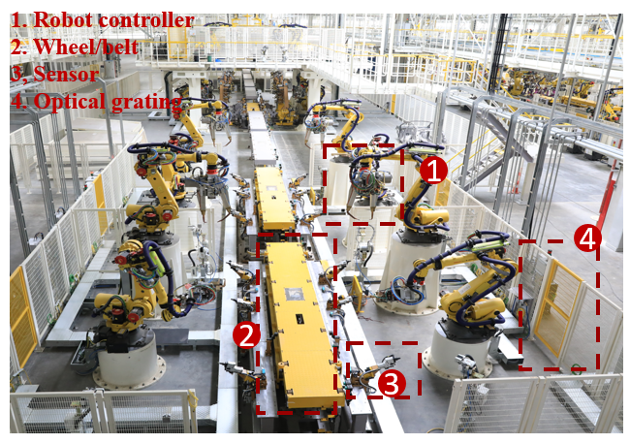
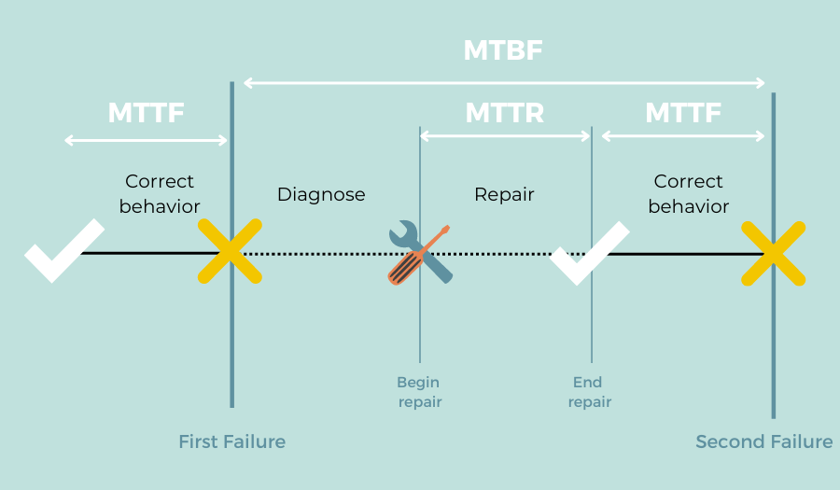
Gap Analysis (latency aspect)
UHR SG Setting
v.s.
Real Need
Distinctiveness - Reliability & Availability
MTTR vs. MTBF vs. MTTF
Use case | Latency | Reliability | Mobility
AGV | 100ms | 99.99% | √
RFID | 100ms | 99.99% | -
PLC to MES | 100ms | 99.99% | -
PLC to IO | 8ms | 99.999% | -
MTTR (MEAN TIME TO REPAIR)
MTBF (MEAN TIME BETWEEN FAILURES)
MTTF (MEAN TIME TO FAILURE)
The current definitions in the PAR, define low latency requirements (Section 5.2b, Section 5.5).
This presentation shows more detail about latency performance from industry.

Slide 5
Example of Industrial Requirements in WLAN
Original requirements from industrial WLAN
Parameter and metric | Value | Remarks
Production time（T） | 5000H/year
MTTR（diagnose + repair） | 3min | If the watchdog period is exceeded, the device will send alarm. Some accidents need human intervention, and some trigger automatic recovery function. Usually human intervention method needs 3 minutes to recover
Number of CPE per AP | 20 | from customer
Total number of CPE (N) | 2000 | 4w square meter，100AP
Watchdog timer (3* send cycle) | 24ms | Watch dog timer =send cycle*3
Latency and reliability requirement of wireless network from application side | 24ms@12 nines (3 * 8ms) | 5000 hour * 60min * 60 sec * 1000ms *2000 CPE /8ms = 4.5e12 (Under specific MCS setting. It is not mandatory that any MCS must meet the requirements of 99.99%. )
PHY layer requirement | 99.99% (3 Tx times) | 1-(1/4.5e12)^(1/3) = 0.9999 (The parameters here are for a single transmission opportunity. No interference or conflict, retransmissions, like HARQ, are not considered. No uncontrolled STAs.)
Although the UHR SG states specific performance improvement objectives/plans/requirements/indicators for Latency and Reliability, there is a gap between these indicators (or guidance) and a real scenario.

Slide 6
Target Consideration for UHR Latency in Industrial Scenarios
Wireless latency requirements/bounds are diverse in WLAN environments.
Especially in industrial scenarios, the performance of latency is higher and more stable.
Understanding that the PAR has already been submitted to IEEE SASB for approval that any update may be challenging, the UHG SG (and the future TGbn) may consider the following latency requirement during the development of functional requirements and specification framework (for example):
- WLAN devices need to reach the latency requirements in feature scenarios. Especially in industrial scenarios, low latency requirements should achieve the range of 1ms to 10ms (unidirectional link-level) with at least 99.99% reliability.’

Slide 7
Summary
We compare the statements of latency in the UHR SG official document (e.g., PAR) with the requirements of real industrial scenarios, and point out the differences.
The addition of some scenario examples to improve accuracy are suggested.

Slide 8
References
[1] UHR proposed PAR, IEEE 802.11-23/480
[2] “Wi-Fi 6/6E for Industrial IoT,” WBA (Wireless Broadband Alliance), May 2018.
[3] Consideration of Industrial Automation Scenarios, IEEE 802.11-23/0815

