Slide 1
Multi-AP for reliability with Coherent and Non-coherent transmissions
Authors:
Name | Affiliation | Address | Phone | Email
Yun Chen | Huawei Technologies |  |  | chenyun66@huawei.com
Yanchun Li |  |  |  | liyanchun@huawei.com
Ross Jian Yu |  |  |  | ross.yujian@huawei.com

Slide 2
Introduction
Multi-AP coordination was proposed in several contributions to meet UHR goals defined in PAR.
Joint transmission (JT) has been extensively discussed as a candidate technology of MAP due to its high gains.
  Grouping together multiple APs as a virtue ‘big’ AP with large number of antennas and high degrees of freedom to provide substantial gains.
Presentations so far have mainly focused on Coherent JT
In this contribution, we introduce the principle of Non-Coherent JT

Slide 3
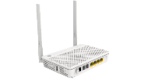



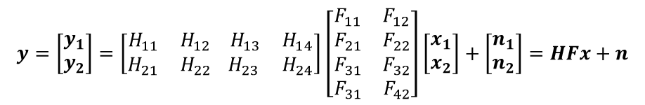



Coherent Joint Transmission Principle
A virtual ‘big’ AP constituting of multiple APs with large number of antennas and high degrees of freedom to perform beamforming to improve the throughput and to reduce inter-STA interference.
System transmission model
  Suppose 2 APs each with 2 antennas performance JT to transmit 2 data streams to 2 single-antenna STAs
  The received signal y can be written as follow:
  where H is the channel, F denotes the precoder, and n is the noise.
Main-AP
Virtual ‘big’ AP
$$⋯$$
AP #1
AP #2
AP #K
$$y=\left[\begin{matrix}y_{1} \\ y_{2}\end{matrix}\right]=\left[\begin{matrix}H_{11} & H_{12} \\ H_{21} & H_{22}\end{matrix} \begin{matrix}{ H}_{13} & H_{14} \\ H_{23} & H_{24}\end{matrix}\right]\left[\begin{aligned}\begin{matrix}F_{11} & F_{12} \\ F_{21} & F_{22}\end{matrix} \\ \begin{matrix}F_{31} & F_{32} \\ F_{31} & F_{42}\end{matrix}\end{aligned}\right]\left[\begin{matrix}x_{1} \\ x_{2}\end{matrix}\right]+\left[\begin{matrix}n_{1} \\ n_{2}\end{matrix}\right]=HFx+n$$
STA #1
STA #2
$$H_{AP1}$$
$$H_{AP2}$$
Notes:
Main AP
Secondary Ap

Slide 4
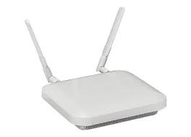

Coherent Joint Transmission Scenarios
The following possible scenarios were discussed in [1]
Scenario #1 Scenario #2
Both scenarios have one “Main AP” (AP1) acting as the AP coordinator which can be heard by all other SAPs (“Secondary APs”)
CSI and data sharing at time T1
Joint transmission at time T2
Data frame
Data frame
Data frame at T1
AP2
at T1
AP2
at T2
Data frame
AP1
AP1
at T2
Data frame
Data frame
STA
Data frame at T2
AP3
STA
Notes:
[x] Consideration on multi-AP coordination for EHT, IEEE 802.11-18/1982r0

Slide 5


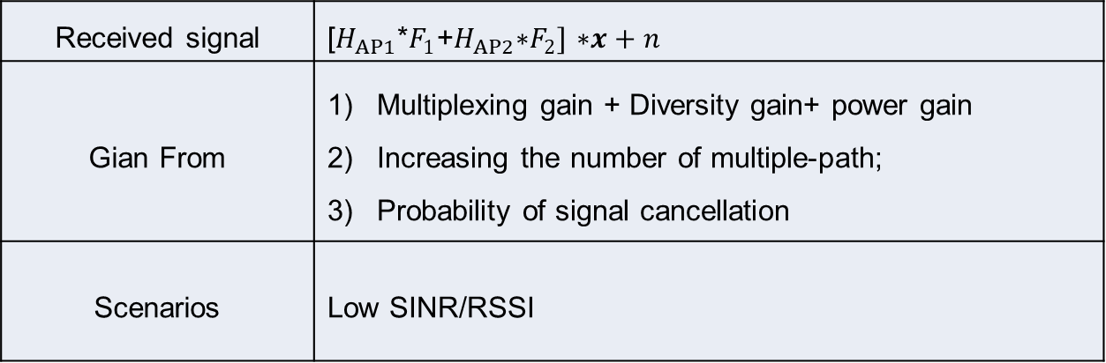


Non-coherent transmission(1)--
Diversity Mode
$$F_{1}$$
$$F_{2}$$
Diversity
All date frames
All date frames
SAP1
SAP2
Received signal | [$H_{AP1}$*$F_{1}$+$H_{AP2}\text{∗}F_{2}]$ $\text{∗}x+n$
Gian From | Multiplexing gain + Diversity gain+ power gain Increasing the number of multiple-path; Probability of signal cancellation
Scenarios | Low SINR/RSSI
Notes:
STA测 联合均衡
, space division multiplexing gain

Slide 6
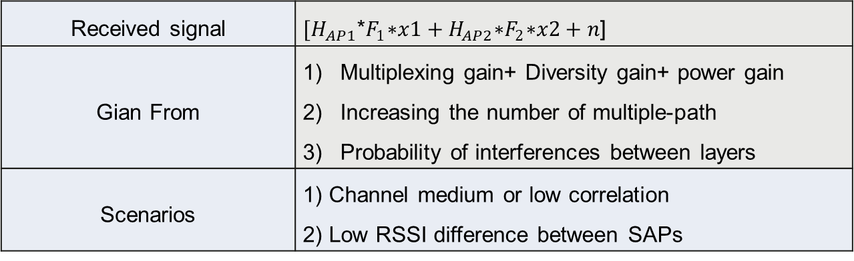


Non-coherent transmission(2)--
Multiplexing mode
$$F_{1}$$
Multiplexing
$$F_{2}$$
Data frame Layer2
Data frame Layer1
SAP1
SAP2
Received signal | ${[H}_{AP1}$*$F_{1}\text{∗}x1+H_{AP2}\text{∗}F_{2}\text{∗}x2+n$]
Gian From | Multiplexing gain+ Diversity gain+ power gain Increasing the number of multiple-path Probability of interferences between layers
Scenarios | 1) Channel medium or low correlation 2) Low RSSI difference between SAPs
Notes:
STA测 单独均衡

Slide 7
Coherent Joint Transmission Protocol
Adapted from [1]
JTA frame backhaul transmission
  Identifying secondary APs participating in joint transmission
Joint Sounding between SAPs
Data frame backhaul transmission
  Data sharing to all SAPs
Joint Transmission Trigger frame “announces” the joint transmission
  Synch. among SAPs
  Estimate CFO, SFO
Joint transmission by SAPs to STAs
Primary-AP
Secondary-AP1
S-AP2
STA1
STA2
JTA frame
All Data frame
All Data frame
JT Trigger frame
Data frame using joint transmission
Notes:
[x] Consideration on multi-AP coordination for EHT, IEEE 802.11-18/1982r0

Slide 8
Non-Coherent Joint Transmission Protocol
Primary-AP
Secondary-AP1
S-AP2
STA1
STA2
Duplicate Multi-Point
JTA frame backhaul transmission
  Identifying secondary APs participating in joint transmission
Data frame backhaul transmission
  Data sharing to all SAPs
No need Joint-sounding and CSI sharing
No need strict Synch. among SAPs
STA can handle SAP’s residual CFO
  “11ax-midambles can be used in the jointly steered packet to offset the impact of residual CFO”[2]
JTA frame
All Data frame
All Data frame
JT Trigger frame
Data frame using joint transmission
Notes:
[x] Consideration on multi-AP coordination for EHT, IEEE 802.11-18/1982r0

Slide 9
Non-Coherent Joint Transmission Protocol
Primary-AP
Secondary-AP1
S-AP2
STA1
STA2
Symmetry Multi-Point
JTA frame backhaul transmission
  Identifying secondary APs participating in joint transmission
No need Joint-sounding and CSI sharing
No need data sharing between SAPs
No need strict Synch. among SAPs
JTA frame
Data frame Layer1
Data frame Layer2
JT Trigger frame
Data frame using joint transmission
Notes:
[x] Consideration on multi-AP coordination for EHT, IEEE 802.11-18/1982r0

Slide 10





Comparison among various JT schemes
Coherent Joint Transmission
Non-Coherent Joint Transmission
Diversity-mode
Non-Coherent Joint Transmission
Multiplexing-mode
Primary-AP
Primary-AP
Primary-AP
Without data sharing:
- Bit stream 1 and 2 can contain separate MPDUs;
Or, with data sharing:
- Split bits from same PPDU into two bit streams
Copies of Bit stream
Bit stream1
Bit stream2
Copies of Bit stream
S-AP1
S-AP2
S-AP1
S-AP2
Secondary-AP1
S-AP2
$$y=\left[\begin{matrix}H_{11} & H_{12}\end{matrix}\right]\left[\begin{matrix}F_{11} & 0 \\ 0 & F_{22}e^{jθ\left(t\right)}\end{matrix}\right]\left[\begin{matrix}x_{1} \\ x_{1}\left(e^{jfτ}\right)\end{matrix}\right]+\left[\begin{matrix}n_{1} \\ n_{2}\end{matrix}\right]$$
$$y=\left[\begin{matrix}H_{11} & H_{12}e^{jθ\left(t\right)}\end{matrix}\right]\left[\begin{matrix}F_{11} & 0 \\ 0 & F_{22}\end{matrix}\right]\left[\begin{matrix}x_{1} \\ x_{2}\end{matrix}\right]+\left[\begin{matrix}n_{1} \\ n_{2}\end{matrix}\right]$$
$$y=\left[\begin{matrix}H_{11} & H_{12}\end{matrix}\right]\left[\begin{matrix}F_{11} & F_{12} \\ F_{21} & F_{22}\end{matrix}\right]\left[\begin{matrix}x_{1} \\ x_{2}\end{matrix}\right]+\left[\begin{matrix}n_{1} \\ n_{2}\end{matrix}\right]$$
Use CSD or STBC to construct non-coherent waveform
$$H_{11},H_{12}∈ℂ^{N_{r}×N_{t}}$$
$$F_{11},F_{12},F_{21},F_{22}∈ℂ^{N_{t}×N_{s}}$$
 | Joint-sounding | CSI sharing | Data sharing | Synchronization
Coherent JT | Y | Y | Y | High (Phase-level)
Diversity Mode | N | N | Y | Low (Symbol-level)
Multiplexing Mode | N | N | Optional | Low (Symbol-level)

Slide 11
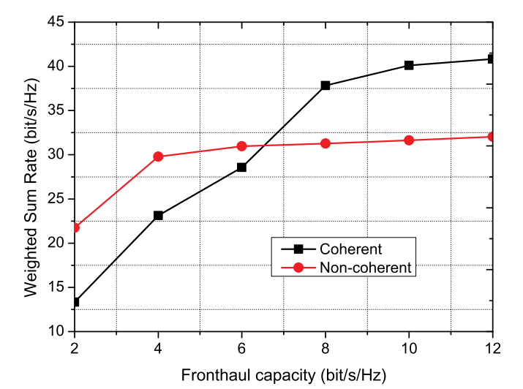
Coherent vs Non-Coherent JT
In the low fronthaul capacity regime, only a limited number of STAs can be supported by the coherent JT[1]
Channel bandwidth B = 20 MHz, the number of transmit antennas of M = 2, 14 APs, 10 STAs

Slide 12
Conclusions
In this contribution, we introduced the principle of coherent/non-coherent Joint Transmission
We consider that Joint Transmission is crucial for UHR reliable transmissions. Non-coherent JT has lower requirement in implementation
  non-coherent Joint Transmission has less information sharing requirement
  non-coherent Joint Transmission has no need strict Synch. among SAPs
We would like to see if people are interested at this candidate JT option for 11bn.

Slide 13
Straw Poll
Are you interested in NC-JT for 11bn
  Yes
  No
  Need more information

Slide 14
Reference
[1] C. Pan, H. Ren, M. Elkashlan, A. Nallanathan and L. Hanzo, "The Non-Coherent Ultra-Dense C-RAN Is Capable of Outperforming Its Coherent Counterpart at a Limited Fronthaul Capacity," in IEEE Journal on Selected Areas in Communications, vol. 36, no. 11, pp. 2549-2560, Nov. 2018, doi: 10.1109/JSAC.2018.2874138.
[2] https://mentor.ieee.org/802.11/dcn/19/11-19-1094-00-00be-joint-bf-simulations.pptx

Slide 15




Appendix: Non-Coherent Joint Transmission (Multiplexing Mode) vs. Co-BF
Non-Coherent Joint Transmission
Multiplexing Mode
Co-BF
Primary-AP
Primary-AP
(e.g. reuse multi-RU interleaver)
STA1’s Bit stream1
STA1’s Bit stream2
STA1’s Bit stream
STA2’s Bit stream
Secondary-AP1
Secondary-AP2
S-AP1
S-AP2
$$y=\left[\begin{matrix}H_{11} & H_{12}e^{jθ\left(t\right)}\end{matrix}\right]\left[\begin{matrix}F_{11} & 0 \\ 0 & F_{22}\end{matrix}\right]\left[\begin{matrix}x_{1} \\ x_{2}\end{matrix}\right]+\left[\begin{matrix}n_{1} \\ n_{2}\end{matrix}\right]$$
$$y=\left[\begin{matrix}H_{11} & H_{12}e^{jθ\left(t\right)}\end{matrix}\right]\left[\begin{matrix}F_{11} & 0 \\ 0 & F_{22}\end{matrix}\right]\left[\begin{matrix}x_{1} \\ x_{2}\end{matrix}\right]+\left[\begin{matrix}n_{1} \\ n_{2}\end{matrix}\right]$$
STA1
STA1
STA2
$x_{1}$ and $x_{2}$ are both for STA1
Small difference
$x_{1}$ and $x_{2}$ are for STA1 and STA2, respectively.

Slide 16

Appendix: Complexity Analysis
Non-Coherent Joint Transmission
Multiplexing-mode
SU MIMO
UL MU MIMO
M-AP
(e.g. reuse multi-RU interleaver)
Bit stream1
Bit stream2
S-AP1
S-AP2
$$y=\left[\begin{matrix}H_{11} & H_{12}e^{jθ\left(t\right)}\end{matrix}\right]\left[\begin{matrix}F_{11} & 0 \\ 0 & F_{22}\end{matrix}\right]\left[\begin{matrix}x_{1} \\ x_{2}\end{matrix}\right]+\left[\begin{matrix}n_{1} \\ n_{2}\end{matrix}\right]$$
STA receives multi-spatial stream PPDU.
STA perform per-AP phase tracking.
STA does not need to run scheduling algorithm and has low complexity
STA receives multi-spatial stream PPDU.
STA perform single-AP phase tracking.
STA does not need to run scheduling algorithm and has low complexity
STA receives multi-spatial stream PPDU.
STA perform per-AP phase tracking.
AP needs to run scheduling algorithm and has low complexity
Similar to SU MIMO Rx

