Slide 1
Summary of AMP SG
September 2023
Doc.: IEEE 802.11-23/1529r0
Date: 2023-09-11
Authors:
Name | Affiliation | Address | Phone | Email
Yinan Qi | OPPO |  |  | v-qiyinan@oppo.com
Weijie Xu |  |  |  | xuweijie@oppo.com

Slide 2
Abstract
Doc.: IEEE 802.11-23/1529r0
The aim of this presentation is to provide a comprehensive overview of the progress of AMP SG, covering below aspects
Requirements
Deployment topologies
Operation modes
Coexistence

Slide 3
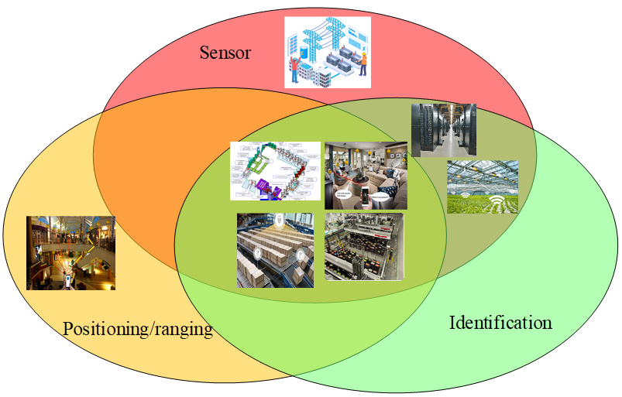
September 2023
Doc.: IEEE 802.11-23/1529r0
Use Cases
Use cases have been proposed in [1]
UC1 Smart manufacturing: inventory, asset tracking/positioning, and environment/production line sensing and monitoring
UC2 Data Center: environmental monitoring, facility monitoring and asset management
UC3 Smart home: asset management, home environment monitoring and home security.
UC4 Logistics and warehouse: goods tracking and inventory check
UC5 Smart agriculture: monitoring of soil moisture, soil fertility, temperature, wind speed, plant growth etc., and controlling of the agricultural facilities
UC6 Indoor positioning: positioning in giant shopping mall, factories, warehouses, etc.
UC7 Smart Power Grid: sensing of sound, heat, pressure, etc., smart meter to achieve awareness of device/equipment status
UC8 Fresh Food supply chain: Route the RTI, sense temperature etc.
Use case categories
Categories | Sensor | Positioning/ranging | Identification
UCs | UC#1、UC#2、UC#3、UC#4、UC#5、UC#7、UC#8 | UC#1、UC#3、UC#4、UC#6、UC#8 | UC#1、UC#2、UC#3、UC#4、UC#5、UC#8
Slide 3
Yinan Qi (OPPO)

Slide 4
September 2023
Doc.: IEEE 802.11-23/1529r0
Requirements [2]-[4]
 | Coverage (dBm) | Maximum payload size (bit) | Peak device power consumption (mWatts) | Device density (per m²) | Horizontal Positioning accuracy (m) | Peak data rate (Kbps) | Others
UC1: Smart Manufacturing | Type1: -30 Type2: -82 | 256 | 1 | Baseline: 1.5 Optional: TBD | 3 | 51.2 kbps
UC2: Data Centre | Type1: -30 Type2: -82 | 256 | 1 | 3 | 1-3 | 51.2 kbps
UC3: Smart Home | Type1: -30 Type2: -82 | 256 | 1 | 0.25 | 1-3 | 51.2 kbps
UC4: Logistics and Warehouse | Type1: -30 Type2: -82 | 256 | 1 | Baseline: 1.5 Optional: TBD | 3 | 51.2 kbps
UC5: Smart Agriculture | Type1: -30 Type2: -82 | 256 | 1 | 1 | 10 | 51.2 kbps
UC6: Indoor Positioning | Type1: -30 Type2: -82 | 256 | 1 | 0.25 | 1-3 | 51.2 kbps
UC7: Smart Power Grid | Type1: -30 Type2: -82 | 256 | 1 | 10⁻² | 10 | 51.2 kbps
UC8: Fresh Food Supply Chain | Type1: -30 Type2: -82 | 256 | 1 | Baseline: 1.5 Optional: TBD | 3 | 51.2 kbps
Note 1: Coverage is calculated based on AWGN Channel Note 2: Type 1: RF powered AMP device; Type 2: non-RF powered AMP device, e.g., thermal, solar, etc. Note 3: Others include requirements only applicable to a subset of use cases Note 4: Some use cases, e.g., UC4, may need higher device density in certain scenarios Note 5: The proposed peak data rate is only the minimum peak data rate, higher peak data rate can be considered, .e.g., 250kbps, 1Mbps.
Slide 4
Yinan Qi (OPPO)

Slide 5
September 2023
Doc.: IEEE 802.11-23/1529r0
Traffic Characteristics
AMP communication has the following traffic characteristics:
Very small payload such as ID or sensor data, typically ranging from 96~256 bits
Extremely low duty cycle for most of the typical use cases
The traffic interval typically ranges from tens of minutes (e.g. 15min) to several hours or even days
High frequency traffic (e.g. in some use cases such as logistics) is normally isolated and constrained within a specific region, e.g., factory, warehouse, etc., and AMP traffic will be the dominant service traffic in such isolated area.
Extremely low channel occupation as analysed in [5] and aggregated channel occupancy percentage is less than 0.5%.
Slide 5
Yinan Qi (OPPO)

Slide 6
September 2023
Doc.: IEEE 802.11-23/1529r0
Device Constraints [6]
Limited power
Very low power density of Ambient powers, ranges from x uW to x mW
Limited energy storage
Small capacitor for RF energy harvester (nJ-uJ)
Actual devices are usually less efficient and energy consumption of 30 nJ is reasonable
Low complexity
Low-complexity frequency generation needs to be supported
It is proposed to support calibrated clock accuracy of 40 ppm
To reduce the power consumption and the complexity, it is expected to support AMP STA that has an oscillator with an accuracy of 1000 ppm
Even lower accuracy clock can be used for idle time
Low complexity transceiver
WUR-like receiver
Ultra-low complexity transmitter
Limited memory and limited power budget for the memory
Slide 6
Yinan Qi (OPPO)
Notes:
802.11-23/1140r0

Slide 7
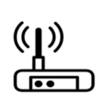
September 2023
Doc.: IEEE 802.11-23/ 1529r0
Topology 1: Direct AMP communication
AMP DL
AP
AMP STA
AMP UL
RF power transfer (Optionally)
The AMP STA communicates directly with the AP [7]
RF power transfer can be provided by the AP
Not necessarily if other ambient power is used
Slide 7
Yinan Qi (OPPO)

Slide 8
September 2023
Doc.: IEEE 802.11-23/1529r0
Topology 2: Direct AMP communication with assisting Node
RF power transfer/Wake-up etc.
AMP DL
AP
Assisting Node
AMP UL
AMP STA
The AMP STA communicates directly with the AP [7]-[8]
Using AMP new interface or legacy interface, e.g., 802.11b/n, etc.
An assisting node can:
Provide RF power for the AMP STA
The power RF power transfer link can be at same or different frequency with the communication link
Send wake-up signal to the AMP STA
Slide 8
Yinan Qi (OPPO)

Slide 9
September 2023
Doc.: IEEE 802.11-23/1529r0
Topology 3: Direct AMP communication with relay Node
Relay Node
DL
AMP DL
AP
AMP UL
AMP STA
UL
RF power transfer/Wake-up etc.
A relay node communicates directly with AMP STA and then forwards the data to the AP [8]
An AMP interface or legacy interface can be used between the relay node and the AMP STA
The relay node can provide RF power for the AMP STA
The power RF power transfer link can be at same or different frequency with the communication link
Slide 9
Yinan Qi (OPPO)

Slide 10
September 2023
Doc.: IEEE 802.11-23/1529r0
Operation Mode @ Sub-1 GHz
Both DL and UL communication in sub-1 GHz:
DL air-interface: new air-interface with WUR-like design (i.e. MC-OOK) with scaling, e.g., SCS 312.5kHz → 31.25kHz, OFDM symbol duration 4us → 40us, etc.
UL air-interface: new air-interface with OOK/FSK/PSK
RF power transfer (when RF power is used)
Fixed AP or mobile AP, e.g., cell phone, as RF energy source
Same S1G band as communication link
Assisted Node can be optionally deployed for additional power source
Slide 10
Yinan Qi (OPPO)

Slide 11
September 2023
Doc.: IEEE 802.11-23/1529r0
Operation Modes @2.4GHz
Two modes of operation@2.4GHz have been discussed.
Mode 1: Both DL and UL communication in 2.4GHz: e.g. WUR(DL)+DSSS(UL) [7]
DL air-interface: Reuse WUR design as much as possible
UL air-interface: DSSS for backward compatibility
E.g., DPBSK, 1Mbps
RF power transfer in other frequency band(e.g. Sub-1 GHz) or Energy harvesting can be up to implementation (if other ambient power is used)
Mode 2: AMP STA compatible to existing WiFi network [8]
The AMP STA is able to communicate with the AP with existing technology e.g. 802.11b/n.
AMP client STA can use a power optimized transceiver and operates in low duty cycle to communicate with existing AP.
Adding DL wake-up receiver (similar to 11ba) can further reduce the power consumption and reduce the DL response latency.
Slide 11
Yinan Qi (OPPO)

Slide 12
September 2023
Doc.: IEEE 802.11-23/1529r0
Benefits of AMP operation@2.4GHz
A unified frequency band all over the world is beneficial to reduce the cost of AMP device via leveraging of market scale effect.
It is also beneficial to support AMP application that may need to operate across different countries and regions.
E.g. international logistics, supply chain management, personal belongings tracking etc.
For both Mode 1 and Mode 2, it is possible to reuse the hardware of the existing AP since no new PHY waveform is introduced.
In addition, it is possible to support AMP service by leveraging usage of the existing WiFi infrastructures in Mode 2.
Slide 12
Yinan Qi (OPPO)

Slide 13
September 2023
Doc.: IEEE 802.11-23/1529r0
Coexistence (1)
Comparing to other technologies, 802.11 AMP technology can better co-exist with existing .11 devices
It is an obvious trend to develop AMP technology in different standard organizations.
Some Ambient IoT tehcnologies@2.4GHz have already been developed to fulfill the urgent market need.
Developing AMP technologies with 802.11 that can well coexisted with existing 802.11 devices greatly benefit the whole 802.11 ecosystem
AMP AP can provide protection for AMP client transmission and coexists well with existing .11 devices
E.g. legacy preamble, TXOP sharing with client, etc.
Flexibly scheduling of AMP traffic based on the channel condition in a controllable manner
Slide 13
Yinan Qi (OPPO)

Slide 14
September 2023
Doc.: IEEE 802.11-23/1529r0
Coexistence (2)
AMP client has a much smaller interference footprint comparing to typical 802.11 and other technology device operated in 2.4GHz band
Transmission time and power is highly constrained by harvested energy.
The harvested power from wireless power transfer is likely in the order of several uWs or tens of uW
Even at the very low transmission power of -25dBm, the active Tx consumes power in the order of several mW
Due to the energy limitation, AMP client has to operate at very low duty cycle (e.g., <1%)
Low transmission power also limit the effective interference range
Leverage waveform from existing technology like MC-OOK, DSSS, etc.
Slide 14
Yinan Qi (OPPO)

Slide 15
September 2023
Doc.: IEEE 802.11-23/1529r0
Summary
Progress of SG has been provided covering requirements, topology, operation mode and coexistence.
Work of SG has completed and TG should be setup to further study and standardization.
Slide 15
Yinan Qi (OPPO)

Slide 16
Reference
September 2023
Doc.: IEEE 802.11-23/1529r0
IEEE 802.11-23/0436r8, Technical Report on support of AMP IoT devices in WLAN
IEEE 802.11-23/1005r0, Discussion on Requirements for AMP Use Cases
IEEE 802.11-23/1063r0, Further Discussion on Requirements for AMP Use Cases
IEEE 802.11-23/1073r0, Device Density in Logistics
IEEE 802.11-23/1354r0, AMP Device Channel Occupancy Analysis
IEEE 802.11-23/1140r0, Considerations for AMP Devices
IEEE 802.11-23/1190r4, Further Discussion on AMP PAR
IEEE 802.11-23/1195r0, Thoughts on AMP IOT and PAR

