Slide 1
AMP Use Case in Smart Photovoltaics
September 2023
Date: 2023-09-09
Authors:
Name | Affiliation | Address | Phone | Email
Shuqiao Chen | Huawei |  |  | chenshuqiao1@huawei.com
Lei Huang
Rojan Chitrakar
Ying Li
Bin Qian
Zhi Mao
Wei Lin
David Xun Yang

Slide 2
Background
September 2023
Following use cases have been previously discussed and captured in AMP draft technical report [1][2]:
  Smart manufacturing
  Data centre
  Smart home
  Logistics and warehouse
  Smart agriculture
  Indoor positioning
  Smart Grid
  Fresh Food Supply Chain
In this contribution, we propose a new AMP use case:
  Smart photovoltaics (PV)

Slide 3
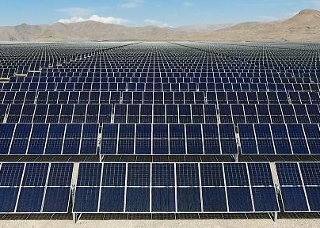
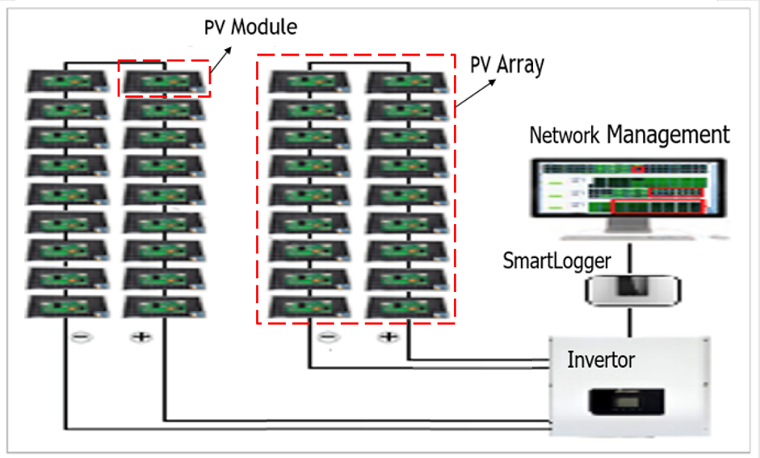
PV Module Positioning in Industrial and Commercial Scenarios
September 2023
Challenges Faced by Large-Scale Smart PV Deployment
  Faults of PV modules affect the power generation efficiency and life cycle of the system, and may also cause serious accidents such as fire and electric shock. Therefore, troubleshooting and positioning are critical issues for operation and maintenance.
  There are a great number of PV modules in a power plant thus the deployment area is huge, which makes it difficult to accurately locate the faulty PV modules.
PV Module
PV Array

Slide 4
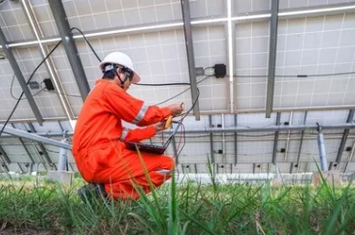
PV Module Positioning in Industrial and Commercial Scenarios
September 2023
Conventional scheme
  Invertor detection: can only achieve array-level fault detection and faulty modules cannot be accurately located.
  Manual module-to-module detection: time-consuming and labor-intensive
Desired scheme: fully automated PV module-level troubleshooting and positioning

Slide 5




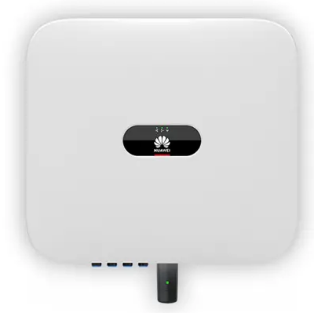
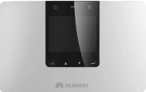
AMP Use Case: Smart Photovoltaics(1/2)
September 2023
Expected Service and Functionalities
  Each PV module can be equipped with an AMP device to monitor the operating environment and status.
  Fault pretreatment: AMP device periodically reports sensing data (e.g. temperature, current, voltage, etc.) to the data collector which is then forwarded to the server for fault pretreatment.
  Fault positioning: When the invertor detects an array-level fault, it informs the server/data collector, which will trigger all the AMP devices in the faulty PV array to transmit their sensing data, from which faulty PV module can be determined. After that, the server/data collector will perform a positioning procedure to position the faulty PV module.
Data Collector
Server
AMP Device
......
PV Array
Invertor
SmartLogger

Slide 6
AMP Use Case: Smart Photovoltaics(2/2)
September 2023
Requirements
  Maintenance-free and battery-less for long service life
  Data rate: up to 20kbps
  Coverage: up to 100m
  Horizontal positioning accuracy: 1m
  Readout interval: 1 day
  Device density: 0.5/m²

Slide 7
Summary
This submission presents
  New AMP use case: Smart Photovoltaics
  Challenges faced and future expectation
  Service and functionalities
  Typical requirements of the use case

Slide 8
References
IEEE 802.11-23/1005r0, Discussion on Requirements for AMP Use Cases
IEEE 802.11-23/1562r8, Draft Technical Report on support of AMP IoT devices in WLAN

