Slide 1
Channel Information Feedback for Smooth Beamforming – Follow Up
Date: 2023-09-07
Authors:

Slide 2
Introduction (1/2)
Beamforming can be a key solution that can achieve one of the goals of UHR [1].
  Increase throughput including at different SNR levels (at least 25%).
However, the throughput of beamforming has been limited due to discontinuity issue of the beam-steering matrix.
  This makes it difficult to achieve the channel smoothing gain (1~3dB).
  This also makes it difficult to estimate the channel using 2x-LTF.
    The 2x-LTF is a widely used LTF type in the commercial WLANs, which requires interpolation for channel estimation.
    However, discontinuous (beamformed) channel cannot be estimated with simple linear interpolation.
    Error floor is inevitable in high QAM (e.g., 4096-QAM), resulting in max throughput degradation.
The reason for the discontinuity is that the current standard of compressed beamforming feedback is optimized to minimize the size of the compressed beamforming report (CBR).

Slide 3
Introduction (2/2)
However, a slight increase in feedback overhead can solve the discontinuity problem, leading to significant throughput gain [2].
  This maximizes the smoothness of the beam-steering matrix.
  Through this, more channel smoothing gain can be obtained for the beamforming signal.
Since actual channel conditions in local area networks are semi-static, the sounding process occurs sparsely compared to frequent transmission of beamforming signals.
  E.g., One sounding process per 100ms.
  A slight increase (or decrease) of the feedback overhead has a negligible effect on throughput performance.
Following [3], this contribution shows additional feedback of channel information is very effective way to increase throughput.

Slide 4
Sounding & Beamforming Process

Slide 5
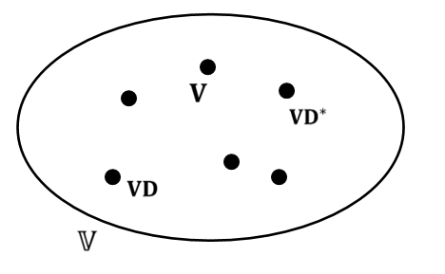
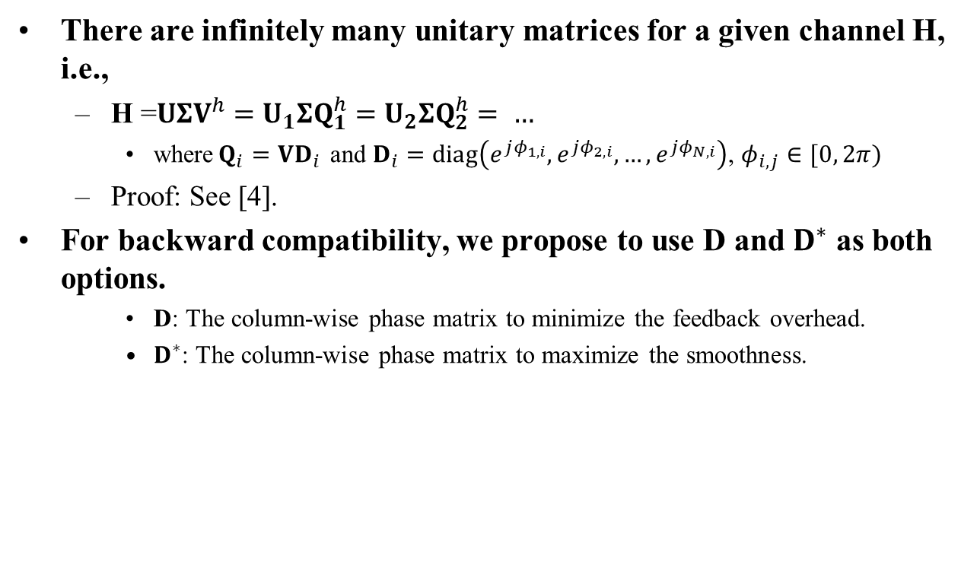
Background Theorem
There are infinitely many unitary matrices for a given channel H, i.e.,
  H =$UΣV^{h}=U_{1}ΣQ_{1}^{h}=U_{2}ΣQ_{2}^{h}= …$
    where$Q_{i}=VD_{i}$ and $D_{i}=diag\left(e^{jφ_{1,i}},e^{jφ_{2,i}},…,e^{jφ_{N,i}}\right)$, $φ_{i,j}∈[0, 2π)$
  Proof: See [4].
For backward compatibility, we propose to use D and $D^{∗}$ as both options.
    D: The column-wise phase matrix to minimize the feedback overhead.
    $D^{∗}$: The column-wise phase matrix to maximize the smoothness.
Proposed: Optimal in terms of maximizing the smoothness
Conventional: Optimal in terms of minimizing the feedback overhead

Slide 6
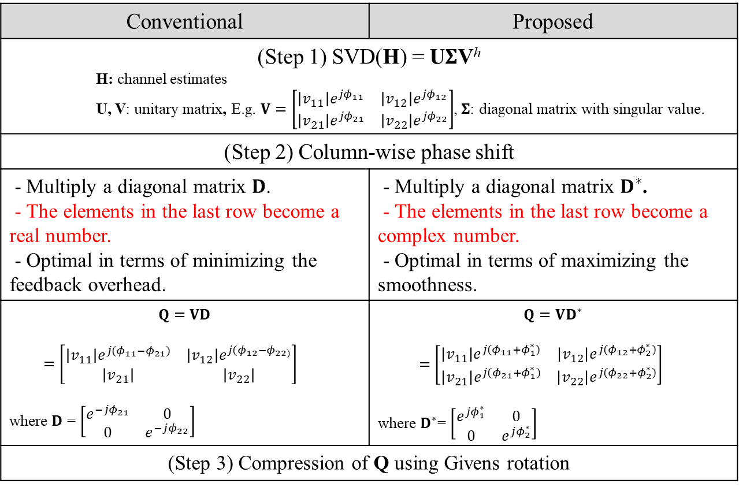
Proposed Smooth Beamforming Feedback
Conventional | Proposed
(Step 1) SVD(H) = U$Σ$V^{h} H: channel estimates U, V: unitary matrix, E.g. $V=\left[\begin{matrix}\left|v_{11}\right|e^{jφ_{11}} & \left|v_{12}\right|e^{jφ_{12}} \\ \left|v_{21}\right|e^{jφ_{21}} & \left|v_{22}\right|e^{jφ_{22}}\end{matrix}\right]$, $Σ$: diagonal matrix with singular value.
(Step 2) Column-wise phase shift
- Multiply a diagonal matrix 𝐃. - The elements in the last row become a real number. - Optimal in terms of minimizing the feedback overhead. | - Multiply a diagonal matrix $D^{∗}$. - The elements in the last row become a complex number. - Optimal in terms of maximizing the smoothness.
$$Q=VD$$ $=\left[\begin{matrix}\left|v_{11}\right|e^{j{(φ}_{11}−φ_{21})} & \left|v_{12}\right|e^{j{(φ}_{12}−φ_{22)}} \\ \left|v_{21}\right| & \left|v_{22}\right|\end{matrix}\right]$ where $D$ = $\left[\begin{matrix}e^{−jφ_{21}} & 0 \\ 0 & e^{−jφ_{22}}\end{matrix}\right]$ | $$Q=VD^{∗}$$ $=\left[\begin{matrix}\left|v_{11}\right|e^{j{(φ}_{11}+φ_{1}^{∗})} & \left|v_{12}\right|e^{j{(φ}_{12}+φ_{2}^{∗})} \\ \left|v_{21}\right|e^{j{(φ}_{21}+φ_{1}^{∗})} & \left|v_{22}\right|e^{j{(φ}_{22}+φ_{2}^{∗})}\end{matrix}\right]$ where $D^{∗}$= $\left[\begin{matrix}e^{jφ_{1}^{∗}} & 0 \\ 0 & e^{jφ_{2}^{∗}}\end{matrix}\right]$
(Step 3) Compression of Q using Givens rotation

Slide 7







How to Design $D^{∗}$ (1/2)
In case of N_{rx} = 1,
  $V=H^{h}$
  Since channel vector (H) is frequency-correlated, V is a smooth beamforming matrix.
  Propose to use $D^{∗}=1$.
    No computation cost required.
$$Q=VD= {\left[\begin{matrix}\left|h_{1}\right|e^{j(φ_{1}−φ_{3})} \\ \left|h_{2}\right|e^{j{(φ}_{2}−φ_{3})} \\ \left|h_{3}\right|\end{matrix}\right]}^{h}$$
Conventional
D = $e^{−jφ_{3}}$
$$H=\left[\begin{matrix}\left|h_{1}\right|e^{jφ_{1}} \\ \left|h_{2}\right|e^{jφ_{2}} \\ \left|h_{3}\right|e^{jφ_{3}}\end{matrix}\right]$$
$$V={\left[\begin{matrix}\left|h_{1}\right|e^{jφ_{1}} \\ \left|h_{2}\right|e^{jφ_{2}} \\ \left|h_{3}\right|e^{jφ_{3}}\end{matrix}\right]}^{h}$$
$$Q=VD^{∗}= {\left[\begin{matrix}\left|h_{1}\right|e^{jφ_{1}} \\ \left|h_{2}\right|e^{jφ_{2}} \\ \left|h_{3}\right|e^{jφ_{3}}\end{matrix}\right]}^{h}$$
Proposed
$D^{∗}$ = $1$

Slide 8

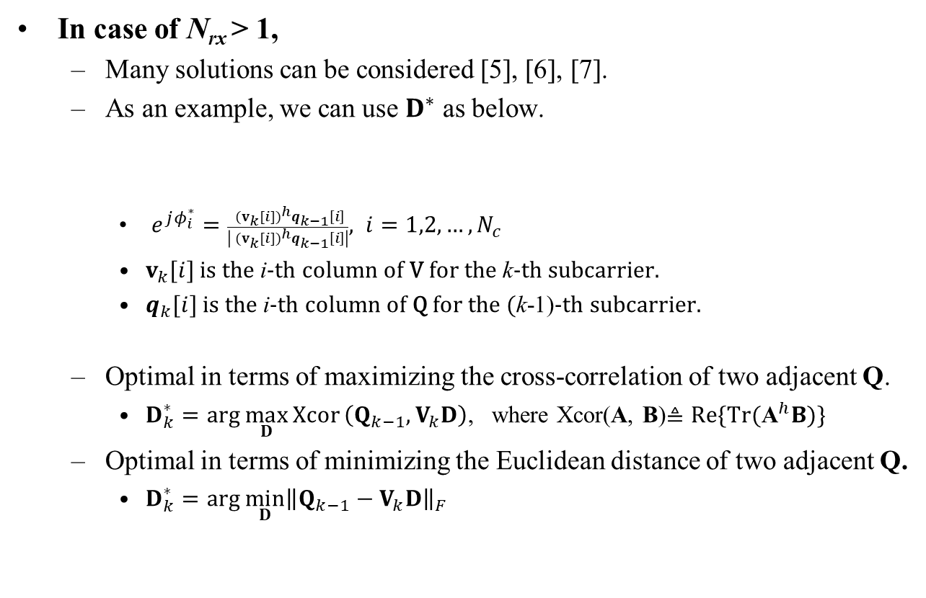
How to Design $D^{∗}$ (2/2)
In case of N_{rx} > 1,
  Many solutions can be considered [5], [6], [7].
  As an example, we can use $D^{∗}$ as below.
    $e^{jφ_{i}^{∗}}=\frac{{ (v_{k}[i])}^{h}q_{k−1}\left[i\right]}{\left|{ (v_{k}[i])}^{h}q_{k−1}\left[i\right]\right|}, i=1,2,…, N_{c}$
    $v_{k}[i]$ is the i-th column of V for the k-th subcarrier.
    $q_{k}[i]$ is the i-th column of Q for the (k-1)-th subcarrier.
  Optimal in terms of maximizing the cross-correlation of two adjacent Q.
    $D_{k}^{∗}=arg \max_{D}{Xcor}\left(Q_{k−1},V_{k}D\right)$, where Xcor(A, B)$≜Re\{\text{Tr}({\text{A}}^{h}B)\}$
  Optimal in terms of minimizing the Euclidean distance of two adjacent Q.
    $D_{k}^{∗}=arg \min_{D}{{\left\|Q_{k−1}−V_{k}D\right\|}_{F}}$
$$D_{k}^{∗}=diag\left(e^{jφ_{1}^{∗}},e^{jφ_{2}^{∗}}, …,e^{jφ_{N_{c}}^{∗}}\right)$$

Slide 9
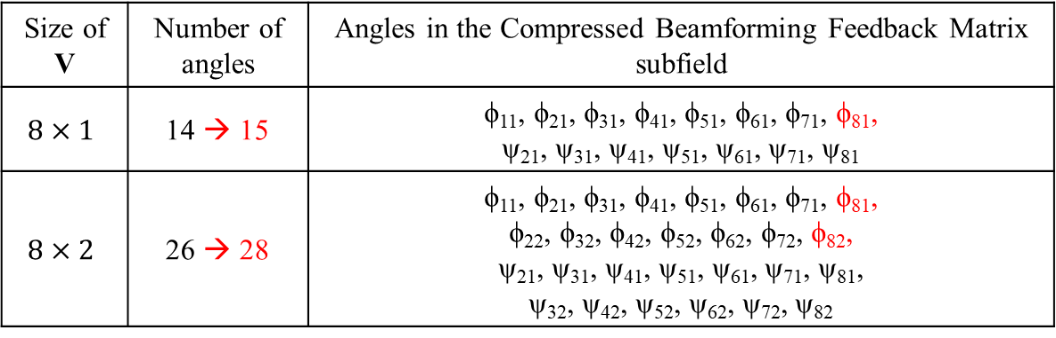

Feedback Overhead (1/2)
The number of angles is increased by $N_{c}$.
  $N_{c}$numer of $φ_{N_{r}i}$, ($i=1,2,…, N_{c}$) is newly added in the Compressed Beamforming Feedback Matrix subfield.
    E.g., Red marked angles in the table below.
  Due to the limited form factor, $N_{c}$ value is generally less than 2 in the current mobile devices. (i.e., using 1 or 2 receive antennas)
Size of V | Number of angles | Angles in the Compressed Beamforming Feedback Matrix subfield
$$8×1$$ | 14 → 15 | ϕ₁₁, ϕ₂₁, ϕ₃₁, ϕ₄₁, ϕ₅₁, ϕ₆₁, ϕ₇₁, ϕ₈₁, ψ₂₁, ψ₃₁, ψ₄₁, ψ₅₁, ψ₆₁, ψ₇₁, ψ₈₁
$$8×2$$ | 26 → 28 | ϕ₁₁, ϕ₂₁, ϕ₃₁, ϕ₄₁, ϕ₅₁, ϕ₆₁, ϕ₇₁, ϕ₈₁, ϕ₂₂, ϕ₃₂, ϕ₄₂, ϕ₅₂, ϕ₆₂, ϕ₇₂, ϕ₈₂, ψ₂₁, ψ₃₁, ψ₄₁, ψ₅₁, ψ₆₁, ψ₇₁, ψ₈₁, ψ₃₂, ψ₄₂, ψ₅₂, ψ₆₂, ψ₇₂, ψ₈₂

Slide 10
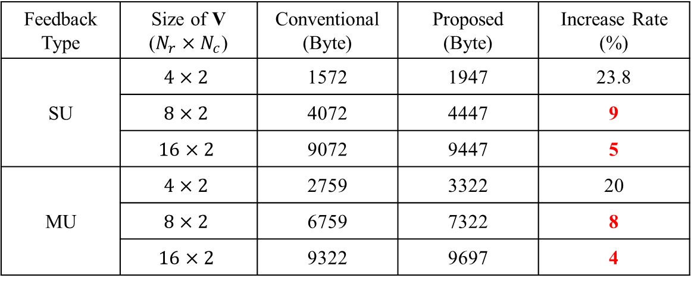
Feedback Overhead (2/2)
As the number of transmit antennas increases, the increase rate of feedback overhead decreases.
  For MU-MIMO, which has larger feedback overhead, the increase rate is smaller.
    We can use the proposed scheme optionally, considering MIMO configuration and/or feedback type.
Feedback Type | Size of V ($N_{r}×N_{c}$) | Conventional (Byte) | Proposed (Byte) | Increase Rate (%)
SU | $$4×2$$ | 1572 | 1947 | 23.8
 | $$8×2$$ | 4072 | 4447 | 9
 | $$16×2$$ | 9072 | 9447 | 5
MU | $$4×2$$ | 2759 | 3322 | 20
 | $$8×2$$ | 6759 | 7322 | 8
 | $$16×2$$ | 9322 | 9697 | 4

Slide 11
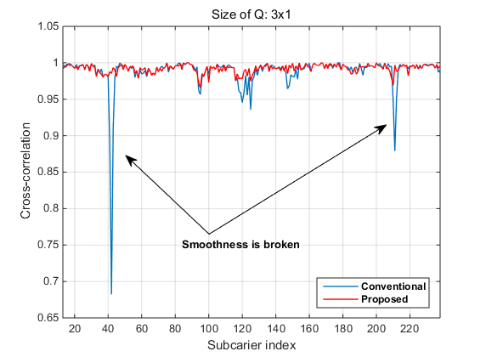
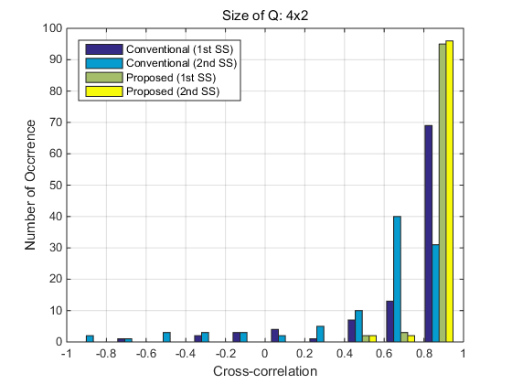
Cross-correlation Comparison
By feeding back additional phase information, cross-correlation between two adjacent beam-steering matrices is significantly improved.
[Snap-shot]
[Histogram]

Slide 12
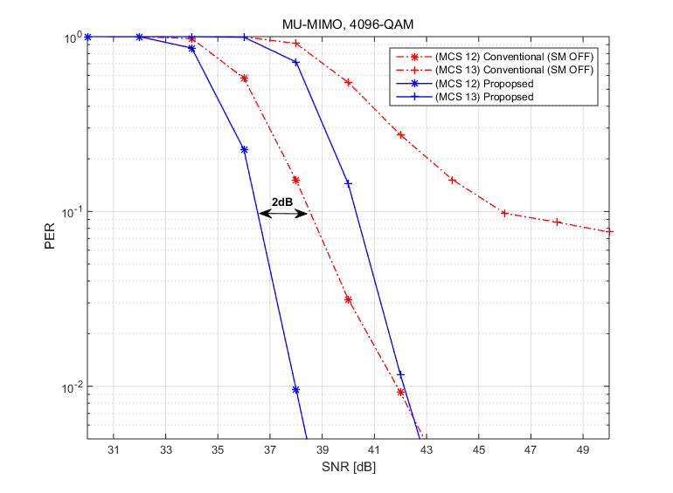
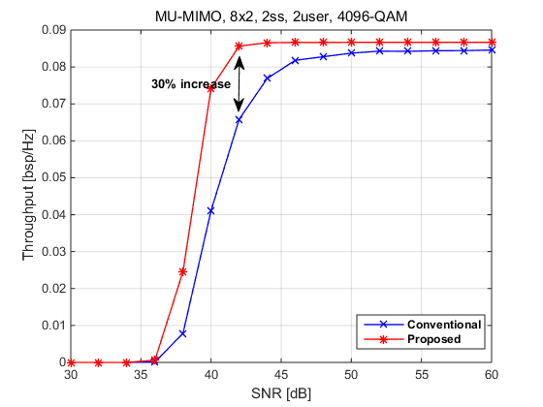
Performance Comparison (1/2)
MU-MIMO, 8x2, 2 user, 4096-QAM, 2x EHT-LTF
  PER
    More than 2dB gain thanks to the application of the channel smoothing.
  Throughput
    Throughput is calcalcuated with considering feedback overhead
      Data payload / (Time for NDPA, NDP, BFRP, SIFS, CBR and Data) * (1-PER) / BW
    About 30% increase in max throughput
      Can satisfy the target of UHR project (25% increase in throughput)

Slide 13
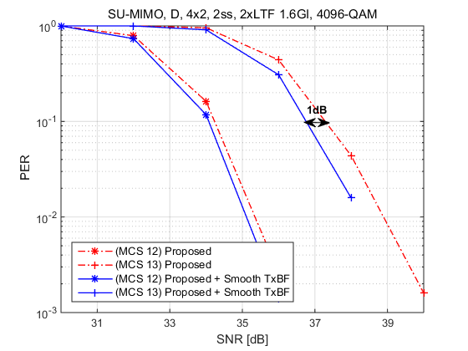
Performance Comparison (2/2)
Some beamformer may have smoothing capability (Smooth TxBF).
  If the proposed scheme is used jointly with Smooth TxBF, more PER performance gain can be obtained.
SU-MIMO, 4x2, 2ss, 4096-QAM, 2x ETH-LTF
  Around 1dB gain can be obtained.

Slide 14
Summary
We discussed the improvement of beamforming which can achieve a target of UHR.
  Proposed to feedback additional phase information to obtain more channel smooth gain for the beamforming signal.
  Considering that sounding occurs very sparsely, a slight increase in overhead has a very small effect on throughput loss,
    but throughput gain of the smooth beamforming is significant.
  When combined with Smooth TxBF, additional performance gain can be obtained.

Slide 15
Reference
[1] 802.11-22/1392r0, Beamforming Improvement for UHR, Samsung.
[2] 802.11-22/1820r1, BF Feedback with the Optimal SVD, Zeku.
[3] 802.11-22/1842r0, Channel Information Feedback for Smooth Beamforming, Samsung.
[4] E. Sengul, H. J. Park and E. Ayanoglu, “Bit-Interleaved Coded Multiple Beamforming with Imperfect CSIT,” IEEE Trans. Commun, vol. 57, no. 5, May 2009.
[5] E. Jeon, M. Ahn, S. Kim, W. B. Lee and J. Kim, "Joint Beamformer and Beamformee Design for Channel Smoothing in WLAN Systems," in Proc. IEEE 92nd Veh. Technol. Conf. (VTC2020-Fall), Nov. 2020.
[6] Y. Qui, D. Qu, Da Chen and T. Jiang, “Smoothed SVD-based Beamforming for FBMC/OQAM Systems Based on Frequency Spreading,” in Proc. IEEE Global Communications Conference (GLOBECOM), Dec. 2016.
[7] J. S. Sadowsky, T. Yamaura and J. Ketchem, “WWiSE Preambles and
MIMO Beamforming,” IEEE, Tech. Rep. 802.11-05/1635r1, Jan. 2005.

Slide 16
SP
Do you support to feed back additional phase information to improve the smoothness of the beam-steering matrix?
  This SP is for information gathering.
  Y/N/A

