Slide 1
Pilot Tone Allocation and Other Considerations of Tone-Distributed RUs for UHR
Date: 2023-09-06
Authors:

Slide 2
Abstract
In this contribution, we discuss pilot tone allocation for Tone-Distributed Resource Unit (dRU) options, and show their impact on PER performance. Also, we discuss some considerations of the adoption of dRUs in UHR.

Slide 3
Background
Tone-Distributed Resource Unit (dRU) is proposed in [1] as a solution for long range
In [2], pilot design and CFO impact have been discussed and the authors have shown how the choice of the pilot tones can significantly impact the performance for different CFO
The authors of [3] proposed reusing the RU allocation indication of rRUs for dRUs

Slide 4
Pilot Tones Allocation
In [2], two options are proposed for pilot tones' locations
  Option 1: Define new pilot locations (e.g., 7th and 20th tones of each 26-tone dRU)
  Option 2: Maintain the conventional pilot tones (11ax/be) (i.e., Reuse the pilot tones of the k-th rRU for the k-th dRU )
Maintaining the conventional pilot tones is simple but may degrade the performance, unless they are allocated differently.
Other allocations of the pilot tones should be considered
  Option 3: Allocate the conventional pilot tones of the nine 26-tone rRUs in a 20 MHz channel with a sufficient distance between the pilot tones
    Allocate two pilot tones out of the 18 conventional pilot tones to each 26-tone dRU
    Choose the two pilot tones such that the distance (measured in number of subcarriers) between the pilot tones is sufficiently large for the nine dRUs

Slide 5
Pilot Tones Allocations
Pilot Tone Indices for 26-tone dRUs in 20 MHz Channel
dRU index | Option 1 [2] |  | Option 2 [2] |  | Option 3
dRU | Tone Pos. | Gap (# of Tones) | Tone Pos. | Gap (# of Tones) | Tone Pos. | Gap (# of tones)
1 | {-67, 50} | 117 | {-116, -102} | 14 | {-116, 10} | 126
2 | {-66, 51} | 117 | {-90, -76} | 14 | {-102, 22} | 124
3 | {-65, 52} | 117 | {-62, -48} | 14 | {-90, 36} | 126
4 | {-64, 53} | 117 | {-36, -22} | 14 | {-76, 48} | 124
5 | {-63, 54} | 117 | {-10, 10} | 20 | {-62, 62} | 124
6 | {-62, 55} | 117 | {22, 36} | 14 | {-48, 76} | 124
7 | {-61, 56} | 117 | {48, 62} | 14 | {-36, 90} | 126
8 | {-60, 57} | 117 | {76, 90} | 14 | {-22, 102} | 124
9 | {-59, 58} | 117 | {102, 116} | 14 | {-10, 116} | 126

Slide 6
Simulation Environment
Simulation Parameters
  Channel Bandwidth = 20 MHz (nine 26-tones dRUs/rRUs)
  LDPC Coding , MCS = 3 and MCS = 7
  SISO with Channel Model D , B , and AWGN
  Residual CFO: [dRU1:+CFO, dRU2: -CFO, …, dRU9: +CFO]
    Phase tracking is used
  SNR is defined as the average received SNR per user.
  The dRUs are comprised by allocating one tone out of each 9 tones to each dRU in turn
  Packet Size = 1000 bytes
  Pilot Positions: Option 1, Option 2, and Option 3 in Slide 5
  The PER for the first dRU/rRU is considered

Slide 7
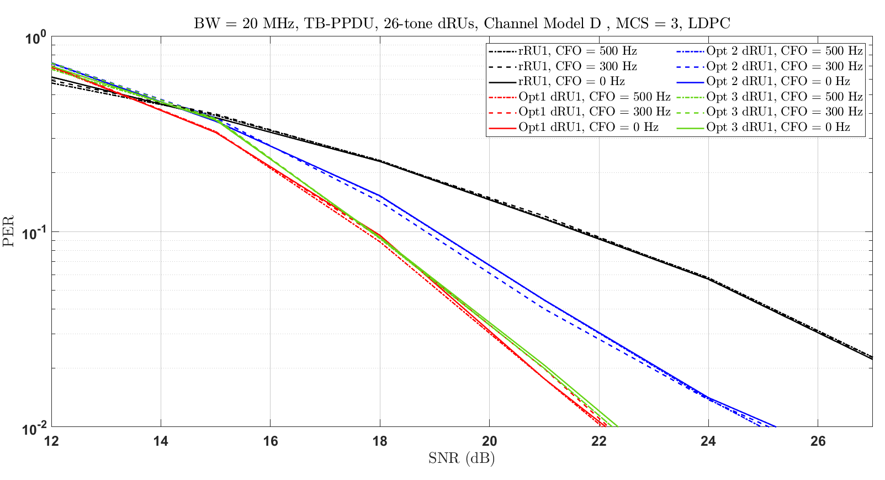
Pilot Tones Allocation Results
Option 3 is performing close to Option 1 and still uses the conventional pilot tones
The gain of dRUs over rRUs due to frequency diversity is about 2 dB and 3 dB at PER = 10% for Option 2 and Option 1/Option 3, respectively

Slide 8
Consideration 1: CFO and Inter-RU Interference
Impact of CFO on Inter-RU Interference
  In EHT TB PPDU, after compensation, the absolute value of residual CFO error with respect to the corresponding triggering PPDU shall not exceed 350 Hz for the data subcarriers when measured at the 10% point of the complementary cumulative distribution function (CCDF) of CFO errors in AWGN at a received power of –60 dBm in the primary 20 MHz channel
  Should we consider a different requirement with respect to the residual CFO for dRUs?
  Would the different tone plans perform differently in mitigating the Inter-RU interference?
  Would different pilot tone allocations perform differently in mitigating the Inter-RU interference?

Slide 9
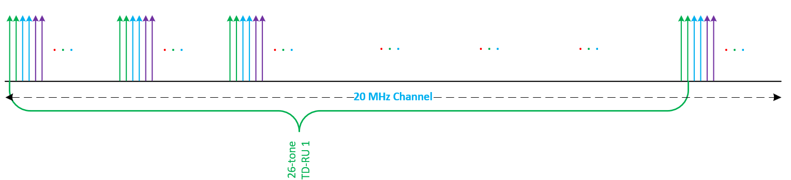
Consideration 2: Tone Plan and Phase Tracking
In rRUs, the phase tracking algorithm can start the phase tracking early by using the LTFs [4]
In the dRU design in [2], it is difficult to start phase tracking from the LTFs
  The data tones are not close to the pilot tones as in rRUs, so it is hard to use the LTFs to estimate the phase shift accurately at the receiver (e.g., By interpolation).
The tones of a 26-tone dRU in 20 MHz channel may be selected in different ways:
  Method 1: One tone out of each 9 tones is allocated to each dRU in turn [2].
  Method 2: Two or more consecutive tones is allocated to the next dRU periodically

Slide 10
Consideration 2: Tone Plan and Phase Tracking
Several tradeoffs may be considered for different tone plans:
  Simplicity: Larger dRUs may be simply comprised of smaller dRUs
  Performance: Some tone plans may have a better PER performance
  Maximum Power Boost: A tradeoff between the maximum power boost and the mitigation of CFO may be considered

Slide 11
Conclusions and Way Forward
Conventional pilot tones of rRUs may be reused for dRUs
  Allocating the pilot tones spaced with a sufficient distance for dRUs improves the PER performance
Designing the tone plan such that two or more data tones are grouped together may allow for early phase tracking by employing the LTFs
We may need to discuss the residual CFO requirements for dRUs
  Investigation of the impact of different tone plans and different pilot tone allocations on the PER performance is required

Slide 12
References
[1] 11-23/0037r0, UHR Feature to Overcome PSD Limitations Distributed-Tone Resource Units
[2] 11-23/1115r0, CFO Impact and Pilot Design for dRU
[3] 11-23/1117r0, dRU Signaling for UHR
[4] 11-16/0089r1, Single Stream Pilots in UL MU MIMO

Slide 13
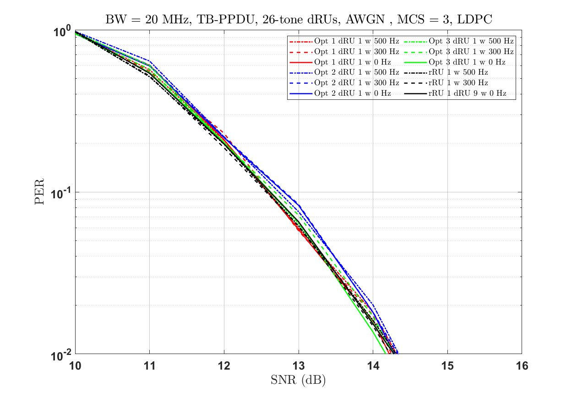
MCS 3 in AWGN
No difference between the performance of rRU and dRU
Also, it seems no much difference between different pilot locations options in AWGN

Slide 14
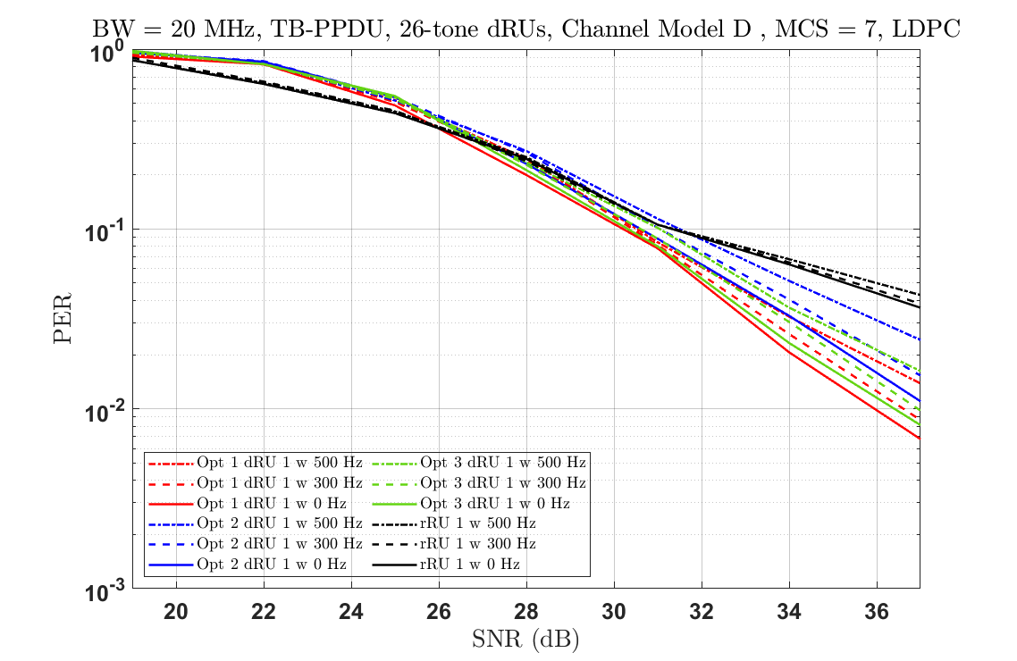
MCS 7 in Channel Model D
Similar trend is seen for MCS = 7

Slide 15
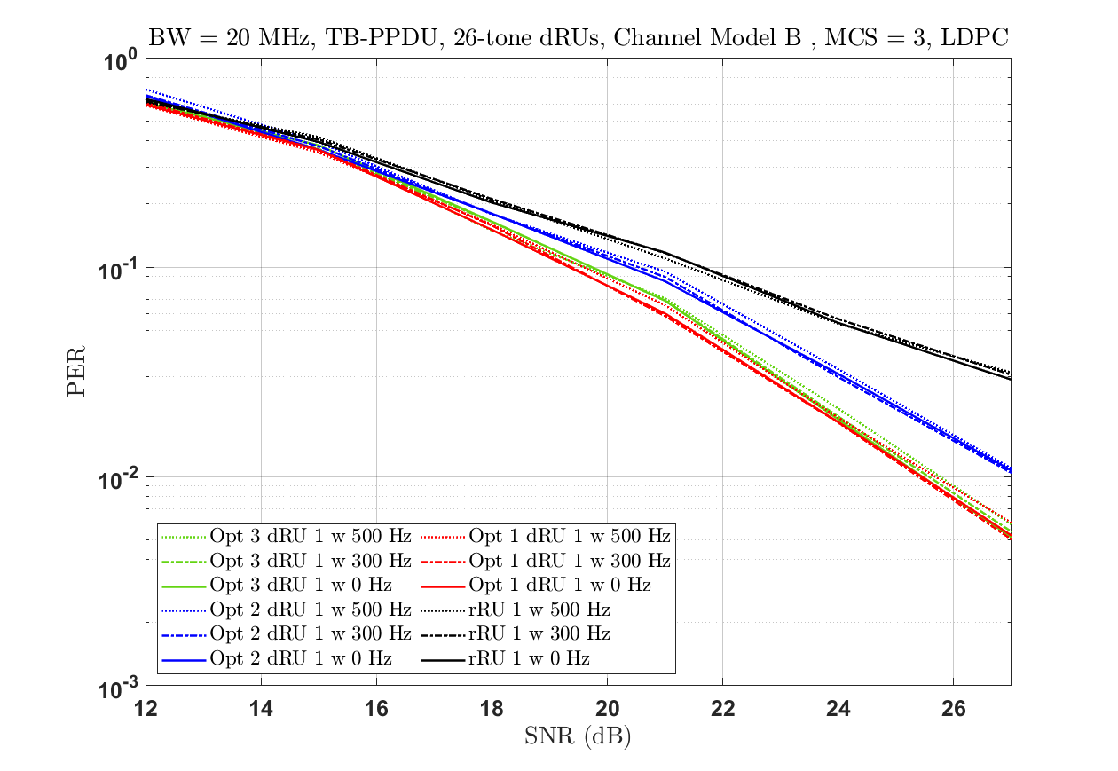
MCS 3 in Channel Model B
Similar trend is seen for MCS = 3 in Channel B

