Slide 1
Bluetooth Wi-Fi Coexistence: Channel Access Simulation Study
Date: 2023-09-13
Authors:

Slide 2
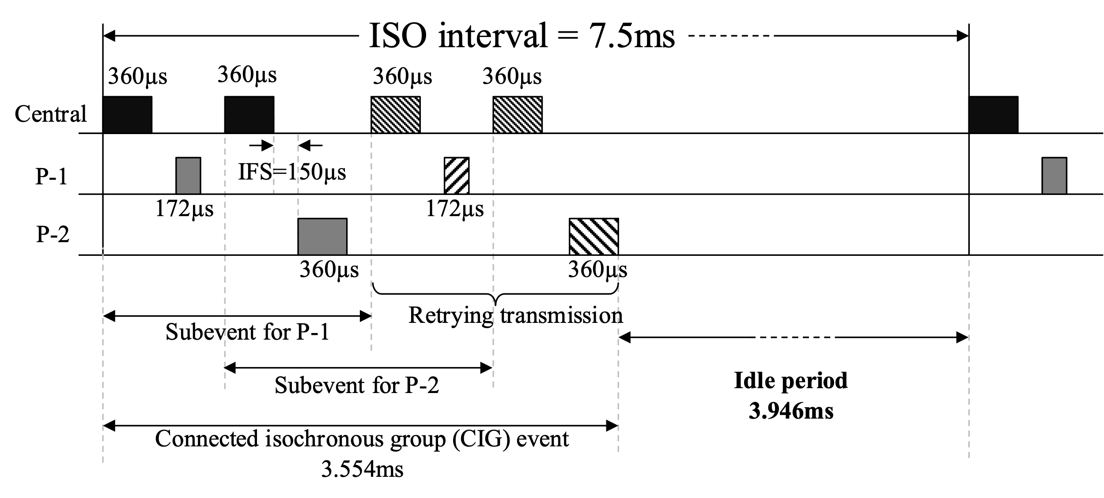
Simulation setup
Bluetooth:
Low Energy (LE) 2M PHY
Gaming audio: 2 earbuds
  1 earbud contains mic
  1 earbud has inertial measurement unit (IMU) sensor
Tx power: 14 dBm
ISO interval = 7.5ms
Max latency = 15ms (2×ISO)
Number of subevents, NSE = 2
1 main TX + 3 retry opportunities
  Total 4 attempts
Number of channels = 80 (each channel 2MHz wide)
Total hopping BW = 160MHz
Bi-directional traffic
Wi-Fi:
1 AP, 1STA
Tx power: 20 dBm at AP/STA
MCS11
Single stream
One directional traffic
Traffic load: Full buffer or 60% constant bit rate, or, beacon-only
TXOP duration ≈ 5ms
Bandwidth = 80MHz
Transmission starts at time=3s
Wi-Fi
80MHz
Overlap
Bluetooth
160MHz
Channel model:
AWGN channel with a breakpoint at 5 m
pathloss = 40.05 + 20log10(f/2.4) + 20log10(min(d, b)) + (d > b) * (35log10(d/b))
where f = 5.18 GHz, d = distance, b = breakpoint = 5 m

Slide 3
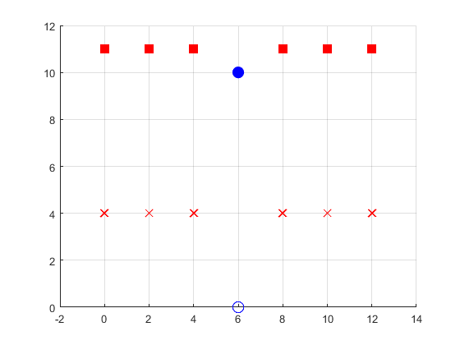
Wi-Fi + Multiple Bluetooth
Bluetooth central
Wi-Fi AP
meters
Bluetooth peripheral with 2 earbuds
Wi-Fi STA
meters

Slide 4
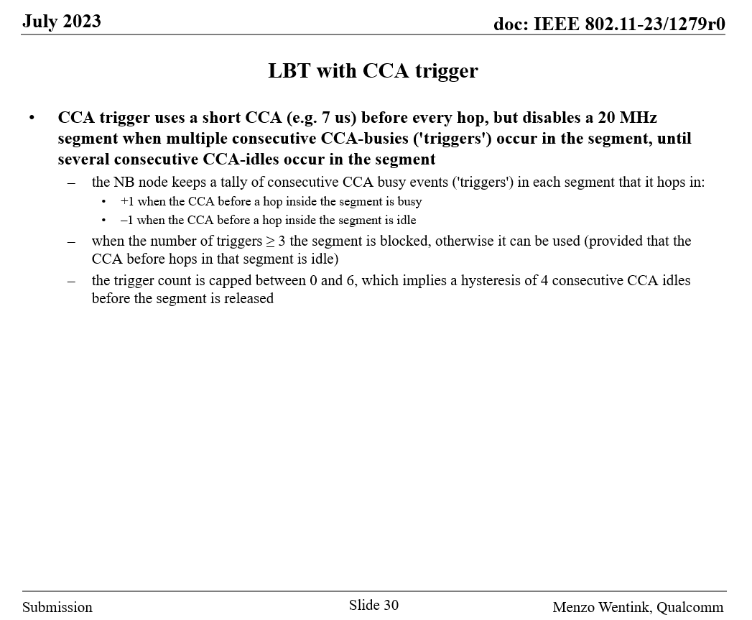
Listen-Before-Talk (LBT) with CCA trigger
LBT parameters:
Trigger threshold = 3
When the threshold of 3 is reached, 3 more is added to CCA-busy for additional hysteresis.
Trigger count is capped at 24
The above set of parameters is referred to as 3+3/24 [1]

Slide 5
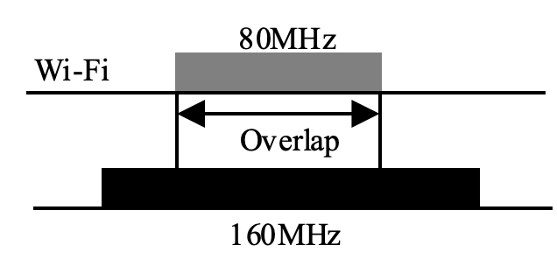
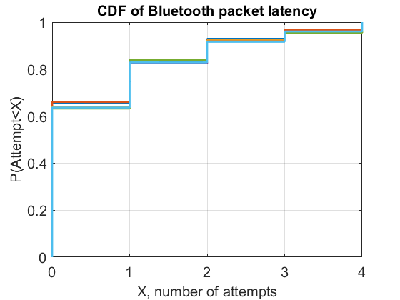
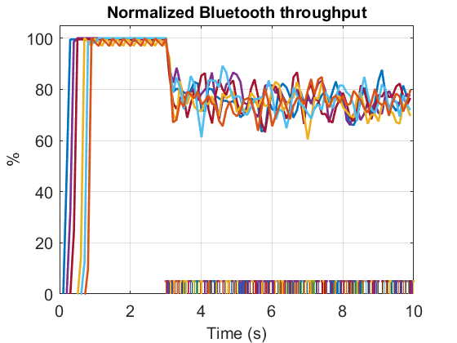
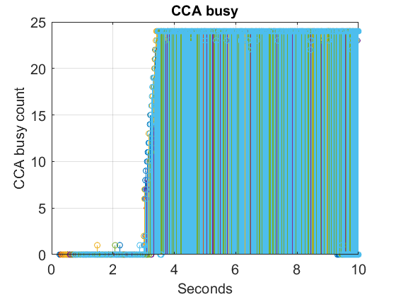
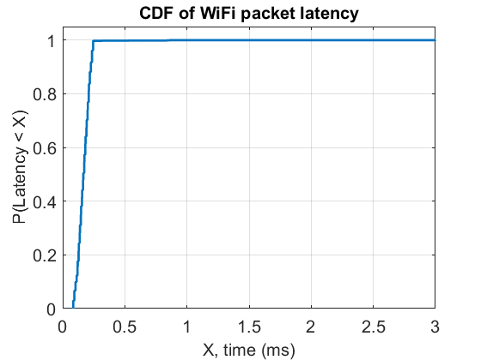
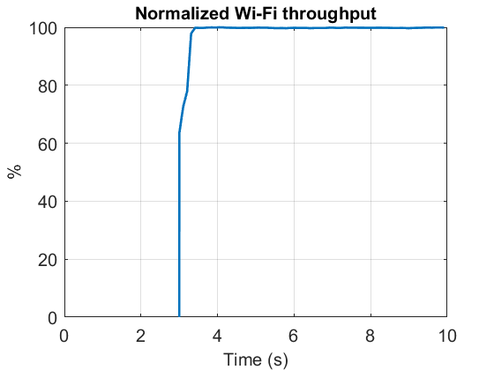
LBT with CCA trigger
Full buffer Wi-Fi
Observations
  Considerably adverse impact on Bluetooth latency with 50% spectrum overlap. Higher overlap would further degrade the performance
  Wi-Fi transmission is not impacted, as Bluetooth defers the transmission in Wi-Fi occupied channels
Some packets did not get transmitted at all resulting in glitches
Bluetooth
Significant impact on Bluetooth latency
Bluetooth transmissions start with ~0.1s offset
Wi-Fi latency is low
Wi-Fi throughput is not impacted
Wi-Fi
Wi-Fi starts at ~3s

Slide 6
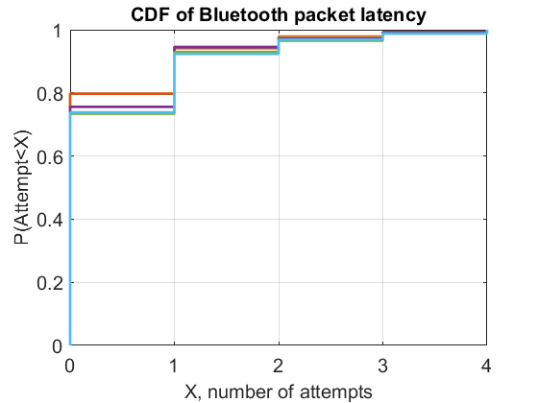
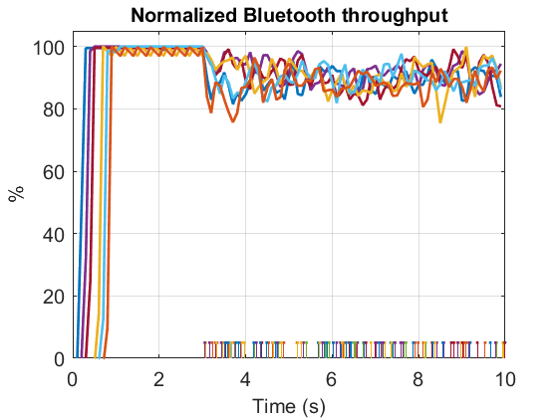
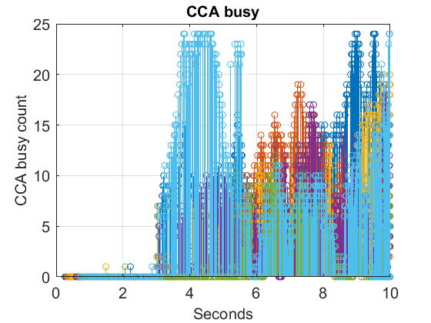
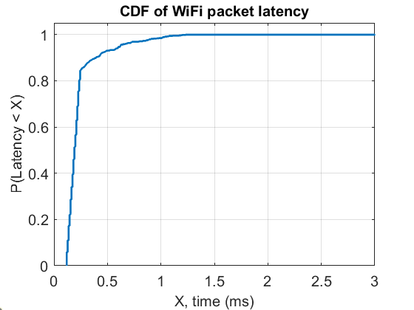
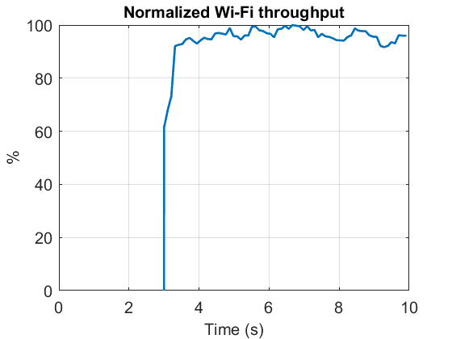
LBT with CCA trigger
Wi-Fi : 60% duty-cycle, constant bit rate
Observations:
  With low-duty-cycle Wi-Fi, Bluetooth cannot always detect, and block Wi-Fi occupied channels
  CCA-busy count keeps oscillating due to gaps in Wi-Fi transmission
  Bluetooth keeps capturing channels during gaps in Wi-Fi transmission, resulting in higher latency for Wi-Fi
Still resulting in some glitches
Bluetooth
Increased Wi-Fi latency
Continuous impact on Wi-Fi throughput
Wi-Fi

Slide 7
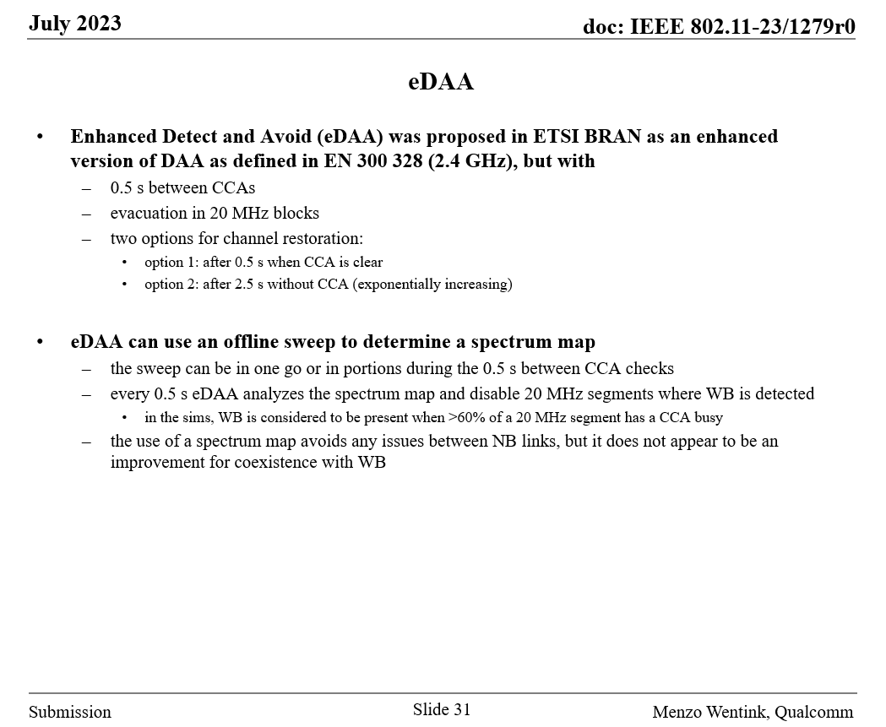
Enhanced Detect and Avoid (eDAA)
eDAA parameters:
A separate 20MHz wideband scanner is used for signal detection
4 sweeps of Bluetooth hopping BW (in this case 160MHz) in 500ms
Vacate a 20MHz band as soon as the band is found busy
Notes:
More than 4 sweeps are also possible

Slide 8
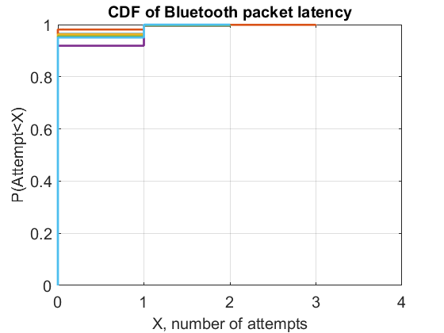
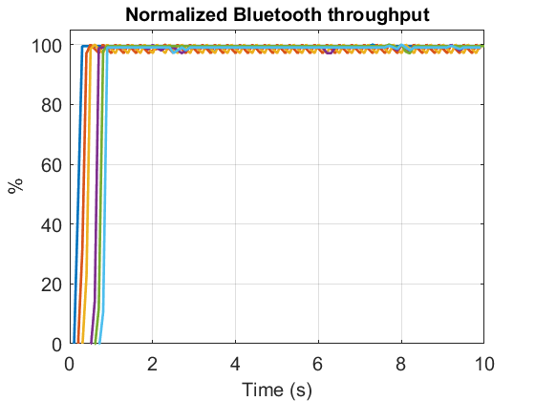
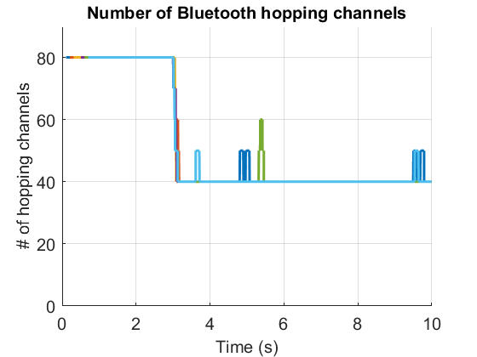
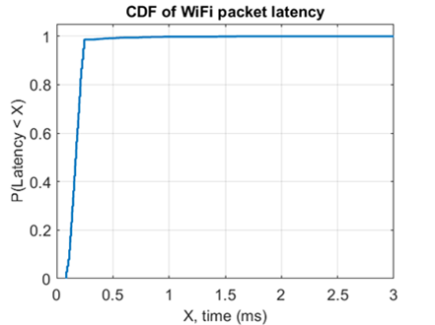
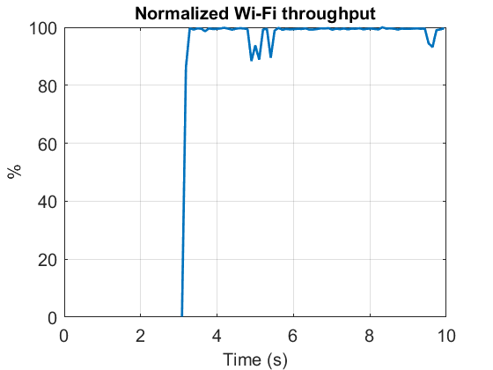
eDAA
Full buffer Wi-Fi
Observations
  All Bluetooth links can detect and vacate Wi-Fi occupied channels
  Wi-Fi throughput is good
  Bluetooth latency is not impacted
Bluetooth performance is good
Bluetooth
Wi-Fi throughput is not significantly impacted
Wi-Fi

Slide 9
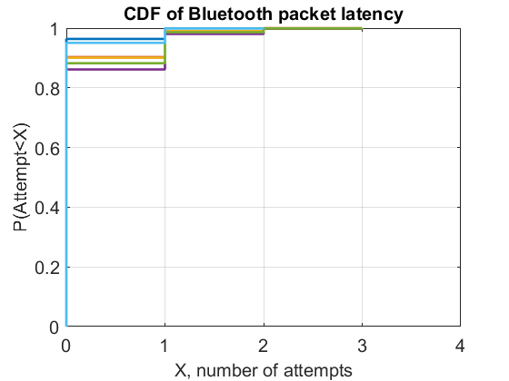
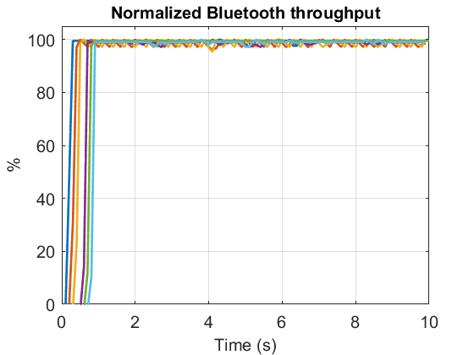
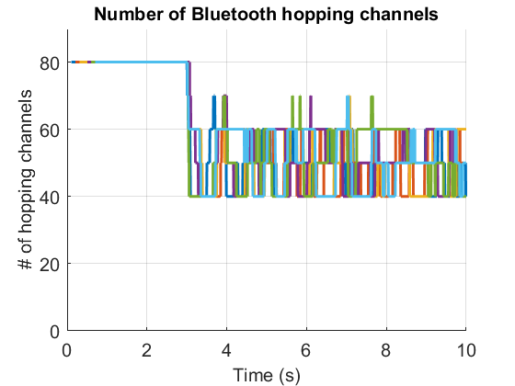
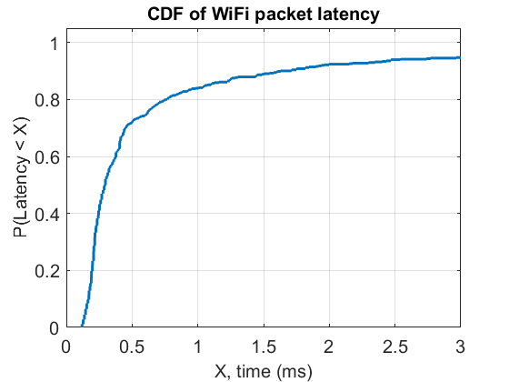
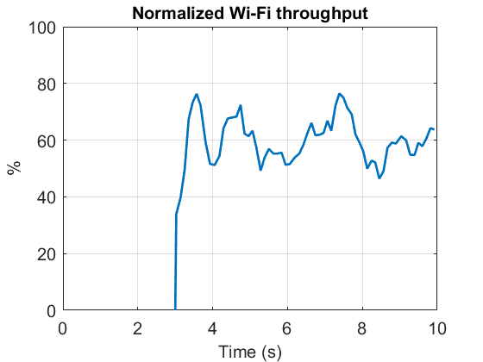
eDAA
Wi-Fi : 60% duty-cycle, constant bit rate
Observations
  Frequent channel restoration caused by unreliable Wi-Fi signal detection in low-duty cycle Wi-Fi scenarios
    Results in collision with Wi-Fi and increase in the size of contention window
  Continuous interference from multiple Bluetooth links is detrimental for Wi-Fi
Bluetooth performance is good
Bluetooth
Continuous interference to Wi-Fi
Wi-Fi
Frequent channel restoration
Significant increase in Wi-Fi latency

Slide 10
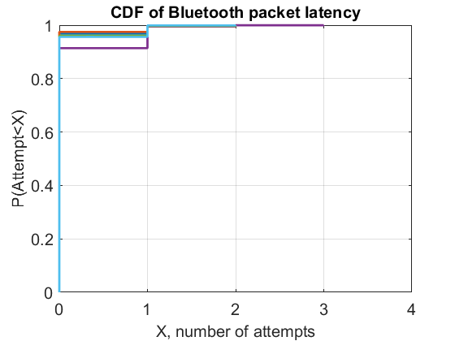
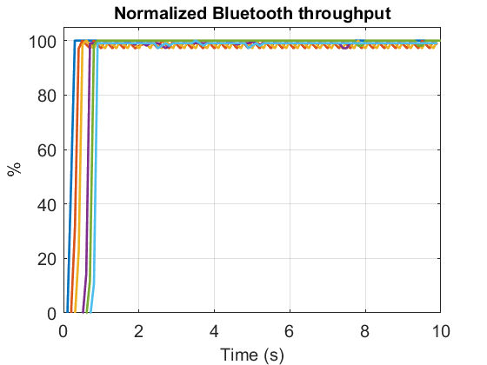
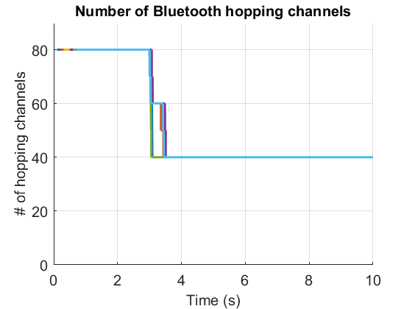

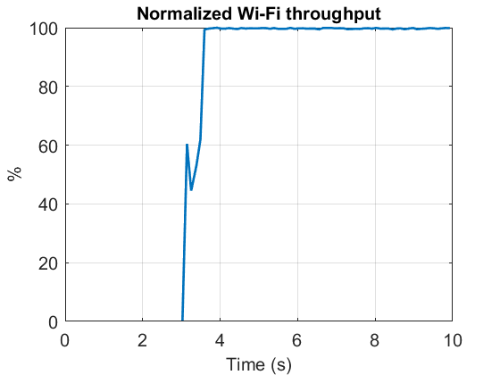
eDAA: An example with modified restoration procedure
Wi-Fi : 60% duty-cycle, constant bit rate
Restoration of a 20MHz band is based on last 10 sweeps
  This example is one of the potential solutions for a more reliable restoration procedure
Observation: the restoration needs to be more rigorous than what is currently proposed in eDAA.
Bluetooth performance is good
Bluetooth
Wi-Fi throughput is not significantly impacted
Wi-Fi

Slide 11
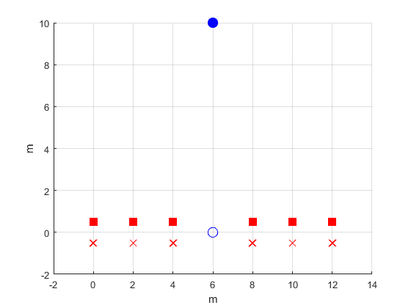
Coexistence with Wi-Fi beacon-only traffic
Wi-Fi AP
Wi-Fi beacons have very low duty cycle with ~100ms period in primary channel.
Parameters
  Wi-Fi beacon-only traffic (300 us, 20 MHz wide) with 102.4ms period
  Bluetooth traffic – same as previous slides
Wi-Fi STA
 | eDAA | LBT with CCA trigger
% of beacons received | 91.5% | 99%
Wi-Fi
20MHz
Overlap
Bluetooth
160MHz
While eDAA results in higher number of collisions with beacons, there were no occurrences where two or more consecutive beacons were not received by the Wi-Fi (non-AP) STA.
Notes:
BT central moved closer to Wi-Fi STA to highlight the impact on beacon.

Slide 12
Observations
LBT with CCA trigger
  Unable to meet the Bluetooth latency requirement in the case of 50% spectrum overlap. With growing overlap, the latency will likely become worse.
    Still seen with newly suggested LBT 3+3/24
  While the performance for full-buffer Wi-Fi is good, Wi-Fi latency is impacted for low duty-cycle Wi-Fi
  No impact on beacon-only transmission
eDAA
  Better for Bluetooth performance
  Significant throughput impact on Wi-Fi specifically when detection is not reliable e.g., low duty-cycle Wi-Fi
  Coexistence with Wi-Fi can be improved by a more robust restoration procedure. This results in better Wi-Fi throughput and latency.
  Slightly higher impact on beacon-only transmission, but may not be significant enough causing loss of connection

Slide 13
Next steps
Agreement on realistic simulation scenarios
  Wi-Fi traffic load: Low duty cycle (5-10%), medium duty cycle (50-60%) and full buffer
  Bluetooth low energy traffic pattern: Based on realistic cases such as gaming audio
  Network topologies: Capturing mutual impact
Agreement on performance metrics for Bluetooth and Wi-Fi
  Throughput
  Latency
  Detection accuracy and speed
  Energy efficiency
Others
  Rethink Frequency hopping kernel
  Impact of the latency associated with channel map update

Slide 14
References
[1] Bluetooth SIG bt_sig_nb_with_lbt_qualcomm_september_2023_budapest_r1
[2] IEEE 11-23-1279-coex-00, IEEE Berlin, July 2023
[3] BRAN(21)109h004r2_EN_303_687_NB_Proposals_for_DAA_Optimisation
[4] BRAN(21)109h007_NB_coexistence_with_WB_in_6_GHz

