Slide 1
Physical Layer Reliability Improvements
Date: 2023-09-07
Authors:

Slide 2
Introduction
Improved reliability and more efficient use of the spectrum are important goals of UHR [1]
  After all, the name of the SG is ‘Ultra High Reliability’; the definition of reliability hasn’t been discussed in the SG
So far, few contributions have addressed reliability directly
One of the most important contributors to the limited reliability in WLAN is interference, resulting from the operation in unlicensed bands
In this contribution we discuss potential physical layer improvements for coping with interference, which lead to significant performance enhancement, particularly latency reduction and increased throughput
  We describe highly important beneficial by-products of mitigating the interference
  NOTE: In 3GPP, one definition of reliability - as part of URLLC - is achieving 99.999% packet success rate with 1msec latency (for a 32B packet) [2]; additional definitions – for various scenarios – are also described

Slide 3
Interference and its Impact on Reliability
Random, unexpected interference is one of the main reasons for the limited reliability in WLAN
Interfering signals can occupy any bandwidth – narrowband or wideband – and can originate from several sources, for example:
  Any valid WLAN signal
  3GPP transmissions in the unlicensed bands
  2MHz narrowband-assisted UWB (as part of 802.15.4ab)
  Bluetooth (in the 2.4GHz band)
Interference can rise at any time
Interference is a problem not only for per-PPDU demodulation, but also for link adaptation (how to converge, given packets experience varying interference over time?) and related PHY measurements (how reliable are they?)

Slide 4
Interference and its Impact on Reliability (cont.)
The following figure depicts the (simplified) impact of interference on particular PPDUs and the link adaptation mechanism,
and how Interference Mitigation (IM) can assist:
Data
Noise
Energy
Interference
PPDU #1
PPDU #2
PPDU #3
PPDU #4
PPDU #5
Time
Without IM
Decoded
successfully
High PPSNR
Failed decoding
Low PPSNR
Decoded
successfully
High PPSNR
Decoded
successfully
High PPSNR
Failed decoding
Low PPSNR
The LA mechanism observes an unstable performance (low PPSNR) and therefore chooses – long term – a robust, low MCS
Decoded
successfully
High PPSNR
Decoded
successfully
High PPSNR
Decoded
successfully
High PPSNR
Decoded
successfully
High PPSNR
Decoded
successfully
High PPSNR
With IM
The LA mechanism observes a stable performance (high PPSNR) and therefore chooses – long term – a high MCS

Slide 5
Coping with Interference: Approach #1
Data can be replicated in the frequency domain, similar to [3], as shown in the figure below
The receiver can identify if a portion of its spectrum is interfered, and based on this decide which subcarriers to combine (and how to combine)
The choice of RU size to use and how many replications
can be opportunistic or based on knowledge
at transmitter side (e.g. interference
properties)
Advantages:
  Simple transmit scheme
  Significantly more robust to (narrowband) interference
Disadvantages:
  Less applicable for wideband interference
26-tone
4x replication to STA #1
26-tone
26-tone
26-tone
26-tone
52-tone
2x replication to STA #2
52-tone

Slide 6
Coping with Interference: Approach #1 – cont.
In order to evaluate the performance of this approach, we simulated the following:
  MCS 4 transmitted over 20MHz, no replication or replicated 2 times
  SIR = 0dB (ratio of total int. power to total signal power), narrowband (2MHz) interference
  2Tx antennas, 4Rx antennas, 1 spatial stream
  Compared three TX-RX schemes:
    No replication at TX (so no combining at RX)
    Naïve combining of replicas with equal
    weights
    Advanced combining of replicas based on
    frequency-selective interference identification
Without replication or with naïve
combining we get an error floor
However, by combining replications
with interference identification at Rx we
get significantly improved performance!

Slide 7

Coping with Interference: Approach #2
Transmitting known pilots – interlaced with the data – will allow a receiver to track and mitigate potential interfering signals
The receiver will apply an interference mitigation (receive beamforming) scheme
  Various algorithms may be employed – one example is given in the
  next slide
Advantages:
  Can handle interference of any bandwidth
Disadvantages:
  Need ‘extra’ Rx antennas (beyond N_SS)
  to cancel the interference
Interference Mitigation Pilot
Data

Slide 8
Coping with Interference: Approach #2 – cont.
Let us assume the following model for the received signal:
where is the received signal, is the channel of the wanted signal , the noise intensity satisfies , is an AWGN and the
interfering signal experiences channel
The covariance of the noise and interference is given by
If the covariance is known to the receiver, then it can be used to
compute the Minimum Variance Distortionless Response (MVDR) beamformer:
Alternative methods can be used to mitigate the interference

Slide 9
Coping with Interference: Approach #2 – cont.
In order to evaluate the performance of this approach, we simulated the following:
  SIR = 10dB & 5dB, interference on entire BW (RU = 106-tone)
  RU with MCS 6 (with ~30% IM pilots)
  1Tx antenna, 4Rx antennas, 1 spatial stream, smoothing CHEST, TGn-D NLOS, LDPC
  Compared 2 receiver schemes:
    MRC (w/o and w/ interference)
    MVDR (when interference is present)
In the presence of interference,
whereas MRC suffers from an
error floor (even with much lower
MCS), Interference Mitigation
(MVDR) enables operation with
high MCS even at SIR = 5 dB !

Slide 10
Coping with Interference: Goodput
In order to further evaluate the impact of interference mitigation on the performance, we looked at the goodput comparing interference mitigation with MRC
We did this based on approach #2 – using IM pilots spread throughout the RU
At each SNR, we chose the MCS
which maximizes the throughput
- for both MRC and MVDR
As shown in the figure, except
at low SNR (where there is no
reason to apply interference
mitigation), the application of
IM significantly improves the
performance, up to (roughly)
tripling the goodput

Slide 11
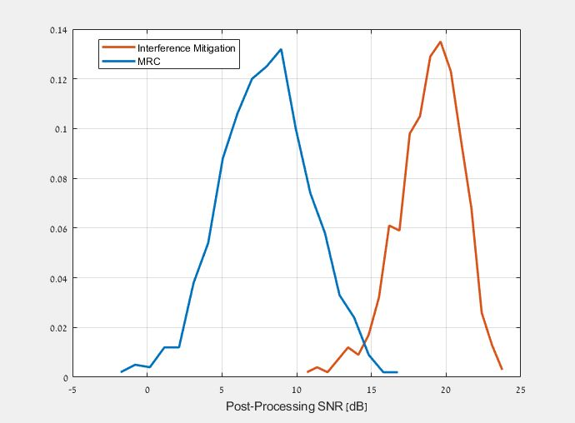
Physical Layer Measurements
Furthermore, applying interference mitigation at the receiver makes the physical layer measurements (e.g. SNR to be reported) much more reliable
Below is a comparison of the average Post-Processing SNR of MRC vs. interference mitigation (MVDR), with the following parameters:
  SNR is 20dB
  SIR is Normally distributed
  with 1dB variance around 5dB
Whereas MRC yields very broad
and unreliable estimates of the
SNR, with IM we get a more
consistent estimate around
the true SNR value
Mean 7.9
Variance 9.1
Mean 18.9
Variance 4.6

Slide 12
Additional Benefits
We’ve shown in previous slides how these two approaches can significantly improve performance in the presence of interference
  In particular, they can cope with very strong interfering signals, while maintaining a high MCS
  We can therefore transfer data, at high rate, while maintaining low retransmission rates – therefore reducing the latency
If interference mitigation techniques are used, then the link-adaptation mechanism, which is highly impacted today by interference, may rely also on physical layer measurements at Rx of post-processing SNR
  Performance can be monitored based on the reported SNR measurements, and LA convergence time can be reduced
  Furthermore, the PHY measurements (e.g. SNR/CQI) which are currently deemed unreliable (by many), will become trustworthy and may therefore be used as a reliable input to the LA mechanisms

Slide 13
Conclusions
We discussed how prevalent interference is in the WLAN bands, and how mitigating this interference (or the majority thereof) would lead to significantly better results, in particular lower latency
We presented two approaches to mitigate the interference and showed, via simulation results, how we can improve the performance in the presence of interference
These approaches lead to not only successful demodulation of particular/individual data packets, but to a long-term, reliable transfer of data, which would help the link-adaptation mechanism to quickly and more efficiently converge to the optimal transmission parameters, in addition to turning certain PHY metrics (e.g. SNR) into reliable estimates of the link performance

Slide 14
References
[1] 11-23/0028r6: PAR Discussion (Laurent Cariou)
[2] 3GPP Technical Specification Group Radio Access Network – Study on Scenarios and Requirements for Next Generation Access Technologies (TR 38.913)
[3] 11-23-0042r0: Thought for Range Extension in UHR (Dongguk Lim et al)
Notes:
at least one mode of operation capable of improved support, compared to 802.11be, for applications with stringentworst-case latency and jitter requirementscompared to 802.11be // i.e., avoid “worst-case”

