Slide 1
  Proposed 8th Generation IEEE802.11 WLAN PHY:
  Dynamic Polarization Spatial Multiplexing and Beamforming
  Carlos A Rios
  CEO, Terabit Wireless Internet LLC
  Sep 12, 2023

Slide 2
Agenda
Proposed 8th Generation 802.11 WLAN
DPSMXBF Mathematical Model
Representative DPSMXBF AP
Representative DPSMXBF Client
2

Slide 3
Proposed 802.11Gen8 “DPSMXBF” WLAN
Specifications
  Up to 32 IEEE802.11be RF spatial streams
  32x32 MIMO Spatial Multiplexing
  32x32 MIMO Beamforming
  5-7 GHz UNII Spectrum Operation
  4096 QAM
  320 MHz BW
  92,224 Mbps peak AP Data Rate
  2882 Mbps peak Client Data Rate
  >2 km AP-Client Free-Space Range
3

Slide 4
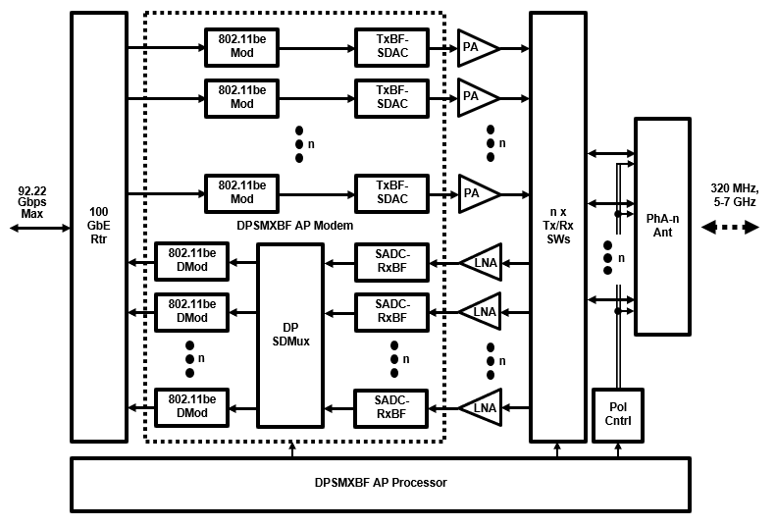
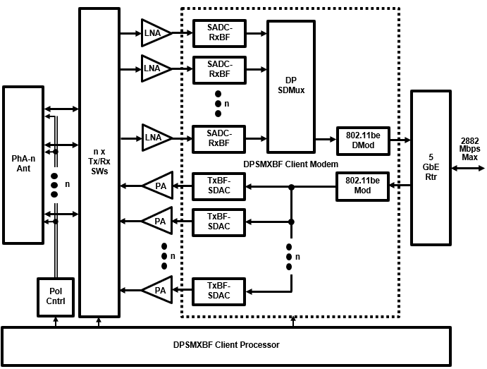
Contemplated DPSMXBF WLAN Architecture
DPSMXBF AP
DPSMXBF CLIENT
4

Slide 5
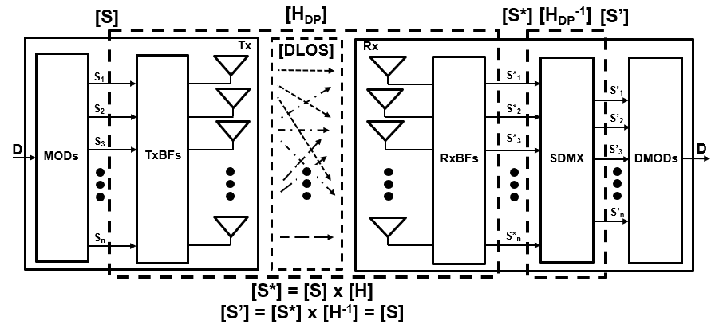
DPSMXBF Tutorial
Reciprocally Interference-Free Cochannel Propagation of
Up to 32 WLAN Spatial Streams in the Terrestrial DLOS Channel
Data “D” is modulated into “n” parallel RF spatial streams [S]
[S] is MIMO Tx and Rx beamformed and launched directionally across Terrestrial DLOS channel to arrive at the receiver SDMX as [S*], all represented by [H]
SDMX computes and applies the inverse transfer function [H⁻¹] to [S*] in order to recover [S] (= [S’]). [S’] are then demodulated and aggregated back into D
5

Slide 6
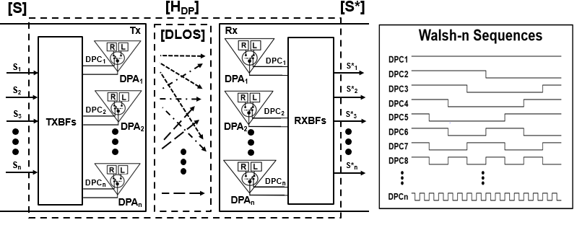
The DPSMXBF Spatial Multiplexer
[H_{DP}]: DPSMXBF Propagation Channel
  n Tx “DPA” antennas “Polarization Modulate” [S] IAW n distinct Walsh-m sequences
  The DLOS channel aggregates and transports n pol-mod [S] onto n Rx DPAs
  Rx DPAs pol-demod [S] aggregates with the same Walsh-n codes to yield [S*]
A2

Slide 7
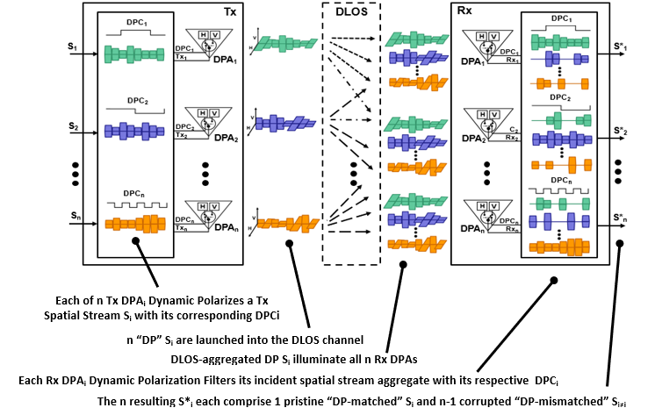
[H_{DP}] Operation
  The one [H_{DP}] output [S*] DP-matched S_{i} component is clearly identical to the [H_{DP}] input [S] S_{i} component, so is represented by a “1” in the [H_{DP}] matrix
  The n-1 [S*] DP-mismatched S_{j≠i} components comprise [S] S_{j≠i} components each missing constituent symbols, and are represented within [H_{DP}] by a variable “r_{ij}” corresponding to the measured similarity (or correlation) between S_{i} and S*_{j}
A3

Slide 8
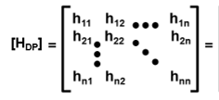
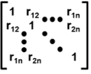

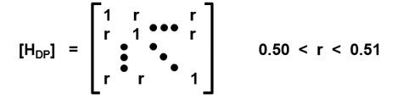
[H_{DP}] Representation
  At this point, the [H_{DP}] transfer function matrix can be represented as follows:
  r_{ij} roughly equals the S_{i}:S*_{j} Walsh sequences cross-correlation (i.e., always 50%)
  The r_{ij} are time-invariant, deterministic and uniform, a constant “r” close to 0.5000
  The precise value of r corresponds to the cross-polarization isolation exhibited between the orthogonally polarized elements comprising the Rx DPA antennas
    For example, commercial X-band antennas spec cross-pol isolation at -25dB typical
    Which gives us the definitive
TxS_{i} symbols
Polarization-matched Rx S_{ii} symbols propagate 1.0000x
Ideal polarization-mismatched
Rx S_{j≠i} symbols propagate 0.0000x
r_{ij} = 0.5000
6 GHz polarization-mismatched Rx S_{j≠i} symbols propagate 0.0032x
r_{ij} = 0.5016
A4

Slide 9
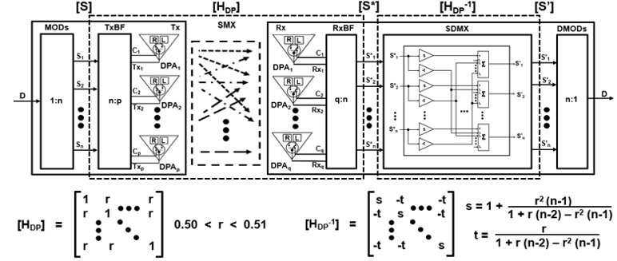
Dynamic Polarization Summary
Finally, the comprehensive Dynamic Polarization MIMO Tx-Rx model:
  DP spatial multiplexing polarization-decorrelates the S_{i} into S*_{i} per [S*] = [S] x [H_{DP}]
  DP spatial demultiplexing matrix-inverts the deterministic, time-invariant and uniform [H_{DP}] into a corresponding DT-IU [H_{DP}⁻¹]
  The SDMX operation [S’] = [S*] x [H_{DP}⁻¹] is equivalent to the n equations
  S’_{i} = s S*_{i} – t Σ S*_{j≠i} for i, j = 1, 2, … n
  IOW, faithfully reproducing the originally transmitted [S] comprises arithmetically manipulating the received [S*] n times, a trivial exercise even for very large n
A5

Slide 10
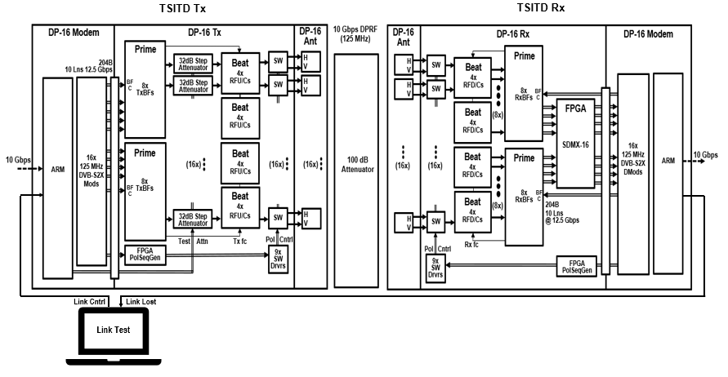
TSI Technology Demonstrator
625 Mbps SISO/ 10 Gbps DP16 LEOSat Tx-Rx
Data Rate vs SNR Test Setup
DPNW
Server
DPNW
Client
B1

