Slide 1
Enabling fully functional 320 MHz sensing
Date: 2023-08-30
Authors:
Name | Affiliations | Address | Phone | Email
Cheng Chen | Intel |  |  | cheng.chen@intel.com
Ali Raissinia | Qualcomm |  |  | alirezar@qti.qualcomm.com
Julia Feng | Mediatek |  |  | Julia.Feng@mediatek.com
Dong Wei | NXP |  |  | dong.wei@nxp.com
Notes:
September 2012

Slide 2
Executive summary
This contribution discusses a technical proposal to enable fully functional 320 MHz sensing for 11bf and the associated changes needed for 11bf D2.0 for this proposal.
  In LB276, there are a few CIDs related to this topic as well. These CIDs include: CID 3349, 3350, 3351, 3352, 3367.
The basic idea is to align the use of 320 MHz SI2SR/SR2SI/SR2SR NDP in 11bf with the 320 MHz EHT Ranging and TB Ranging NDP recently defined in 11bk.

Slide 3
320 MHz sensing in 11bf D2.0
Currently, 320 MHz sensing is only partially supported in 11bf D2.0.
  TB sensing measurement exchange
    Only supported in the NDPA sounding phase.
    Not supported in SR2SI TF sounding phase.
    Not supported in SR2SR TF sounding phase
  Non-TB sensing measurement exchange
    Not supported.
Therefore, existing 320 MHz sensing solution in 11bf D2.0 is not a complete one and is not fully functional.

Slide 4
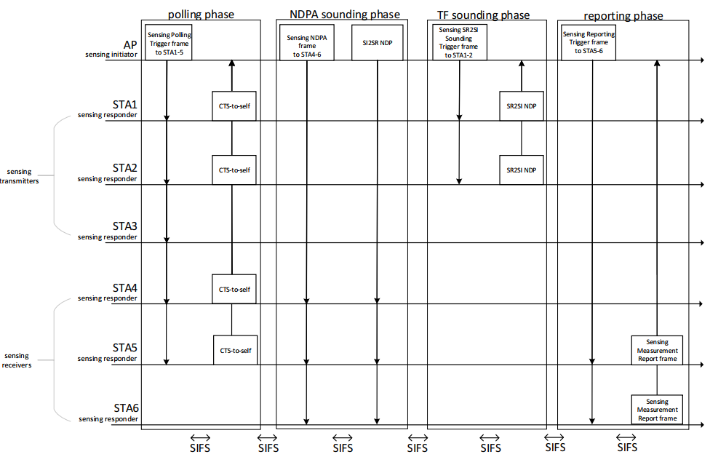
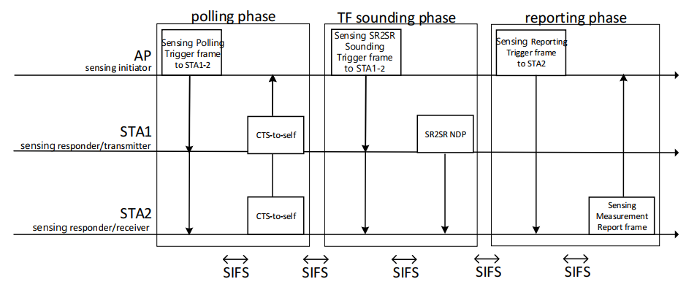
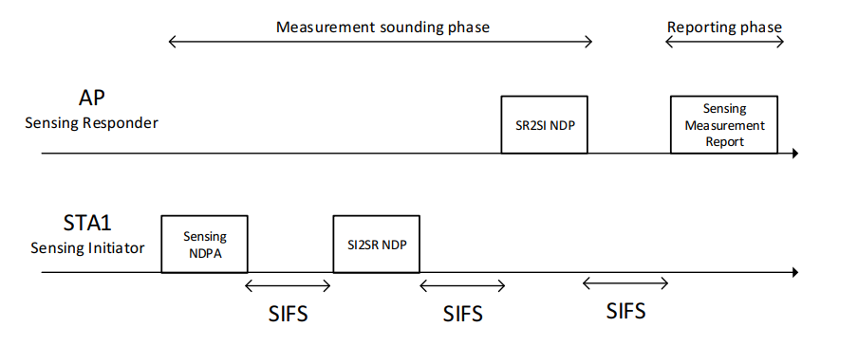
TB and NTB sensing measurement exchange
320 MHz NOT Supported
320 MHz Supported
320 MHz NOT Supported
320 MHz NOT Supported

Slide 5
Background for existing 320 MHz sensing solution
The adoption of existing 320 MHz sensing solution was mainly due to restrictions of available options back in D0.1 timeframe.
  Existing 320 MHz sensing solution was adopted by 11bf with Motion 141 run on Sep. 12, 2022.
  At that time, the only available 320 MHz NDP is the 320 MHz EHT NDP defined in 11be.
    Note that 11bf PAR does not allow us to make any PHY changes in sub-7 GHz, so we can only reuse existing NDPs or NDPs defined by other TGs.
  Because of the strong interest from TGbf members to define 320 MHz sensing, we ended up adopting 320 MHz EHT NDP as the solution.
  Moreover, given the 320 MHz EHT NDP is only applicable to the DL NDPA sounding phase in TB sensing measurement exchange, 320 MHz sensing is only supported in NDPA sounding phase in TB sensing measurement exchange.

Slide 6
Motivation for enabling fully-functional 320 MHz sensing
In Jan. 2023, TGbk (320 MHz Positioning) was formed, and the primary goal for TGbk is to enhance the IEEE 802.11 FTM positioning protocols with the IEEE 802.11be derived 320MHz waveforms¹, including defining 320 MHz Ranging and TB Ranging NDP.
Most recently, TGbk has generally completed the design of 320 MHz Ranging and TB Ranging NDP in its released D0.2, which is available to all 802.11 members².
¹https://www.ieee802.org/11/Reports/tgbk_update.htm
²https://www.ieee802.org/11/private/Draft_Standards/11bk/index.html

Slide 7
Proposal to enable fully functional 320 MHz sensing
With the definition of 320 MHz EHT Ranging and TB Ranging NDP in 11bk, in order to enable fully-functional 320 MHz sensing, we would like to propose the following changes to 11bf D2.0 for the group’s consideration.
  1. Replace the current 320 MHz EHT NDP used in NDPA sounding phase in TB sensing measurement exchange with the 320 MHz EHT Ranging NDP defined in 11bk.
    Note: Currently for BW <= 160 MHz, we are already using Ranging NDP in this scenario.
  2. Extend the TF sounding phase in TB sensing measurement exchange and Non-TB sensing measurement exchange to 320 MHz with the use of 320 MHz EHT Ranging and TB Ranging NDP defined in 11bk.
    Note: Again, for BW <= 160 MHz, we are already using Ranging NDP and TB Ranging NDP for these two scenarios.

Slide 8
Benefits of the proposed changes
There are a variety of benefits for this proposal:
  1. It enables fully functional 320 MHz sensing covering all scenarios in 11bf.
    In contrast, existing solution only supports 320 MHz sensing in NDPA sounding phase in TB sensing measurement exchange.
  2. 320 MHz EHT Ranging NDP brings more flexibilities compared to EHT NDP, such as LTF repetition etc.
  3. It fully aligns the use of SI2SR/SR2SI/SR2SR NDP with Ranging/TB Ranging NDP in all TB and NTB flows in 11bf.
    Note that we are already reusing Ranging NDP in all scenarios with BW <= 160 MHz.
    Moreover, we are already reusing Ranging NDPA frame and Ranging Trigger frame formats for Sensing NDPA and Sensing Trigger frame formats.
  4. It unifies the NDP support for an 11bf device for sub-7 GHz.
    Currently, an 11bf 320 MHz capable STA needs to support both Ranging NDP (<= 160 MHz) and EHT NDP (320 MHz) for the same protocol flow. It brings additional complexity for the implementation to support two variants of NDP formats for the same protocol flow.
  5. It eases the implementations complexity for existing 11az capable devices to also support 320 MHz sensing.
    Existing 11az devices can be upgraded to also support 320 MHz EHT Ranging and TB Ranging NDP defined in 11bk. If they are also reused in 11bf, it will significantly reduce the effort for these implementations to also support 320 MHz sensing.

Slide 9
Puncturing support in 11bf and 11bk
In 11bf D2.0, we have already agreed that 11bf shall support all 320 MHz puncturing modes defined in 11be (Motion 189 and Motion 238).
In 11bk, whether to support all 320 MHz puncturing modes is still pending, and there are some contributions proposing mandatory support for a subset of puncturing modes.
As a result, some TGbf members have some concern that if TGbk decides to only mandatorily support a subset of 320 MHz puncturing patterns, there might be some issues for 11bf to reuse the 320 MHz EHT Ranging and TB Ranging NDP.

Slide 10
Puncturing support in 11bf and 11bk
After extensive study and discussions, we beleive that whether 11bk decides to mandatorily support all or a subset of 320 MHz puncturing modes does NOT impact the puncturing support for 11bf due to the following reasons:
  We are only proposing to reuse the 320 MHz EHT Ranging NDP and EHT TB Ranging NDP format defined in 11bk, not the puncturing support.
  TGbk still follows and defines all 11be puncturing patterns using the indication in the Disabled Subchannel Bitmap subfield of the EHT Operation element for the 320 MHz EHT Ranging and TB Ranging NDP.
  The only difference is that in 11be we do not have any capabilities fields to indicate support for a specific puncturing pattern, so all puncturing patterns shall be supported. In contrast, in 11bk if it is decided to only mandatorily support a subset of puncturing patterns, 11bk will define corresponding capabilities for those puncturing patterns. However, this does NOT impact the definition of any punctured 320 MHz EHT Ranging or TB Ranging NDP format.
  For 11bf, we will not define any capabilities for any specific puncturing pattern, so all 320 MHz puncturing patterns remain mandatory, the same as in 11be. Therefore, there should be no problems for 11bf to reuse the 320 MHz EHT Ranging and TB Ranging NDP with any puncturing pattern.

Slide 11
Conclusions
In this contribution we presented a proposal to enable fully functional 320 MHz sensing.
  The basic idea is to align the use of 320 MHz SI2SR/SR2SI/SR2SR NDP in 11bf with the 320 MHz EHT Ranging and TB Ranging NDP recently defined in 11bk.
  We believe there are multiple benefits for this proposal, and it will greatly help to enhance and promote 320 MHz sensing.

Slide 12
SP
Do you agree with the following?
  11bf shall adopt the following changes with respect to 320 MHz sensing:
    1. Replace the current 320 MHz EHT NDP used in NDPA sounding phase in TB sensing measurement exchange with the 320 MHz EHT Ranging NDP defined in 11bk.
    2. Extend the TF sounding phase in TB sensing measurement exchange and Non-TB sensing measurement exchange to 320 MHz with the use of 320 MHz EHT TB Ranging NDP and EHT Ranging NDP defined in 11bk.

