Slide 1
NPC sims follow-up
Date: 2023-08-31
Authors:

Slide 2
Introduction
In our previous round of sims we presented some evaluations on non-primary channel access for the case when all STAs can hear each other.
In this presentation we try to address the scenarios with non-ideal channel conditions specifically cases where the RSSI from UHR BSS to OBSS on secondary channel falls between ED and PD thresholds fully or partially.
As KPI we consider the following scenarios:
  Full buffer UDP throughput
  Latency in a typical VR scenario.

Slide 3
Topology 1 @23dBm AP Tx power
:05
OBSS AP-2 (sec 40)
-40
:06
-81 (p) and -78 (s)
-76 (p) and -73 (s)
-66
:03
UHR AP
(80 MHz)
:04
-53
-47
OBSS AP-1 (prim 40)
-73
Notes:
Non-ht dup ctrl frame rx power is for primary 20
Data is over entire BW

Slide 4
Traffic config for full-buffer case
Variable On-off traffic pattern at OBSS APs repeated every 500ms with random initial offset.
For example, if percentage is 40%, then on-period is 200ms and off is 300ms.
NSS-2. Static MCS: 7/5/3.
NP switch deferral duration (“NPSwitchTime”): 0ms/2.7ms.
Tx Power:
  For all APs: 21dBm + 2 dB TX gain
  For all STAs: 17dBm + 0 dB gain

Slide 5
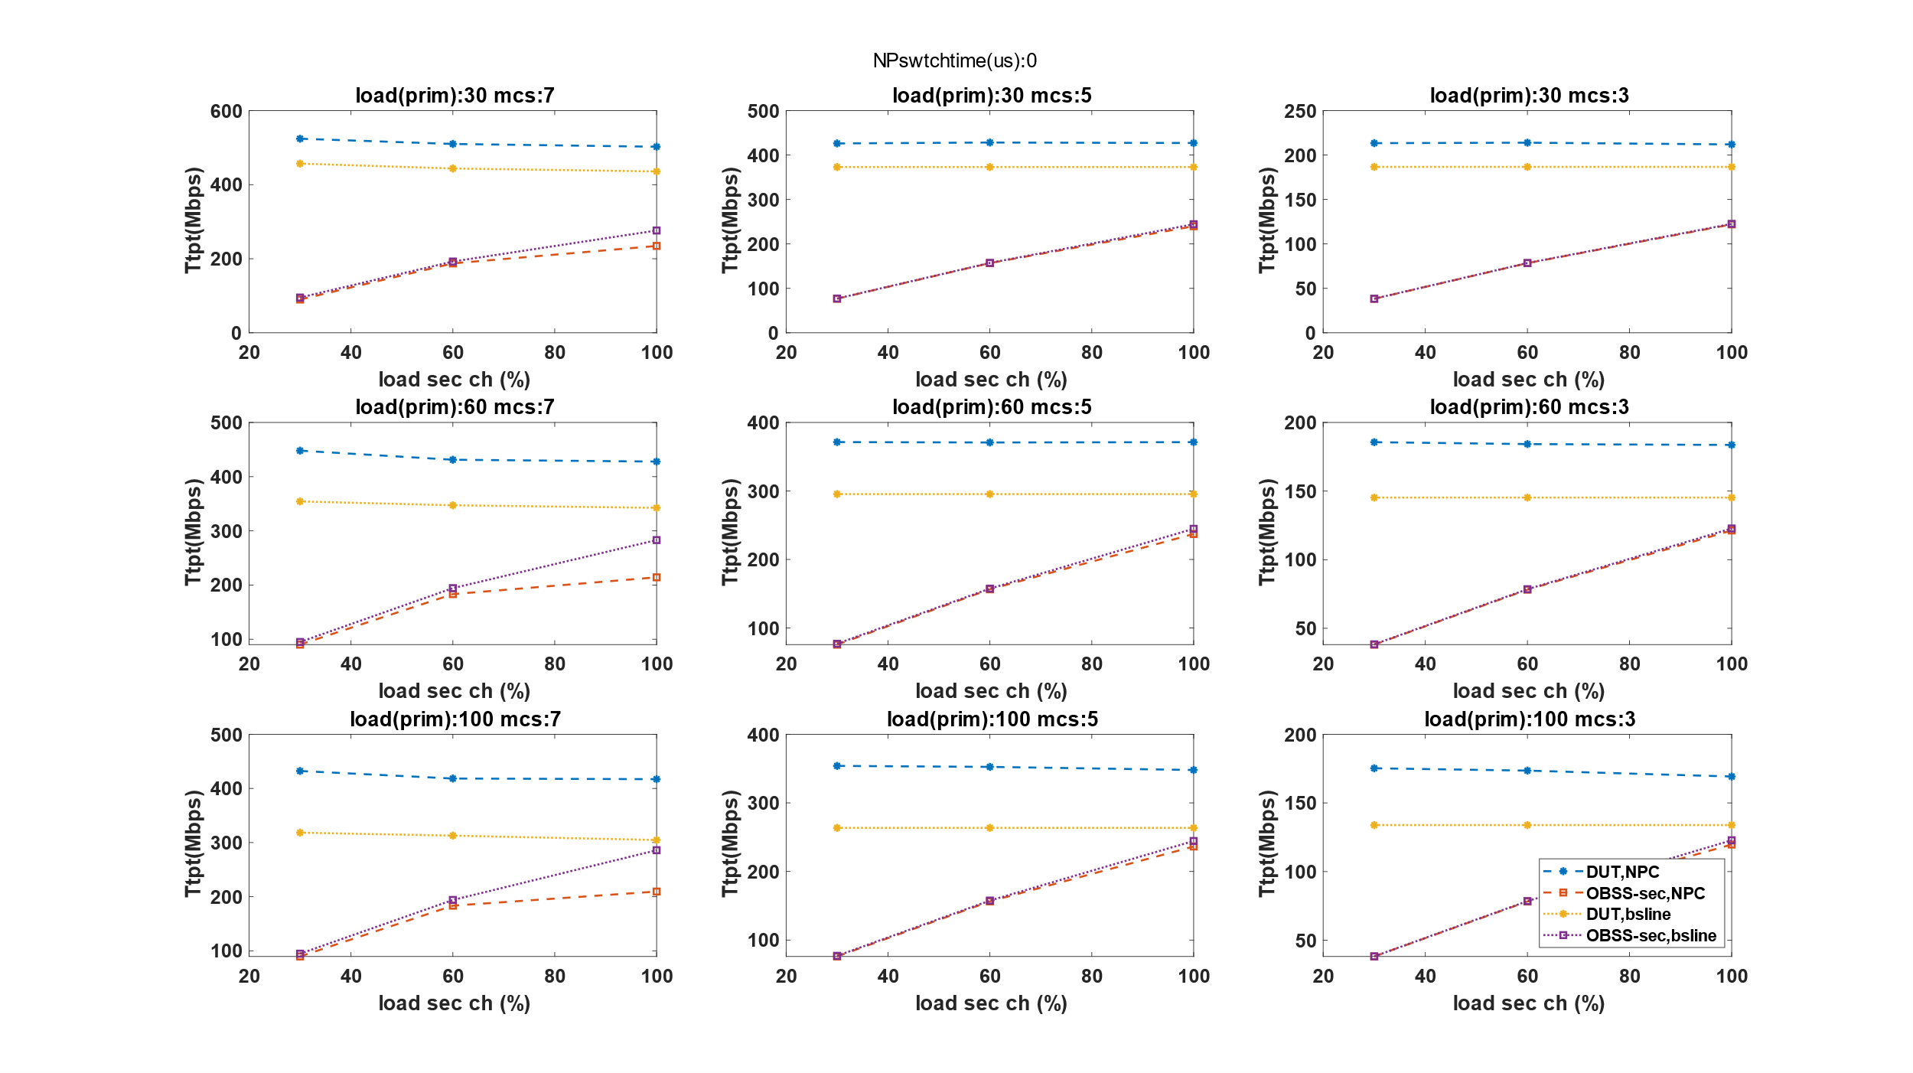
Results for NPSwitchTime = 0
AT MCS-5 Gain is 15% @ 30% load, 25% at 60% load, and 31% @ 90% load. Similarly for MCS-7.
AT MCS-7 OBSS fails to deliver all packets when load is high. No problem at lower MCS presumably because MCS is robust even if UHR BSS’ transmissions temporarily lowers OBSS’s SINR..

Slide 6
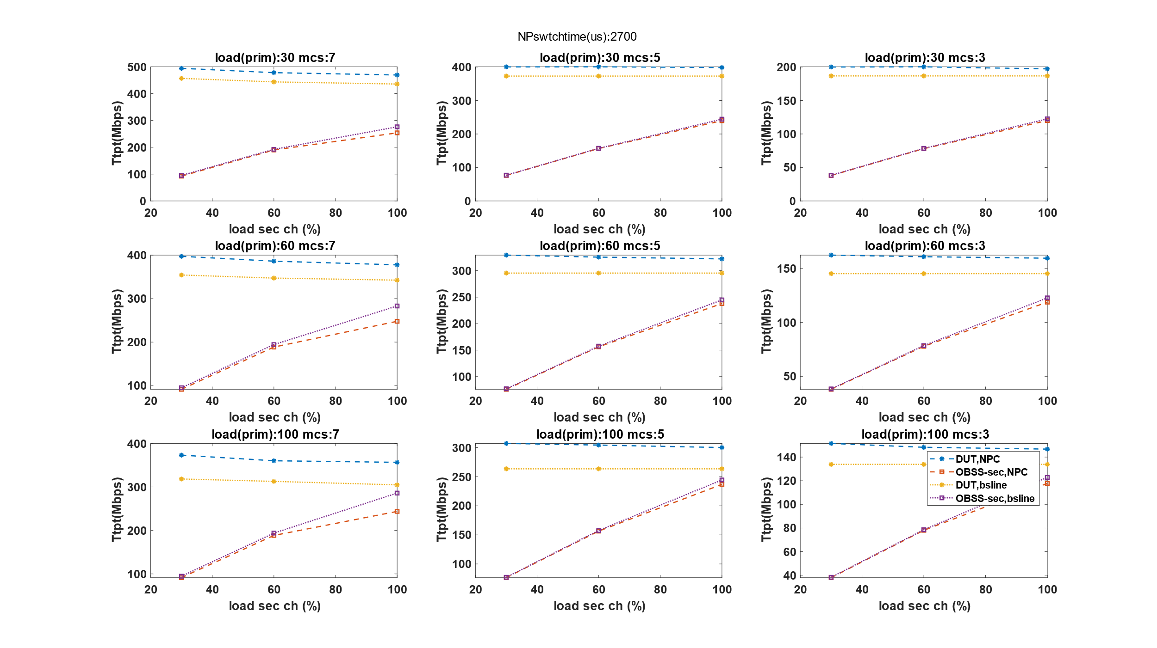
Results for NPSwitchTime = 2.7ms
Gains are reduced but still non-trivial.

Slide 7
XR traffic config
IMU
IMU delay
Data rate in UL (IMU)~200 kbps
Data rate in DL (Render data) ~ 20 Mbps
Assumes server renders data based on latest received IMU and no encoding-decoding delay.
4ms
MTP latency
Rendered data
Render delay
16 ms
HMD/client
VRserver/AP

Slide 8
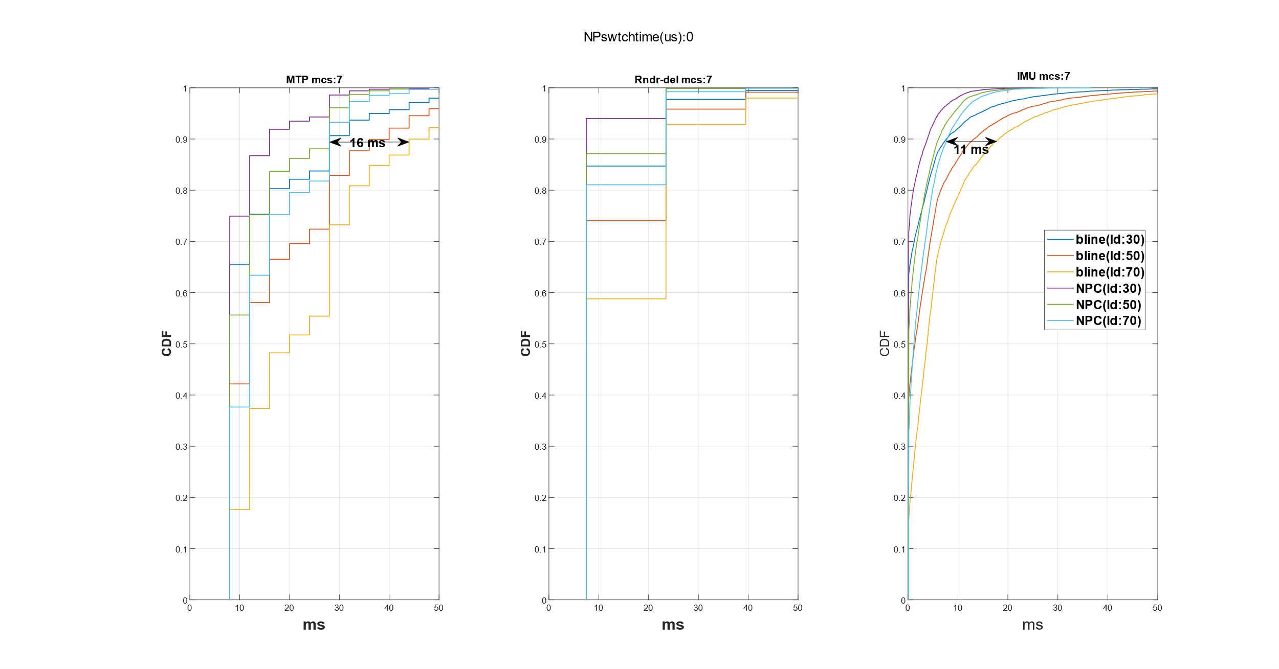
Results for XR case
@ 70% OBSS load, close to 50% reduction in 99-%ile IMU latency and ~38% reduction in 99-%ile MTP latency

Slide 9
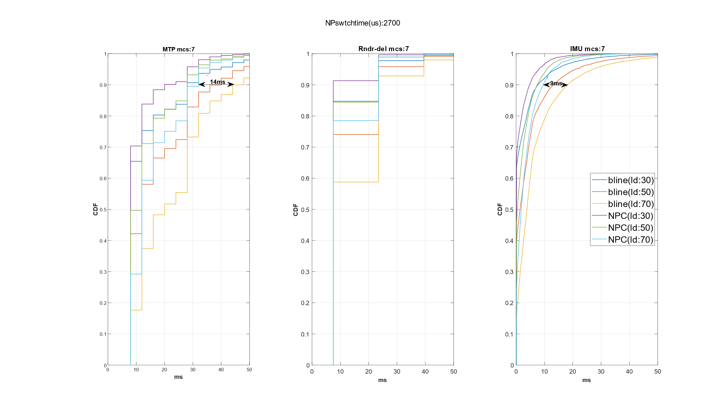
Results for XR case (contd.)
Gains are lower but still significant.

Slide 10
Topology 2 @23dBm AP Tx power
OBSS AP-2 (sec 40)
OBSS AP-2 and UHR AP are not hidden but STAs are.
-68
-66
-66
DUT AP
-56
-50
OBSS AP-1 (prim 40)
-73

Slide 11
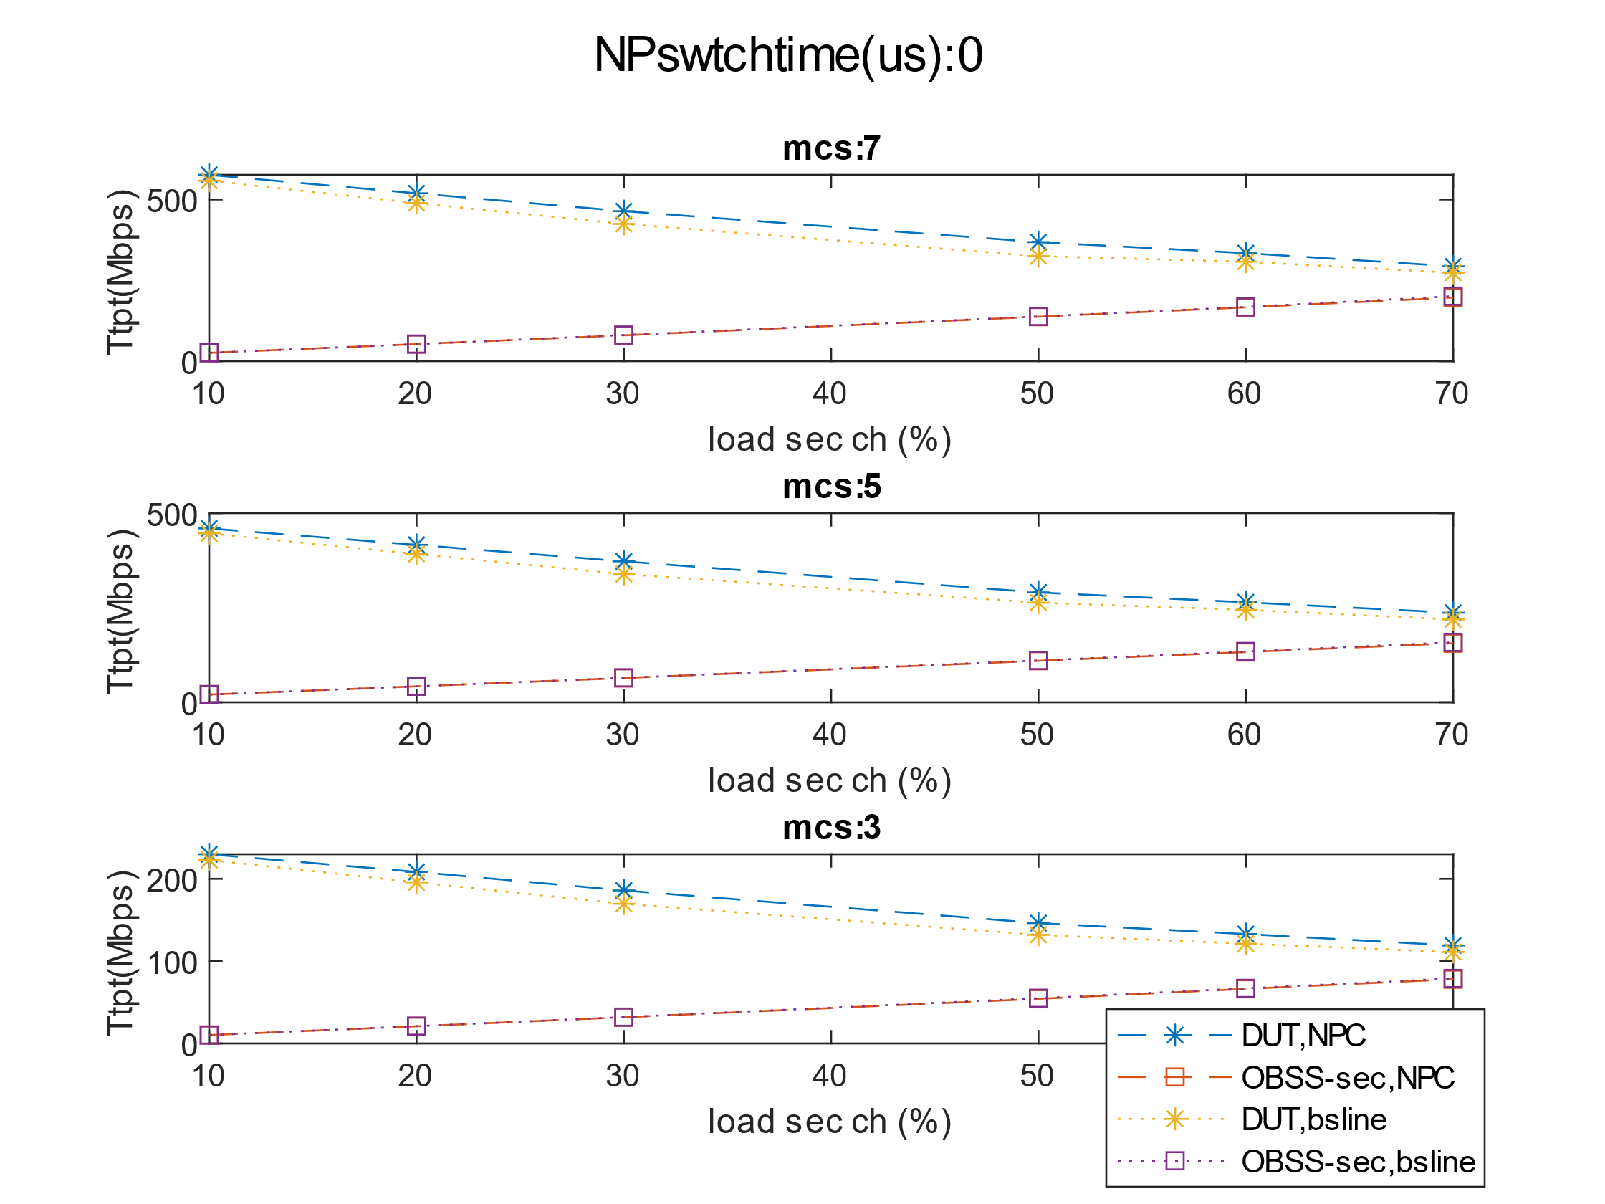
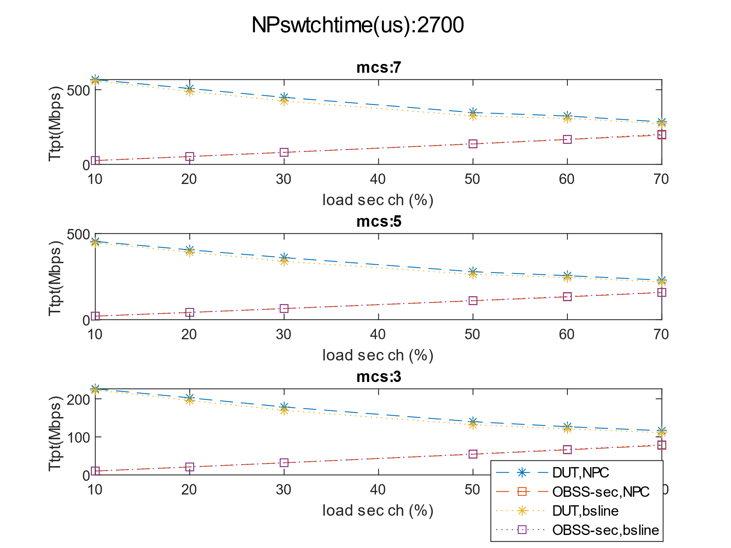
Full buffer throughput case
For each data point, load in primary and secondary channels are set to same value.
Gains are limited in this case in the range of 10-15% when NPC switch time is 0 and lower when this is increased.

Slide 12
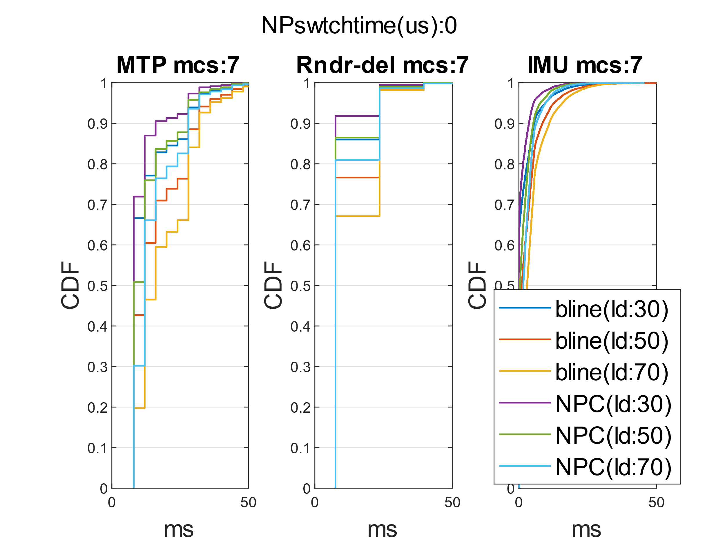
XR case
@70% OBSS load, 90%-ile IMU latency drops by about 4ms from 9ms. 95%-ile MTP latency also drops by about 4ms
@30% load, 90%-ile IMU latency drops to 3.6ms from 5.5ms while 90%-ile MTP latency drops from about 28ms to 16ms.

Slide 13
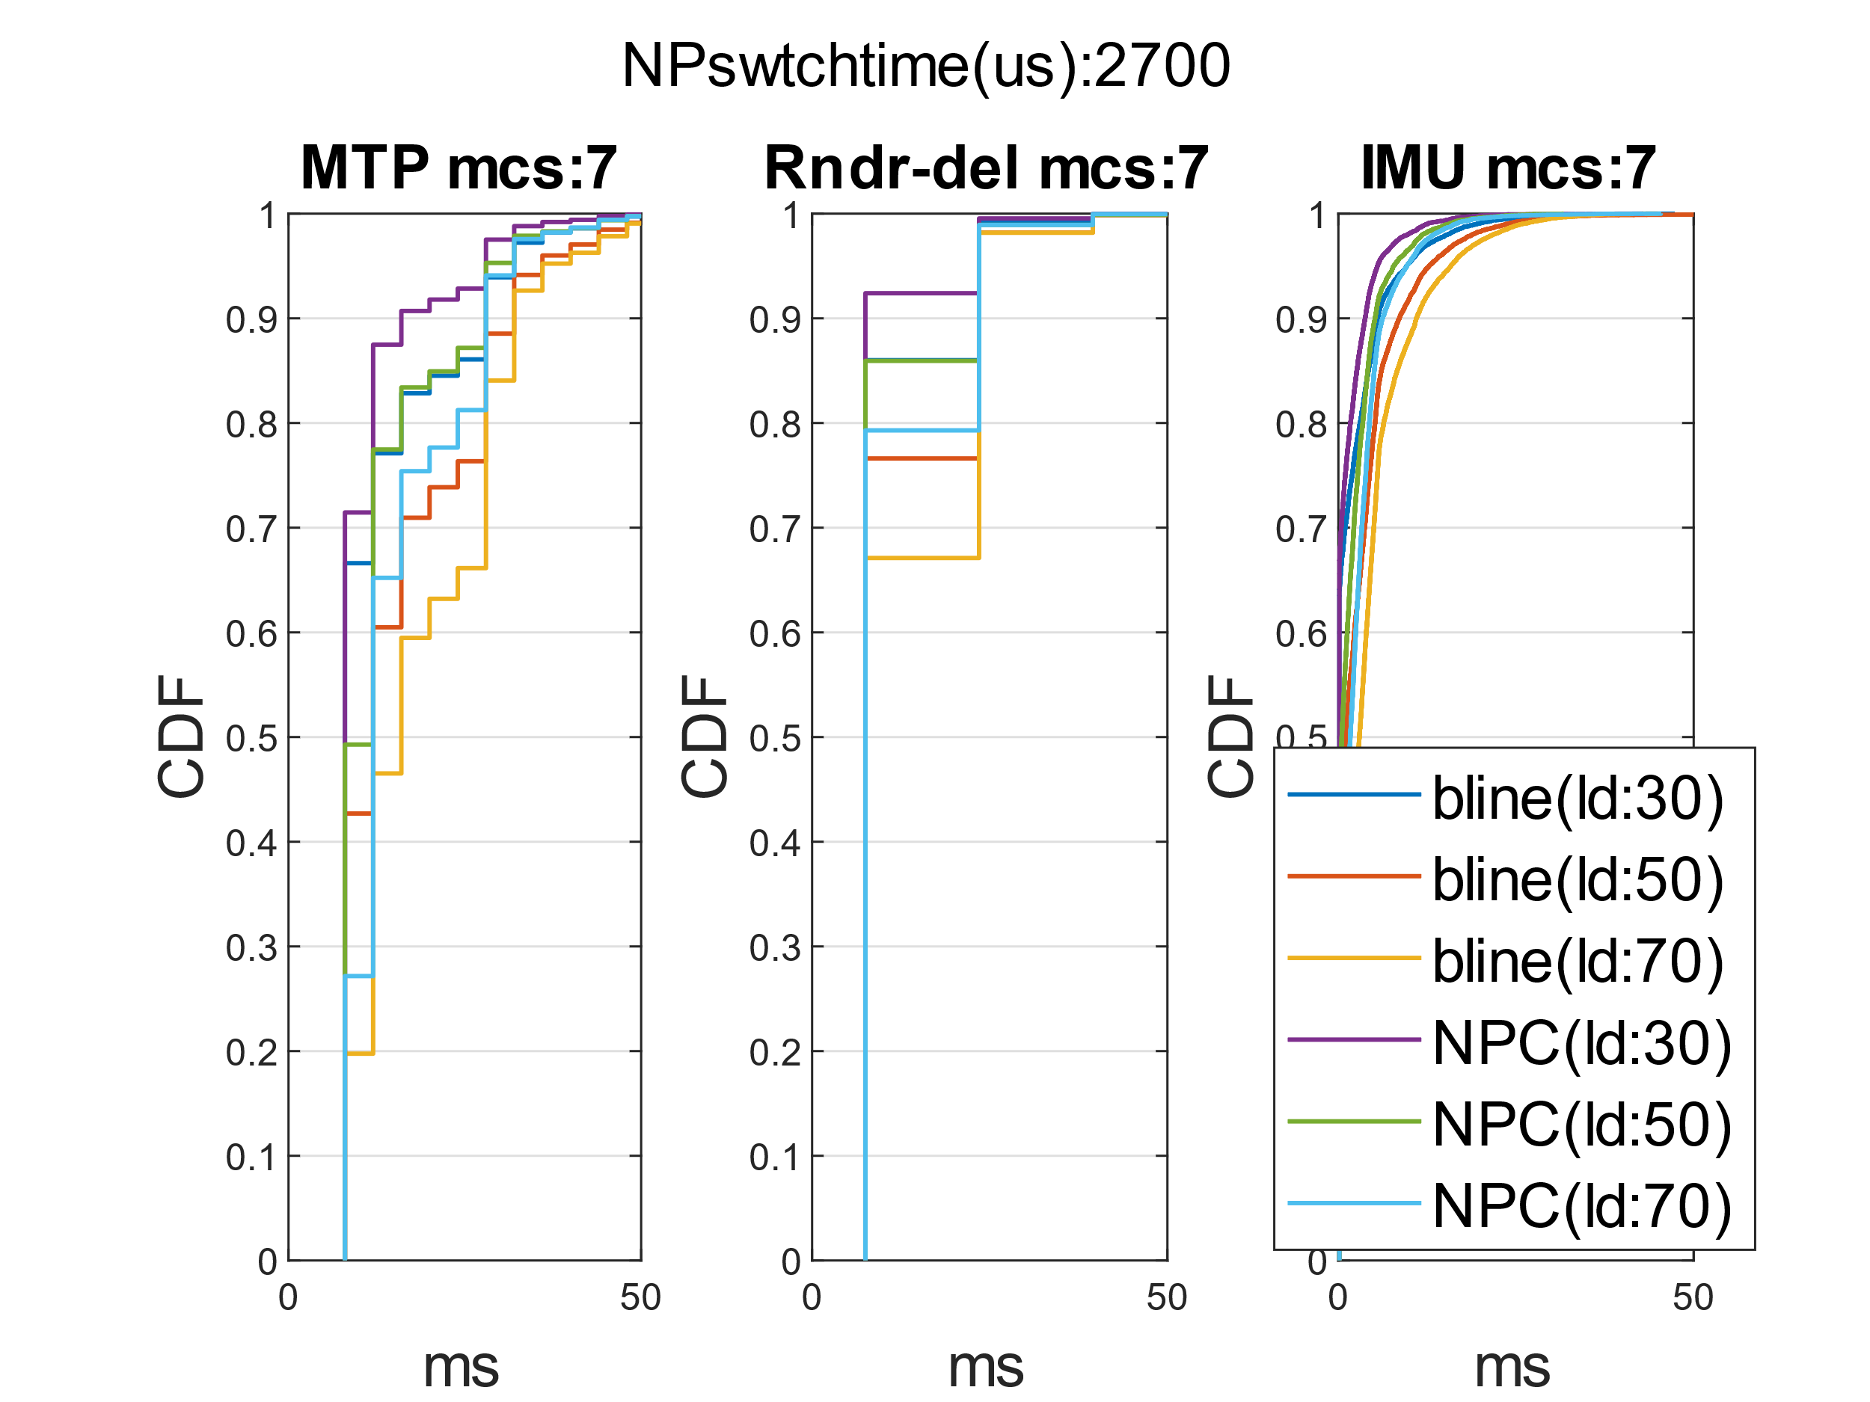
XR case (contd.)
Similar trends as previously. Most pronounced gains @30% load, where 90%-ile IMU latency drops to 3.8ms from 5.5ms while 90%-ile MTP latency drops from about 28ms to 16ms.

Slide 14
Conclusions
Non-primary channel access shows gains in terms of throughput even in the extreme scenarios when the BSS on secondary channel are somewhat hidden from the UHR BSS.
However, even in those topologies significant latency reduction is observed for XR scenarios.
  Those gains are expected to increase when NPC is used together with other current or in-development mechanisms (e.g., TXOP sharing).

