Slide 1
[CID18 and CID111 Resolution for LB274]
Date: 2023-08-27
Authors:

Slide 2
Abstract
This document proposes a solution to address CID18 and CID111, which are about non-AP STA to non-AP STA identification.

Slide 3
CID18 and CID111
Two CIDs about communication between non-AP STAs
CID | Comment | Proposed Change
18 | two non-AP STA commnucation is improtant, and widely used in Wi-Fi industry, like Wi-Fi Mirocast . But one STA to identify another STA with RCM via IRM is missing,11bh SPEC should add this part support. | add non-AP STAs' identification with RCM
111 | D1.0 does not address some of the scenarios such as TDLS. | If applicable, add support for IRM and/or device ID in TDLS.

Slide 4
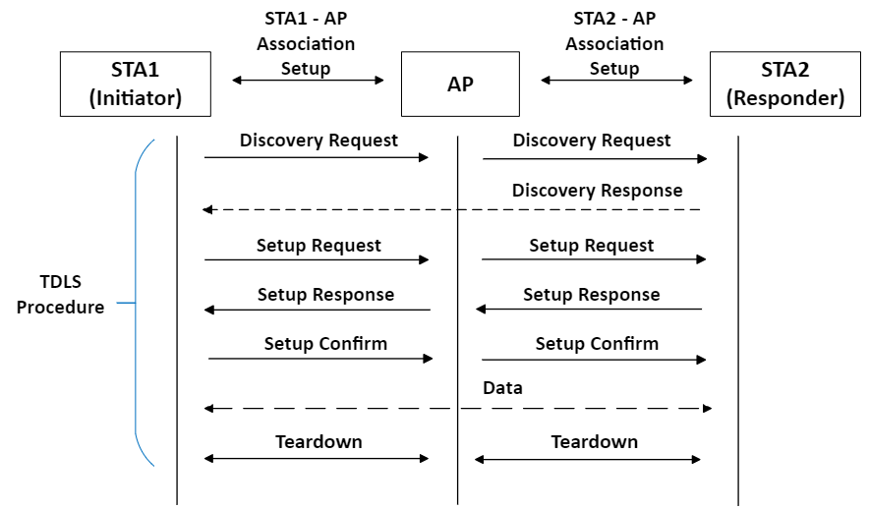
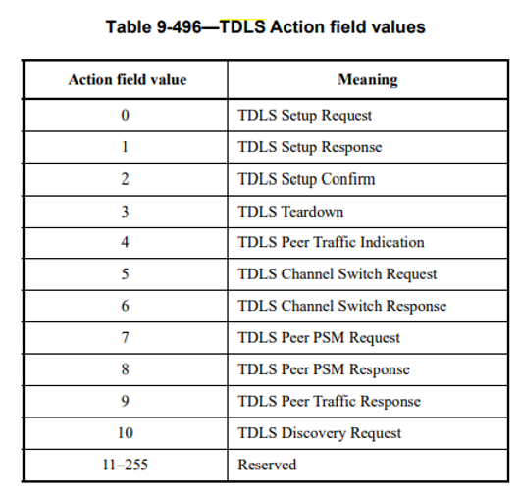
Recap: TDLS
TDLS (Tunnel Direct Link Setup) enables at least two non-AP STAs to communicate with each other (while they are associated) to the same AP (ESS)

Slide 5
Recap: TDLS
TDLS uses action frames (called TDLS Action frames).
These frames are encapsulated in data frames so they are protected, such as:
This is seen in the air (Encrypted Data Frame)
This is the real content in the encrypted Data Frame

Slide 6
What CID18 and CID111 want?
The current 802.11bh D1.0 only addresses AP (ESS) to identify the non-AP STA. It does not address a (non-AP) STA identifying the other (non-AP) STA in the same ESS for TDLS. Example:
STA1 (e.g., phone)
AP
STA2 (e.g., TV)
Association
Association
Initial Connection
(device ID/IRM allocation)
(device ID/IRM allocation)
TDLS connection
TDLS connection
Association
Association
AP identifies STA1 and STA2
Next Connection
(device ID/IRM usage)
(device ID/IRM usage)
TDLS connection
TDLS connection
STA1 and STA2 don’t identify each other

Slide 7
Proposal to address CID18 and CID111
Since TDLS Action Frames are encapsulated in data frames (and hence protected), device ID/IRM element can be put into one of the TDLS Action Frame.
Specifically, Setup Request/Setup Response looks like a good way to go.
STA2 receives STA1’s (TDLS) device ID/IRM)
In the next TDLS connection, because STA1 and STA2 have other side’s device ID/IRM, it can identify the other side.
STA1 receives STA2’s (TDLS) device ID/IRM)

Slide 8
Proposal to address CID18 and CID111
To put it into words,
In the initial connection,
STA1 and STA 2 associates with AP (device ID/IRM allocation for AP)
TDLS initiator (e.g. STA1) sends its TDLS device ID/IRM to TDLS responder (e.g. STA2) in TDLS Setup Request TDLS responder (e.g. STA2) sends its TDLS device ID/IRM to TDLS initiator (e.g. STA1) in TDLS Setup Response (device ID/IRM allocation for STAs)
In the next connection,
STA1 and STA 2 associates with AP (device ID/IRM usage so that AP identifies them)
STA1 and STA2 sends allocated device ID/IRM in TDLS Setup Request/Response (device ID/IRM usage so that STAs identify each other)

Slide 9
SP1
Q: Do you think 802.11bh should address identification between two non-AP STA’s? Yes, No, Don’t care, Abstain

Slide 10
SP2
Q: Do you think the proposal in this document (device ID/IRM allocation and usage in TDLS Setup Request and TDLS Setup Response) is a good way to address STA to STA identification for TDLS ? Yes, No, Don’t care, Abstain

