Slide 1
Nonprimary Channel Access Discussions
Date: 2023-09-12
Authors:
Name | Affiliations | Address | Phone | email
Gaurang Naik | Qualcomm Technologies Inc. |  |  | gnaik@qti.qualcomm.com
George Cherian
Yanjun Sun
Abhishek Patil
Alfred Asterjadhi
Duncan Ho
Abdel Karim Ajami

Slide 2
Introduction
IEEE 802.11 offers support for very large bandwidths
  EHT has defined support for up to 320 MHz
However, access to wideband channels in 802.11 is contingent on access to the primary 20 MHz channel
This limitation leads to underutilization of the spectrum
Harvesting this unutilized medium (BW) can help improve latency and throughput
Nonprimary channel access can help improve the spectral efficiency
Frequency
S80
Unutilized resource
In-BSS Transmission
Pre-UHR
S40
S20
P20
OBSS Transmission
subchannels
Time

Slide 3
Design Principles
Enable nonprimary channel access with simple changes to the baseline 802.11 channel access rules
These include
  Enable the feature without requiring concurrent packet detection/CCA capabilities on different subchannels
  Allow access only on one nonprimary channel
    To reduce coordination loss between AP & STA due to asymmetric view of the primary channel
  Limit the TXOP on nonprimary channel to the duration of OBSS TXOP on primary channel
    To ensure backward compatibility with legacy STAs
  Initiate TXOPs on nonprimary channel with a short Control frame
    To confirm the peer STA’s presence on the nonprimary channel

Slide 4
Nonprimary channel access protocol (1/2)
When an OBSS PPDU is detected, AP & STAs switch to nonprimary channel and contend for access
  A TXOP on nonprimary channel is initiated with a Control frame
AP & STAs return to the primary channel by the end of OBSS TXOP
An illustration of downlink frame exchange using nonprimary channel access
Contend for access
Control frame, addressed to STA
R
C
Data (STA)
ACK
Return to Primary
AP
Detect OBSS &
Switch to Nonprimary
R
C
Nonprimary
OBSS
Primary
R
C
Data (STA)
ACK
Detect OBSS &
Switch to Nonprimary
R
C
Non-AP STA
Nonprimary
OBSS
Primary

Slide 5
Nonprimary channel access protocol (2/2)
Device requirements
  A STA must be capable of switching dynamically from primary channel to nonprimary channel and vice versa
Signaling considerations
  AP signals the nonprimary channel where contention is allowed
  AP and STAs signal their respective delays to switch from primary channel to nonprimary channel, and vice versa
Medium synchronization
  Before initiating a TXOP on the nonprimary channel, a STA must follow baseline medium synchronization recovery rules

Slide 6
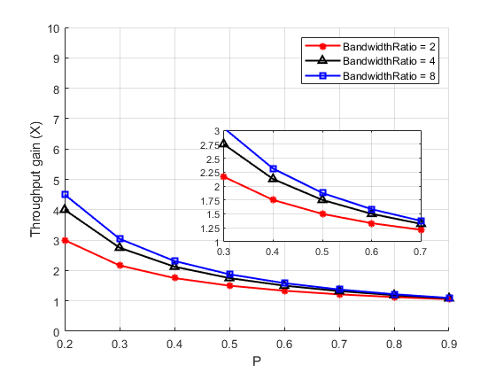
Gain Analysis – Setup 1: Idealistic Scenario (above ED)
Theoretical gains
Assumptions:
  Two BSSs are in ED range
  Primary channels are the same
  No adjacent channel interference
  Concurrent CCA/PD on subchannels
Notations:
  In-BSS occupancy fraction = p
  BW ratio = In-BSS BW / OBSS BW

Slide 7
Setup 1 – Idealistic Scenario (above ED)
Topology
  All devices are within ED range, i.e., above -62 dBm
  Legacy BSS supports 40 MHz
  UHR BSS supports 80 MHz
  Total number of STAs = 10.
    Number of STAs in the UHR BSS is varied from 1 to 9.
    Remaining STAs are in the legacy BSS
    Define P = Fraction of STAs in the UHR BSS
Traffic
  UL only, full buffer
KPI
  Average Throughput gain of UHR STAs
Channel and bandwidth configuration
1
10
Legacy AP
5
UHR AP
2
AP0
9
AP1
8
3
4
6
7
Topology when P = 0.5
Legacy primary
2
1
8
3
AP0
9
AP1
(I)
UHR primary
7
UHR channel BW
No nonprimary channel access (Baseline)
4
6
Legacy primary
5
10
(II)
UHR Nonprimary
UHR Primary
Topology when P = 0.2
UHR channel BW
Nonprimary channel access enabled

Slide 8
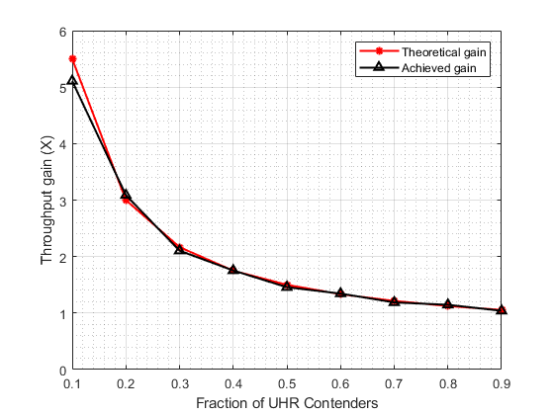
Setup 1 – Simulation Results
When all STAs are within ED range, the gain from nonprimary channel access matches the theoretical gains
  When the share of UHR and legacy contenders is 1:1, avg. throughput gain = 50%.

Slide 9
Caveats
When devices are assumed to be in ED range, gains of nonprimary channel access are promising
  However, the gains diminish if
    Primary channels of overlapping BSSs are different
    Overlapping BSSs are in the [PD, ED] range
    Transmitter and receiver have different views of the channel
    Medium sync recovery incurs delays
    Adjacent channel interference is non-negligible
  We discuss the performance gains in a more realistic setup in the next few slides

Slide 10
Setup 2 – Between PD and ED
Topology with 4 APs, one associated STA each
  AP0 and AP1 are legacy APs (40 MHz)
  AP2 and AP3 are UHR APs (80 MHz)
  All APs hear each other b/w PD and ED threshold, i.e., b/w -82 to -62 dBm
Traffic
  DL only, ON-OFF, all APs have same offered load
KPI
  Average Throughput gain of UHR APs
Channel and bandwidth configurations
0
Legacy STA
(random)
2
Legacy AP
UHR AP
0
2
UHR STA
(random)
Legacy AP
UHR AP
1
3
1
3
Legacy primary
Legacy primary
(A)
UHR primary
(B)
UHR Primary
(C)
UHR Nonprimary
UHR Primary
UHR channel BW
UHR channel BW
UHR channel BW
No nonprimary channel access
(Baseline)
Staggered primary channels
Legacy primary
Nonprimary channel access enabled

Slide 11
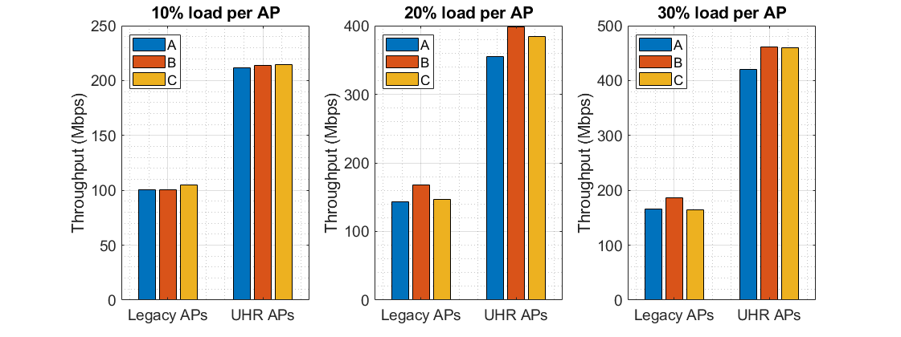
Setup 2 – Simulation Results
Compared to baseline configuration (i.e., A) nonprimary channel access (i.e., C) provides modest gains in average throughput for UHR APs
  Gains are limited between 1.4 – 9.7% depending on offered load conditions
However, staggering the primary channels of UHR and legacy APs (i.e., B) provides equivalent or more gains for UHR APs
  Gains are between 1 – 12.2% depending on offered load conditions

Slide 12
Conclusions
In these slides, we presented our views on various aspects of nonprimary channel access
Gains of nonprimary channel access are scenario-specific
  Lower gains in the simulated scenario can be attributed to the increased spatial reuse for the baseline performance when APs are between the PD and ED threshold range
  In general, the gains are not as much as the idealistic theoretical estimates
  Furthermore, in the simulated scenario, gains from nonprimary channel access are smaller than or are comparable to the gains from staggering the primary channels of overlapping BSSs
Nonprimary channel access protocol design must be simple with the following considerations:
  Enable the feature without the need for concurrent packet detection/CCA capabilities
  Allow channel access only on one nonprimary channel
  Limit TXOP on nonprimary channel to the OBSS TXOP on primary channel
  Initiate TXOP on nonprimary channel with a short Control frame

