Slide 1
TXOP optimizations to support XR use-cases
Date: 2023-09-13
Authors:

Slide 2

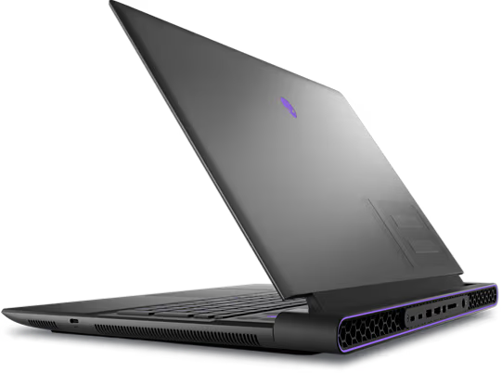

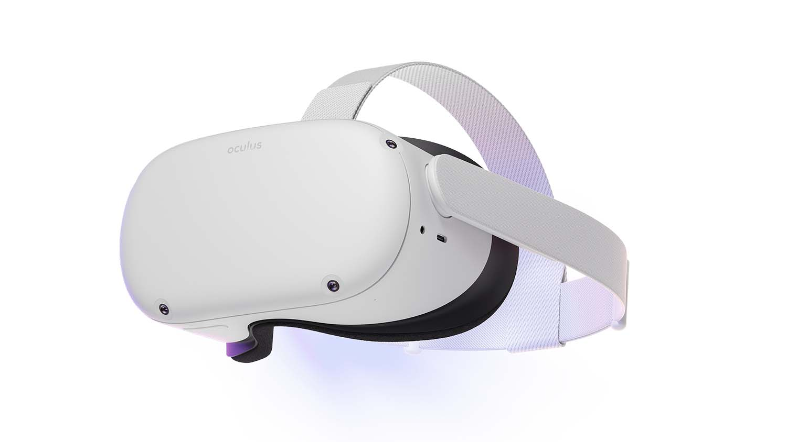
Introduction
XR compute offloading over wireless links is a key capability to scale the adoption of XR devices and applications
A typical XR compute offload scenario involves a rendering machine (e.g., a PC or edge server) connected to an HMD over a wireless link.
  Ideally, the two devices are connected through a P2P wireless link (Topology 1) but could also be via an infra-AP on a wired (Topology 2) or wireless link (Topology 3).
  Pose estimate offload is also an active research area.
Edge server
PC
AP
Pose data
Render data
Pose data
Pose data
Render data
Render data
HMD
HMD
HMD
Topology 3
PC
Topology 1
Topology 2
Notes:
Add figures for first slide.
Move stuff to second slide

Slide 3
Introduction (contd.)
Few aspects to consider regarding QoS in such scenarios:
  Some VR applications follow a well-known cycle: The traffic in one direction (e.g., TCP Data) requires a response in other direction (e.g., TCP Acks) before generating next data (see next slide).
  The End-to-end (E2E) QoS is what matters not just the one-hop QoS.
  Minimizing the HMD awake time is also important to improve battery life.
Clearly, sharing an obtained TXOP improves overall QoS by reducing E2E latency especially in presence of legacy device contention since the participating devices don’t have to compete.
Notes:
Add figures for first slide.
Move stuff to second slide

Slide 4
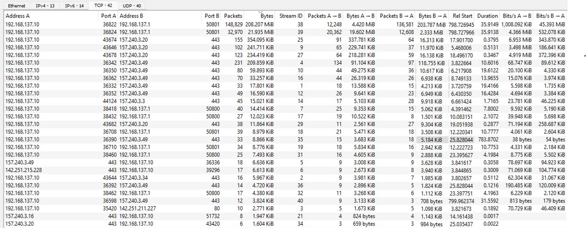
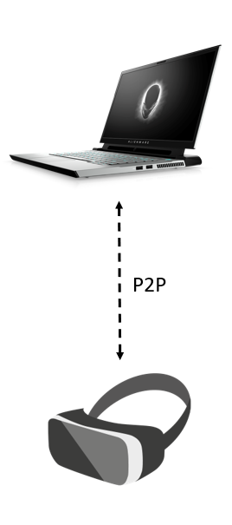
Some observations from current VR tech
Setup:
  An Oculus Quest 2 HMD
  An Alienware gaming laptop with Killer enabled that sets up a P2P (WFD) link with the HMD on an almost-free 80 MHz channel.
Collected traces for the first few minutes of Half-Life : Alyx
The WireShark traces shows most of the traffic is contained in a few asymmetric TCP streams.
Mobile AP
client

Slide 5
Analysis of traffic traces for VR gaming with Oculus Quest 2 (contd.)
TXOP owned by laptop
TXOP owned by HMD
Typical flow consists of
  heavy TCP data (Video) from laptop to HMD
  light data (IMU + response TCP Acks) from HMD to laptop.
The laptop typically reserves TXOP of ~3ms longer than it needs and release it through CF-end.
There is a significant number of events when the TXOP of the HMD STA starts within the initially obtained TXOP of laptop STA.
  number of TXOP obtained by laptop = 18864
  number of such events = 9174
  in ~50% of a time a responding device has data to transmit when utilizing TCP protocol
RTS
Data
CF-end
BA
Laptop (Mobile AP)
CTS
BA
Data
HMD (client)
Notes:
The numbers may not be exactly accurate since I had to manually ignore some packets which did not make sense (e.g., a QoS Data frame with Duration set to 9 ms in the middle of a TXOP of 3ms).

Slide 6
TXOP optimizations
If we allow a device to share its obtained TXOP in opposite direction (Topology 1, 2) or for forwarding (topology 3), then we can reduce contention latency for the TXOP responder for co-related flows.
Note: typically, non-AP STAs and Mobile APs don’t receive TB PPDUs.
Possible solutions:
  Reuse RDG: possible but there is no large-scale RDG implementation yet => burden of implementing whole of RDG.
  Reuse SU-TF: possible since response PPDU is not TB but (a) not sent by non-AP STAs and (b) overhead of the TF + SIFS+ CTS.
  Other possibility: use a new shorter signaling (e.g., CF-Poll or no CTS in SU-TF etc.)
Proposal: allow any STA to share TXOP with minimal overhead for reverse direction or forwarding traffic to fit in the TXOP.
Notes:
In general, UL XR traffic could also be heavier: e.g., video frames + IMU to offload pose estimate calculations.

Slide 7
Examples
TXOP owned by PC (topo 1) or AP (topo 2)
TXOP owned by HMD (topo 1, 2)
RTS
Data
Ctrl
BA
RTS
Data
Ctrl
BA
PC/AP
New/updated signaling
HMD
CTS
BA
Data
CTS
BA
Data
HMD
PC/AP
TXOP owned by PC or HMD (topo 3)
PC (/HMD)
Data
Ctrl
TXOP shared by owner
Associated AP
BA
Data
BA
HMD(/PC)
Notes:
Maybe have some signaling that after sending BA there will be Data..
initially in RDG days feedback from allocated STA was discarded because people wanted to simplify.

Slide 8
Summary
Simple extensions to baseline TXOP sharing mechanisms can reduce overall latency for XR flows.
Addresses both single hop and two hop flows.

