Slide 1
PAPR of OFDMA Transmission
Date: 08/18/23
Authors | Affiliations | Address | Email
Xiaogang Chen | Spreadtrum Communications, USA | 2680 N 1st St. San Jose, CA. 95134 | Xiaogang.chen1@unisoc.com
Hua Qian
William Li
Chunyu Hu
John Yi

Slide 2
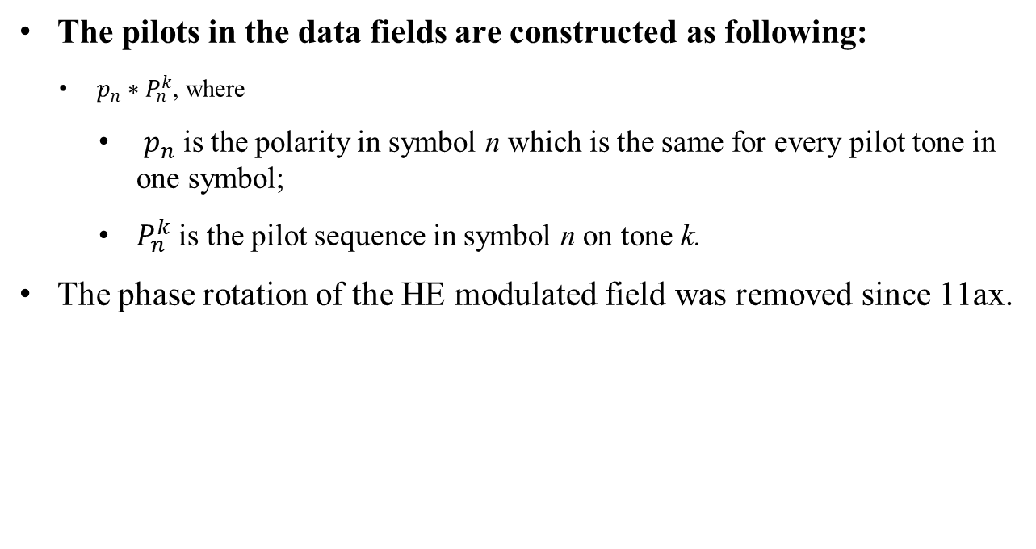
Background
The pilots in the data fields are constructed as following:
  $p_{n}∗P_{n}^{k}$, where
    $p_{n}$ is the polarity in symbol n which is the same for every pilot tone in one symbol;
    $P_{n}^{k}$ is the pilot sequence in symbol n on tone k.
The phase rotation of the HE modulated field was removed since 11ax.

Slide 3
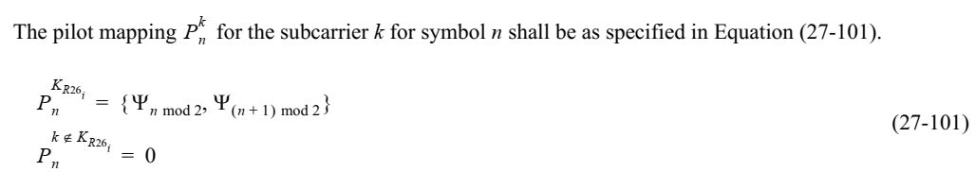
Problem Statements (1/2)
  Taking pilot design of 26-tone RU as an example:
  In one OFDM symbol, the pilot sequence is the same for different 26-tone RUs.
  If AP schedules multiple 26-tone RUs for multiple STAs, there are several repeated “templet” of pilot sequence.
    If AP schedules 36 STAs and each of which is allocated with a 26-tone RU in one symbol, the frequency domain repeated pilots will generate peaks in the time domain.

Slide 4
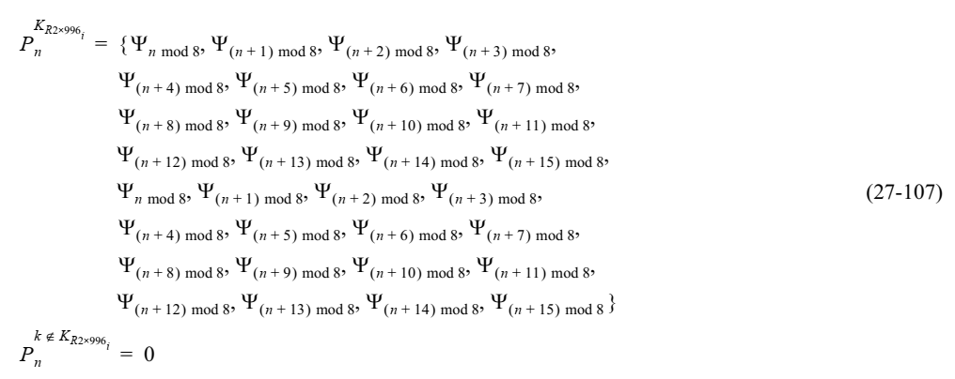
Problem Statements (2/2)
The same problem is applicable to all RU/MRU size in OFDMA transmission.
Another example of RU 2x996.
  n mod 8 == (n + 8) mod 8
  The pilot sequences are 4 copies of pilot sequence of 242 tone RU.

Slide 5
PAPR of the EHT data field
Simulation configurations:
1Tx antenna.
80/160/320MHz.
QPSK.
Randomized data.
5000 symbols are simulated.
Simulated options:
  Opt1: 11be;
  Opt2: Fully randomized pilot sequence in each symbol;
  Opt3: 11be + per user phase rotation. Rotation is chosen from [1 -1].
Note: Multi-stream with multiple antenna has similar pattern.

Slide 6
80MHz RU26, RU52, RU106, RU242

Slide 7
160MHz RU26, RU52, RU106, RU242

Slide 8
320MHz RU26, RU52, RU106, RU242

Slide 9
Observations & Thoughts
Observations:
  The PAPR degradation is obvious for smaller RU in 80MHz;
  Observable PAPR degradation for 242 tone RU in large BW.
Thoughts:
  Equal RU size scheduling, which are the simulated cases, is a popular scheduling algorithm.
    Easier to do SIG load balancing;
    Avoid excessive padding.
  What’s the impacts of PAPR to EVM?
    EVM impairments are simulated with reasonable clipping level and shown in the next 3 pages.

Slide 10
80MHz PPDU
With a reasonable clipping threshold, the EVM impacts due to PAPR should be improved for 26 tone RU.
  if high order modulation is considered for small RU, 52 tone RU also needs to be improved
EVM(dB) with different clipping levels
Clipping level /RU size | 7dB Clipping |  | 8dB Clipping |  | 9dB Clipping
 | 11be pilots | Random pilots | 11be pilots | Random pilots | 11be pilots | Random pilots
RU26 | -28.1 | -32.7 | -32.4 | -38.7 | -37.2 | -45.7
RU52 | -31.1 | -32.4 | -36.9 | -38.5 | -43.9 | -46.9
RU106 | -32.6 | -32.8 | -38.9 | -39.3 | -46.7 | -47.3
RU242 | -32.7 | -32.7 | -39.1 | -39.4 | -47.1 | -47.5

Slide 11
160MHz PPDU
With a reasonable clipping threshold, the EVM impacts due to PAPR should be improved for 26 tone RU and 52 tone RU.
  if high order modulation is considered for small RU, 106 tone RU also needs to be improved
EVM(dB) with different clipping levels
Clipping level /RU size | 7dB Clipping |  | 8dB Clipping |  | 9dB Clipping
 | 11be pilots | Random pilots | 11be pilots | Random pilots | 11be pilots | Random pilots
RU26 | -24.5 | -32.6 | -27.5 | -39.0 | -30.8 | -46.8
RU52 | -29.3 | -32.7 | -33.9 | -39.2 | -39.8 | -47.3
RU106 | -32.3 | -32.8 | -38.4 | -39.2 | -46.0 | -47.2
RU242 | -32.4 | -32.7 | -38.8 | -39.2 | -46.1 | -46.7

Slide 12
320MHz PPDU
With a reasonable clipping threshold, the EVM impacts due to PAPR should be improved for 26, 52, 106, 242, 484 RU.
  A 320MHz PPDU with 8 x 484RU use the same sequence as a 320MHz PPDU with 16x242RU.
EVM(dB) with different clipping levels
 | 7dB Clipping |  | 8dB Clipping |  | 9dB Clipping |  | 10dB Clipping
 | 11be pilots | Random pilots | 11be pilots | Random pilots | 11be pilots | Random pilots | 11be pilots | Random pilots
RU26 | -21.0 | -32.6 | -22.8 | -38.9 | -24.9 | -47.0 | -27.9 | -57.1
RU52 | -26.1 | -32.7 | -29.5 | -39.1 | -33.6 | -47.3 | -39.2 | -57.6
RU106 | -31.6 | -32.8 | -37.3 | -39.2 | -44.1 | -47.2 | -53.1 | -57.6
RU242 | -31.8 | -32.7 | -37.8 | -39.1 | -44.9 | -46.8 | -54.0 | -57.0
RU484 | -31.9 | -32.8 | -37.8 | -39.0 | -44.9 | -47.1 | -53.5 | -56.5

Slide 13
Summary
Suggest to revisit the pilot pattern for OFDMA transmission in 11bn.

