Slide 1
Discussion on AMP Power link
July 2023
Doc.: IEEE 802.11-23/1356r0
Date: 2023-08-08
Authors:
Name | Affiliation | Address | Phone | Email
Weijie Xu | OPPO |  |  | xuweijie@oppo.com
Yinan Qi |  |  |  | v-qiyinan@oppo.com

Slide 2
Abstract
Doc.: IEEE 802.11-23/1356r0
During the previous discussion, there has been proposal [1] to study and specify at least one mode to support RF energy harvesting.
In this submission, detailed aspects on the power link for AMP will be discussed.

Slide 3
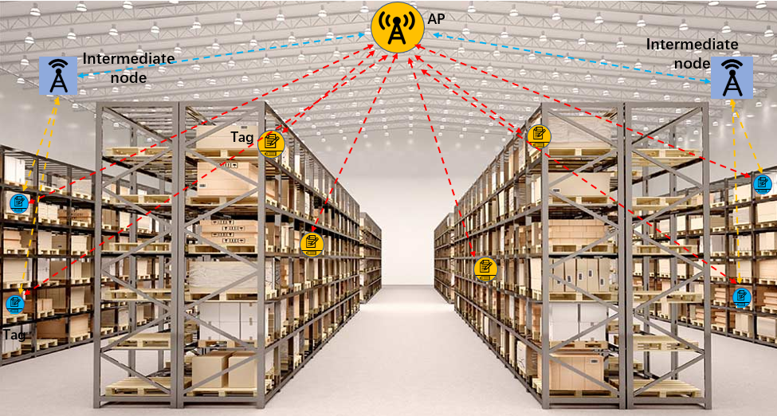
July 2023
Doc.: IEEE 802.11-23/1356r0
Scenarios
In different use cases, it can use different node to provide the RF power. Based on the discussion of the typical use case[2], the RF power may be provided by:
The AP that communicate to the AMP STA
An non-AP STA that communicate to the AMP STA
A dedicated intermediate power node as shown in the following Figure 1.
Advantages of providing RF power using a dedicated power node:
Extend the coverage of power link with low cost deployment
Resolve the blocking issue in real deployment
Ease the implementation of the AP, especially when backscattering is used.
Figure 1: Use intermediate node to extend coverage of power link
Slide 3
Weijie Xu (OPPO)

Slide 4
July 2023
Doc.: IEEE 802.11-23/1356r0
Requirement
Functionality of the power link
Provide RF power to the AMP STA
Additional control signaling?
Requirement of the RF power link
Shall meet the regulation requirements
Frequency bands/Channel bandwidth
Maximum transmission power
ACLR
Frequency hopping
In S1G, there is hopping requirement
Maximum duration of one transmission
Maintain coexistence with other transmission
Etc.
Provide sufficient coverage
10-30 meters indoor
Slide 4
Weijie Xu (OPPO)

Slide 5
July 2023
Doc.: IEEE 802.11-23/1356r0
Operation of power link
Control the power link if an intermediate node used
The network shall be able to activate or deactivate the power link for power saving and interference management
The power link is operated based on network’s configuration
Maximum transmission power, transmission duration, operation frequency, waveform, duty cycle etc.
AMP power node
AMP AP AMP STA
When backscattering is used, the incident carrier for backscattering shall be present when the AMP STA is scheduled to do backscattering.
When the incident carrier is send by an intermediate node, the transmission timing of incident carrier shall be well managed.
Slide 5
Weijie Xu (OPPO)

Slide 6
July 2023
Doc.: IEEE 802.11-23/1356r0
Summary
In this submission, the following aspects on power link for AMP were discussed
Scenarios
Requirements
Operation of power link
Slide 6
Weijie Xu (OPPO)

Slide 7
Reference
May 2023
Doc.: IEEE 802.11-23/1356r0
IEEE 802.11-23/1190r4, Further Discussion on AMP PAR
IEEE 802.11-23/0436r0 Technical Report on support of AMP IoT devices in WLAN

