Slide 1
802.18 Liaison Report – September 2023
Date: 13 September 2023
Author:

Slide 2
RR-TAG at a glance
Membership as of 14 July 2023
  55 voters (including 8 on LMSC)
  0 nearly voters
  11 aspirants
Officers
  Chair: Edward Au (Huawei Technologies)
  Co-Vice Chair: Stuart Kerry (OK-Brit; Self)
  Co-Vice Chair: Al Petrick (Skyworks Solutions)
  Secretary: VACANT
Ad-hoc chair
  IEEE Statement Update on Spectrum (ISUS): VACANT

Slide 3
Progress since the 2023 July plenary (1)
Reviewed the latest ongoing consultations.
Approved the following IEEE 802 LMSC submissions:
Topics | DCN
Malaysia MCMC: Public consultation on proposed Malaysia's positions for World Radiocommunication Conference 2023 (WRC-23) agenda items | 18-23/0077r9
Japan MIC: Consultation on technical conditions re: wireless LAN systems | 18-23/0081r8
European Commission RSPG: DRAFT Opinion on “The development of 6G and possible implications for spectrum needs and guidance on the rollout of future wireless broadband networks” | 18-23/0085r8
ITU-R Working Party 5A submissions for the September 2023 meeting | 18-23/0082r3 18-23/0083r1 18-23/0084r3
Czech Republic CTU: Call for comments on the update of the Radio Spectrum Management Strategy | 18-23/0094r11
China MIIT: Proposed abolition of two normative documents re: 40-50 GHz | 18-23/0098r4

Slide 4
Progress since the 2023 July plenary (2)
Reviewed the liaison statements from ITU-R Working Party 5D on
    framework and overall objectives of the future development of IMT for 2030 and beyond
    the schedule for updating recommendation ITU-R M.2012 to revision 7
Discussed the latest topics related to spectrum and regulation in Europe, North America, and Asia Pacific.
Reviewed the draft IEEE 802 wireless position statement with the reviewers’ edit (18-23/0097r2).

Slide 5
Objectives this week: Tuesday AM2
Reviewed and discussed the possibility of preparing response to selected ongoing consultations and liaison statements
  UK Ofcom: Consultation: Hybrid sharing: enabling both licensed mobile and Wi-Fi users to access the upper 6 GHz band
    Proposed response (18-23/0103r9) is now under IEEE 802 EC’s letter ballot
  US FCC: NoI: Advancing understanding of non-federal spectrum usage (WT Docket No. 23-232)
  US FCC: NPRM: Cybersecurity labeling for Internet of Things (PS Docket No. 23-239)
  US NIST: RFI: Implementation of the United States Government National Standards Strategy for Critical and Emerging Technology (USG NSSCET) (Docket No. 230819-0199)
Reviewed the latest spectrum and regulation decisions/announcement in Asia Pacific.

Slide 6
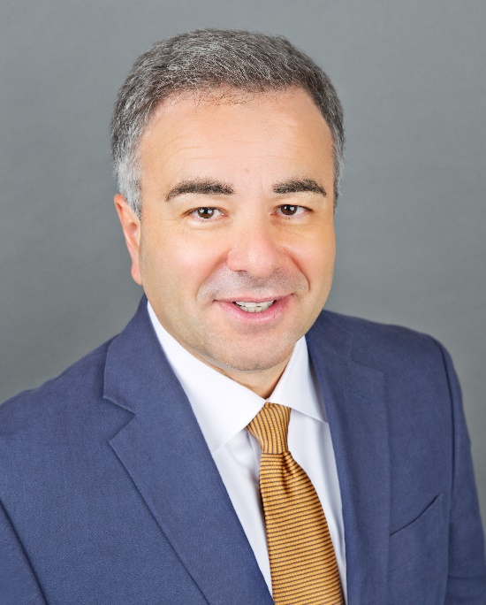
Objectives this week: Thursday AM1
Member enrichment activities
  Title: International spectrum regulatory process: 2023 World Radiocommunication Conference - 6 GHz Spectrum
  Author: Alex Roytblat (Vice President of Worldwide Regulatory Affairs, Wi-Fi Alliance)
  A 30-minutes tutorial introducing the World Radio Conference (WRC) process, the recognized regional groups that formulate multi-country proposals to WRC, and WRC-23 Agenda Item 1.2 (with emphasis on 6 GHz)
  Document: 18-23/0105
Source: Wi-Fi Alliance

Slide 7
Future meeting schedule
(scheduled till the January 2024 interim)
Events | Date and time*
Weekly teleconference | 3:00pm ET to 3:55pm ET, Every Thursdays 21 September 2023 through 9 November 2023, 23 November 2023 through 11 January 2024, 25 January 2024
ISUS ad-hoc (on demand) | 12:00pm ET to 1:00pm ET, Every Fridays 22 September 2023 through 10 November 2023, 24 November 2023 through 12 January 2024, 26 January 2024
*Call in info is also available at 18-16/0038 and the 802.18 Google Calendar

Slide 8
Call for actions
If interested in serving as the RR-TAG secretary or the ISUS ad-hoc chair, please let me know as per your earliest convenience, please let me know as per your earliest convenience.
Draft IEEE 802 wireless position statement (18-23/0097r2)
  Please review and provide your comments/edits to me offline by Wednesday, 27 September 2023.

