Slide 1
Considerations on Return TXOP between multiple APs
August 2023
Date: 2023-08-07
Authors:
Name | Affiliations | Address | Phone | Email
Si-Chan Noh | Newracom |  |  | sc.noh@newracom.com
Joonsoo Lee |  |  |  | js.lee@newracom.com

Slide 2
Motivation
Reusing EHT’s Triggered TXOP Sharing (TXS) is under discussion in [1-4]
TXOP sharing with neighbor APs (e.g., C-TDMA)
Sharing TXOP acquired by non-AP STA with the AP
When shared AP may not be able to use all its allocated TXOP, how to return the remaining TXOP to sharing AP has been discussed
TXOP return between APs may improve medium efficiency and flexibility
However, a challenge could arise when 3rd party STA try to access channel or defer transmission after returning the TXOP to sharing AP
This contribution discusses some issues considering 3rd party STA when shared AP return TXOP before the end of allocated TXOP

Slide 3
Recap : Triggered TXOP sharing
In 11be, AP may allocate time within an obtained TXOP to the associated non-AP EHT STA by transmitting an MU-RTS TXS Trigger frame
The non-AP EHT STA may use the time allocated by the associated AP according to triggered TXOP sharing Mode subfield in MU-RTS TXS Trigger frame
Mode 1 : Transmit one or more non-TB PPDUs to associated AP within the allocated time
Mode 2 : Transmit one or more non-TB PPDUs to associated AP and P2P transmission to a STA within the allocated time

Slide 4
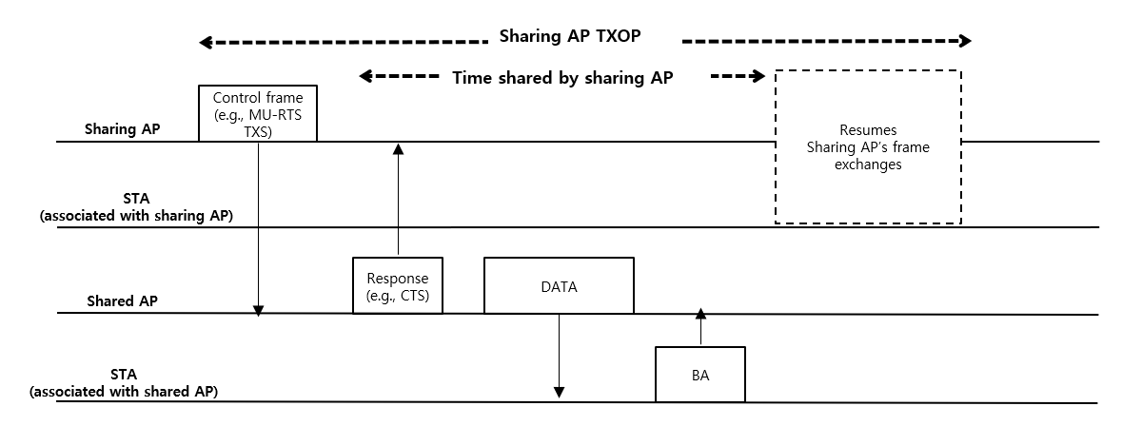
TXOP sharing in UHR
TXOP sharing between APs (e.g., in C-TDMA) is under discussion
A Sharing AP transmits a control frame to share its TXOP to a shared AP
After sending response frame solicited by control frame, the shared AP can transmit or soliciting PPDUs in its BSS within the allocated time period
The sharing AP resumes its transmissions after allocated time is over

Slide 5
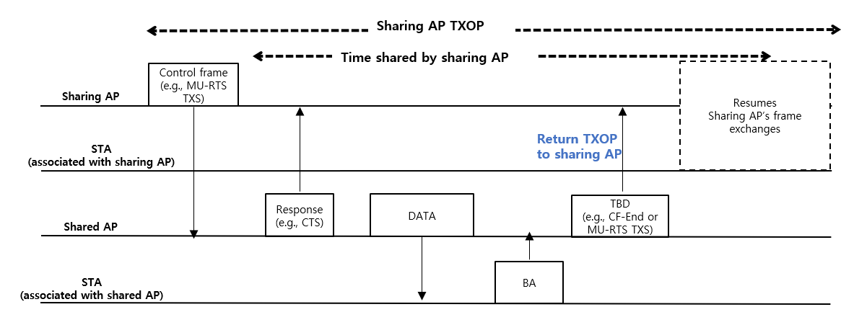
TXOP Return to sharing AP
When the shared AP could not fully use allocated TXOP time in some scenarios, it may return remaining TXOP to the sharing AP
The sharing AP may use the returned TXOP
To allow the sharing AP using the returned TXOP without collision and to offer channel access opportunity for the 3rd party STA regardless of the sharing AP, it may be necessary to consider some baseline when design TXOP return sequence (e.g., TBD frame to return TXOP, etc)
Option 1 : MU-RTS TXS (i.e., reuse initial TXOP sharing control frame)
Option 2 : CF-End frame ([4])

Slide 6
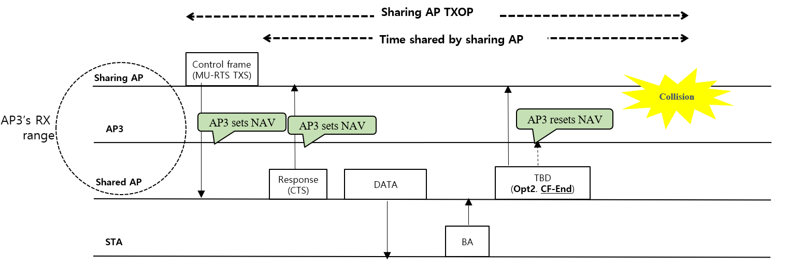
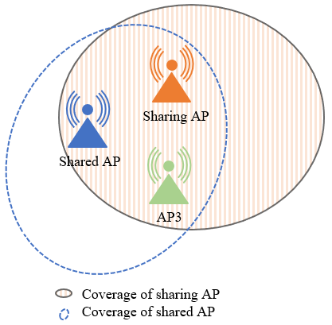
TXOP Return Case 1
The 3rd party STA(e.g., AP3) set the NAV value by initial TXOP sharing sequence between a sharing AP and a shared AP
When the shared AP returns remaining TXOP to the sharing AP through TBD frame(e.g., CF-End), the AP3 overhears the TBD frame and resets all its maintained NAV can try to access the channel during returned TXOP duration
The overheard TBD frame is an inter-BSS PPDU and most recently updated NAV was due to inter-BSS PPDU(e.g., CTS, response frame from the shared AP), AP3 can misunderstand channel status and can collide with the sharing AP
*Note that we only consider UHR devices

Slide 7
TXOP Return Case 1 (Cont’d)
To avoid collision with the sharing AP, the AP3 defer transmission by maintain/update NAV value through TBD frame until the end of returned TXOP duration
In this case, option 1 is preferred in previous slide 5
*Note that we only consider UHR devices

Slide 8
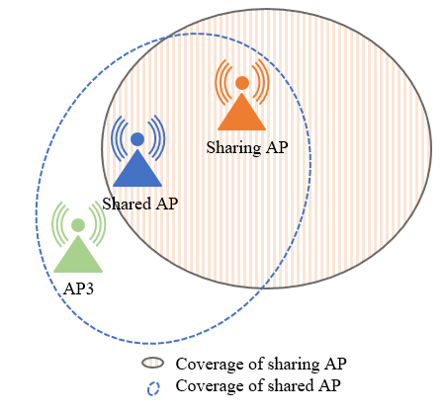
TXOP Return Case 2
The 3rd party STA(e.g., AP3) set the NAV value by only response frame(e.g., CTS) from a shared AP
When the shared AP returns remaining TXOP to the sharing AP through TBD frame(e.g., MU-RTS TXS), the AP3 may defer transmission by maintain or update NAV until the end of returned TXOP duration
However, the sharing AP is not affected by the AP3, so deferring the transmission of AP3 can waste resource
*Note that we only consider UHR devices

Slide 9
TXOP Return Case 2 (Cont’d)
To improve medium efficiency, the AP3 should be notified that it can try to access channel
In this case, option 2 is preferred in previous slide 5
*Note that we only consider UHR devices

Slide 10
Summary
This contribution discussed some consideration when a shared AP return remaining TXOP to a sharing AP considering 3rd party STA
Case 1 : Option 2 may cause collision with 3rd party STA
Case 2 : Option 1 may defer transmission of 3rd party STA
Need further expansion considering STAs associated with sharing AP

Slide 11
Reference
[1] 23/581, Non-AP initiated TXOP sharing
[2] 23/261r0, C-TDMA procedure in UHR
[3] 23/0249r1, Extended TXOP Sharing
[4] 23/0739r1, Follow-up on Coordinated TDMA (C-TDMA)

