Slide 1
Considerations on Inter-PPDU based
Preemption Scheme
Date: 2023-07-11
Authors:

Slide 2
Abstract
In UHR SG, there were some discussions on pre-emption schemes[1]-[4].
However, some issues, such as channel access scheme, fairness control and ACK mechanism in preemption operation are not fully discussed.
In this contribution, considerations on preemption scheme for UHR will be discussed.

Slide 3
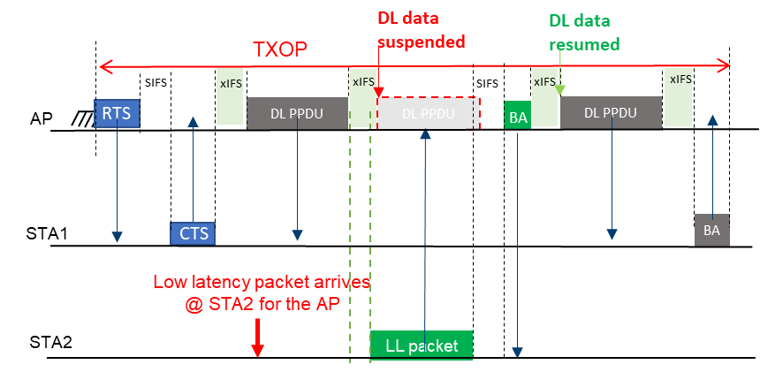
Background:
Inter-PPDU based Preemption Scheme
In [3]-[4], inter-PPDU based preemption scheme was proposed
With the proposed scheme, frames of low latency traffics can be transmitted within the TXOP of other AC or STA(AP).
[3]: 23/0092r0

Slide 4
Issues
In order to support the proposed inter-PPDU based preemption scheme, the followings should be considered:
  1. How to coordinate preemption?
    STAs need to be coordinated for the timing to perform preemption.
  2. When TXOP responder should transmit ACK?
    It’s not clear when TXOP responder should transmit ACK during inter-PPDU based preemption procedure.
  3. How to access channel in XIFS?
    A channel access scheme for preemption performing STA is not defined.
    Fairness between preemption performing STA and preemption allowing STA(AP) should be considered .

Slide 5
Issues (Cont’d)

Slide 6
1. Preemption coordination
A STA which intends to transmit using preemption scheme may not know whether it can transmit or not during IFSs.
  This lack of knowledge of transmission timing may lead to collision in a TXOP
AP: TXOP Holder / STA 1: TXOP responder / STA 2: Preemption performing STA

Slide 7
1. Preemption coordination (Cont’d)
A preemption indication shall be defined to perform preemption in UHR
  A TXOP holder can indicate the timing for preemption.
  Preemption performing STAs can transmit frame(s) based on the indication.
A preemption indication may further provide more ‘hints’ for channel access
  For example, TXOP holder can indicate the following parameters:
    Preemption indication can indicate the final PPDU for a TXOP responder.
      The TXOP responder can transmit ACK after SIFS or XIFS of the final PPDU when it received the indication.
    Channel access parameters for preemption performing STAs can be transmitted in each PPDU(s).
      Preemption performing STAs can contend for the medium within XIFS using the parameters.

Slide 8
2. Ack in preemption
A TXOP responder may not know when it should transmit ACK to a TXOP holder
The TXOP holder can indicate ‘ACK indication’ which includes information about whether the TXOP responder should transmit ack
The TXOP responder can transmit response frame when it received ‘ack indication’ from the TXOP holder

Slide 9
3-1. Multiple access in preemption
If two or more STAs attempt to transmit without channel access, collisions may occur.
Channel access operation for the preemption may be similar to the current EDCA or DCF operation
  UHR may adopt or develop another channel access operation for the preemption

Slide 10
3-2. Resource Control for preemption
A STA may greedily utilize another STA’s TXOP with preemption
To address this issue, a control method is required to prevent abusing.
  For instance, the resource for the preemption operation could be restricted by the TXOP holder.

Slide 11
Summary
In this contribution, some considerations on inter-PPDU based preemption scheme were discussed
Current preemption operation is lack of some details: preemption coordination, ACK transmission timing, and channel access in XIFS
UHR SG should address the ambiguity of the inter-PPDU based preemption scheme identified in this contribution and make some solutions if the preemption is adopted to UHR

Slide 12
References
[1] 11-22/1393r0: Latency Reduction Scheme for UHR, https://mentor.ieee.org/802.11/dcn/22/11-22-1393-00-0uhr-latency-reduction-scheme-for-uhr.pptx
[2] 11-22/1880r1: Latency and Reliability enhancements for UHR, https://mentor.ieee.org/802.11/dcn/22/11-22-1880-01-0uhr-latency-and-reliability-enhancements-for-uhr.pptx
[3] 11-23/0092r0: Preemption, https://mentor.ieee.org/802.11/dcn/23/11-23-0092-00-0uhr-preemption.pptx
[4] 11-23/0018r1: Low Latency Support in UHR, https://mentor.ieee.org/802.11/dcn/23/11-23-0018-01-0uhr-low-latency-support-in-uhr.pptx

