Slide 1
Introduction to IEEE 802c SLAP
Authors:

Slide 2
Intro to IEEE 802c
IEEE 802c defines Local Medium Access Control (MAC) Address Usage
It is not a mandatory standard, but it will help to the reuse of the local MAC address space in the future.
  Structured Local Address Plan (SLAP) specifies different assignment approaches in four specified regions of local MAC address space.
Local MAC addresses are not presumed globally unique across all IEEE 802 networks.
Unlike universal addresses, which are persistent to the MAC entity, local MAC addresses are not necessarily persistent. The local MAC address assigned to a MAC entity, including any subsequent change to that assignment, is entirely within the scope of the local administration.

Slide 3
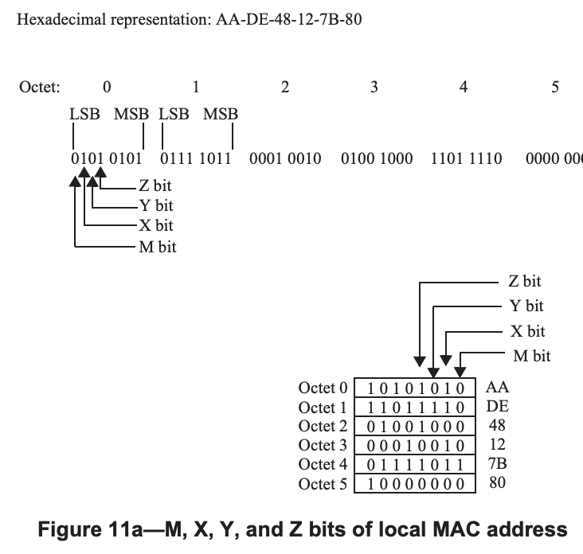
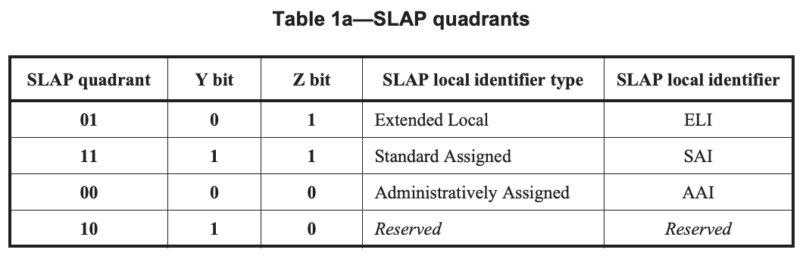
Local MAC Addresses and SLAP
U/L bit, 1 Local admin
I/G bit, 0 unicast

Slide 4
Slide taken from 19/1307r00

Slide 5
July 2023
Slide taken from 19/1307r00
Antonio de la Oliva, InterDigital

Slide 6
July 2023
Slide taken from 19/1307r00
Antonio de la Oliva, InterDigital

Slide 7
July 2023
Slide taken from 19/1307r00
Antonio de la Oliva, InterDigital

Slide 8
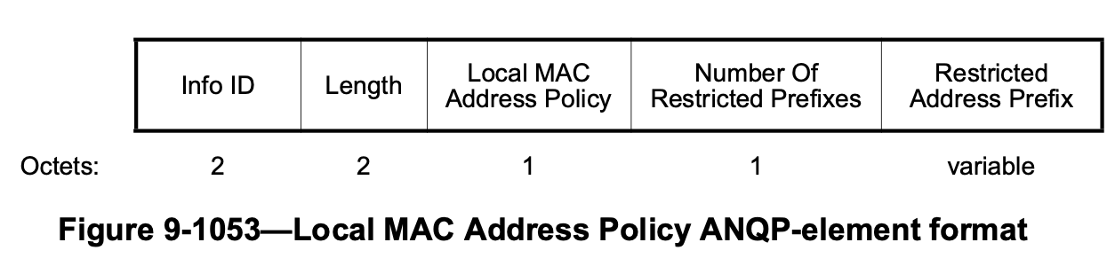
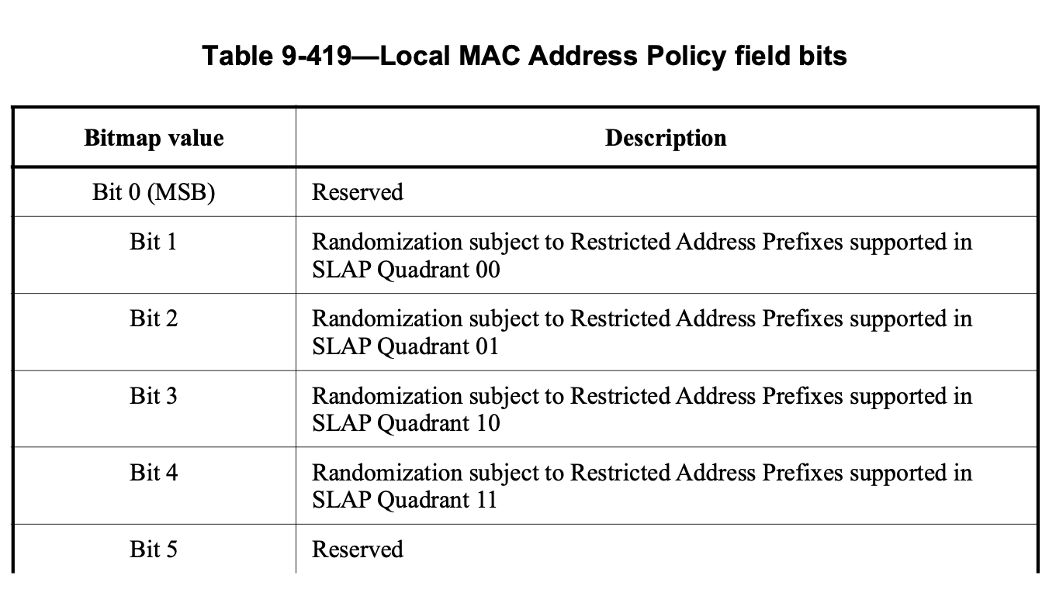
Support in IEEE 802.11
July 2023
Local MAC address SLAP is already partially supported in IEEE 802.11-2020
Please see Local MAC Address Policy ANQP-element
Antonio de la Oliva, InterDigital

Slide 9
Strawpoll
Should we consider a definition of IRM following the IEEE 802c SLAP (Structured Local Address Plan)?

