Slide 1
Clock Generation for X-Band Operation
Date: 2023-07-11
Authors:

Slide 2
Abstract
There were questions on the generation of the 2.4 GHz clock out of the sub-GHz signal in 11-23/867r0, slide 14.
The idea is to receive sub-GHz signals on the downlink and use them for 2.4 GHz signals on the uplink.
This presentations shows an exemplary implementation of the Integer-N-PLL for the generation of the 2.4 GHz signal out of the sub-GHz signal.
The presentation shows that the proposed system is able to operate in all relevant sub-GHz bands (US, Europe, China, etc.)

Slide 3





Possible Hardware-Realization of X-band Concept
RX Antenna
Uplink Data
N
$$f_{loop}$$
Demodulator
OOK Decoder
Microcontroller
Main Divider
Phase Detector
Loop filter
Charge pump
R
$$f_{ref}$$
up/
down
$$v_{tune}$$
VCO
$f_{1} (2.4 GHz)$
RF Modulator
Reference Divider
$f_{2}$
sub-GHz
Integer-N PLL
TX Antenna
The signal frequency of the AMP-assisting STA provides the reference clock (ideally sub-GHz)
The signaling in the downlink signal to the AMP STA indicates the actual signal frequency
An Integer-N-PLL creates the TX frequency of the AMP STA using the aforementioned information
➔ No expensive and power-hungry crystal oscillator needed
VCO: Voltage Controlled Oscillator
OOK: On-off-keying

Slide 4
Demodulator
The AMP STA demodulator is comparable to a demodulator used in the UHF-RFID standard since 2004 [2]
The very high bandwidth of 860-960 MHz supports operation in all ITU regions, no additional filters are used
  Loss due to high noise is compensated due to high reception powers (anyhow required for energy supply)
The modulation uses OOK for highly power efficient decoding

Slide 5

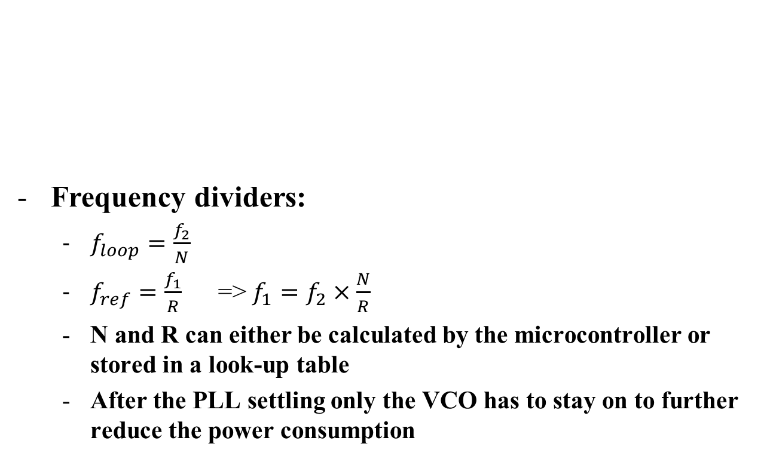



Integer-N PLL
Frequency dividers:
  $f_{loop}=\frac{f_{2}}{N}$
  $f_{ref}=\frac{f_{1}}{R}$ => $f_{1}=f_{2}×\frac{N}{R}$
  N and R can either be calculated by the microcontroller or stored in a look-up table
  After the PLL settling only the VCO has to stay on to further reduce the power consumption
$$f_{loop}$$
N
Main Divider
Phase Detector
Loop Filter
Charge pump
R
$$f_{ref}$$
up/
down
$$v_{tune}$$
VCO
$f_{1}$ (2.4 GHz)
Reference Divider
$f_{2}$ (sub-GHz)
Integer-N PLL

Slide 6
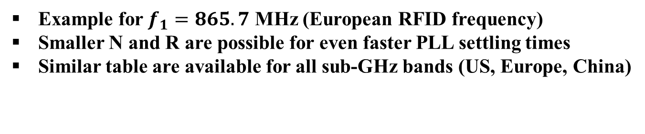
Determining the PLL Dividers
CHNL ID | Channel Freq (MHz) | N | R | Frequency Deviation in Hz | Deviation in ppm
1 | 2412 | 847 | 304 | 329 | 0.1
2 | 2417 | 2778 | 995 | 402 | 0.2
3 | 2422 | 1978 | 707 | 849 | 0.4
4 | 2427 | 2554 | 911 | 878 | 0.4
5 | 2432 | 1694 | 603 | 332 | 0.1
6 | 2437 | 3364 | 1195 | 167 | 0.1
7 | 2442 | 2220 | 787 | 0 | 0
8 | 2447 | 5820 | 2059 | 486 | 0.2
9 | 2452 | 2501 | 883 | 340 | 0.1
10 | 2457 | 4209 | 1483 | 202 | 0.1
11 | 2462 | 4647 | 1634 | 61 | 0
12 | 2467 | 2522 | 885 | 452 | 0.2
13 | 2472 | 8655 | 3031 | 495 | 0.2
14 | 2484 | 1779 | 620 | 484 | 0.2
Example for $f_{1}=865.7$ MHz (European RFID frequency)
Smaller N and R are possible for even faster PLL settling times
Similar table are available for all sub-GHz bands (US, Europe, China)

Slide 7
Benefits of X-Band Operation
Minimized on-air times in the 2.4 GHz band
Energizer and slow OOK downlink use existing RFID bands (→ fits to existing frequency regulation)
The frequencies are supported by state-of-the-art smartphones
No actual full-duplex requirement in AMP-assisting STA
RX of AMP STA comparable to current UHF-RFID → proven and simple energy-efficient technology

Slide 8
Conclusions
This presentation shows a method to generate the
2.4 GHz frequency out of any sub-GHz frequency using an Integer-N-PLL
The concept is low cost and low power as no crystal oscillators are required
No full duplex operation is required for the AMP-assisting STA
The proposed system is covered by existing frequency regulation

Slide 9
Literature
[1] Behzad Razavi, “RF Microelectronics”, Prentice Hall
[2] EPC™ Radio-Frequency Identity Protocols Generation-2 UHF RFID Standard, 2018, https://www.gs1.org/sites/default/files/docs/epc/gs1-epc-gen2v2-uhf-airinterface_i21_r_2018-09-04.pdf

