Slide 1
AMP Device Density
Date: 2023-07-09
Authors:

Slide 2
Abstract
This document presents typical densities and reading times for the logistics use-case and extends 11-23/1073r0.
It is a response to document 11-23/1005r0 that defines very low device numbers for the logistics use-case.

Slide 3
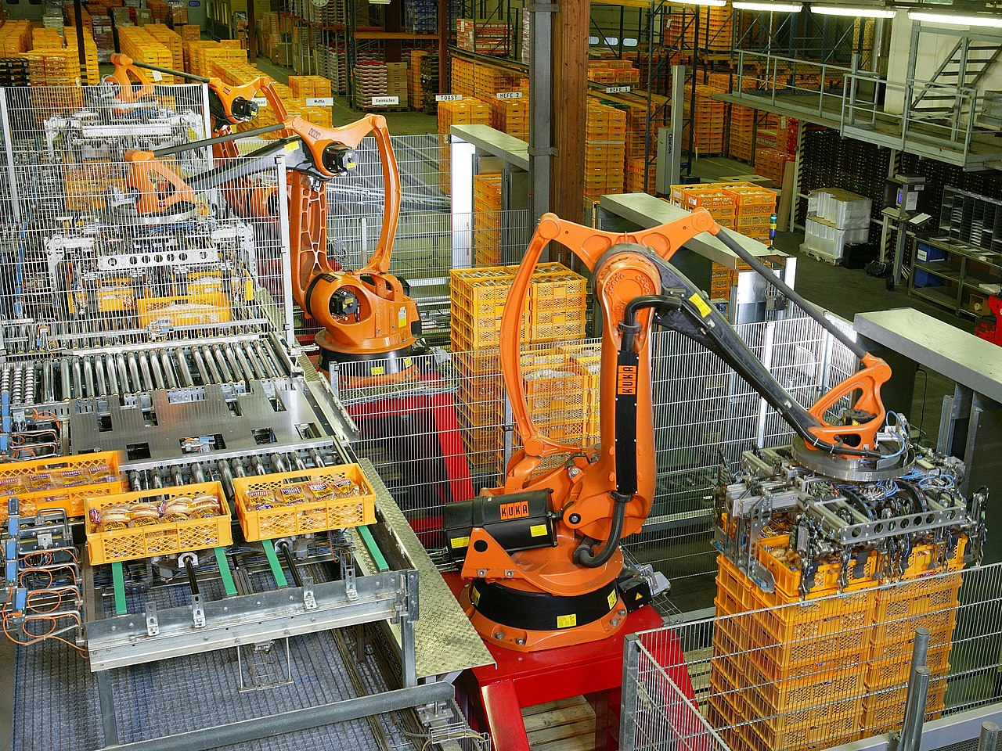
Production Hall with Small Containers (KLT)
Source: Wikipedia

Slide 4
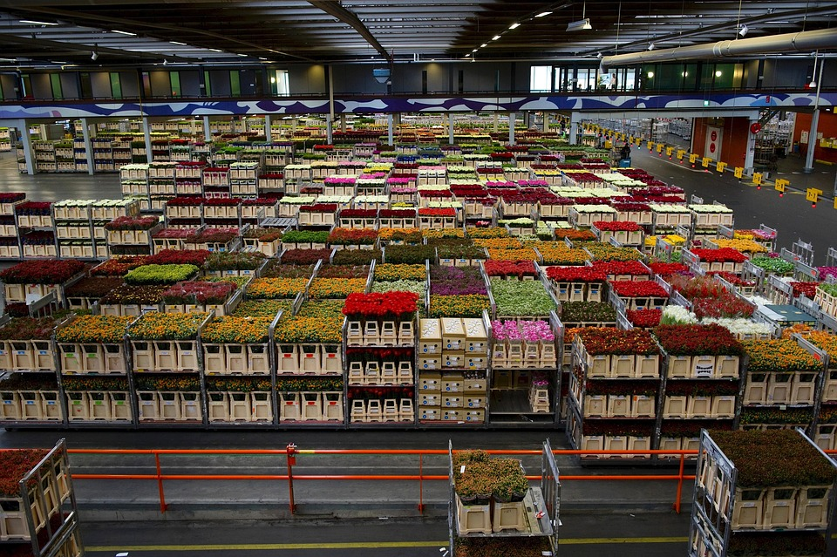
Flower Logistics

Slide 5
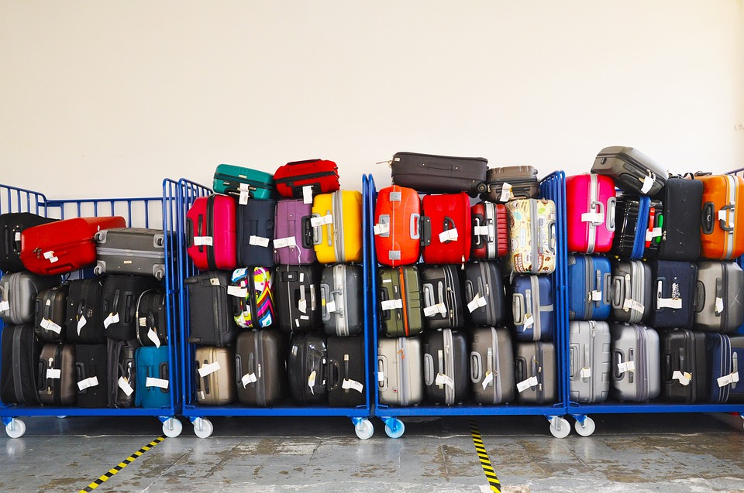
Luggage

Slide 6
Required Densities
Example 1: Small Containers (KLT)
  Size: 300 x 200 x 147.5 mm
  16 KLT / m² and 20 KLT stacked on each other
  ➔ 320 KLT / m²
Example 2: EUR-pallet
  Size: 1200 x 800 mm (approx. 1m²)
  200 KLT stacked on EUR-pallet
  Reading time of few seconds in case of truck loading
  ➔ 100 devices / s

Slide 7
Initial Query Problem
The AMP devices will be passive devices, i.e. they will never start a communication or send a beacon
The non-AMP device has to query the available AMP devices within range
We have to define the number of AMP devices that a non-AMP device is able to query
Theoretically, there could be thousands of AMP devices in range

Slide 8
Conclusions
The logistics use-case requires high densities of devices
Typical densities are in the range of 300 device/m² or more ➔ 1000 devices/m² should be the minimum assumption
Transporting devices with fork-lifts lead to short reading times with typical numbers of 100 devices / s
We have to define the number of AMP devices in a query
We have to define the number of devices that we can read within e.g. one second

Slide 9
Strawpoll 1
How many devices should we be able to query in a given area? (Time for the query is irrelevant)
Up to 10
Up to 100
Up to 1000
Up to 10000

Slide 10
Strawpoll 2
How many AMP devices shall we be able to read in one second?
Up to 10
Up to 100
Up to 1000
Up to 10000

