Slide 1
CID 1673: Utilizing Legacy STA
Date: 2023-7-10
Authors:
Name | Affiliation | Address | Phone | Email
Chaoming Luo | OPPO |  |  | luochaoming@oppo.com
Ning Gao
Chaoming Luo (OPPO)

Slide 2
Introduction
This contribution proposes a solution to CID 1673.
PDT doc will be submitted later.
CID | Commenter | Page | Comment | Proposed Change
1673 | Chaoming Luo | 191.06 | Add support for using opportunistic sensing by SBP to utilize legacy STAs. | Add one bit in SBP request to indicate using of opportunistic sensing, and add corresponding procedure.

Slide 3
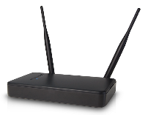
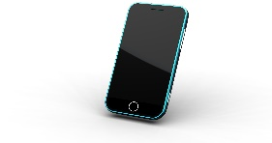
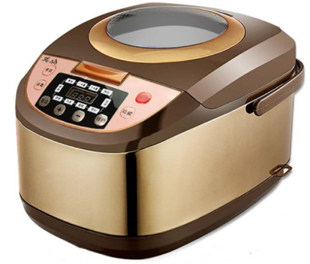
Scenario
The reality of the early stage of 11bf:
There are good number of 11ax clients (i.e., legacy STAs) in the existing deployments (houses, offices, malls, etc.)
Will new 11bf clients be popular in those deployments in a short time? Probably NO! It takes time. A user would have one 11bf AP and one or two 11bf phone/pad, which is a typical and realistic deployment in the early stage of 11bf. As stated in [1], in 2023 the market share of 11ax devices is dominant.
A few 11bf devices
A good number of legacy HE devices
。。。

Slide 4
Motivation
Utilizing legacy HE STAs in sensing would be beneficial in the marketing of sensing.
Is it enough for a user to have a pretty good sensing result using TB measurement in a deployment as shown in slide 3? May be NOT! It is limited in TX/RX diversity and area coverage due to limited number of 11bf STAs.
Utilizing legacy STAs in such a deployment could be complementary to the current TB/SBP sensing.
[2] introduces the concept of opportunistic sensing on regular PPDUs.
[3] uses opportunistic sensing with changes required in legacy STA.

Slide 5
Opportunistic sensing as a complementary way

Slide 6
Simple Changes
Is it complex to optionally support the opportunistic sensing as a complementary way? No, it’s simple and with very few changes.
Some of the existing APs already support opportunistic sensing in a proprietary manner.
To be complementary to TB measurement, an AP just needs to do measurements on regular UL PPDUs from legacy HE STAs and indicates the CSI to its SME via the MLME primitive.
To be complementary to TB measurement initiated by SBP procedure, SBP initiator use one bit ‘opportunistic’ in SBP request to ask the SBP responder to do TB measurements with 11bf STAs AND do measurements on regular UL PPDUs from legacy HE STAs.

Slide 7
Q&A
It may be possible to let AP also obtain CSI on regular UL PPDUs from sensing responders in order to get a higher frequency of report than the current TB measurement.
Fine to add it.
Privacy may be a concern.
Privacy talks about data/frames carrying information related to a user. In the case of sensing receiver, the CSI data is generated by the sensing receiver, and he does not want another STA to use this CSI data owned by this sensing receiver. It may make sense because ‘I decide how should my data be used’.
However, in the case of sensing transmitter non-AP STA (or the legacy HE STAs in opportunistic sensing), the CSI data is generated by the AP, it should be the AP to decide how its data be used.
BTW, keep in mind that an attacker can generate CSI upon receiving any PPDU carrying a Data frame. If this causes privacy issue, then all kinds of wireless communication systems (Wi-Fi, BLE, cellular, etc.) should be abandoned!

Slide 8
Q&A
HT/VHT PPDUs use different LTF and carrier spacing, so the ‘numerical’ values of CSI varies. HE PPDUs use 2xLTF, which requires no change of CSI structure.
Fine to limit to legacy HE STAs.
How much value this complementary opportunistic sensing adds to the TB sensing?
It’s complementary and shall be used together with TB sensing. The sensing application should still rely on the TB measurements results and use the complementary CSIs to improve accuracy.
Cases a legacy HE STA happens to send regular UL PPDUs continuously and not change transmitting parameters much
The AP could intentionally schedule a legacy HE STA to transmit UL PPDUs using fixed transmitting parameters.
There are bunch of papers using experimental setups such as: let the transmitting STA sends continuous UL PPDUs carrying Data frames of ICMP packets.

Slide 9
Summary
Propose to add opportunistic sensing as a complementary way to the TB and SBP procedure.
Local sensing application in an AP may ask the AP to obtain CSI on regular UL HE PPDUs from sensing responders and/or legacy HE STAs.
Add one bit in SBP Request frame to ask the SBP responder to obtain CSI on regular UL HE PPDUs from sensing responders and/or other associated legacy HE STAs. The corresponding SBP report may be delivered outside of the AVW or delay to the next AVW.
Note1: To keep the report structure and the ‘numerical’ the same, AP may only include CSI of UL when it schedules UL transmission using 2xLTF having the same Ng, etc.
Note2: this requires no change in legacy HE STAs.

Slide 10
Reference
[1] 11-23-0284-00-0uhr-beacon-design
[2] 11-21-1581-01-00bf-opportunistic-sensing-measurements
[3] 11-21-1745-02-00bf-opportunistic-wlan-sensing
Chaoming Luo (OPPO)

