Slide 1
COST Action INTERACT: Intelligence-Enabling Radio Communications for Seamless Inclusive Interactions
Date: 2023-07-11
Authors:
Name | Affiliations | Address | Phone | email
Periklis Chatzimisios | International Hellenic University & University of New Mexico | P.O. Box 141 Sindos 57400 Thessaloniki (Greece) |  | pchatzimisios@ihu.gr
Daniele Medda | International Hellenic University
Athanasios Iossifides | International Hellenic University

Slide 2
Outline
What is a COST Action?
Status of the INTERACT COST Action.
Objectives and Transversal Issues.
Working Groups.
Vertical Teams.
Horizontal Activities.
Deliverables.
References.

Slide 3
What is a COST Action (objectives & organization)?
The general framework of a COST action (4 years) is built mainly around networking. It supports some meetings (but not for all), Training schools (TS), Short Terme Scientific Missions (STSM).
Objective: Building collaboration between searchers across Europe and beyond.
Participants: Mainly from Europe but also from all over the world. Anybody can join.
3 meetings per year: 500+ Working Group members; Every meeting is about 80 to 100 persons, 70 technical documents presented, a lot of discussions….

Slide 4
What is a COST Action?
Memorandum of Understanding
4 years (11/2021-10/2025)
Network
Research coordination
&
Capacity building
500 000 euros
(indicative)

Slide 5
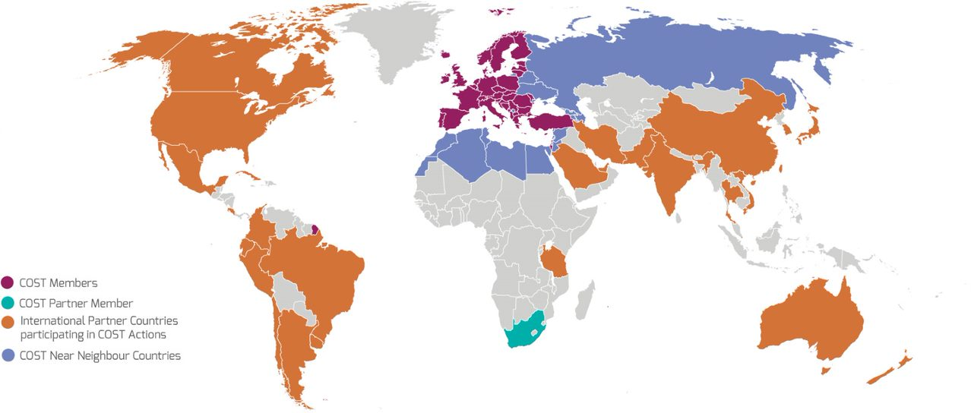
What does “anywhere in the world” mean?
COST Full/Cooperating Member
COST Partner Member
Near Neighbour Countries (list to be confirmed)
Third States
currently participating

Slide 6
What can be funded by COST?

Slide 7
Status of the COST Action INTERACT [1]

Slide 8
Objectives
O1: Fundamental research in the fields of
Antennas and Propagation,
Signal processing and Localisation,
Network Architectures and Protocols
O2: To make the Wireless Network Intelligent – aware, adaptive and parsimonious
O3: To contribute to the creation of Intelligent Environments
Health
Transportation
Industry
Buildings and Cities

Slide 9
Transversal Issues
Achieve trade-offs in model-driven versus data-driven communication engineering
To support the research by making available datasets on real world scenarios

Slide 10
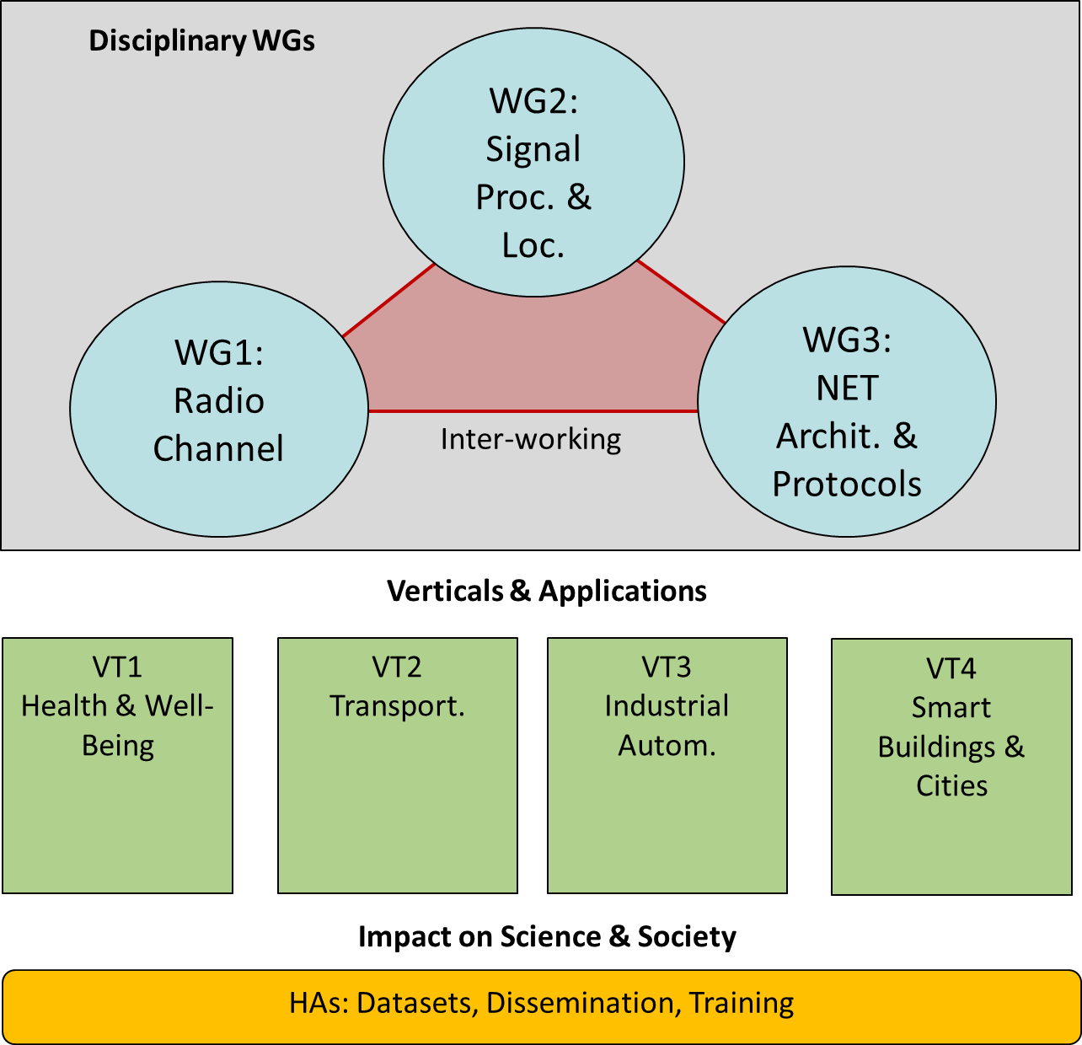
Implementation

Slide 11
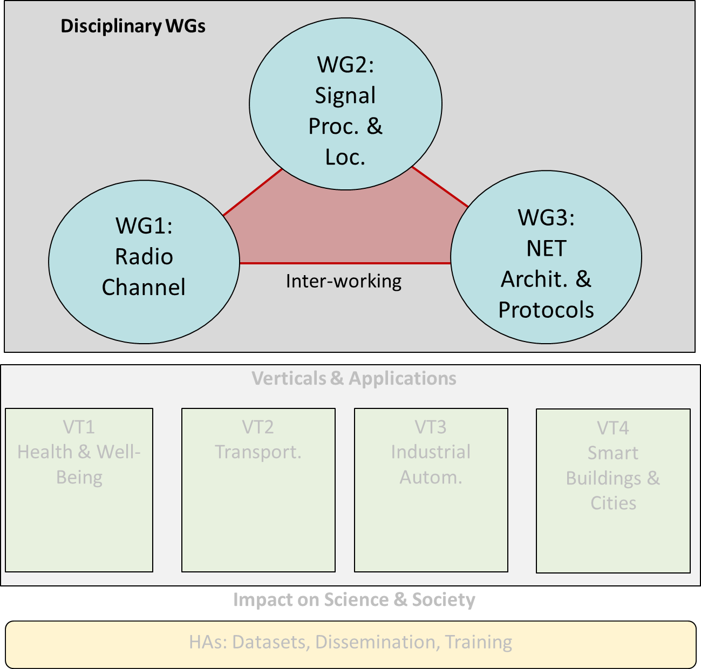
Working Groups
WG1: Radio channel
Radio channel modelling
ML-based propagation modelling
Shape the radio channel through RIS
WG2: Signal Processing and Localisation
Novel PHY layer technologies
ML-based positioning
WG3: Network Architectures and Protocols
ML-Based network management and orchestration
Dynamic networks
Novel network paradigms for full interactive experience

Slide 12
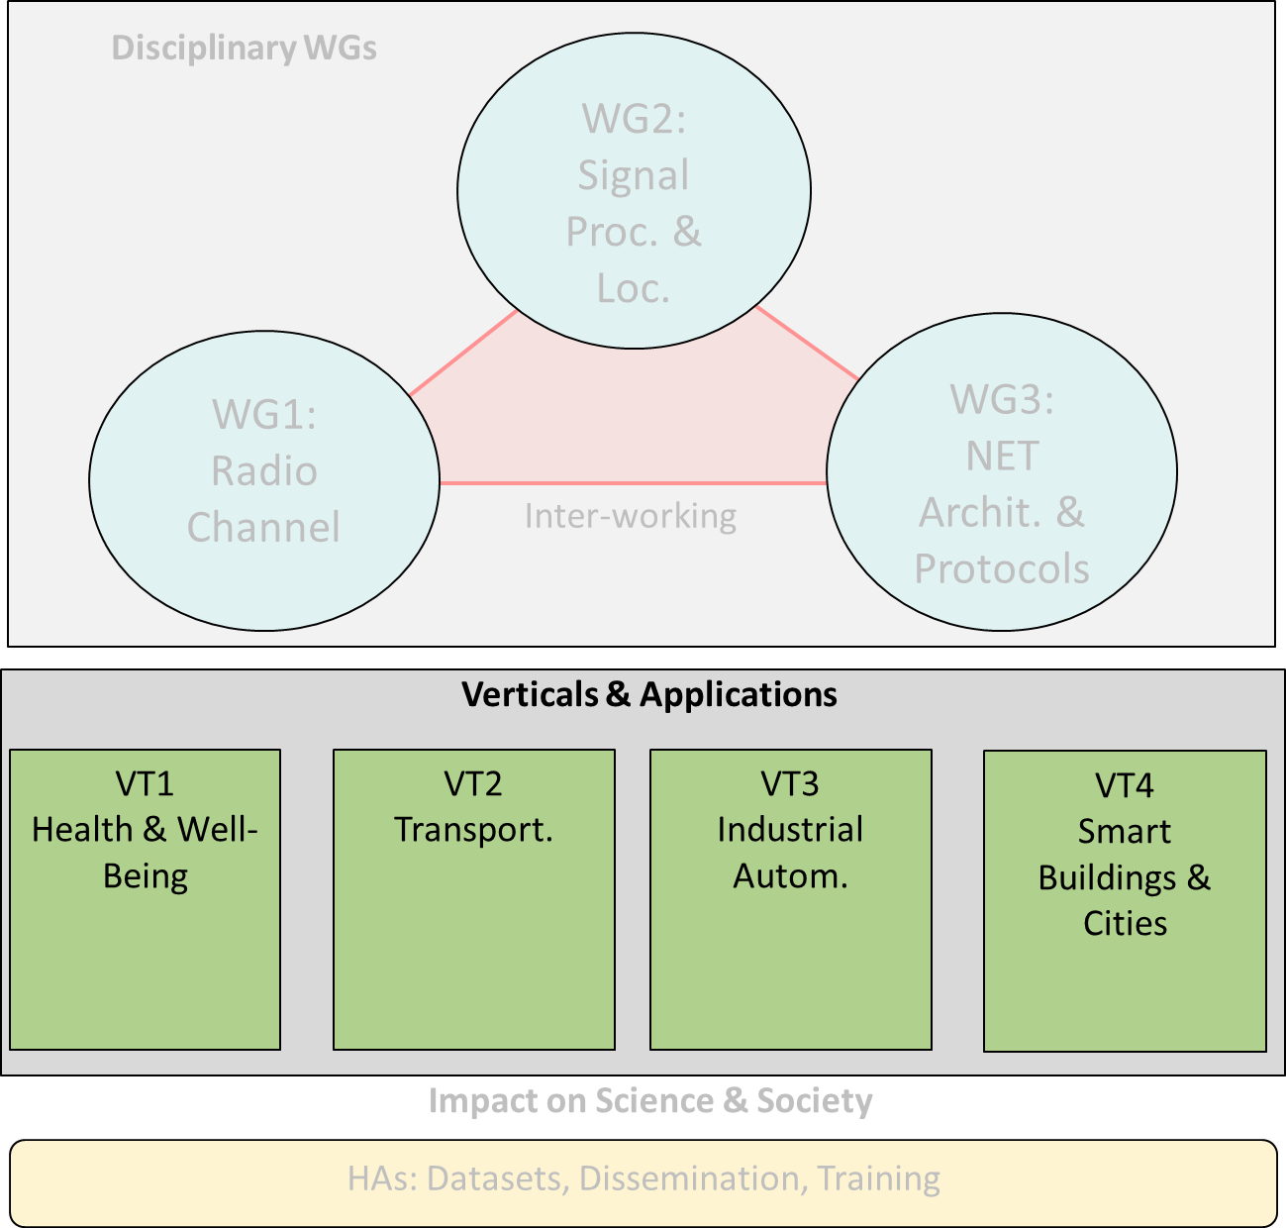
Vertical Teams
VT1: Health and Well-Being
Mission-critical body-centric communications
Novel human-to-machine interaction applications
VT2: Transportation
High-mobility scenarios, including cars, trains and UAVs (3D)
VT3: Industrial Automation
Critical communication (Ultra reliable, guaranteed latency)
VT4: Smart Buildings and Cities
Ultra-dense, low rate and low energy scenarios

Slide 13
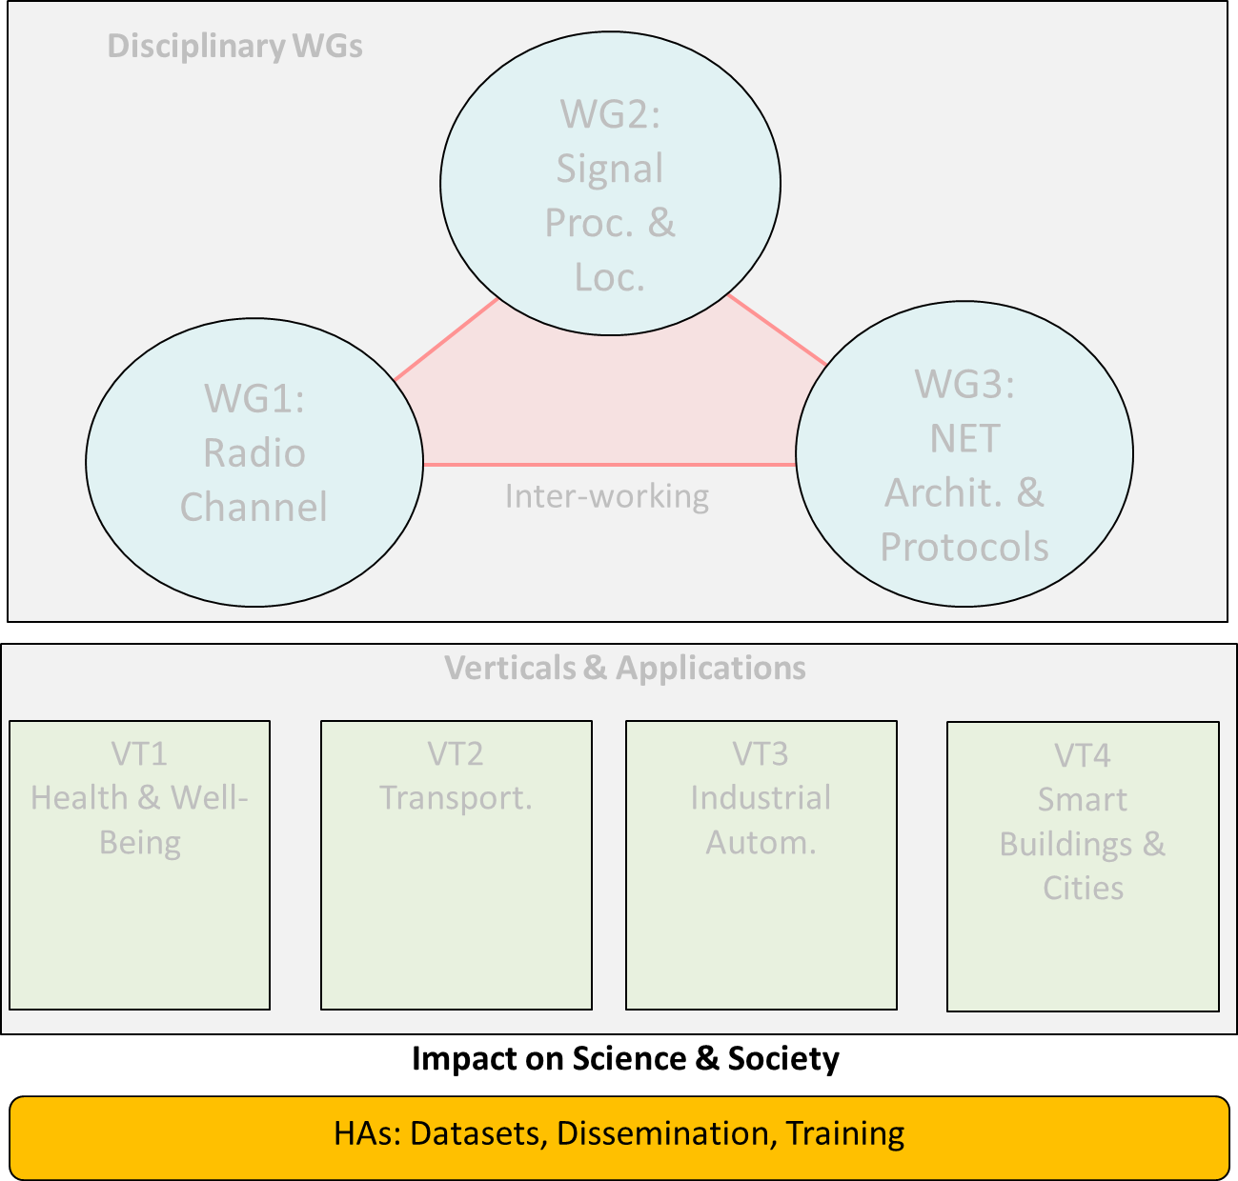
Horizontal Activities
HA1: Datasets
Set-up and maintenance of datasets, including measurement results, simulation scenarios and models, etc.
HA2: Dissemination
Organisation of workshops, special sessions
Setup and maintenance of website, social media, newsletters
HA3: Training
Organisation of training schools, tutorials in conferences, etc.
Organisation of training sessions of soft-skills

Slide 14
Deliverables (1)
Month 12 Deliverable 1 (HA1) - H1: Database structure and content requirements.
Deliverable 2 (All) - D1: State-of-the-art and key challenges
Month 16 Deliverable 3 (WG1) - White paper on radio channel modelling and prediction to support environment-aware communications
Month 32 Deliverable 4 (WG2) - White paper on novel physical layer technologies and localization algorithms for future wireless networks

Slide 15
Deliverables (2)
Month 36 Deliverable 5 (All WGs and verticals) - Disciplinary solutions to the research challenges (preliminary draft of the final report)
Month 48 Deliverable 6 (HA1) - H2: Database with data sets available.
Deliverable 7 (WG3) - White paper on novel network architectures and protocols for future wireless networks
Deliverable 8 (All) - FR: Final report (open-access book) including all research outcomes of the different disciplinary and interdisciplinary work.

Slide 16
Working Groups
WG1 Radio Channels (Vittorio Degli Esposti, UNIBO, Italy; Mate Boban, HUAWEI, Germany)
Increase the theoretical and experimental understanding and modelling of radio channels
SWG mmWave and THz sounding (Diego Dupleich, TUIL, Germany; Wei Fan, AAU, Denmark)
Concentrate the expertise on radio channel measurements and analysis
SWG on Reconfigurable Intelligent Surfaces (Marco Di Renzo, CNRS & CentraleSupélec, Paris-Saclay University, Paris, France; Joonas Kokkoniemi Centre for Wireless Communications, University of Oulu, Oulu, Finland)
Develop electromagnetically consistent analytical, numerical, and experimental models for RIS and RIS-aided radio channels

Slide 17
Working Groups
WG2 Signal Processing and Localisation (Alister Burr, UOY, United Kingdom; Ana Garcia Armada, UC3M, Spain)
Design new positioning and localization techniques
SWG Integrated Sensing and Communication (Yang Miao, University of Twente, Netherlands; Carsten Smeenk IIS Fraunhofer, Germany)
Develop transceivers and information retrieve approaches that simultaneously sense and communicate
WG3 Network Architectures and Protocols (Hamed Hamadi, UOY, United Kingdom; Konstantin Mikhaylov, OULU, Finland)
Propose new networking paradigms to perform human-to-thing communication

Slide 18
Vertical Teams
VT1 Health and Well-Being (Kamran Sayrafian, NIST, United States; Slawomir Ambroziak, PG, Poland)
...scientific challenges dealing with communications around or inside the human body,..
SWG Exposure to Electromagnetic Fields (Joseph Wout, UGENT, Belgium; Conchi Garcia-Pardo, Spain)
..contribute to measurement analysis for the assessment of human exposure to electromagnetic fields.
VT2 Transportation (Thomas Blazek, SAL, Austria; Adrian Kliks, PUT, Poland)
...challenges related to high mobility, requesting precise knowledge of the radio channel
VT3 Industrial Automation (Golsa Ghiaasi, SAL, Austria; Raheeb Muzaffar, SAL, Austria)
... calling for the design of novel transmission techniques, considering mmWave and THz bands…
VT4 Smart Buildings and Cities (Periklis Chatzimisios, IHU, Greece; Fernando José Velez, UBI, Portugal)
...will emphasise both very high-rate communications and/or ultra-dense networks. ...

Slide 19
References
[1] https://interactca20120.org/ (COST CA20120 INTERACT website)

