Slide 1
Multi-link devices with receive-only STAs for UHR
Date: 2023-08-28
Authors:
Name | Affiliations | Address | Phone | email
Thomas Handte | Sony Group Corporation |  |  | Thomas.Handte@sony.com
Yusuke Tanaka |  |  |  | Yusuke.YT.Tanaka@sony.com
Dana Ciochina
Daniel Verenzuela
Ken Tanaka
Kosuke Aio
Ryuichi Hirata
Qing Xia

Slide 2
Introduction
Support of multiple links is very important for UHR [1]
Applications include
Seamless roaming
Reduced channel access delay
Preemption traffic indication
The more links a device supports, the better
Support of multiple links is device specific
AP STA may support multiple links
However, AP power consumption may increase with number of links [2]
For non-AP STA support of multiple links may be difficult (power consumption, complexity, …)
TGbe introduced EMLSR/EMLMR to leverage MLO under limited link capabilities
Goal is to increase number of supported links with manageable power consumption and complexity
This submission aims at extending TGbe’s MLO under limited link capabilities
The proposal is to have receive-only STAs i.e., STAs that can receive but not transmit, as part of an MLD

Slide 3
Motivation
Connectivity via multiple links should be leveraged for high reliability or availability
Fast channel access may get more important than high throughput
Data rate and PPDU size of “high reliability” traffic is often small
At same time coexistence with “regular” traffic is important
For example, “seamless roaming” application
High throughput traffic (e.g. buffered video, browsing, etc.) can tolerate a transition delay between APs in order of 10 to 100ms without degradation of QoE
Low to medium throughput traffic (e.g. cloud gaming, control data, VoIP, video call, etc.) requires low transition delay between APs
Transition delay should be well below communication latency target (~1 … 10ms)
The need of retransmission is questionable, because lifetime of a MPDU may be shorter than a typical retransmission delay

Slide 4
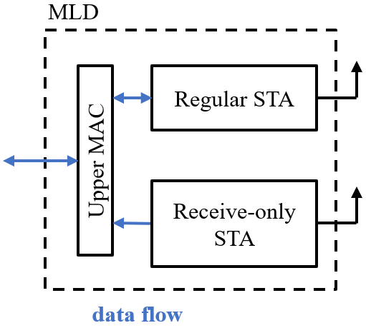
Proposal
Extend MLDs by receive-only STAs
A receive-only STA…
… can receive, but not transmit
It may have low PHY/MAC capabilities (e.g. 20 MHz only, non-HT, S-MPDU only)
… can observe a link different to the link served by a regular STA and can receive data on that link which is addressed to it
… has 11be’s upper MAC as a convergence entity
Actions that require a transmission are either omitted or performed by a regular STA via different link
A receive-only STA requires at least one regular STA affiliated to same MLD for association, setup, and response frames

Slide 5
Benefits of a receive-only STA in MLD
A receive-only STA can observe a link different to a link served by a regular STA affiliated to same MLD
It can receive data on this link
E.g. a peer STA can reach the MLD via a further link
It can receive control information on this link
E.g. an initial control frame for EMLSR/EMLMR operation
It can observe this link
E.g. for creating busy-idle profile, network scan
A receive-only STA can have a low power consumption
It can be an important tool for power safe at AP and non-AP MLDs [2, 6]
Power consumption can be reduced further by low PHY/MAC capability [6] of receive-only STA
It can play an important role for AP power safe
E.g. listening for low-rate uplink traffic on a link while a regular AP is in power safe

Slide 6
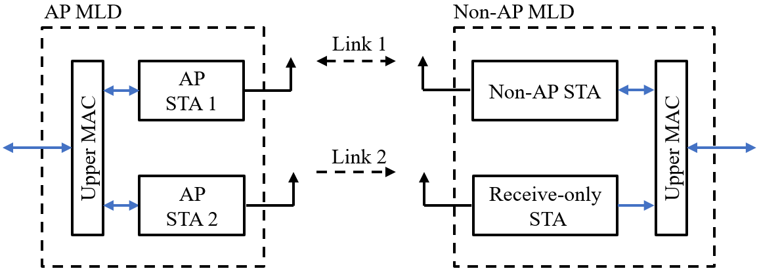
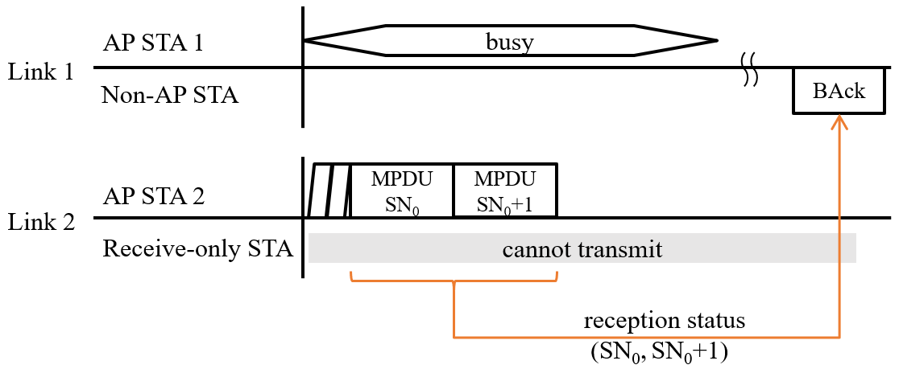
Exemplary frame exchange with a receive-only STA
Setup
AP MLD with two AP STAs
Non-AP MLD with a non-AP STA and a receive-only STA
Exemplary frame exchange
Link 1 is busy, link 2 is idle
AP STA 2 contends for channel access on link 2
AP STA 2 transmits MPDUs to receive-only STA
Reception status (if requested) is transmitted on link 1 via the non-AP STA affiliated with non-AP MLD
Benefit
Channel access delay of link 1 is avoided

Slide 7
Role of Acknowledgements
Essentially two options for Ack policy exist when transmitting to a receive-only STA
no Acknowledgement (“noAck” policy)
Acknowledgment via a non-AP STA (type of “BlockAck” policy)
Significance of Ack/ BAck response depends on application and traffic type
If the Ack delay via a regular STA is too long, robust transmission should be considered
robust MCS, duplication, d-RU [3], or soft combining [4] may be appropriate
An Ack via a regular STA may be required for link adaption purposes and CW reset
Impact to higher layer Acks is probably small, because their transmission may require a new contention anyways
RD protocol or TXS mode 1 is not supported by receive-only STA

Slide 8
Comparison receive-only STA and EMLSR/ EMLMR
EMLSR/ EMLMR is for high throughput (EHT)
Once link switch is done, high throughput is achieved
However, link switch comes at the expense of delay
initiating frame, padding delay, transition delay, NAV resetting
=> Beneficial for long PPDUs, high rate, weak latency bounds
Receive-only STA can immediately receive transmissions
It can readily receive without link switch delays and impact to main radio
However, no or delayed response frames, typ. lower throughput as EMLSR/ EMLMR
Ack is delayed, CTS not possible
=> Beneficial for short PPDUs, low rate, stringent latency bounds

Slide 9
Conclusion
UHR may benefit strongly of multiple link support
E.g., seamless roaming, low-latency applications
Deploying receive-only STAs as part of MLDs may increase the number of supported links at manageable power consumption and complexity increase
A receive-only STA can observe a link different to a link served by a regular STA, and can receive data on that link addressed to it
Any transmissions are handled by a regular STA affiliated to the same MLD
Response frames are transmitted via a different link by a regular STA
Whereas EMLSR/EMLMR is good for high throughput, a receive-only STA can readily receive data without link switch delay and impact to regular STAs of same MLD

Slide 10
References
[1] 11-23/480 “UHR proposed PAR”
[2] 11-23/10 “Considerations for enabling AP power save”
[3] 11-23/37 “UHR Feature to Overcome PSD Limitations Distributed-Tone Resource Units”
[4] 11-22/1880 “Latency and Reliability enhancements for UHR”
[5] 11-22/1790 “Green AP and resilience requirements for home networks”
[6] 11-22/1414 “Low Power Listening Mode”

