Slide 1
Nulling Performance of Coordinated Beamforming
Date: 2023-06-25
Authors:
Name | Affiliation | Address | Phone | Email
Wicky Wang | Huawei |  |  | Wicky.wangweijie@huawei.com
Yanchun Li |  |  |  | liyanchun@huawei.com
Xiaolong Zhang |  |  |  | zhangxiaolong66@huawei.com
Tony Zeng |  |  |  | tony.zengyan@huawei.com
Shengsen Wang |  |  |  | wangshengsen@huawei.com
YunChen |  |  |  | chenyun66@huawei.com
Xin Li |  |  |  | Luna.lixin@huawei.com

Slide 2
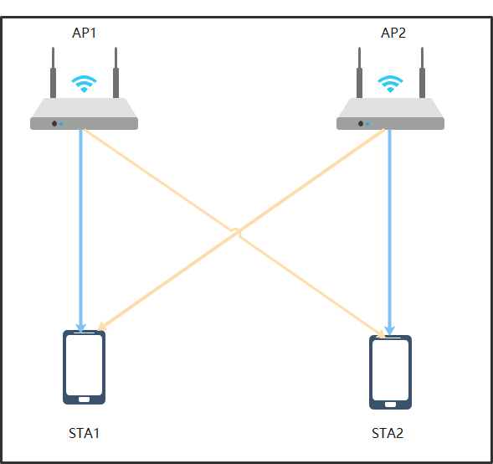
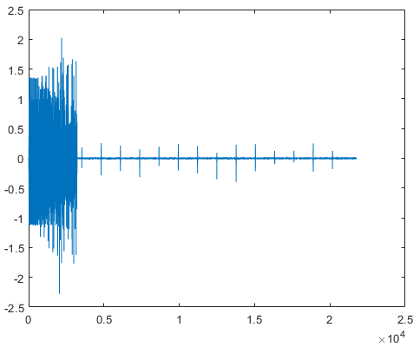
Introduction
Coordinated Beamforming (Co-BF) has been introduced to IEEE 802.11 in EHT SG [1-5].
However, periodic bursts arrives during OFDM data transitions even in part of the signal with nulling precoding [1].
This contribution discussed the issue of periodic bursts and evaluated the its impact in various synchronous conditions.

Slide 3
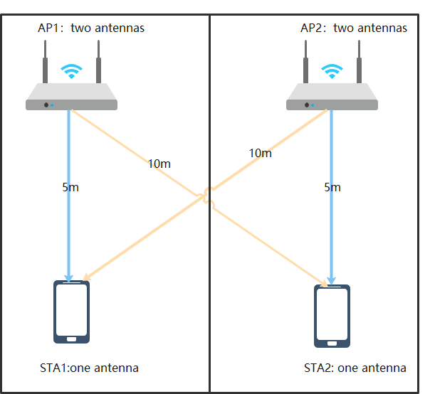
Further Analysis of Co-BF
Questions
What’s the Performance of Co-BF in the symbolic synchronous and asynchronous systems?
Simulation Setup
Parameters | Co-BF
Bandwidth | 80M
AP antennas | 2+2 (2 APs)
STA antennas | 1+1 (2 STAs)
streams | 1+1
Comm channel | Model-B;
Interference channel | Model-B;
Tx power | 20 dBm
Noise level | -90 dBm
Guard interval | 3.2 us
Test number | 1000

Slide 4
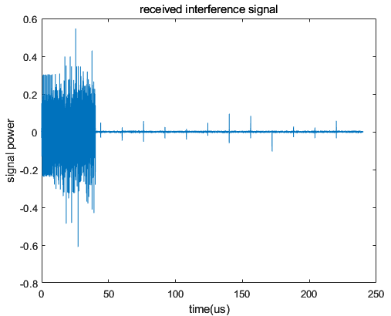
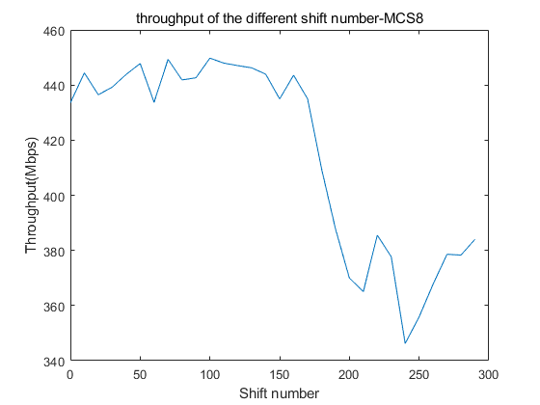
Signal Channel Pathloss = 70dB & MCS=10
15% loss
Shift number
CP+data
2.5 μs
Shift number=0:10:300 simulates the unsynchronized case (zero means synchronized).
6081 is the begin index of data in the PPDU.
FFT size is 1024, CP size is 256, selected index of FFT data is 200:1223.
There is an obvious throughput gap if the interference exists in the selected FFT data when moving the CP in the noise_limited case.
Synchronization can improve data throughput.
rx(6081+shift_num:end,:) = rx(6081+shift_num:end,:) + rx_interf(6081:end-shift_num,:);

Slide 5
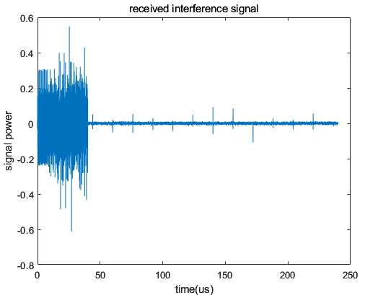
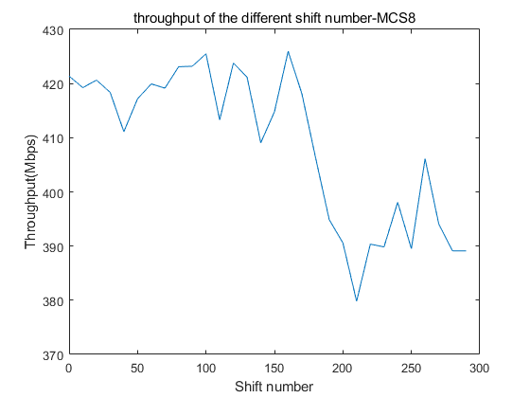
Signal Channel Pathloss = 75dB & MCS=8
6% loss
2.5μs
Synchronization can improve data throughput.
The throughput gap decreases in the medium-noise case.

Slide 6
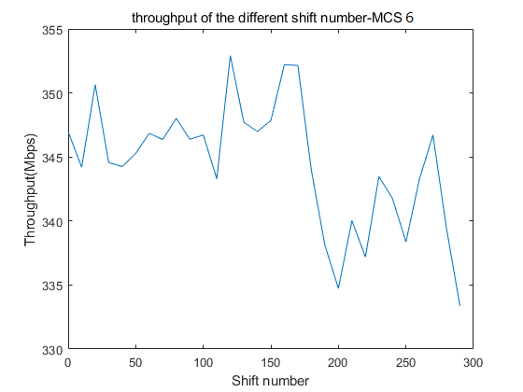
Signal Channel Pathloss = 80dB & MCS=6
1.7% loss
2.5μs
Synchronization can still improve data throughput.
The throughput of synchronous and asynchronous solutions is very close

Slide 7
Summary
Synchronization can improve the throughput of Co-BF.
When the interference increases, the benefit of the synchronization scheme becomes more significant.
Better align multiple APs when their served STAs suffer such periodic burst in Co-BF transmissions.

Slide 8
References
[1] 11-19-0445-00-0eht-nulling-and-coordinated-beamforming
[2] Terminology for AP Coordination, doc.: IEEE 802.11-18/1926r2
[3] Nulling and Coordinated Beamforming, doc.: IEEE802.11-19/0638
[4] Performance of Coordinated Null Steering in 802.11be, doc.: IEEE802.11-19/1212
[5] 11-22-1821-01-0uhr-system-level-simulation-of-co-bf-and-joint-tx

