Slide 1
Nulling Performance of Coordinated Beamforming
Date: 2023-06-25
Authors:
Name | Affiliation | Address | Phone | Email
Wicky Wang | Huawei |  |  | Wicky.wangweijie@huawei.com
Yanchun Li |  |  |  | liyanchun@huawei.com
Xiaolong Zhang |  |  |  | zhangxiaolong66@huawei.com
Tony Zeng |  |  |  | tony.zengyan@huawei.com
Shengsen Wang |  |  |  | wangshengsen@huawei.com
YunChen |  |  |  | chenyun66@huawei.com
Xin Li |  |  |  | Luna.lixin@huawei.com

Slide 2
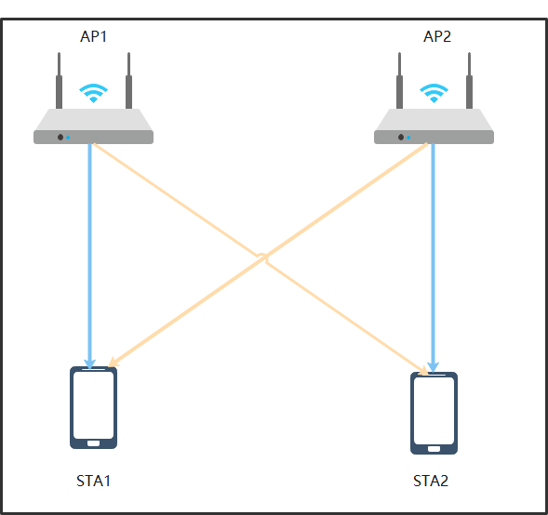
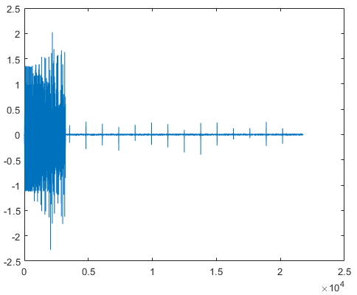
Introduction
Coordinated Beamforming (Co-BF) has been introduced to IEEE 802.11 in 11be.
However, periodic bursts arrives during OFDM data transitions even in part of the signal with nulling precoding [1].
This contribution discussed the issue of periodic bursts and evaluated the performance of synchronous and asynchronous solutions in different cases.

Slide 3
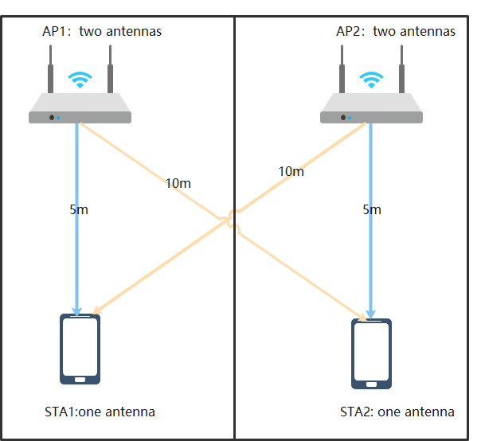
Further Analysis of Co-BF
Questions
What’s the Performance of Co-BF in the symbolic synchronous and asynchronous systems?
Simulation Setup
Parameters | Co-BF
Bandwidth | 80M
AP antennas | 2*2（ two AP）
STA antennas | 1*2（two STA）
streams | 1*2
Comm channel | Model-B; distance=5
Interf channel | Model-B; distance=10
Tx power | 20 dBm
Noise level | -90 dBm
Guard interval | 3.2 us
Test number | 1000

Slide 4
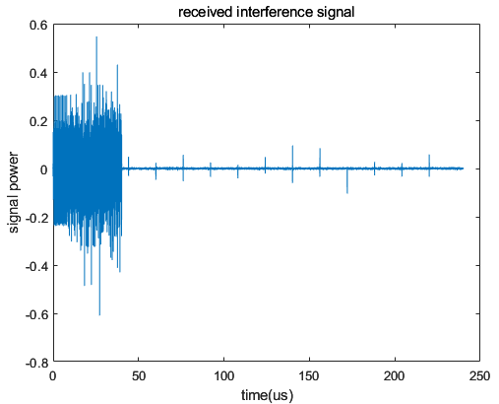
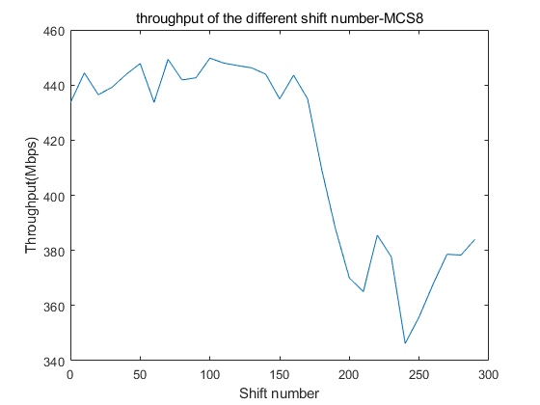
Noise-limited case: Pathloss = 70dB & MCS=10
Shift number
CP+data
Shift number=0:10:300 simulates the unsynchronized case (zero means synchronized).
6081 is the begin index of data in the PPDU.
FFT size is 1024, CP size is 256, selected index of FFT data is 200:1223.
There is an obvious throughput gap if the interference exists in the selected FFT data when moving the CP in the noise_limited case.
Synchronization can improve data throughput.
rx(6081+shift_num:end,:) = rx(6081+shift_num:end,:) + rx_interf(6081:end-shift_num,:);

Slide 5
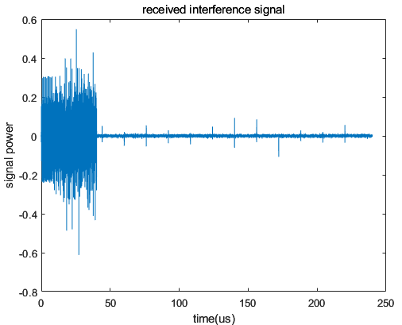
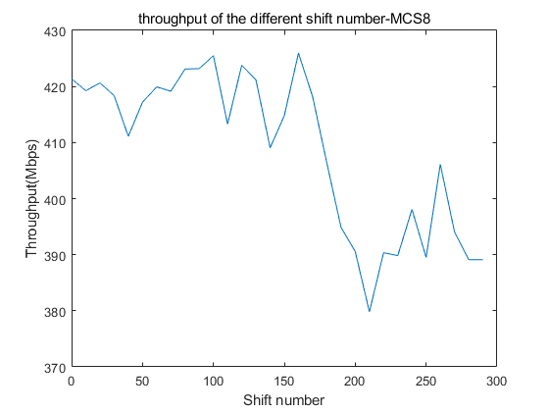
Noise-Medium case : Pathloss = 75dB & MCS=8
Synchronization can improve data throughput.
The throughput gap decreases in the medium-noise case.

Slide 6
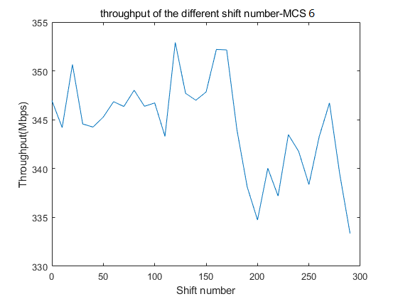
Noise-high case : Pathloss = 80dB & MCS=6
Synchronization can still improve data throughput.
The throughput of synchronous and asynchronous solutions is very close

Slide 7
Summary
Synchronization can improve the throughput of Co-BF.
As the noise increases, the benefits of the synchronization scheme decrease.
The solution to the issue of periodic burst in Co-BF should be adjusted based on the noise level.

Slide 8
References
[1] 11-19-0445-00-0eht-nulling-and-coordinated-beamforming
[2] Terminology for AP Coordination, doc.: IEEE 802.11-18/1926r2
[3] Nulling and Coordinated Beamforming, doc.: IEEE802.11-19/0638
[4] Performance of Coordinated Null Steering in 802.11be, doc.: IEEE802.11-19/1212
[5] 11-22-1821-01-0uhr-system-level-simulation-of-co-bf-and-joint-tx

