Slide 1
Nulling Performance of Coordinated-Beamforming
Date: 2023-07-07
Authors:
Name | Affiliation | Address | Phone | Email
Wicky Wang | Huawei |  |  | Wicky.wangweijie@huawei.com
Yanchun Li |  |  |  | liyanchun@huawei.com
Xiaolong Zhang |  |  |  | zhangxiaolong66@huawei.com
Tony Zeng |  |  |  | tony.zengyan@huawei.com
Shengsen Wang |  |  |  | wangshengsen@huawei.com
YunChen |  |  |  | chenyun66@huawei.com
Luna Li |  |  |  | Luna.lixin@huawei.com

Slide 2
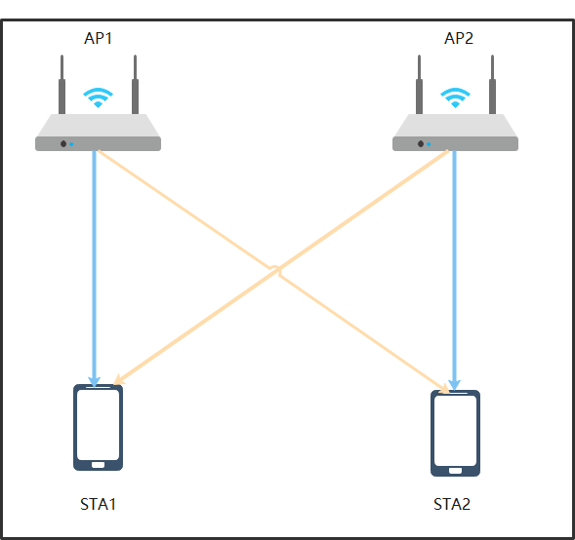
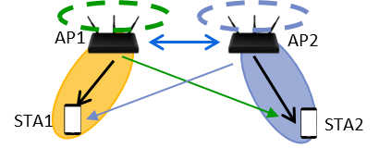
Introduction
Coordinated Beamforming (Co-BF)
Independently operating APs creating nulls to avoid mutual interference between OBSSes.
Less difficult to realize than Joint Tx (no need of tight synchronization and data sharing).

Slide 3
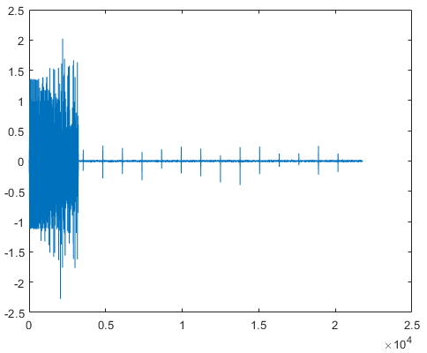
Challenges of Co-BF
Challenges existed in the Co-BF[1]
Periodic bursts arrives during data transitions even in part of the signal that is precoded.
The Problem can be solved by Proper synchronization[1].
Preamble still arrives at full power(don’t precode on the preamble)

Slide 4
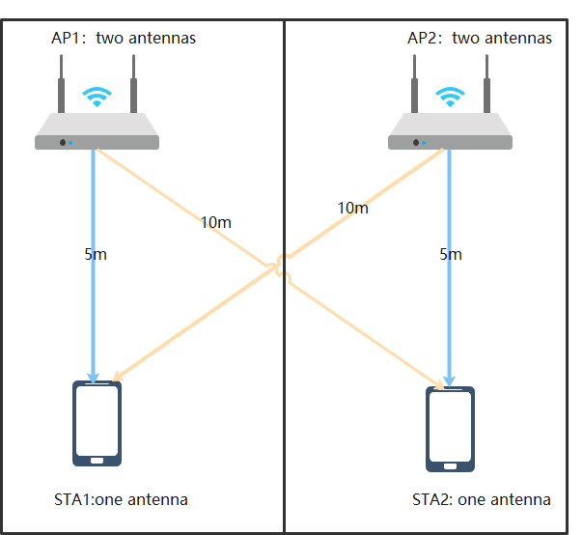
Further Analysis of Co-BF
Questions
What’s the Performance of Co-BF in the unsynchronized system?
Simulation Setup
Parameters | Co-BF
Bandwidth | 80M
AP antennas | 2*2（ two AP）
STA antennas | 1*2（two STA）
streams | 1*2
Comm channel | Model-B; distance=5
Interf channel | Model-B; distance=10
Tx power | 20dBm
Noise level | -90dBm
Guard interval | 3.2us
Test number | 1000

Slide 5
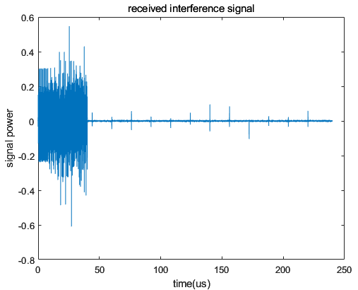
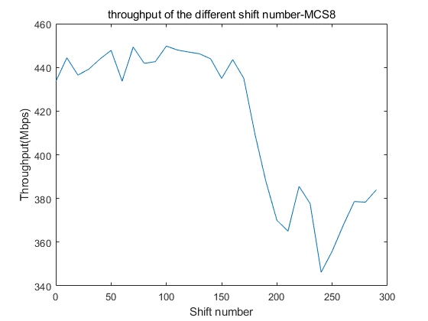
Noise-limited case: Pathloss = 70dB & MCS=10
Shift number
CP+data
Shift number=0:10:300 simulates the unsynchronized case (zero means synchronized).
6081 is the begin index of data in the PPDU.
FFT size is 1024, CP size is 256, selected index of FFT data is 200:1223.
There is an obvious throughput gap if the interference exists in the selected FFT data when moving the CP in the noise_limited case.
Synchronization can improve data throughput.
rx(6081+shift_num:end,:) = rx(6081+shift_num:end,:) + rx_interf(6081:end-shift_num,:);

Slide 6
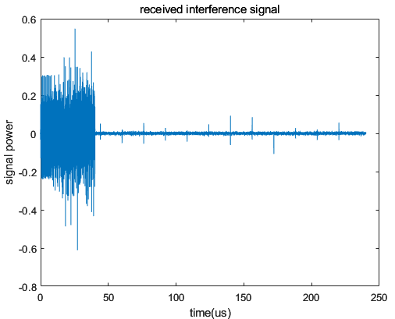
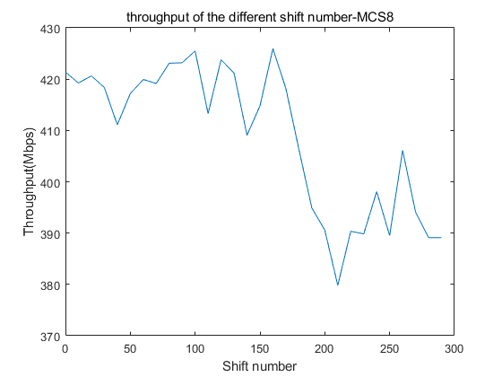
Medium-noise case : Pathloss = 75dB & MCS=8
Synchronization can improve data throughput.
The throughput gap decreases in the medium-noise case.

Slide 7
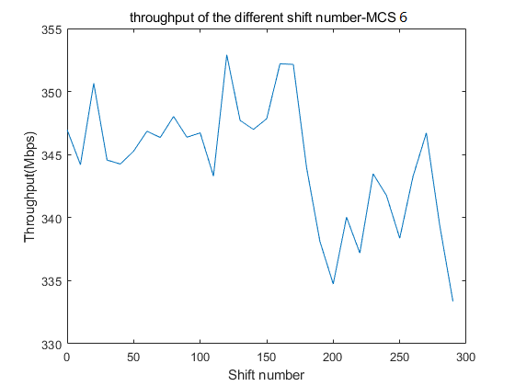
Interference-limited case : Pathloss = 80dB & MCS=6
Synchronization can still improve data throughput.
The throughput gap is not obvious in the interference-limited case.

Slide 8
Summary
Synchronization can improve the throughput of Co-BF, regardless of noise-limited or interference-limited scenarios.
The nulling interference is negligible, especially in interference-limited scenarios.

Slide 9
References
[1] 11-19-0445-00-0eht-nulling-and-coordinated-beamforming-Quantenna
[2] Terminology for AP Coordination, doc.: IEEE 802.11-18/1926r2
[3] Nulling and Coordinated Beamforming, doc.: IEEE802.11-19/0638
[4] Performance of Coordinated Null Steering in 802.11be, doc.: IEEE802.11-19/1212
[5] 11-22-1821-01-0uhr-system-level-simulation-of-co-bf-and-joint-tx

