Slide 1
Band Management Challenges for 802.11be and Beyond
Date: 2023-07-11
Authors:
Name | Affiliations | Address | Phone | email
Daniele Medda | International Hellenic University | P.O. Box 141 Sindos 57400 Thessaloniki (Greece) |  | dmedda@ihu.gr
Athanasios Iossifides
Periklis Chatzimisios | International Hellenic University & University of New Mexico

Slide 2
Outline
Introduction
Band allocation policies.
Employed system model and simulation setup.
Obtained results for both access delay and throughput.
Identified trade-offs and final remarks
References
Annex

Slide 3
Introduction
Mixed device types
  We cannot ignore the presence of legacy devices. Several works proved they can impact the network performance [1][2].
Multi-Link Operation
  MLO introduces several new dimensions to deal with.
Aim
  Study how the employment of different band allocation policies affect mainly the access delay performance in mixed networks

Slide 4
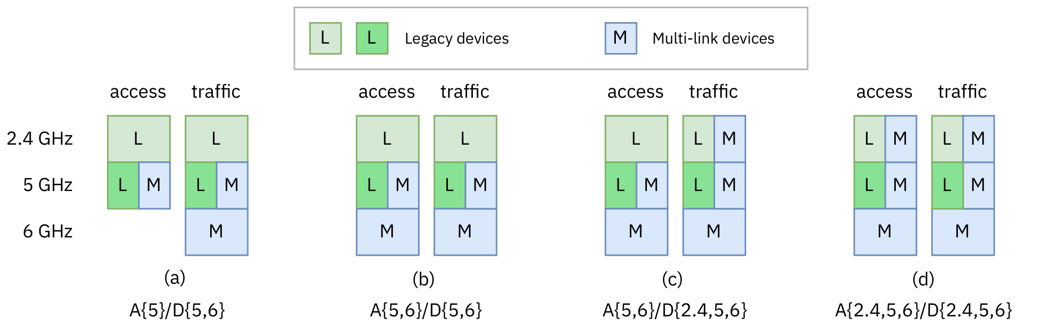
Study cases
Legacy devices behaviour is constant for all four cases.
Investigated the band allocation only for the MLDs:
  Access and traffic bands are handled separately: a device could use a single band for access and transmit data to additional bands if they have been idle for at least two DCF slots.

Slide 5
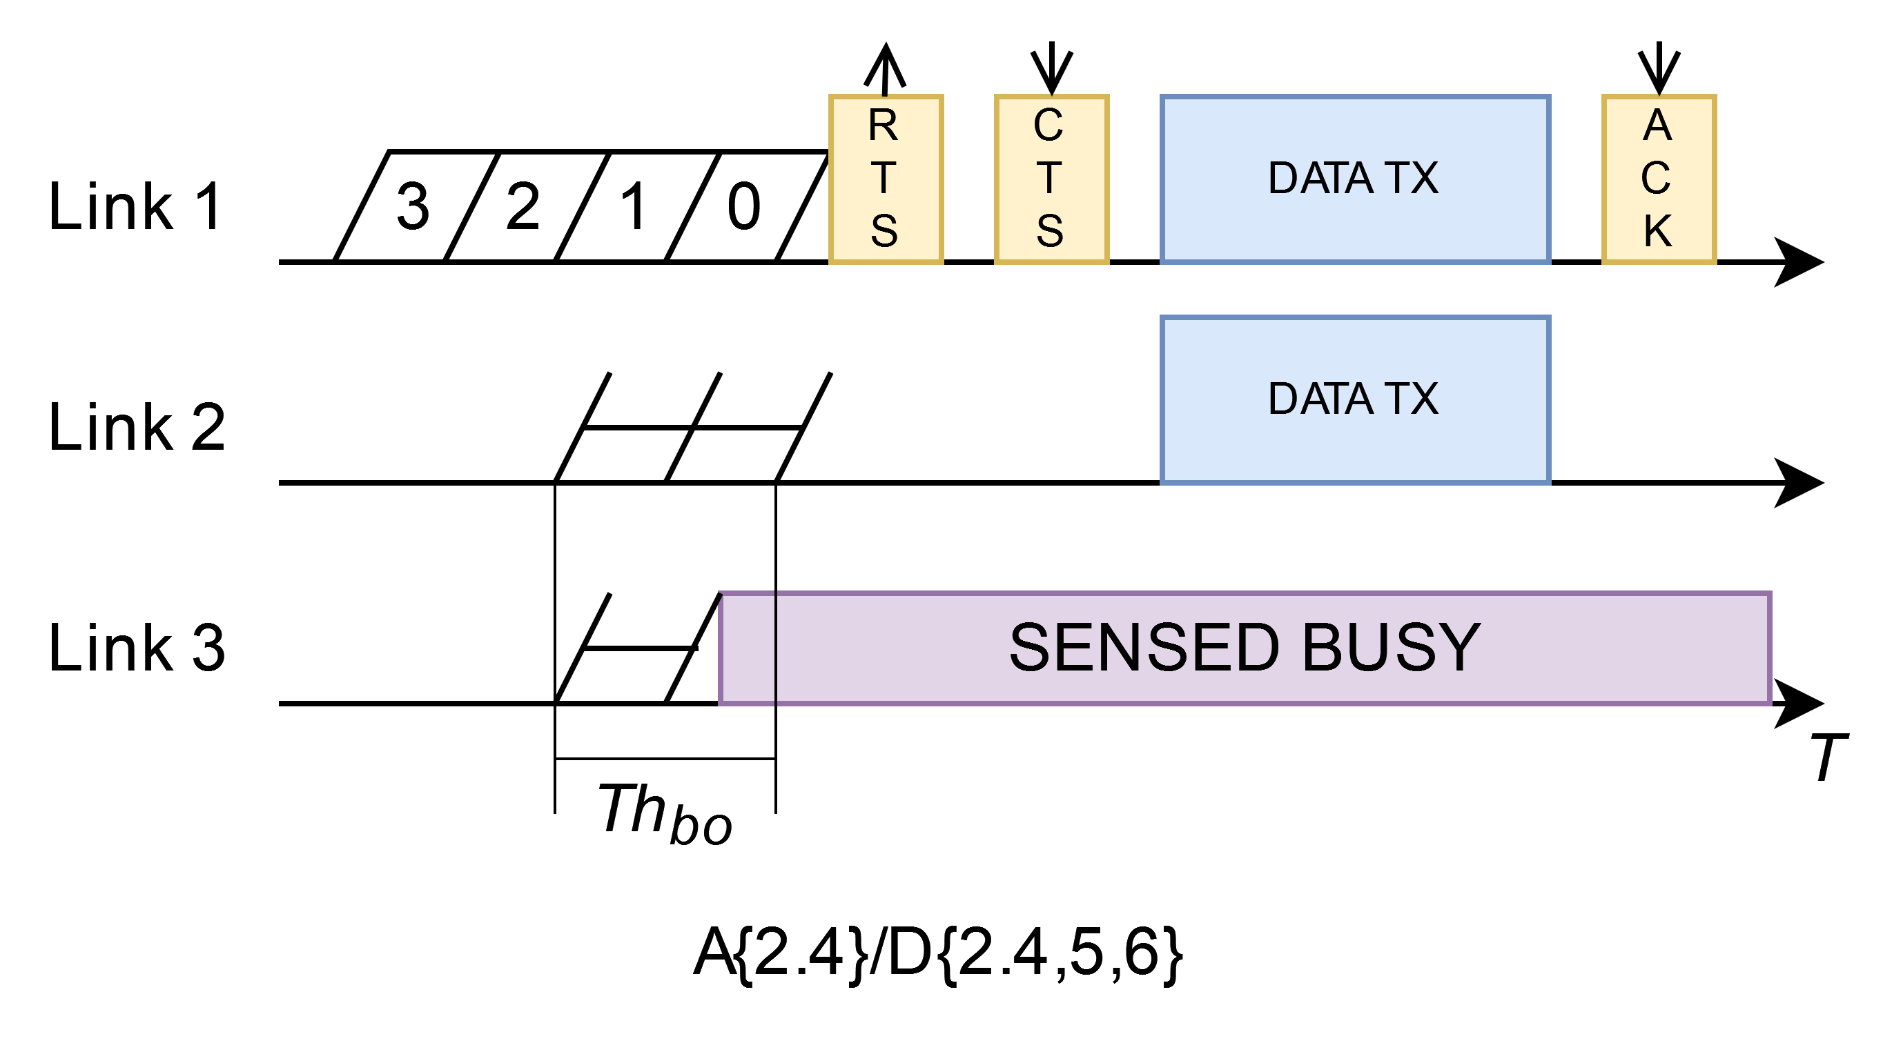
System model and simulation setup
MLDs employ MLA-S channel access methodology [3][4]
30 or 50 total devices over a physical area of 15 x 15 m².
  Single IEEE 802.11be enabled AP placed at the center of the area.
  All stations operating using RTS/CTS mechanism and in full buffer condition.
Legacy devices are of IEEE 802.11ac type and are split in two bands:
  Ratio 1: 50%-50% → 50% on 2.4 GHz, 50% on 5 GHz.
  Ratio 2: 75%-25% → 75% on 2.4 GHz, 25% on 5 GHz.
MLA-S

Slide 6
Simulation trials
Simulations carried out on a custom event-based Python simulator.
Percentage of legacy devices were varied in 10% steps.
MCS selection: genie fashion via lookup tables aiming for PER < 10%.
Parameter | Value
Channel BW | 80 MHz
CW_{min} | 16
Retry limit | 7
Payload | 1500 bytes
Control frames rate | 6.8 Mbps
Replications/point | 150

Slide 7
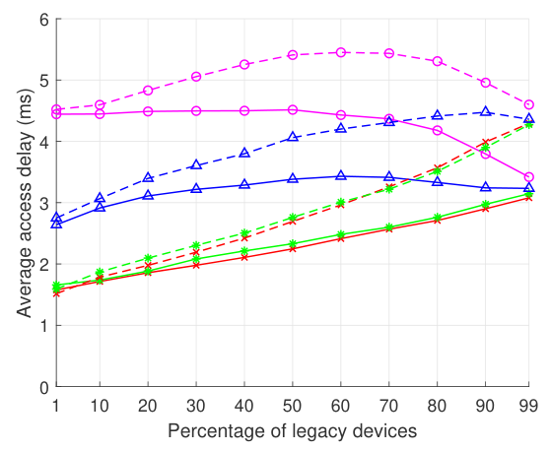
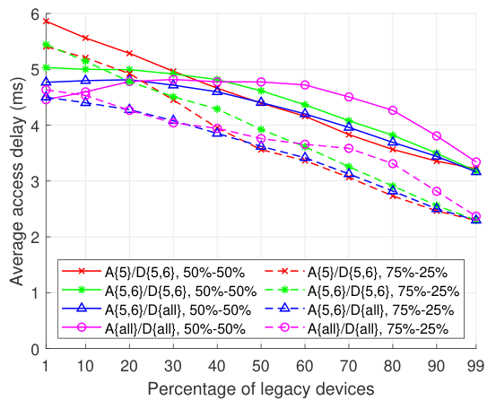
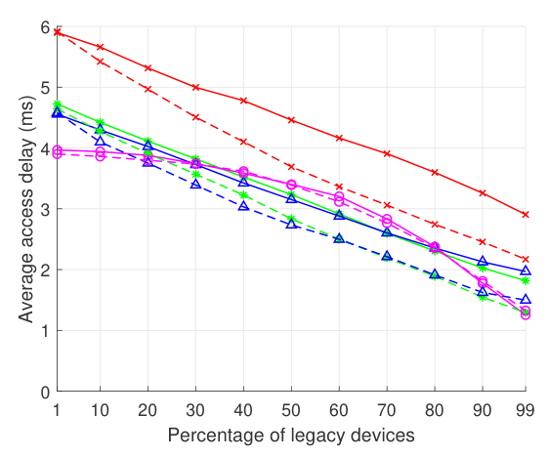
Obtained results: average access delay (50 devices)
a) Legacies 2.4
b) Legacies 5
c) MLDs
Note on Figure b: looks counter-intuitive. In fact, increasing number of legacies → decreases the total devices contending for the 5 GHz band (see Annex).

Slide 8
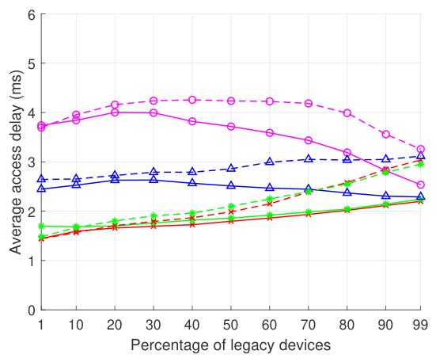
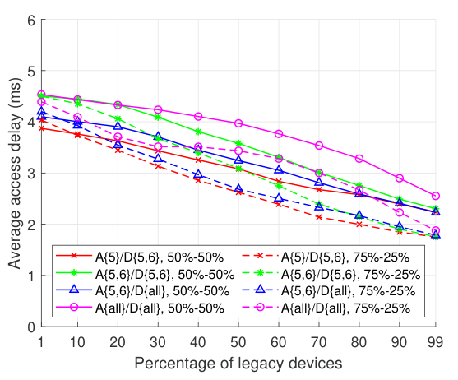
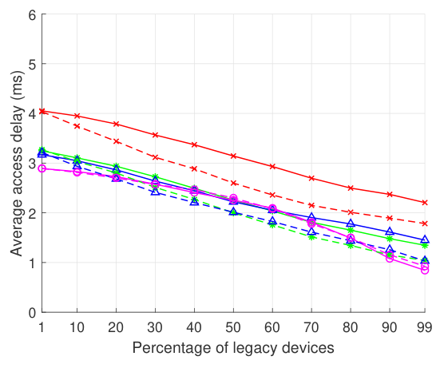
Obtained results: average access delay (30 devices)
a) Legacies 2.4
b) Legacies 5
c) MLDs
Trends are identical, just shifted downwards (as expected).

Slide 9
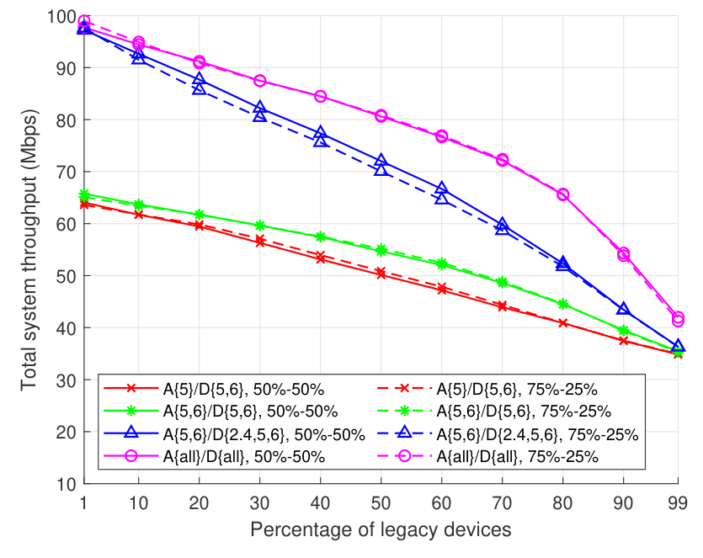
Brief look at the system throughput (50 devices)
Not a huge difference between the 50%-50% and the 75%-25% ratios.
A{all}/D{all} (purple curve) indeed provides the highest throughput, but on the other hand leads to overall higher delays.

Slide 10
Identified trade-offs: final remarks
Lowest access delay for legacy devices on 2.4 GHz → no MLDs at all in this band. Throughput is severely affected.
Lowest access delay for legacy devices on 5 GHz → achieved when A{5, 6}/D{all} is used. Satisfactory throughput.
Network-wise low access delay → A{5,6}/D{all}.
Legacy split ratio in the lower bands can be used to balance the gain (loss) of 5 and 6 GHz devices:
  Throughput is practically unaffected if balancing is properly done.
Overall, there is a need to appropriate manage access and traffic bands to attain the desirable performance.

Slide 11
References
[1] M. Carrascosa, G. Geraci, E. Knightly, and B. Bellalta, “An Experimental Study of Latency for IEEE 802.11be Multi-link Operation,” in ICC 2022
[2] N. Korolev, I. Levitsky, and E. Khorov, “Analytical Model of Multi-link Operation in Saturated Heterogeneous Wi-Fi 7 Networks,” IEEE Wireless Communications Letters, 2022.
[3] 802.11-19/1546r0 Legacy Performance Impact on Multi-Link Operation
[4] 802.11-20/0026r7 MLA: Sync PPDUs
[5] 802.11-19/1144r6 Channel Access for Multi-link Operation

Slide 12
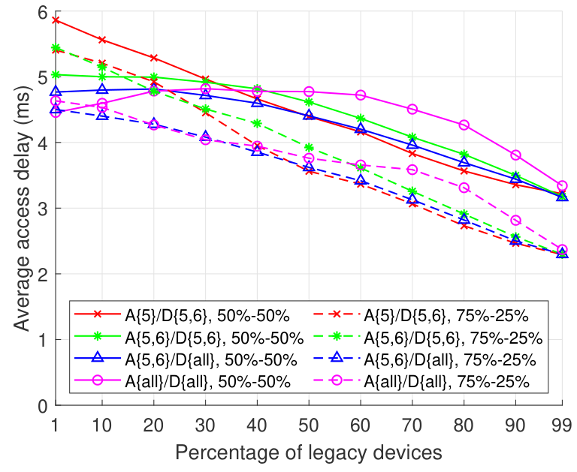
Annex
Consider the A{5}/D{5,6} case with 50%-50% ratio (red solid curve):
At 30%, 50 total devices split in:
  8 legacies on 2.4 GHz;
  8 legacies on 5 GHz;
  34 MLDs accessing on 5 GHz;
  Devices contending for 5 GHz: 42.
At 60%, 50 total devices split in:
  15 legacies on 2.4 GHz;
  15 legacies on 5 GHz;
  20 MLDs accessing on 5 GHz;
  Devices contending for 5 GHz: 35.

